Slide 1
Probability
By Sharmila Sambasivam

Slide 2
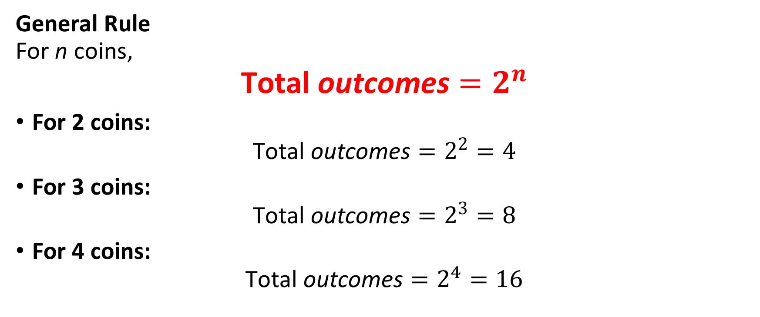
COIN BASED
General Rule For n coins,
$$\text{Total} \text{outcomes}=2^{n}$$
For 2 coins:
$$\text{Total} \text{outcomes}=2^{2}=4$$
For 3 coins:
$$\text{Total} \text{outcomes}=2^{3}=8$$
For 4 coins:
$$\text{Total} \text{outcomes}=2^{4}=16$$

Slide 3


Two coins are tossed simultaneously. Sample Space $$S=\{HH,HT, TH, TT\}$$
Total Number of Outcomes
For 4 coins:
$$\text{Total} \text{outcomes}=2^{2}=4$$
1.Find the probability that no tail appears.
2.Find the probability of getting exactly one tail.
3.Probability of getting two heads.
4. Probability of getting at least one head.
5.Probability of getting no head
6. Probability that both coins show the same face.
7. Probability of getting a tail on the second coin
Answers : Probability
1/4
1/2
1/4
3/4
1/4
1/2
1/2

Slide 4
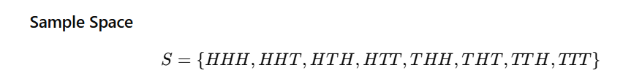
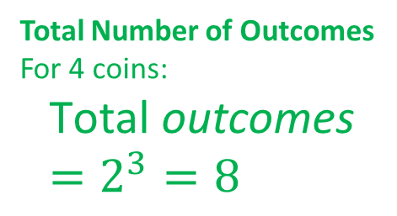
Three coins are tossed simultaneously
Total Number of Outcomes
For 4 coins:
$$\text{Total} \text{outcomes}=2^{3}=8$$
Find the probability of getting at least two heads
Find the probability of getting no heads
Find the probability of getting at least one head and at least one tail.
what is the probability of getting more heads than tails?
Find the probability that the number of heads is greater than or equal to 2.
Answers : Probability
1/2
1/8
3/4
1/2
1/2

Slide 5

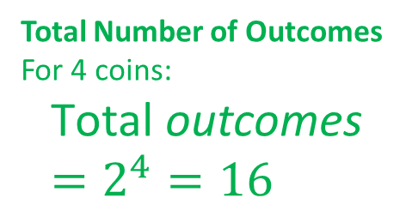
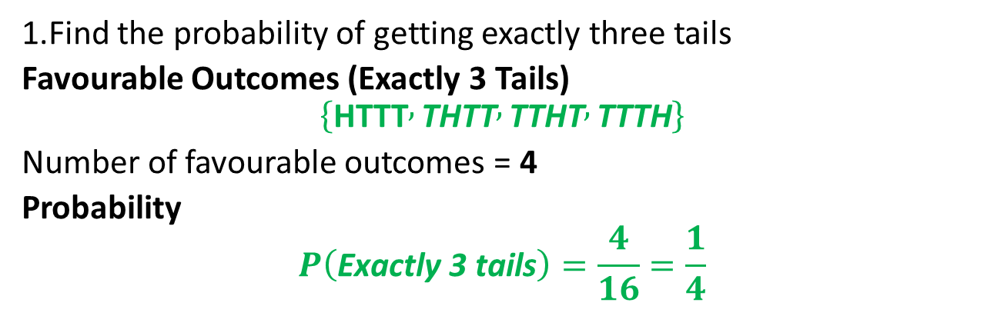
Four coins are tossed once..
Total Number of Outcomes
For 4 coins:
$$\text{Total} \text{outcomes}=2^{4}=16$$
1.Find the probability of getting exactly three tails
Favourable Outcomes (Exactly 3 Tails)
$$\left\{\text{HTTT} , \text{THTT} , \text{TTHT} , \text{TTTH}\right\}$$
Number of favourable outcomes = 4
Probability
$$P\left(\text{Exactly} \text{3 }\text{tails}\right)=\frac{4}{16}=\frac{1}{4}$$
2. Find the probability of atleast 1 tail ?

Slide 6
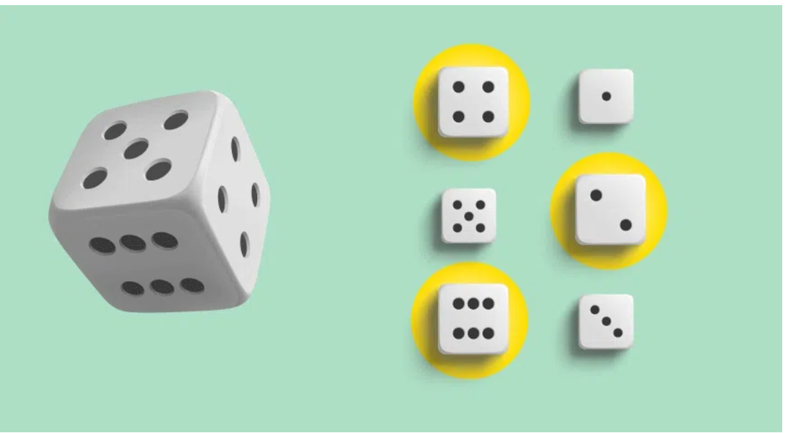
DICE BASED PROBLEMS

Slide 7
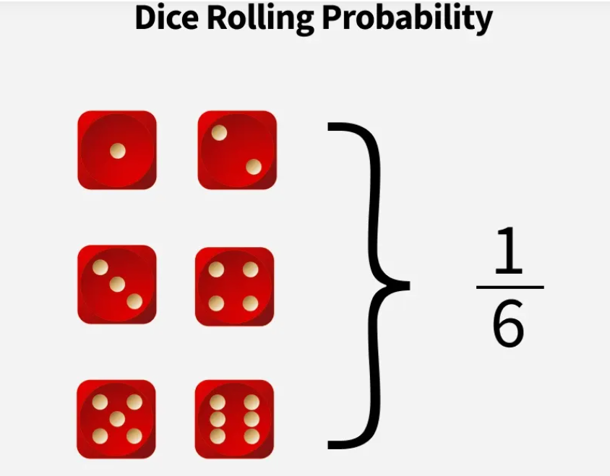
Rolling a die we get any number from 1 to 6.
The outcome of any number in case of rolling a single die is 1/6.
This is calculated using the formula,
Probability = (Favorable Value)/(Total Values)

Slide 8
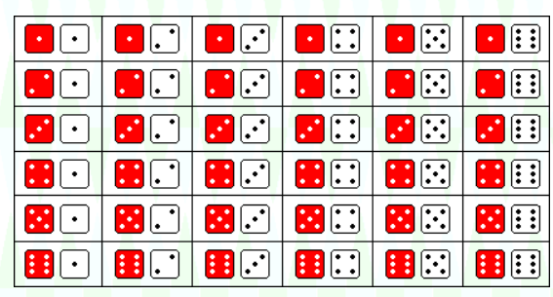
Rolling two Dice
 | 1 | 2 | 3 | 4 | 5 | 6
1 | (1,1) | (1,2) | (1,3) | (1,4) | (1,5) | (1,6)
2 | (2,1) | (2,2) | (2,3) | (2,4) | (2,5) | (2,6)
3 | (3,1) | (3,2) | (3,3) | (3,4) | (3,5) | (3,6)
4 | (4,1) | (4,2) | (4,3) | (4,4) | (4,5) | (4,6)
5 | (5,1) | (5,2) | (5,3) | (5,4) | (5,5) | (5,6)
6 | (6,1) | (6,2) | (6,3) | (6,4) | (6,5) | (6,6)

Slide 9
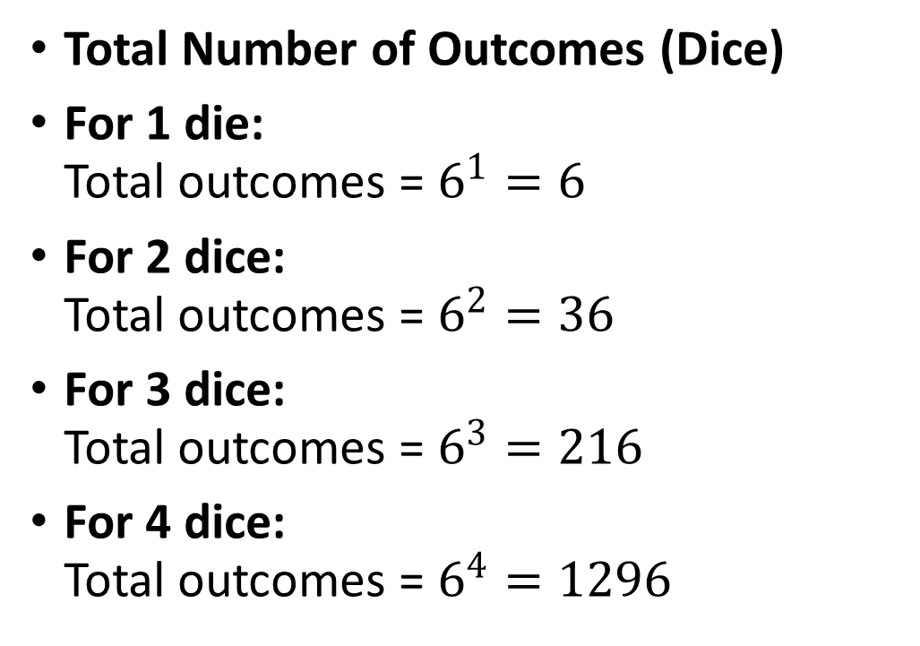
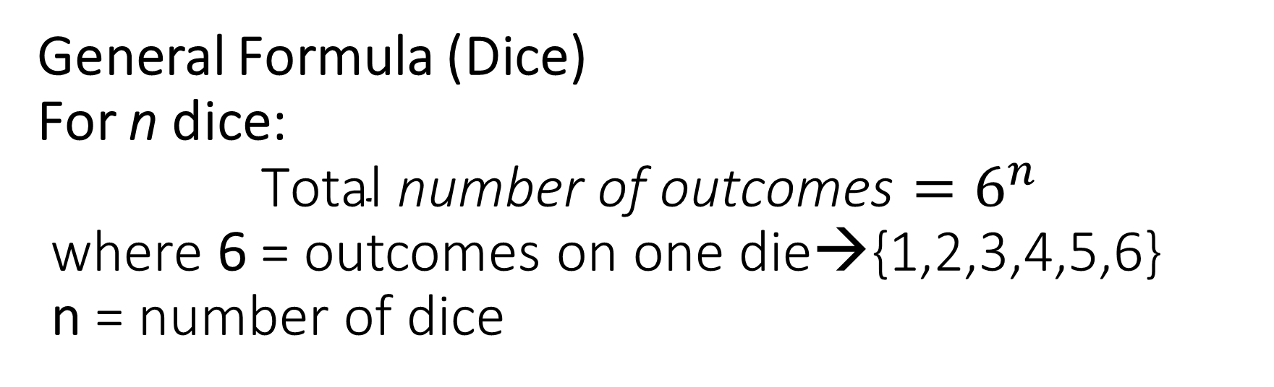
General Formula (Dice) For n dice: $$\text{Total} \text{number} \text{of} \text{outcomes}=6^{n}$$ where 6 = outcomes on one die→{1,2,3,4,5,6} n = number of dice
Total Number of Outcomes (Dice)
For 1 die: Total outcomes = $6^{1}=6$
For 2 dice: Total outcomes = $6^{2}=36$
For 3 dice: Total outcomes = $6^{3}=216$
For 4 dice: Total outcomes = $6^{4}=1296$

Slide 10
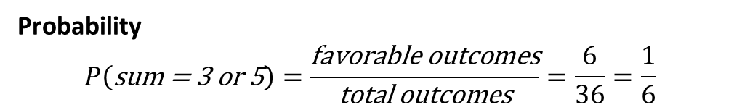
 | 1 | 2 | 3 | 4 | 5 | 6
1 | (1,1) | (1,2) | (1,3) | (1,4) | (1,5) | (1,6)
2 | (2,1) | (2,2) | (2,3) | (2,4) | (2,5) | (2,6)
3 | (3,1) | (3,2) | (3,3) | (3,4) | (3,5) | (3,6)
4 | (4,1) | (4,2) | (4,3) | (4,4) | (4,5) | (4,6)
5 | (5,1) | (5,2) | (5,3) | (5,4) | (5,5) | (5,6)
6 | (6,1) | (6,2) | (6,3) | (6,4) | (6,5) | (6,6)
2. Probability of getting doublet ?
3. Probability of getting total of 11 ?
4. Probability of getting total of 12 ?
1.In a single throw of two dice, find the probability of getting a sum of 3 or 5.
 | 1 | 2 | 3 | 4 | 5 | 6
1 |  | 🔴(1,2) |  | 🟢(1,4)
2 | 🔴(2,1) |  | 🟢(2,3)
3 |  | 🟢(3,2)
4 | 🟢(4,1)
5
6
Probability
$$P\left(\text{sum}\text{ = }\text{3 }\text{or} \text{5}\right)=\frac{\text{favorable} \text{outcomes}}{\text{total} \text{outcomes}}=\frac{6}{36}=\frac{1}{6}$$

Slide 11
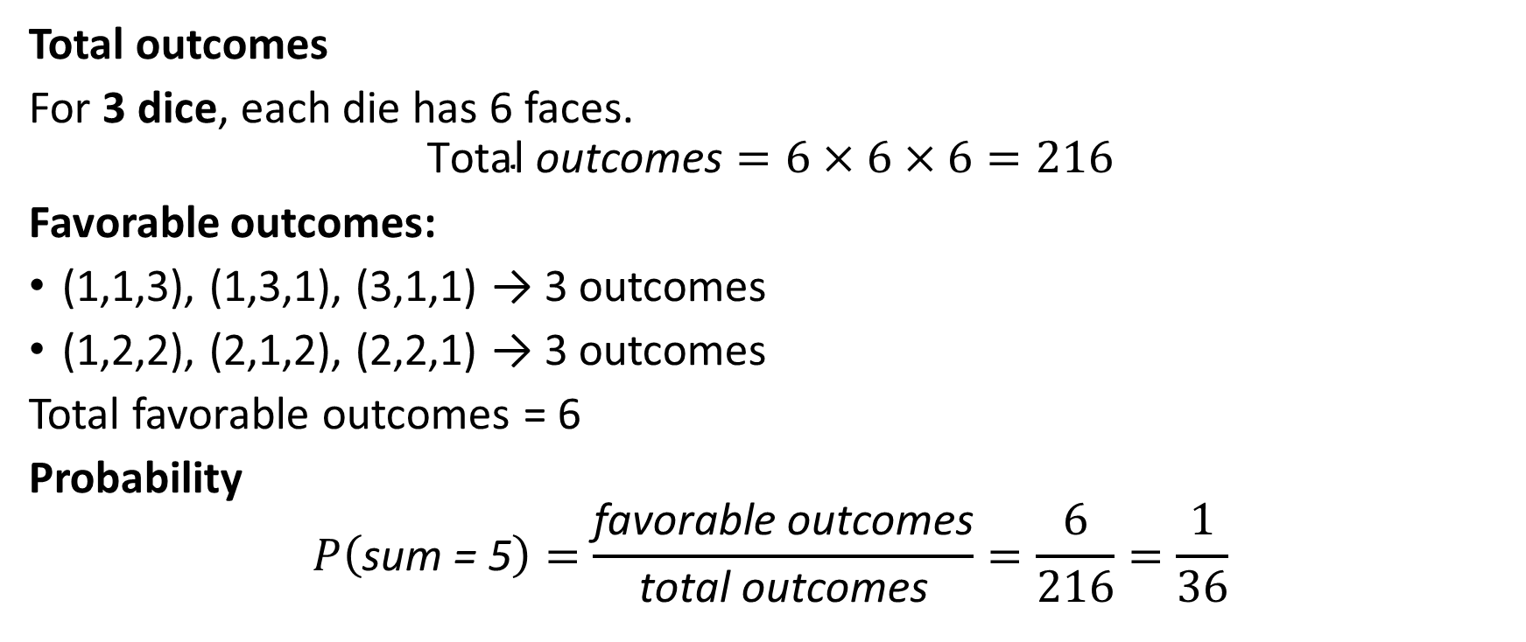
3. In a single throw of 3 dices , probability of getting a total of 5 ...
Total outcomes
For 3 dice, each die has 6 faces.
$$\text{Total} \text{outcomes}=6×6×6=216$$
Favorable outcomes:
(1,1,3), (1,3,1), (3,1,1) → 3 outcomes
(1,2,2), (2,1,2), (2,2,1) → 3 outcomes
Total favorable outcomes = 6
Probability
$$P\left(\text{sum}\text{ = }\text{5}\right)=\frac{\text{favorable} \text{outcomes}}{\text{total} \text{outcomes}}=\frac{6}{216}=\frac{1}{36}$$

Slide 12
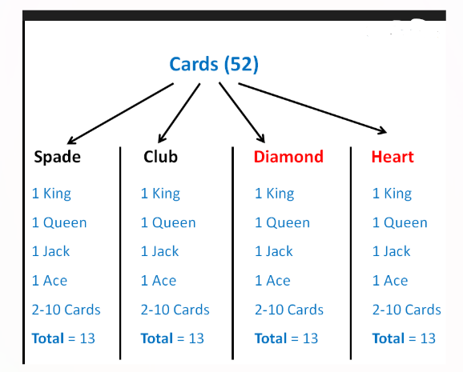
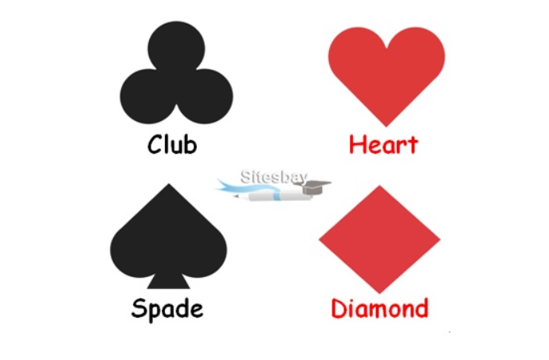
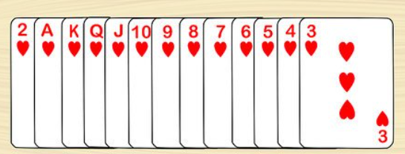
Problems based on playing CARDS

Slide 13
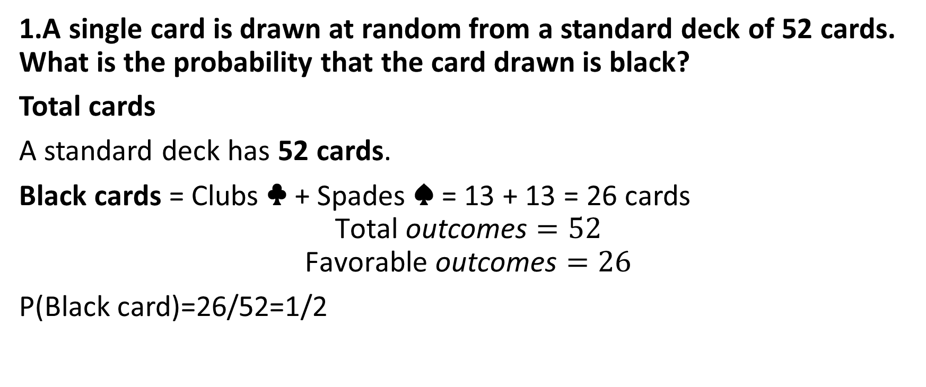
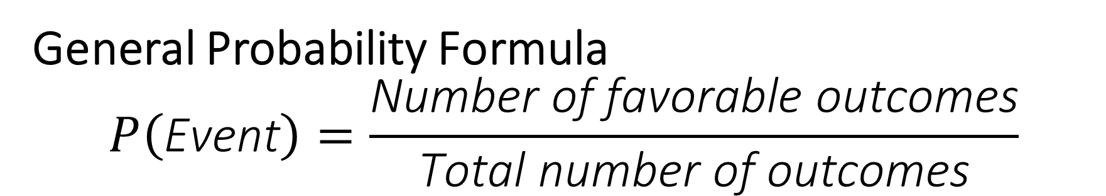
General Probability Formula $$P\left(\text{Event}\right)=\frac{\text{Number} \text{of} \text{favorable} \text{outcomes}}{\text{Total} \text{number} \text{of} \text{outcomes}}$$
1.A single card is drawn at random from a standard deck of 52 cards. What is the probability that the card drawn is black?
Total cards
A standard deck has 52 cards.
Black cards = Clubs ♣ + Spades ♠ = 13 + 13 = 26 cards
$$\text{Total} \text{outcomes}=52$$
$$\text{Favorable} \text{outcomes}=26$$
P(Black card)=26/52​=1/2

Slide 14
S.No | Question | Explanation | Answer
1 | A single card is drawn from a standard deck. What is the probability of picking a black card? | There are 26 black cards (Clubs + Spades) out of 52 total cards. Probability = favorable/total = 26/52 | 1/2
2 | A single card is drawn. Probability of drawing a red card? | Red cards = Hearts + Diamonds = 26. Probability = 26/52 | 1/2
3 | A single card is drawn. Probability of drawing a King? | There are 4 Kings in the deck. Probability = 4/52 | 1/13
4 | A single card is drawn. Probability of drawing a Heart? | There are 13 Hearts in the deck. Probability = 13/52 | 1/4
5 | A single card is drawn. Probability of drawing a number card (2–10)? | Number cards per suit = 9. Total = 9×4 = 36. Probability = 36/52 | 9/13
6 | A single card is drawn. Probability of drawing a face card (J, Q, K)? | 3 face cards per suit × 4 suits = 12. Probability = 12/52 | 3/13

Slide 15
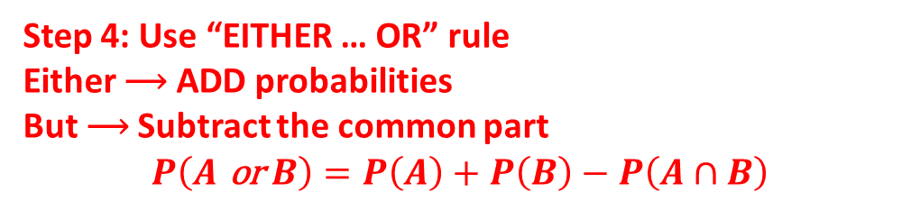
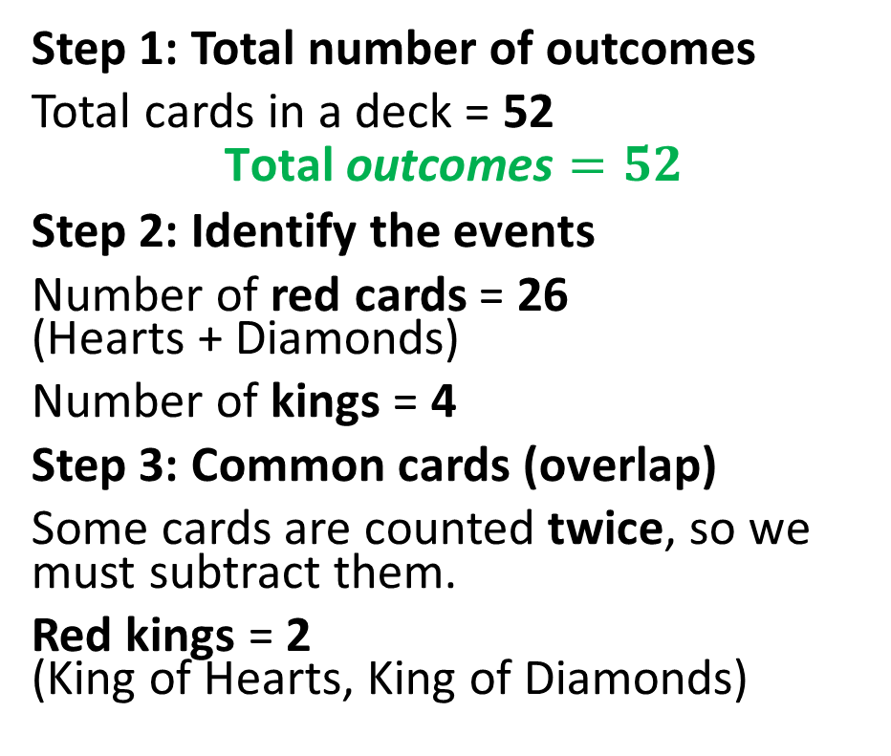


3.A card is drawn at random from a well-shuffled standard deck of 52 playing cards. What is the probability that the card drawn is either a red card or a king?
Step 1: Total number of outcomes
Total cards in a deck = 52
$$\text{Total} \text{outcomes}=52$$
Step 2: Identify the events
Number of red cards = 26 (Hearts + Diamonds)
Number of kings = 4
Step 3: Common cards (overlap)
Some cards are counted twice, so we must subtract them.
Red kings = 2 (King of Hearts, King of Diamonds)
Step 4: Use “EITHER … OR” rule
Either ⟶ ADD probabilities But ⟶ Subtract the common part
$$P\left(A \text{or} B\right)=P\left(A\right)+P\left(B\right)−P\left(A∩B\right)$$
P(Red card or King)
$$=\frac{26}{52}+\frac{4}{52}−\frac{2}{52}$$
Final calculation
$$=\frac{26+4−2}{52}$$
$$=\frac{28}{52}$$
$$=\frac{7}{13}$$

Slide 16
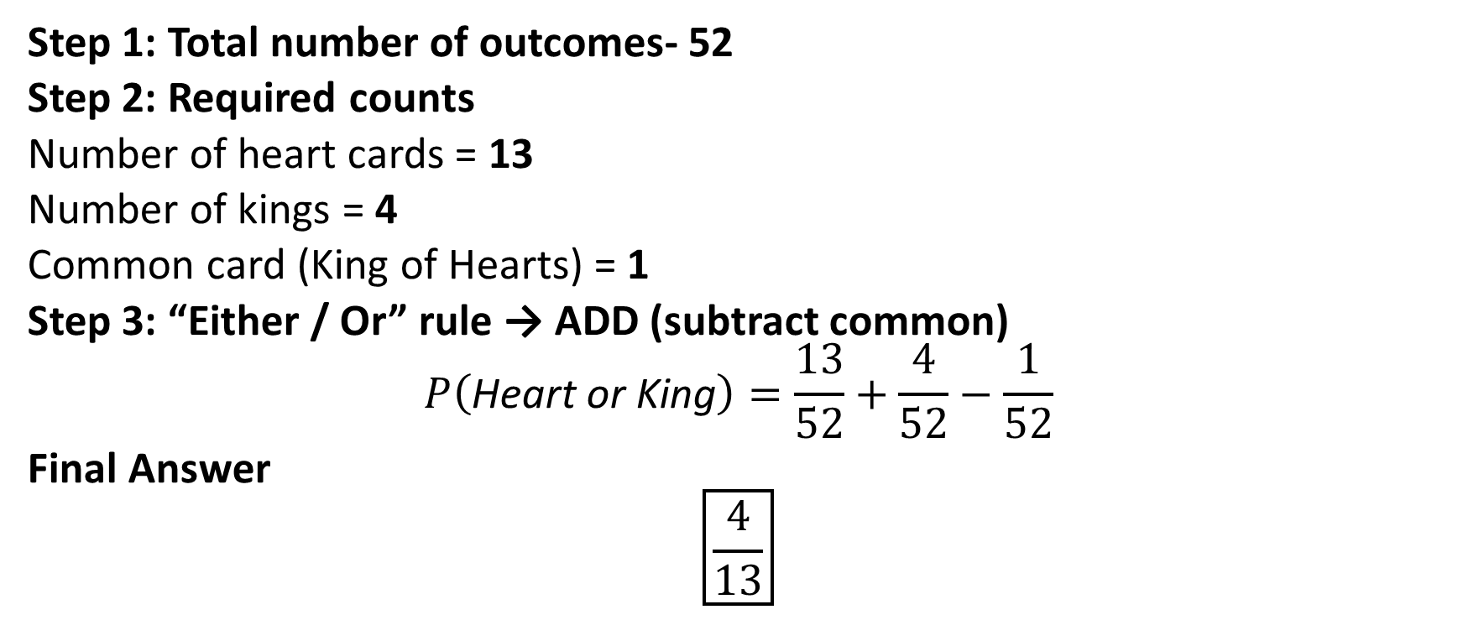
4.A card is drawn at random from a well-shuffled deck of 52 playing cards. What is the probability that the card drawn is either a heart or a king?
Step 1: Total number of outcomes- 52
Step 2: Required counts
Number of heart cards = 13
Number of kings = 4
Common card (King of Hearts) = 1
Step 3: “Either / Or” rule → ADD (subtract common)
$$P\left(\text{Heart} \text{or} \text{King}\right)=\frac{13}{52}+\frac{4}{52}−\frac{1}{52}$$
Final Answer
$$\boxed{\frac{4}{13}}$$

Slide 17
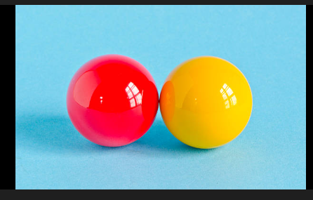
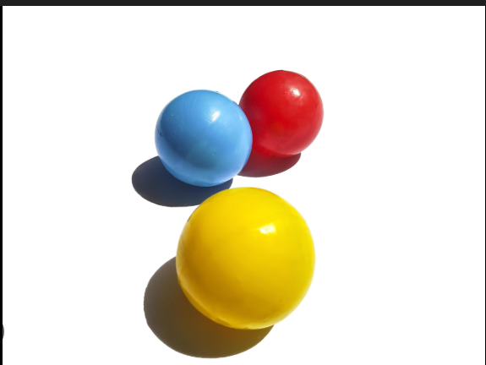

Slide 18

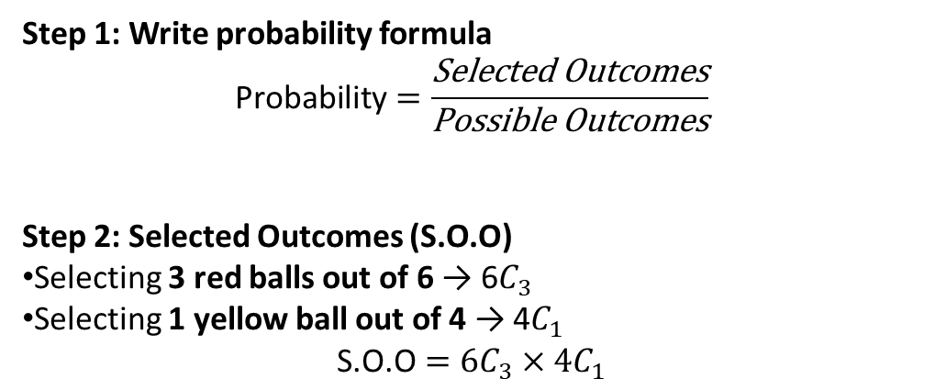

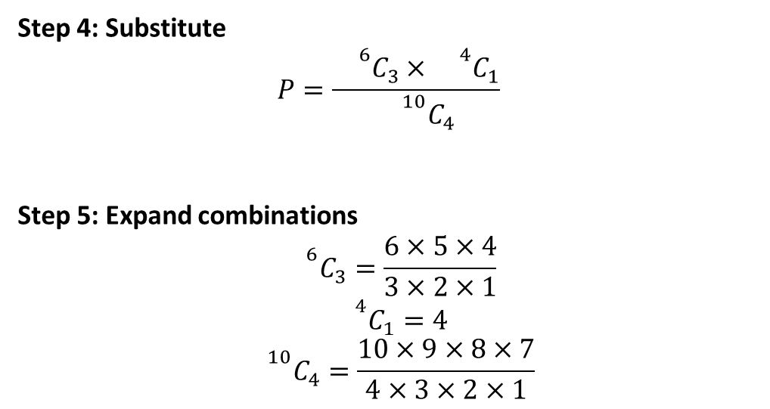
A bag contains 6 red balls and 4 yellow balls. If 4 balls are drawn at random from the bag at the same time, what is the probability that exactly 3 of the balls are red and 1 is yellow?
Step 4: Substitute
$$P=\frac{{}^{6}C_{3}×{}^{4}C_{1}}{{}^{10}C_{4}}$$
Step 5: Expand combinations
$${}^{6}C_{3}=\frac{6×5×4}{3×2×1}$$
$${}^{4}C_{1}=4$$
$${}^{10}C_{4}=\frac{10×9×8×7}{4×3×2×1}$$
Step 1: Write probability formula
$$\text{Probability}=\frac{\text{Selected} \text{Outcomes}}{\text{Possible} \text{Outcomes}}$$
Step 2: Selected Outcomes (S.O.O)
Selecting 3 red balls out of 6 → 6$C_{3}$
Selecting 1 yellow ball out of 4 → 4$C_{1}$
$$\text{S}\text{.}\text{O}\text{.}\text{O}=6C_{3}×4C_{1}$$
Step 3: Possible Outcomes
Selecting 4 balls out of 10
$$\text{Possible} \text{outcomes}={}^{10}C_{4}$$
Step 6: Simplify
$$P=\frac{5×4×4}{10×3×7}$$
$$=\frac{80}{210}$$
$$=\frac{8}{21}$$

Slide 19

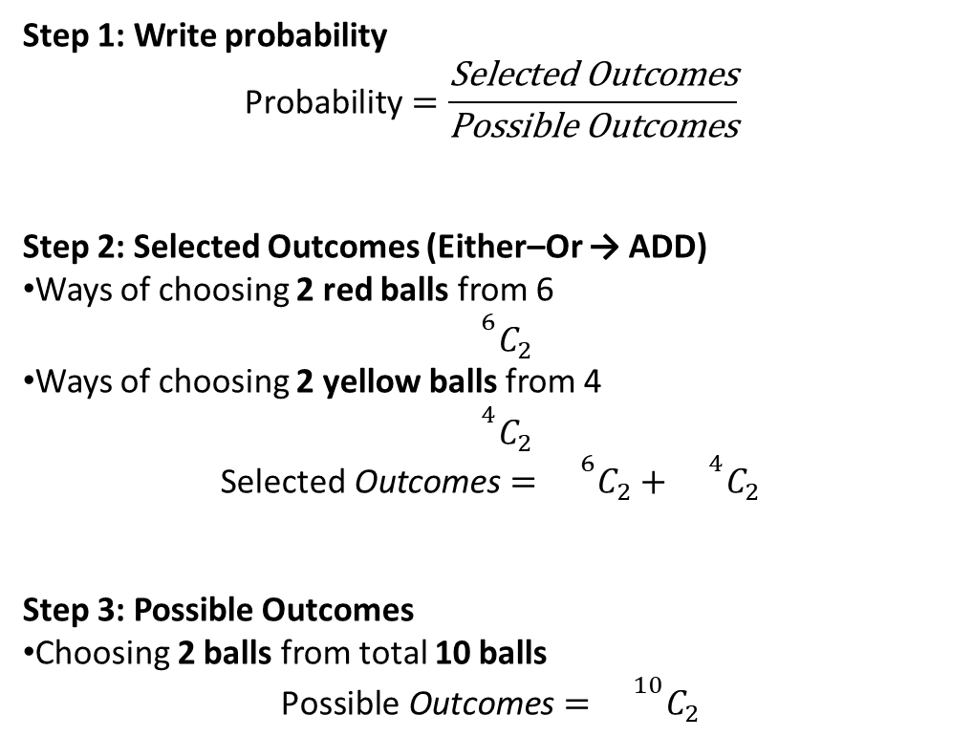
A bag contains 6 red balls and 4 yellow balls. If 4 balls are drawn at random from the bag at the same time, what is the probability that either exactly 2 balls are red OR exactly 2 balls are yellow?
Step 1: Write probability
$$\text{Probability}=\frac{\text{Selected} \text{Outcomes}}{\text{Possible} \text{Outcomes}}$$
Step 2: Selected Outcomes (Either–Or → ADD)
Ways of choosing 2 red balls from 6
$${}^{6}C_{2}$$
Ways of choosing 2 yellow balls from 4
$${}^{4}C_{2}$$
$$\text{Selected} \text{Outcomes}={}^{6}C_{2}+{}^{4}C_{2}$$
Step 3: Possible Outcomes
Choosing 2 balls from total 10 balls
$$\text{Possible} \text{Outcomes}={}^{10}C_{2}$$
Step 4: Substitute
$$P=\frac{{}^{6}C_{2}+{}^{4}C_{2}}{{}^{10}C_{2}}$$
Step 5: Expand
$${}^{6}C_{2}=\frac{6×5}{2×1}=15$$
$${}^{4}C_{2}=\frac{4×3}{2×1}=6$$
$${}^{10}C_{2}=\frac{10×9}{2×1}=45$$
Step 6: Simplify
$$P=\frac{15+6}{45}=\frac{21}{45}=\frac{7}{15}$$

Slide 20
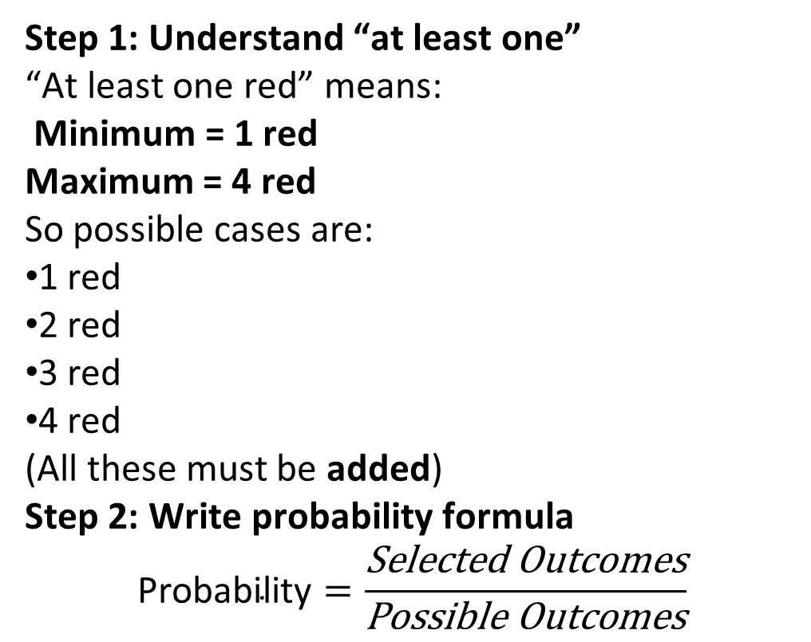
A bag contains 6 red balls and 4 yellow balls. If 4 balls are picked at random at the same time, what is the probability that at least one ball is red?
Step 1: Understand “at least one”
“At least one red” means:
Minimum = 1 red Maximum = 4 red
So possible cases are:
1 red
2 red
3 red
4 red
(All these must be added)
Step 2: Write probability formula
$$\text{Probability}=\frac{\text{Selected} \text{Outcomes}}{\text{Possible} \text{Outcomes}}$$

Slide 21
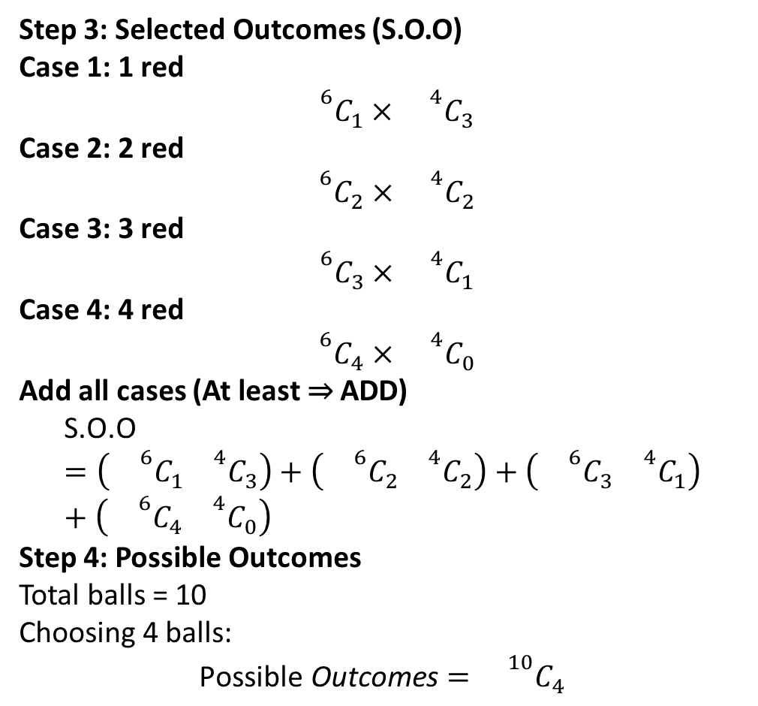
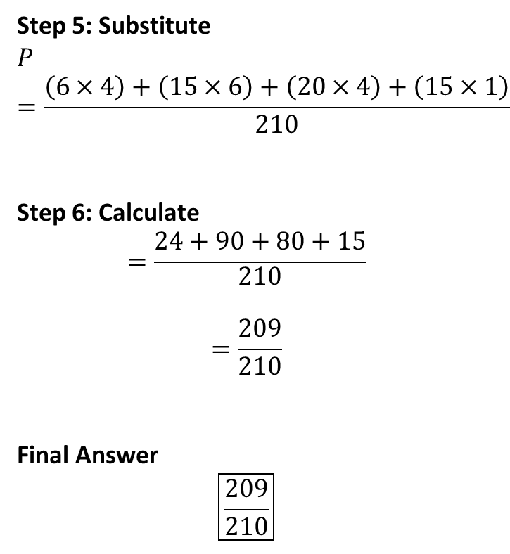
Step 3: Selected Outcomes (S.O.O)
Case 1: 1 red
$${}^{6}C_{1}×{}^{4}C_{3}$$
Case 2: 2 red
$${}^{6}C_{2}×{}^{4}C_{2}$$
Case 3: 3 red
$${}^{6}C_{3}×{}^{4}C_{1}$$
Case 4: 4 red
$${}^{6}C_{4}×{}^{4}C_{0}$$
Add all cases (At least ⇒ ADD)
$$\text{S}\text{.}\text{O}\text{.}\text{O}=\left({}^{6}C_{1}{}^{4}C_{3}\right)+\left({}^{6}C_{2}{}^{4}C_{2}\right)+\left({}^{6}C_{3}{}^{4}C_{1}\right)+\left({}^{6}C_{4}{}^{4}C_{0}\right)$$
Step 4: Possible Outcomes
Total balls = 10 Choosing 4 balls:
$$\text{Possible} \text{Outcomes}={}^{10}C_{4}$$
Step 5: Substitute
$$P=\frac{\left(6×4\right)+\left(15×6\right)+\left(20×4\right)+\left(15×1\right)}{210}$$
Step 6: Calculate
$$=\frac{24+90+80+15}{\begin{aligned}210 \\ \end{aligned}}$$
$$=\frac{209}{210}$$
Final Answer
$$\boxed{\frac{209}{210}}$$

Slide 22
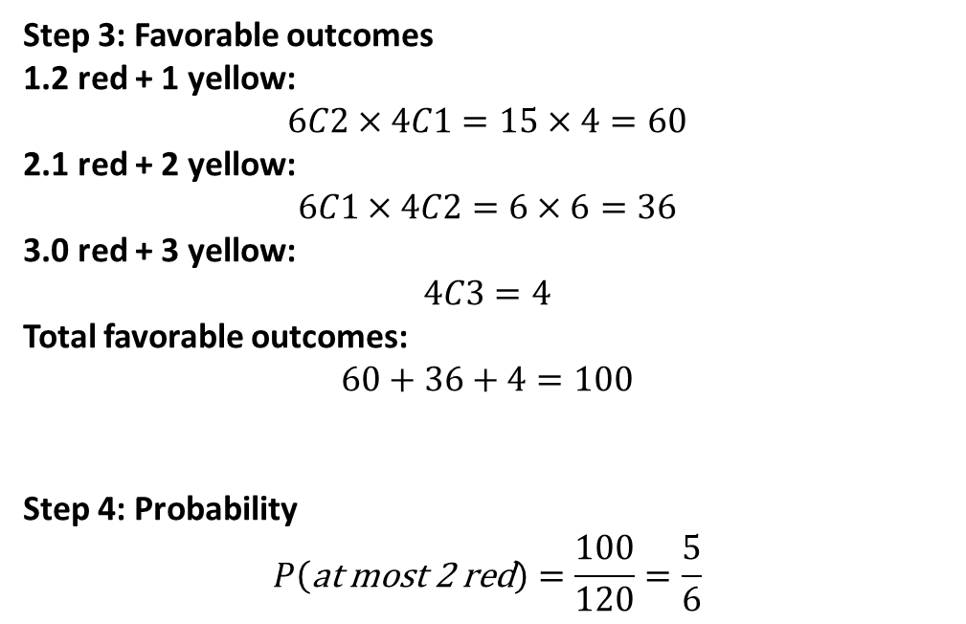
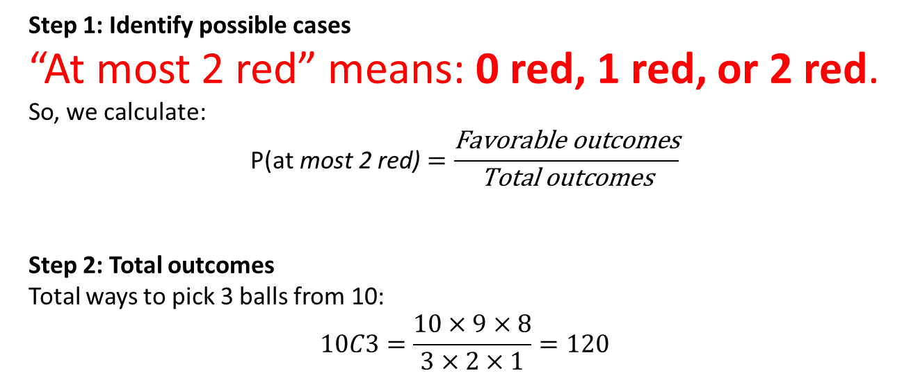
A bag contains 6 red balls and 4 yellow balls. Three balls are picked at random. Find the probability that at most 2 are red.
Step 1: Identify possible cases
“At most 2 red” means: 0 red, 1 red, or 2 red.
So, we calculate:
$$\text{P}\text{(}\text{at} \text{most} \text{2 }\text{red}\text{)}=\frac{\text{Favorable} \text{outcomes}}{\text{Total} \text{outcomes}}$$
Step 2: Total outcomes
Total ways to pick 3 balls from 10:
$$10C3=\frac{10×9×8}{3×2×1}=120$$
Step 3: Favorable outcomes
2 red + 1 yellow:
$$6C2×4C1=15×4=60$$
1 red + 2 yellow:
$$6C1×4C2=6×6=36$$
0 red + 3 yellow:
$$4C3=4$$
Total favorable outcomes:
$$60+36+4=100$$
Step 4: Probability
$$P\left(\text{at} \text{most} \text{2 }\text{red}\right)=\frac{100}{120}=\frac{5}{6}$$

Slide 23
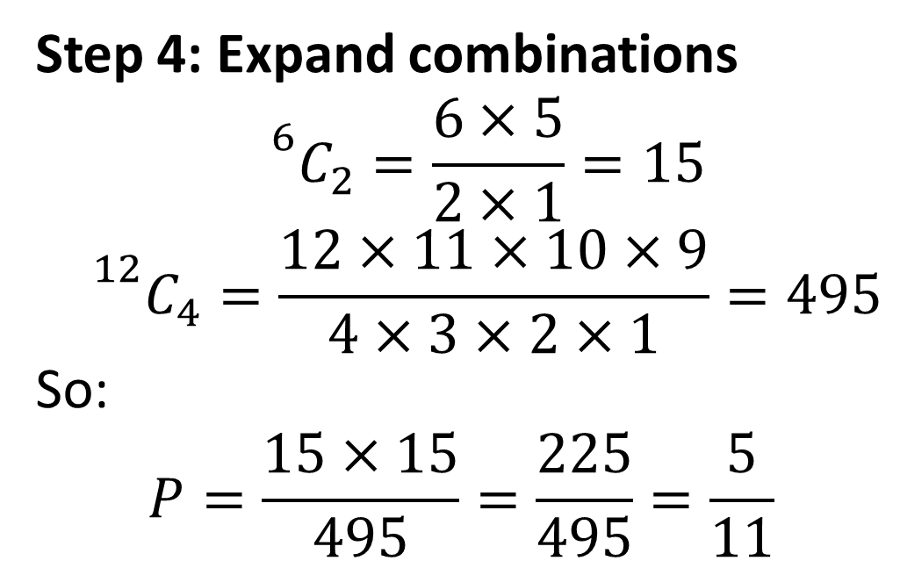
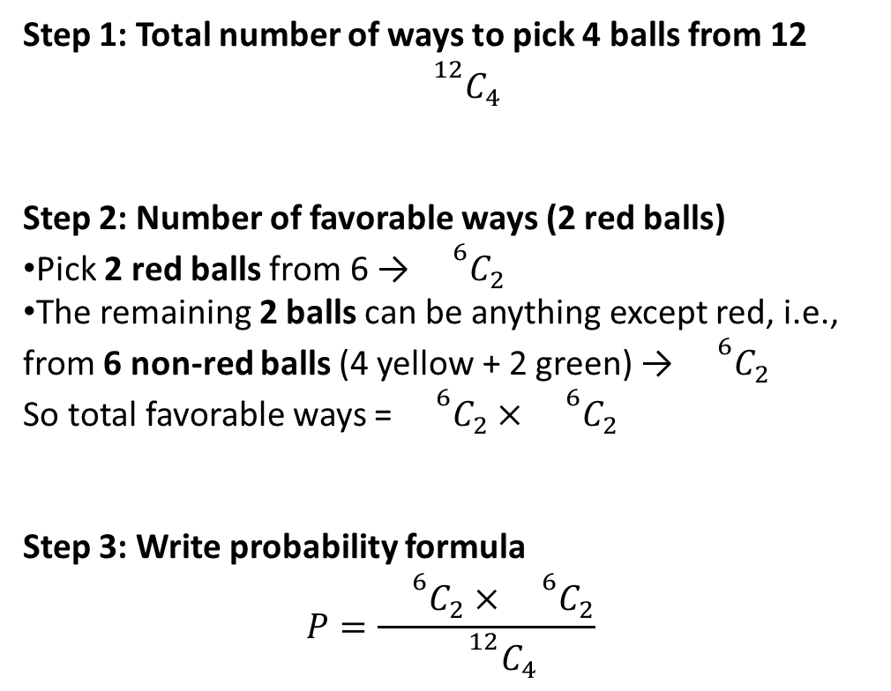
A bag contains 6 Red balls, 4 Yellow balls and 2 Green Balls. Four balls are picked at random. What is the probability two are red?
Step 1: Total number of ways to pick 4 balls from 12
$${}^{12}C_{4}$$
Step 2: Number of favorable ways (2 red balls)
Pick 2 red balls from 6 → ${}^{6}C_{2}$
The remaining 2 balls can be anything except red, i.e., from 6 non-red balls (4 yellow + 2 green) → ${}^{6}C_{2}$
So total favorable ways = ${}^{6}C_{2}×{}^{6}C_{2}$
Step 3: Write probability formula
$$P=\frac{{}^{6}C_{2}×{}^{6}C_{2}}{{}^{12}C_{4}}$$
Step 4: Expand combinations
$${}^{6}C_{2}=\frac{6×5}{2×1}=15$$
$${}^{12}C_{4}=\frac{12×11×10×9}{4×3×2×1}=495$$
So:
$$P=\frac{15×15}{495}=\frac{225}{495}=\frac{5}{11}$$

Slide 24
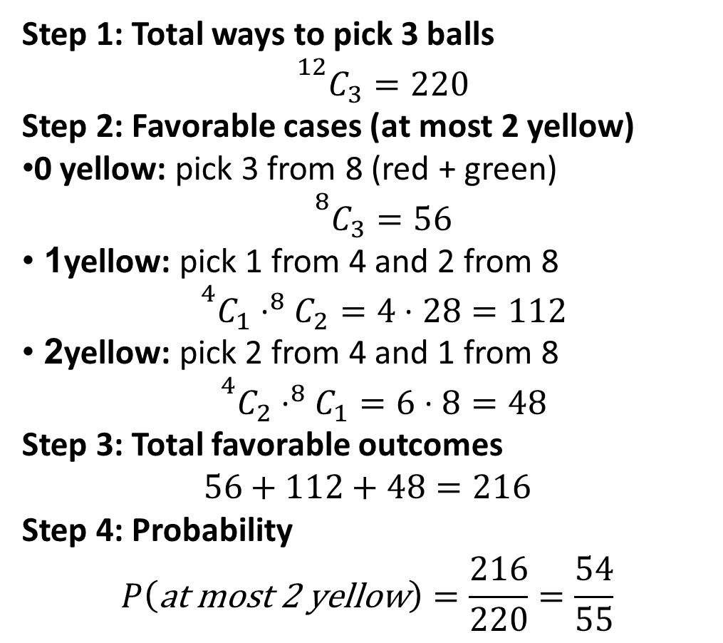
A bag contains 6 Red balls, 4 Yellow balls and 2 Green Balls. Three balls are picked at random. What is the probability at most 2 are yellow ?
Step 1: Total ways to pick 3 balls
$${}^{12}C_{3}=220$$
Step 2: Favorable cases (at most 2 yellow)
0 yellow: pick 3 from 8 (red + green)
$${}^{8}C_{3}=56$$
1 yellow: pick 1 from 4 and 2 from 8
$${}^{4}C_{1}⋅^{8}C_{2}=4⋅28=112$$
2 yellow: pick 2 from 4 and 1 from 8
$${}^{4}C_{2}⋅^{8}C_{1}=6⋅8=48$$
Step 3: Total favorable outcomes
$$56+112+48=216$$
Step 4: Probability
$$P\left(\text{at} \text{most} \text{2 }\text{yellow}\right)=\frac{216}{220}=\frac{54}{55}$$

Slide 25
PRACTISE QUESTIONS
1. An urn consists of some green, red and black balls. Total number of balls in the urn is 15. If two balls are picked, Probability that the two balls being green is 2/21. Now one ball is picked from the urn, find the probability that the ball is either red or black.
A. Cannot be determined
B. 2/15
C. 1/5
D. 1/10
E. 2/3

Slide 26
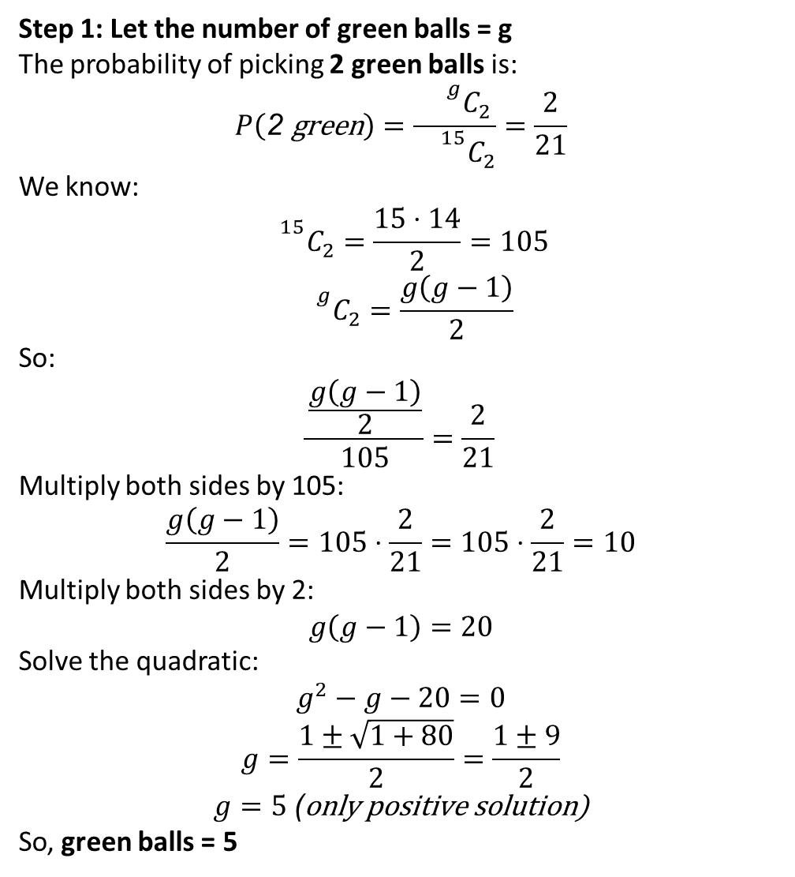
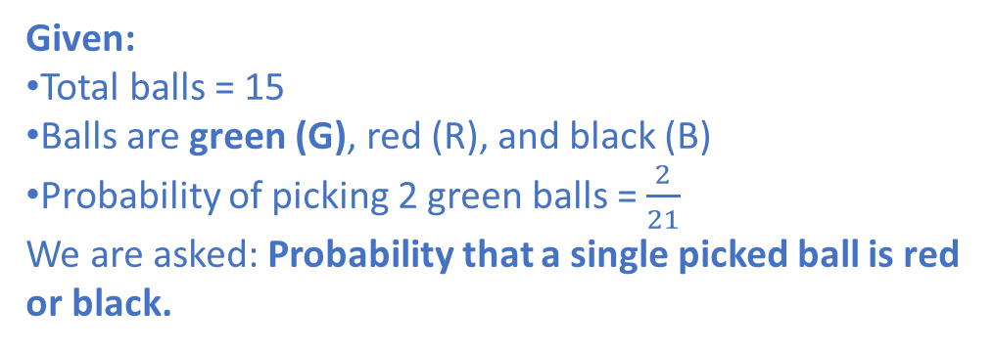
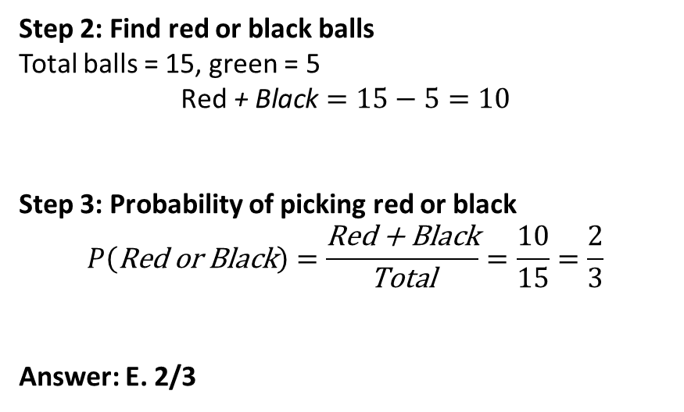
Given:
Total balls = 15
Balls are green (G), red (R), and black (B)
Probability of picking 2 green balls = $\frac{2}{21}$
We are asked: Probability that a single picked ball is red or black.
Step 1: Let the number of green balls = g
The probability of picking 2 green balls is:
$$P\left(\text{2 }\text{green}\right)=\frac{{}^{g}C_{2}}{{}^{15}C_{2}}=\frac{2}{21}$$
We know:
$${}^{15}C_{2}=\frac{15⋅14}{2}=105$$
$${}^{g}C_{2}=\frac{g\left(g−1\right)}{2}$$
So:
$$\frac{\frac{g\left(g−1\right)}{2}}{105}=\frac{2}{21}$$
Multiply both sides by 105:
$$\frac{g\left(g−1\right)}{2}=105⋅\frac{2}{21}=105⋅\frac{2}{21}=10$$
Multiply both sides by 2:
$$g\left(g−1\right)=20$$
Solve the quadratic:
$$g^{2}−g−20=0$$
$$g=\frac{1±\sqrt{1+80}}{2}=\frac{1±9}{2}$$
$$g=5 \text{(}\text{only} \text{positive} \text{solution}\text{)}$$
So, green balls = 5
Step 2: Find red or black balls
Total balls = 15, green = 5
$$\text{Red}\text{ + }\text{Black}=15−5=10$$
Step 3: Probability of picking red or black
$$P\left(\text{Red} \text{or} \text{Black}\right)=\frac{\text{Red}\text{ + }\text{Black}}{\text{Total}}=\frac{10}{15}=\frac{2}{3}$$
Answer: E. 2/3

Slide 27
2.There are three groups of fire extinguishers in a city i.e. P, Q and R. In group P there are (x-6) females and (x+21) males. In group Q, there are 3 females and 12 males whereas in group R, there are 5 females and 7 males. One person is selected at random from each group. Find the number of females in group P, if the probability of selecting all three males is 4/15.
A. 81
B. 85
C. 83
D. 71
E. 89.

Slide 28
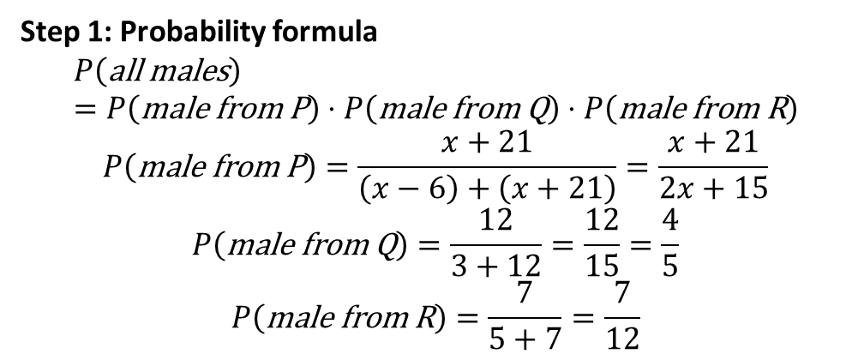
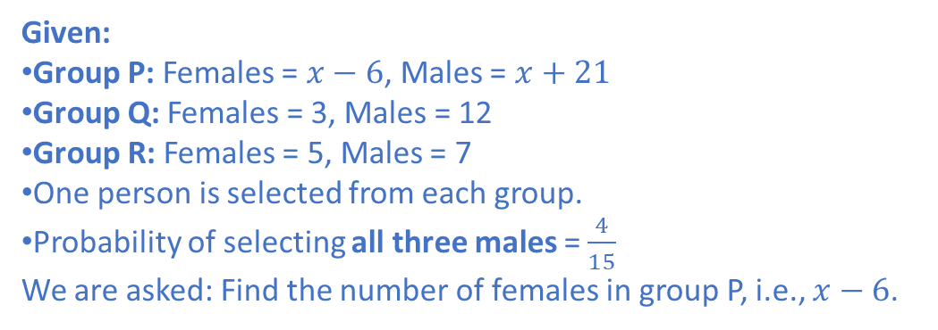
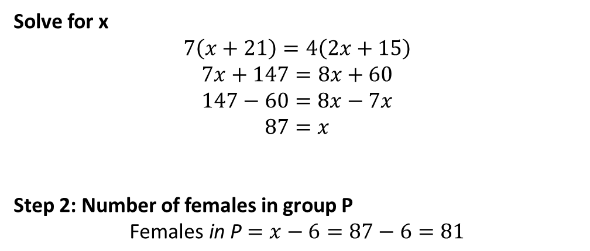

Given:
Group P: Females = $x−6$, Males = $x+21$
Group Q: Females = 3, Males = 12
Group R: Females = 5, Males = 7
One person is selected from each group.
Probability of selecting all three males = $\frac{4}{15}$
We are asked: Find the number of females in group P, i.e., $x−6$.
Step 1: Probability formula
$$P\left(\text{all} \text{males}\right)=P\left(\text{male} \text{from} \text{P}\right)⋅P\left(\text{male} \text{from} \text{Q}\right)⋅P\left(\text{male} \text{from} \text{R}\right)$$
$$P\left(\text{male} \text{from} \text{P}\right)=\frac{x+21}{\left(x−6\right)+\left(x+21\right)}=\frac{x+21}{2x+15}$$
$$P\left(\text{male} \text{from} \text{Q}\right)=\frac{12}{3+12}=\frac{12}{15}=\frac{4}{5}$$
$$P\left(\text{male} \text{from} \text{R}\right)=\frac{7}{5+7}=\frac{7}{12}$$
Solve for x
$$7\left(x+21\right)=4\left(2x+15\right)$$
$$7x+147=8x+60$$
$$147−60=8x−7x$$
$$87=x$$
Step 2: Number of females in group P
$$\text{Females} \text{in} \text{P}=x−6=87−6=81$$
So:
$$\frac{x+21}{2x+15}⋅\frac{4}{5}⋅\frac{7}{12}=\frac{4}{15}$$

