Slide 1

Leaf Disease Detection
By: Komal Giri
Kanika Tilkan
Amrit Chandra

Slide 2
Content
Introduction
Literature Survey
System Design
Implementation
Tensorflow and Keras
Results
Conclusion

Slide 3
INTRODUCTION
Automatic detection of the diseases by just seeing the symptoms on the plant leaves makes it easier also machine vision to provide image based automatic process control.
Image segmentation is grouping an image into different parts. In this Thresholding process is advanced color method This process is based on various features found in the image. Genetic algorithm searches from a large sampling of the cost surface.
Large number of variables can be processed and Gives a number of optimum solutions, different image segmentation results can be obtained.

Slide 4
LITERATURE SURVEY
Key Takeaways:
In 2015, S. Khirade et Al. tackled the problem of plant disease detection using digital image processing techniques and back propagation neural network (BPNN).
Authors concluded that GCLM features are effective to detect normal leaves. Whereas color features and Gabor filter features are considered as best for detecting anthracnose affected leaves and leaf spot respectively.

Slide 5
SYSTEM DESIGN
Neural Network:
Neural networks are composed of multiple layers of interconnected "neurons," which process and transmit information.
Neural networks are able to learn and make intelligent decisions on their own, without being explicitly programmed to perform specific tasks. This is achieved through the training process, during which the network adjusts the strength of the connections between neurons to find patterns in data and make predictions or decisions.

Slide 6
IMPLEMENTATION
For this project we have used public dataset for plant leaf disease detection called Plant Village.
The dataset consists of 87000 RGB images of healthy and unhealthy plant leaves having 38 classes out of which We have selected only 25 classes for experimentation of our algorithm.

Slide 7

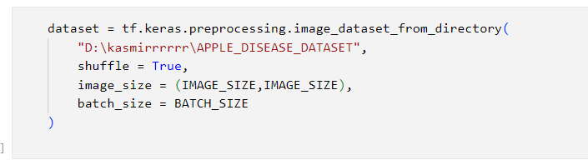
IMPLEMENTATION
This is the File directory for our project. It contain Apple Rot leaves, healthy leaves, leaf blotch, and scab leaves.
It is important that one has mentioned correct file directory in the model.

Slide 8
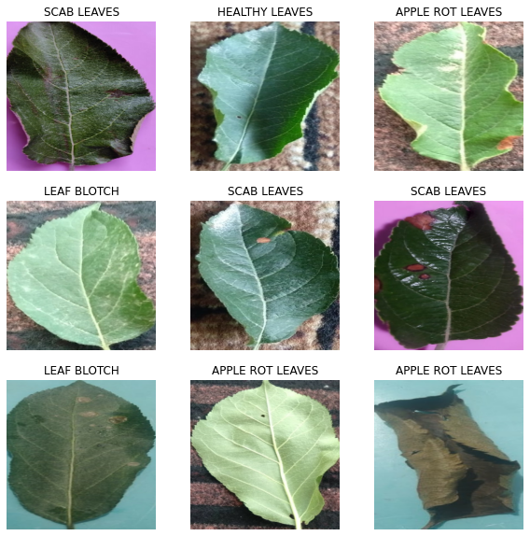
IMPLEMENTATION

Slide 9
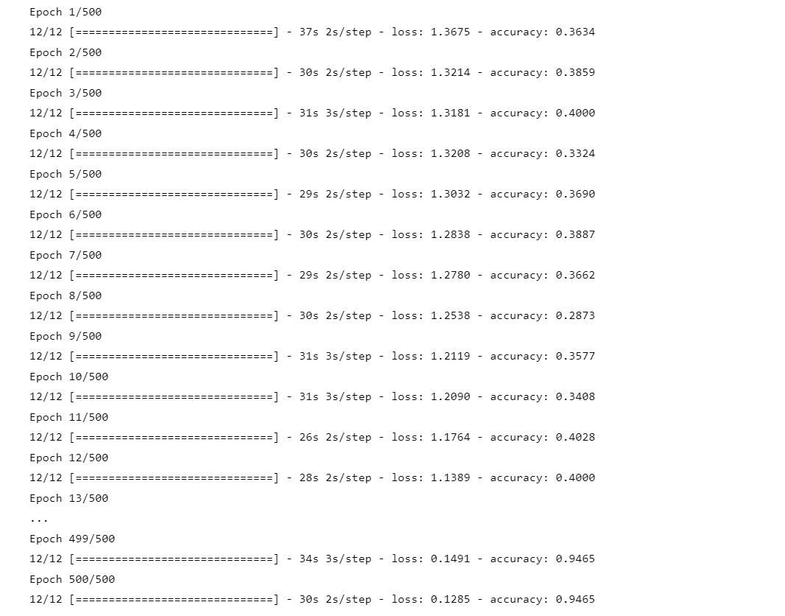
IMPLEMENTATION:
An epoch in machine learning refers to one full pass through the training dataset. During training, a machine learning model processes and learns from the training data, and the number of epochs specifies how many times the model will cycle through the data.

Slide 10
TensorFlow and Keras:
TensorFlow is a free and open-source software library for machine learning and artificial intelligence. It was developed by Google and is widely used for training and deploying machine learning models.
TensorFlow allows developers to define, optimize, and execute numerical computations involving multi-dimensional arrays (tensors) with high performance and flexibility.
Keras is a high-level neural network API written in Python and built on top of TensorFlow. It is designed to make working with TensorFlow more user-friendly and intuitive, allowing developers to prototype, build, and train deep learning models with minimal code.
Keras features a variety of tools and functions for building and training neural networks, including support for convolutional and recurrent layers, as well as the ability to easily switch between different backends (such as TensorFlow, Theano, and CNTK) to run the models.

Slide 11
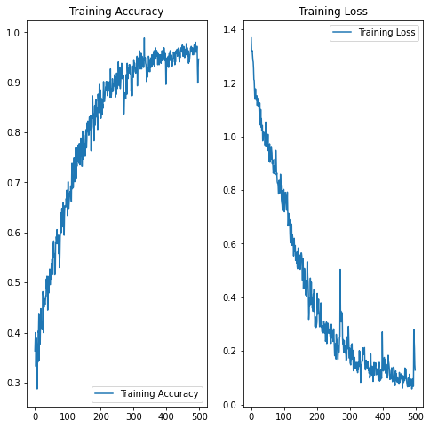
Results
Training accuracy is a measure of how accurately a machine learning model is able to predict the correct output for a given input during the training phase.
Training loss, on the other hand, is a measure of how well the model is able to fit the training data.

Slide 12
Conclusion
The use of TensorFlow and Keras allowed for the efficient development and training of a deep learning model for leaf disease detection.
The model was able to achieve high accuracy in classifying different types of leaf diseases, demonstrating its effectiveness in identifying and distinguishing between different diseases based on visual characteristics of the leaves.
The use of deep learning techniques allowed the model to learn and recognize complex patterns in the images, making it more robust and accurate compared to traditional machine learning approaches.
The project has the potential to have a significant impact in the field of agriculture, as it provides a reliable and automated method for detecting and diagnosing plant diseases, which can help farmers prevent and mitigate the spread of diseases and improve crop yields.

