Slide 1
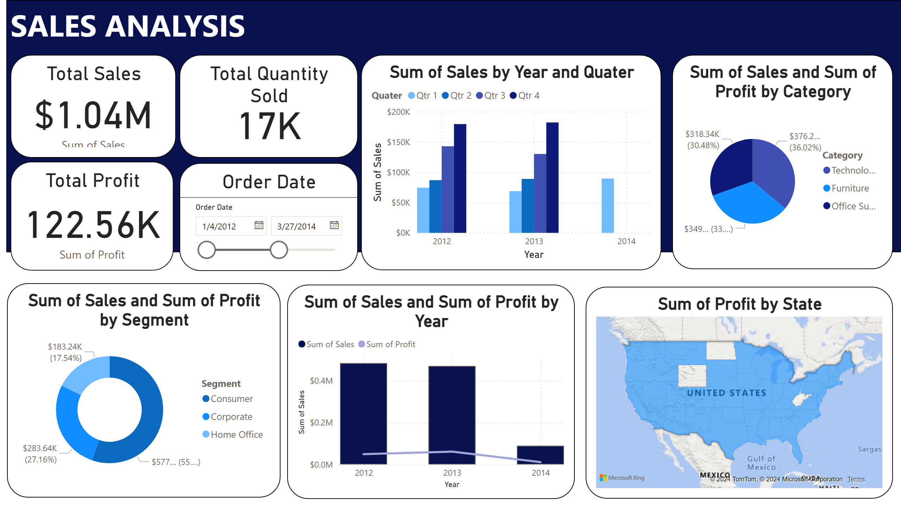
Overall Sales
Notes:
textbox
No alt text provided
Total Sales
No alt text provided
Total Quantity Sold
No alt text provided
Total Profit
No alt text provided
Order Date
No alt text provided
lineStackedColumnComboChart
No alt text provided
lineClusteredColumnComboChart
No alt text provided
filledMap
No alt text provided
donutChart
No alt text provided
pieChart
No alt text provided

Slide 2
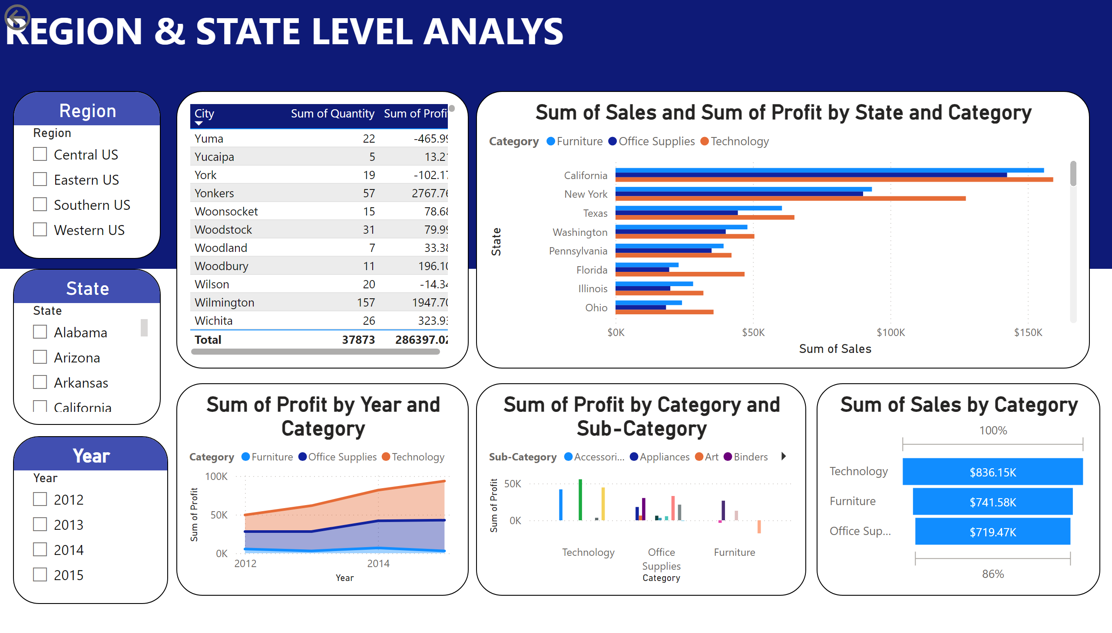
Region State
Notes:
textbox
No alt text provided
textbox
No alt text provided
State
No alt text provided
Year
No alt text provided
tableEx
No alt text provided
actionButton
No alt text provided
Region
No alt text provided
clusteredBarChart
No alt text provided
stackedAreaChart
No alt text provided
lineClusteredColumnComboChart
No alt text provided
funnel
No alt text provided

Slide 3
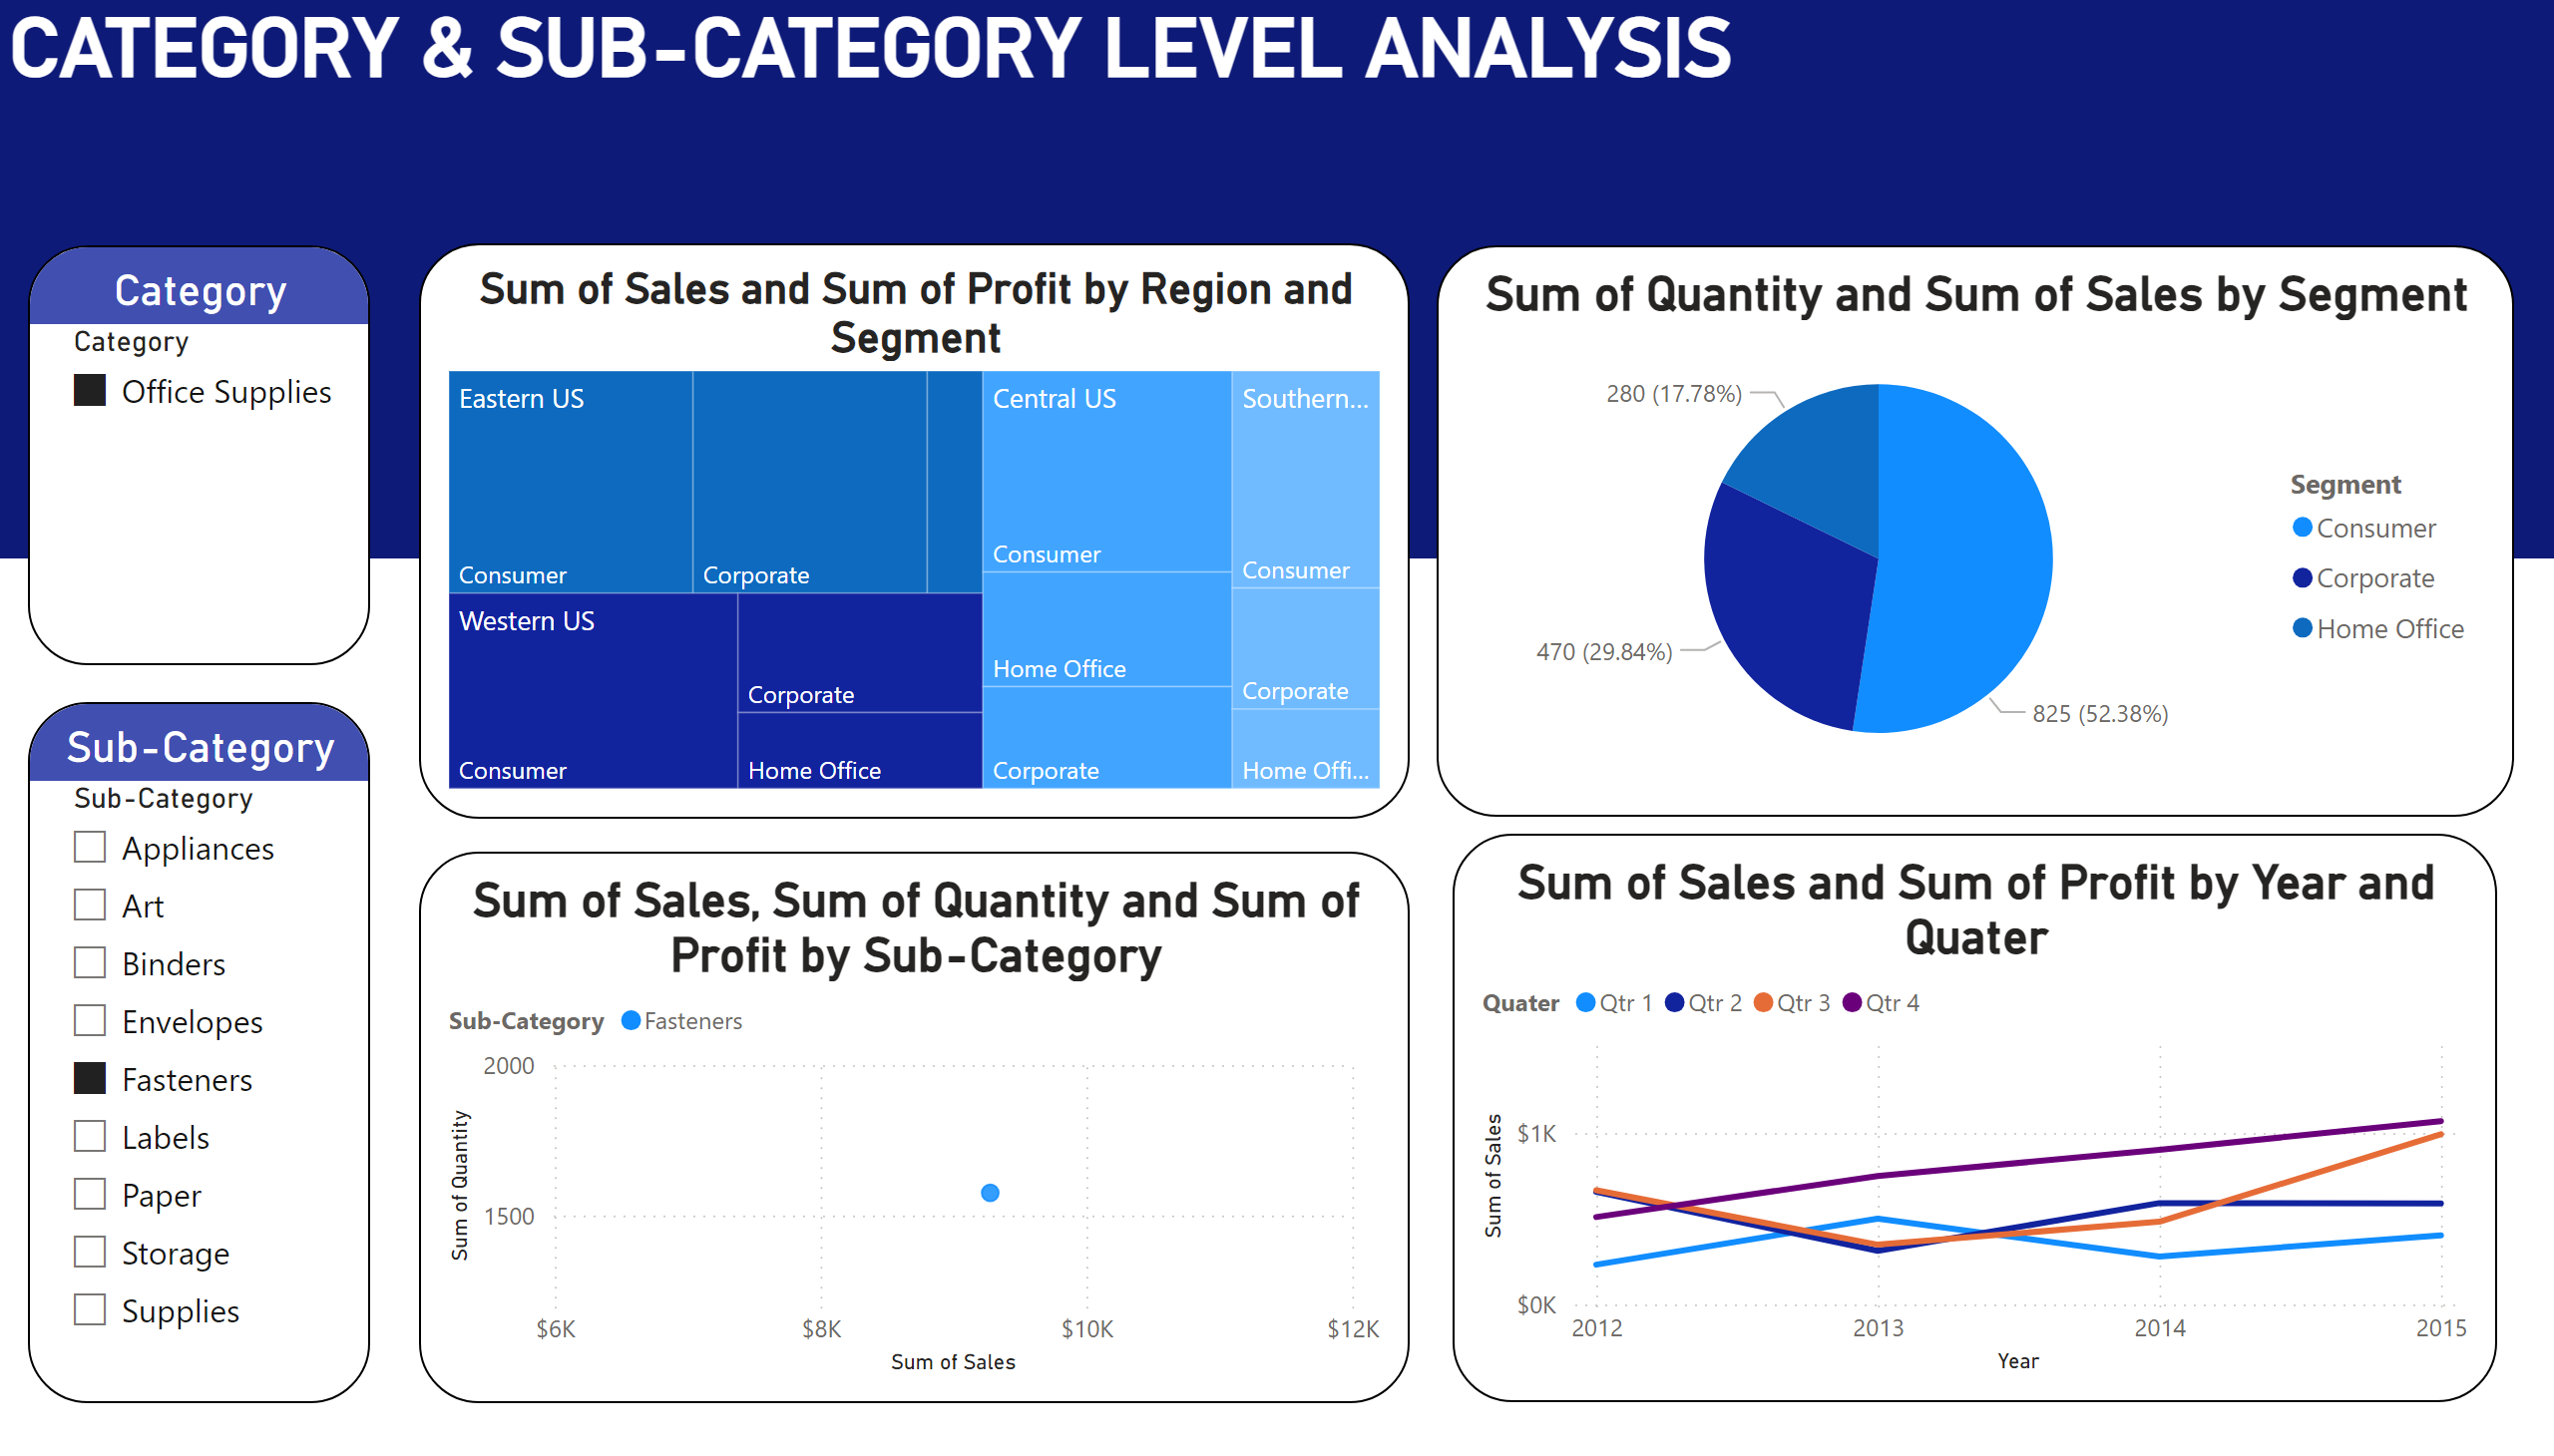
Category & Sub-category Analysis
Notes:
CATEGORY & SUB-CATEGORY LEVEL ANALYSIS
No alt text provided
Category
No alt text provided
Sub-Category
No alt text provided
treemap
No alt text provided
pieChart
No alt text provided
scatterChart
No alt text provided
lineChart
No alt text provided

