Slide 1
HR_ART Web Based HR System Team name : Nerds of a Feather

Slide 2
Web Based HR System Calculate salary automatically based on the leave application and attendance of employees. We need a system where we calculate salary automatically: List of all employees. Their details.2 login access- one for employees and one for admin (role based access) Employee can see only their profile. Employee can apply for leaves (half/ full day).Employee can mark their attendance. Employee can log a meeting details if he had gone for a meeting for half day and then came to office in the other half. Employee can apply for reimbursements.Salary to be calculated based on all above parameters. ie. no of days present, client meeting to be added as employee was working & reimbursement to be added.No tax deductions.Manager approval system required for reimbursement, client meeting & leave applications

Slide 3
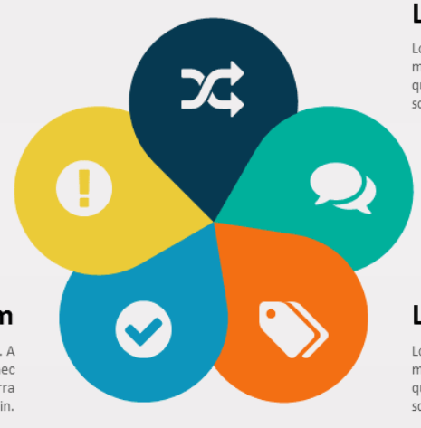
WORKFLOW FOR EMPLOYEE
Profile
Client Meetings
Leave Application
Attendance
Reimbursement

Slide 4
WORKFLOW FOR ADMIN
Dashboard
Salary Calculator
Leave Tracker
Attendance
Reimbursement

Slide 5
PROBLEMS SOLVED BY THE SYSTEM
Employee Interface
Efficient Database Management
Time and Labour Management
Recruitment and Retention
Payroll Function

Slide 6
TECHNOLOGY STACK
Frontend
Backend
Integration
HTML
CSS
JAVASCRIPT
BOOTSTRAP
MySQL Database
PyMySQL
Logistic Regression
FLASK

Slide 7
FUTURE SCOPE:
Automated Reimbursement Verification
Sentiment Analysis so that employee affairs can be handled
Dynamic creation of databases that functions for multiple companies

Slide 8
Thank you

