Slide 1
Signal-to-Shock
Financial event intelligence
and portfolio stress testing
Devanshi Gupta
Indira Gandhi Delhi Technical University for Women
devanshi034bteceai24@igdtuw.ac.in
S&P Global & CRISIL Campus Hackathon 2026
Notes:
Open: A negative headline is only the beginning. Which issuer is exposed, which positions should we stress, and can another analyst reproduce the result? This is an individual prototype by Devanshi Gupta. AI assistance supported implementation, documentation and testing.

Slide 2
The analyst’s decision
Which positions should this headline affect?
A bank default can affect its equity, loan and swap.
Applying the same issuer shock to an unrelated
technology company distorts the scenario.
Our approach
Show the matched evidence.
Let the analyst choose scope.
Explain every position’s P&L.
Designed for event triage and reproducible scenario discussion.
The shocks are illustrative assumptions.
2 / 7
Notes:
Sources: data/synthetic_portfolio.csv; data/scenarios.json; src/reporting/report.py. The business value is consistent issuer mapping and a traceable analyst discussion. No measured productivity or client deployment claim.

Slide 3
System design and data flow
INPUT
RULE ENGINE
ANALYST REVIEW
STRESS ENGINE
Synthetic text
Portfolio CSV
→
Sentiment counts
Event evidence
→
Scenario + issuer
Intensity 1–10
→
Eligibility mask
Position P&L
AUDIT OUTPUT
Input snapshot + scenario assumptions + position ledger + SHA-256 fingerprint
Python / pandas calculations · Streamlit interface · JSON and CSV exports
3 / 7
Notes:
Source: app.py; src/nlp/analyzer.py; src/risk/stress.py; src/reporting/report.py. All components run offline after installation. The classifier is rule-based, not trained. The fingerprint identifies the input and assumptions, not a security signature.

Slide 4
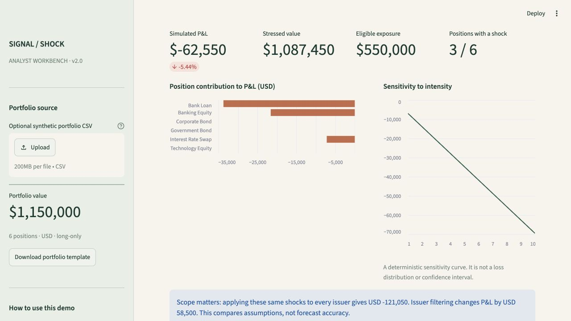
A working, auditable prototype
Analyst controls
Upload a synthetic CSV
Inspect matched words
Review ambiguous events
Compare scenarios
Export a complete audit
4 / 7
Notes:
Source: actual screenshot docs/workbench.png captured from the local Streamlit app, 19 October 2026. Demo: choose NEWS-002, Credit Event, Example Bank Ltd, intensity 9. Click Run portfolio stress test. Explain that the sensitivity curve is deterministic, not probabilistic.

Slide 5
Issuer scope changes the result
Bank default scenario / intensity 9 / USD 1.15m synthetic portfolio
Bank position | Market value | Applied shock | Simulated P&L
Banking equity | $200,000 | −10.8% | −$21,600
Bank loan | $250,000 | −13.5% | −$33,750
Interest rate swap | $100,000 | −7.2% | −$7,200
−$62,550
3 of 6 positions shocked
Portfolio change: −5.44%
Same shocks applied to every issuer: −$121,050. Scope difference: $58,500.
This compares scenario assumptions, not forecast accuracy.
5 / 7
Notes:
Source: results/demo/bank_credit_audit.json, regenerated by python scripts/reproduce.py. Calculation: 200000*(-.12)*.9 + 250000*(-.15)*.9 + 100000*(-.08)*.9 = -62550. Naive all-issuer comparison includes unrelated positions using the same asset-type shocks. No measured loss avoidance is claimed.

Slide 6
Evidence and domain relevance
Sentiment on 3,453 sentences | Accuracy | Macro F1
Always-neutral baseline | 62.15% | 0.2555
Current keyword rules | 67.33% | 0.4319
Negative recall: 9.52%. Analyst review remains essential.
Historical context
KRE: −19.91% XLF: −2.77% EWU: −5.52%
Selected T−1 to T+5 returns illustrate why event triage matters.
They neither establish causation nor calibrate our shocks.
6 / 7
Notes:
Sources: results/real_data/metrics.json; docs/real_data_evaluation.md; https://huggingface.co/datasets/takala/financial_phrasebank (Malo et al., 2014, CC BY-NC-SA 3.0). Current rules re-evaluated on retained labelled inputs 19 October 2026 without tuning. Historical sources: data/market_data/price_cache.csv and results/market_data/event_returns.csv. KRE SVB bank-run period 2023-03-09; XLF broad US financial ETF during Credit Suisse crisis 2023-03-15, not Credit Suisse equity; EWU UK mini-budget 2022-09-23. SPY is a broad comparator, not a causal control.

Slide 7
Limits and the next validation steps
What this prototype establishes
A reproducible headline-to-scenario workflow with issuer filtering,
position attribution and explicit assumptions.
What remains unvalidated
Next experiments
Contextual event understanding
Shock calibration and contagion
Bond and derivative repricing
Measure a contextual NLP baseline
Use held-out events for calibration
Add duration and DV01 sensitivities
No trained model or live feed. Synthetic positions. Illustrative scenarios.
The immediate use case is analyst triage and transparent what-if discussion.
7 / 7
Notes:
Explain how you would separate training, validation and test periods for a future model. A contextual model such as FinBERT is a comparison candidate, not a proven improvement here. Bond duration, credit spread and swap DV01 require instrument data absent from this demonstration. The software tests establish consistency, not real-world prediction accuracy.

