Slide 1
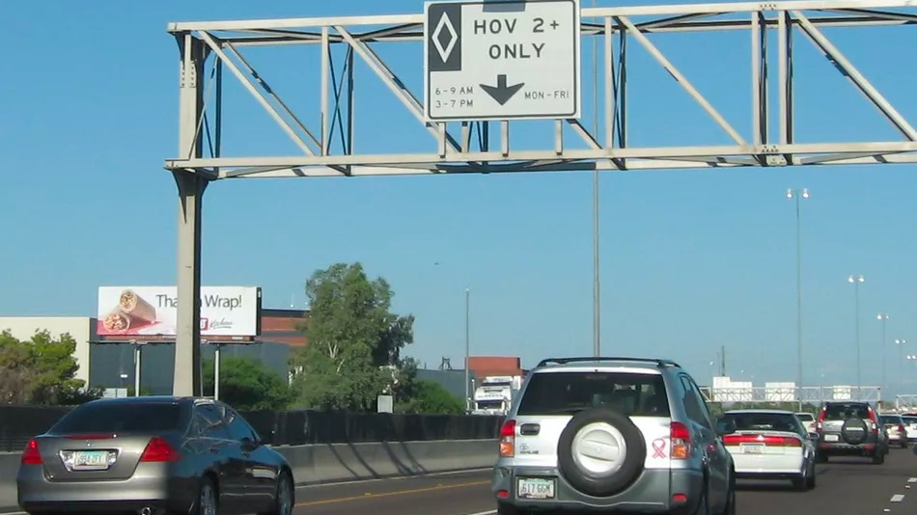
Predicting fines Paid by Single Occupancy Vehicle on a HOV Lane using Monte Carlo Simulation
Submitted by Aditya Kadrekar, Devanshi Bhatt and Ankita Pant

Slide 2


What are HOV Lanes and Benefits?
A high-occupancy vehicle lane (also known as a carpool lane, diamond lane, 2+ lane, and transit lane or T2 or T3 lanes) is a restricted traffic lane reserved for the exclusive use of vehicles with a driver and one or more passengers. These restrictions may only be imposed during at peak travel times or may apply at all times. The normal minimum occupancy level is 2 or 3 occupants.
HOV Benefits
HOV lanes move more people in fewer vehicles, reducing the demand for new highways.
HOV lanes increase the efficiency of existing highways.
HOV lanes reduce the use of personal resources such as time and fuel.
HOV lanes benefit drivers of single-occupant vehicles by taking car-poolers out of general use lanes.

Slide 3
Purpose of the simulation
Predict the fine that a single occupant vehicle (SOV) will have to pay, under different circumstances, when it enters the high occupant vehicle lane
01
Is there a increase/decrease in the single occupancy vehicle on the HOV lanes on the basis of fines they are paying
02
Are HOV lanes really benefitting people in reducing their travel time
03
Is there a potential pressure to convert under performing HOV lanes to general-purpose use
04

Slide 4
Hypothesis before running the simulation
All SOV vehicle will have to pay the same fine when they enter a HOV lane
HOV lanes helps in reducing the travel time

Slide 5
Variables of Uncertainty
Peak Hour
Accident
Accident_intensity
Weather
Weather_intensity
Camera_functionality/police_presence
Number of HOV vehicles
Number of SOV vehicles
Speed
Fuel Efficient cars
Regulated Fuel Efficient cars
Non Regulated Fuel Efficient cars

Slide 6
Limitations & Future Scope
In this simulation we are predicting the total fines charged per day for 1 city , the same can be used to predict for other cities as well in the country
We are creating our own dataset as we couldn’t get a perfect one for our simulation

Slide 7

References
http://people.eecs.berkeley.edu/~varaiya/papers_ps.dir/accessF05v2.pdf
https://ops.fhwa.dot.gov/publications/fhwahop08034/hot1_0.htm
https://en.wikipedia.org/wiki/High-occupancy_vehicle_lane
https://ops.fhwa.dot.gov/publications/exemptvehicleshov/chapter2.htm
https://www.seattletimes.com/seattle-news/transportation/how-many-hov-lane-cheaters-are-there-and-how-many-get-caught/
https://www.tn.gov/tdot/high-occupancy-vehicle--hov--lane.html
https://www.latimes.com/local/california/la-me-ln-clean-air-car-decals-20180917-story.html
https://www.wklaw.com/consequences-of-driving-alone-in-the-carpool-or-hov-lane/

Slide 8


Thank You

