Slide 1
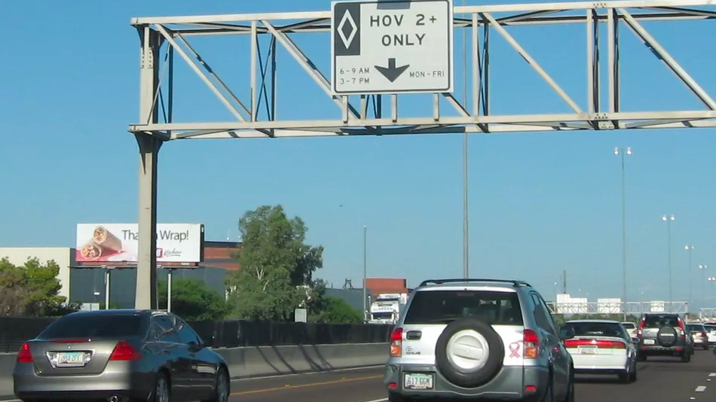
Predicting fines paid by Single Occupancy Vehicle on a HOV Lane using Monte Carlo Simulation
Submitted by Aditya Kadrekar, Devanshi Bhatt and Ankita Pant

Slide 2
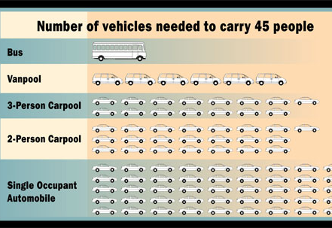
What are HOV Lanes and Benefits?
A high-occupancy vehicle lane (also known as a carpool lane, diamond lane, 2+ lane, and transit lane or T2 or T3 lanes) is a restricted traffic lane reserved for the exclusive use of vehicles with a driver and one or more passengers. These restrictions may only be imposed during at peak travel times or may apply at all times. The normal minimum occupancy level is 2 or 3 occupants.
HOV Benefits
HOV lanes move more people in fewer vehicles, reducing the demand for new highways.
HOV lanes increase the efficiency of existing highways.
HOV lanes reduce the use of personal resources such as time and fuel.
HOV lanes benefit drivers of single-occupant vehicles by taking car-poolers out of general use lanes.

Slide 3
Simulation & Analysis
Predict the fine that a single occupant vehicle (SOV) will have to pay, under different circumstances, when it enters the HOV lane
Predicting the revenue lost by the state due to usage of registered hybrid vehicles
Are HOV lanes really reducing the travel time by calculating affects on speed of vehicles on freeways/highways due to their presence. Is there a potential pressure to convert under performing HOV lanes to general-purpose use
Considering 2 possibilities of fine calculation – Physical patrol and installing Cameras .Depending on our analysis on efficiency of physical patrol we will predict if the state decides to install cameras which will have an extra cost involved i.e. installation revenue .This gives us more scope of analysis on calculation of fines collected which will help the state to earn more than the camera installation revenue

Slide 4
Hypothesis before running the simulation
All SOV vehicle will have to pay the same fine when they enter a HOV lane
HOV lanes helps in reducing the travel time

Slide 5
Variables of Uncertainty
Peak Hour
Accident
Accident_intensity
Weather
Weather_intensity
Camera_functionality/police_presence
Number of HOV vehicles
Number of SOV vehicles
Speed

Slide 6
Assumptions
At any given time of day, the number of fuel-efficient/hybrid SOV vehicles is 20% of the actual number of SOV vehicles in the HOV lane.
Out of the total number of fuel-efficient/hybrid SOV vehicles, 70% are registered to drive in the HOV lane.
The fine amount that an SOV vehicle is required to pay when it enters the HOV lane is $450.

Slide 7
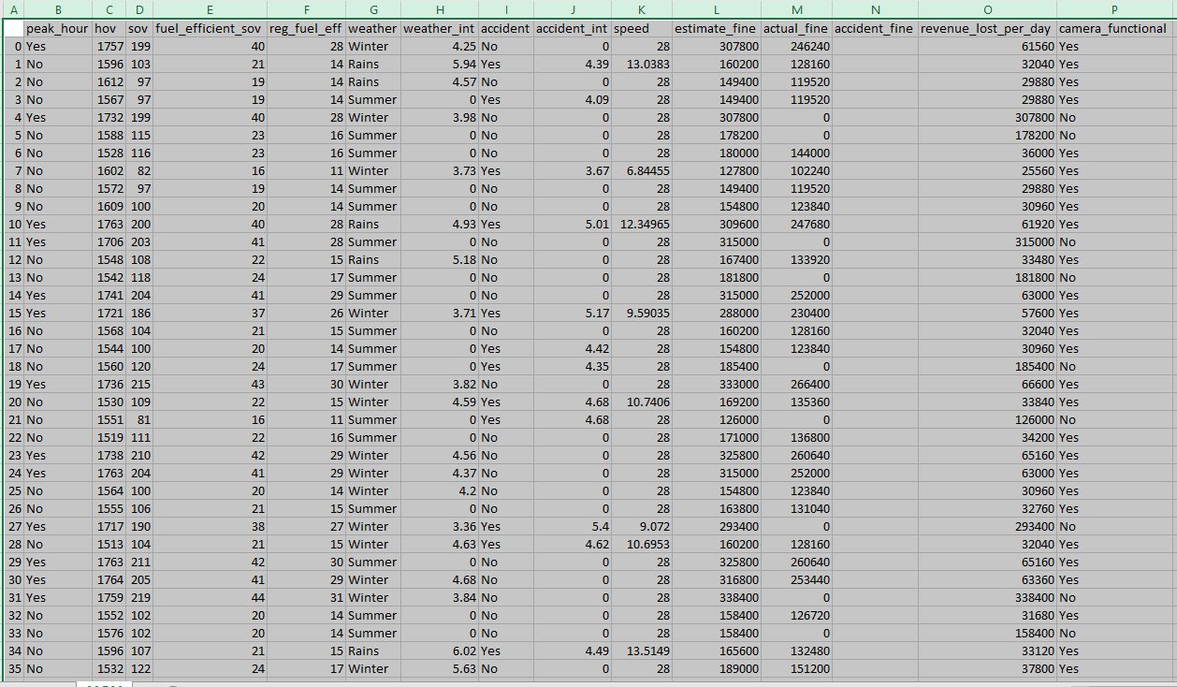
Simulations(=100)

Slide 8
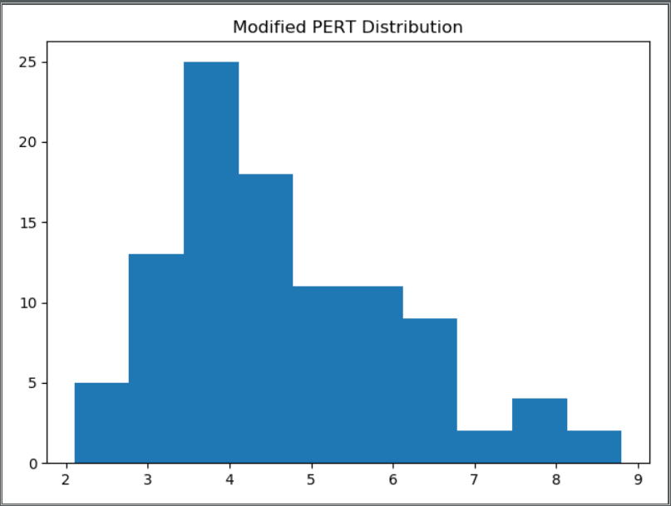

Slide 9
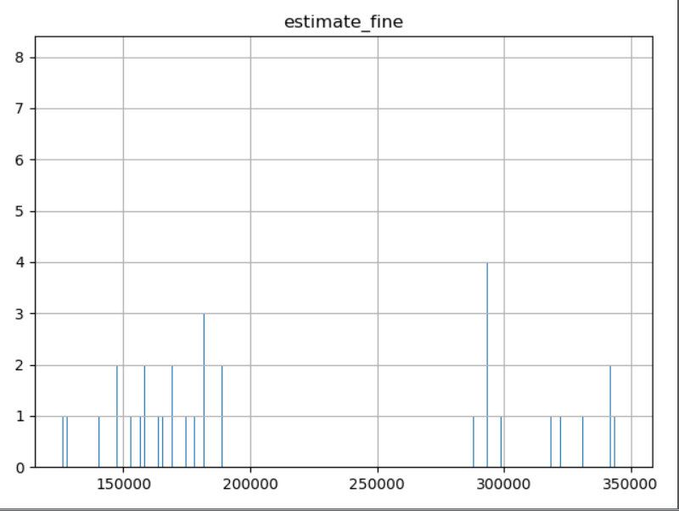
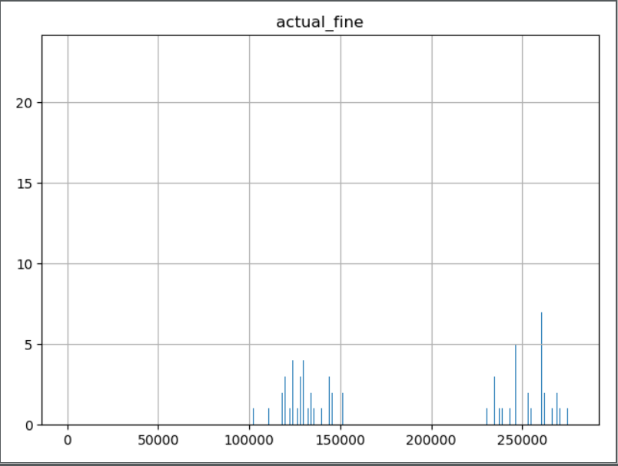
Plotting calculated fines on histograms

Slide 10
Limitations & Future Scope
We are creating our own dataset as we couldn’t get a perfect one for our simulation. We have taken random variables based on online statistics to create the dataset
In this simulation we are predicting the total fines charged per day for 1 city , the same can be used to predict state wise and city wise fines by taking specific data. Currently we have taken fine amount as $450 after researching on fines charged in different states

Slide 11

References
http://people.eecs.berkeley.edu/~varaiya/papers_ps.dir/accessF05v2.pdf
https://ops.fhwa.dot.gov/publications/fhwahop08034/hot1_0.htm
https://en.wikipedia.org/wiki/High-occupancy_vehicle_lane
https://ops.fhwa.dot.gov/publications/exemptvehicleshov/chapter2.htm
https://www.seattletimes.com/seattle-news/transportation/how-many-hov-lane-cheaters-are-there-and-how-many-get-caught/
https://www.tn.gov/tdot/high-occupancy-vehicle--hov--lane.html
https://www.latimes.com/local/california/la-me-ln-clean-air-car-decals-20180917-story.html
https://www.wklaw.com/consequences-of-driving-alone-in-the-carpool-or-hov-lane/

Slide 12


Thank You

