Slide 2
Project Title
Minor Project End-Term Presentation
An AI-Driven System for Automated Requirements Engineering from
Unstructured Stakeholder Communication
SUBMITTED BY:-
NAME | Enroll No. | Course | Specialization
Sreyas Sharma | R2142230271 | B.Tech CSE | DevOps
Shreyash Shivhare | R2142231555 | B.Tech CSE | DevOps
Shivang Mangal | R2142230269 | B.Tech CSE | DevOps
Devanshi Jain | R2142230278 | B.Tech CSE | DevOps
MENTORED BY:-
Dr.Mitali Chugh - SeniorAssociate Professor and Program Lead DevOps

Slide 3
Content
Introduction
Technical Background
Motivation & Problem Statement
Area of Application
Dataset & Input Format
Literature Review
Cite Related Work
SWOT Analysis
Objectives
Methodology
Reference Model
Processing Steps
Timeline
Results
Test Cases
Outcome Graphs
Comparative Analysis
Screenshots
Conclusion
Justification of Objectives
Future Scope
References
Publication Proof
List of Cited Papers

Slide 4
Introduction
Technical Background of Project
Requirements scattered across Jira, Slack, emails
Unstructured → hard to manage
Manual RE is slow and error-prone
Nexus automates RE using NLP:
Detect → Extract → Structure
Cluster, prioritize, summarize
Outputs structured (JSON/Markdown)
Technical Concepts (Algorithms) Used
Transformer Models (DistilBERT, BERT, T5)
Named Entity Recognition (spaCy + BERT)
Sentence Embeddings (Sentence-BERT)
Agglomerative Clustering (semantic grouping)
Rule-based Prioritization Algorithm
Abstractive Summarization (Transformer-based)
Regex-based Preprocessing & PII Filtering

Slide 5
Introduction
Motivation
Requirements often get lost in scattered communication
Manual extraction is slow and inconsistent
Leads to delays, miscommunication, and poor documentation
Need for faster, accurate, and automated RE
Goal: Improve efficiency, consistency, and traceability using AI
Problem Statement
Stakeholder intent is scattered across Jira tickets, Slack chats, and informal discussions
Communication is noisy, unstructured, and lacks clear requirement boundaries
Traditional RE methods fail to capture and trace such dynamic inputs
Existing tools focus on retrieval, not structured requirement extraction
Problem: Lack of a system that converts multi-channel, unstructured communication into structured, traceable, and prioritized requirements

Slide 6
Introduction
Area of Application
Agile Software Development & Requirements Engineering
Enterprise Communication Analysis (Jira, Slack)
AI-assisted Decision Support for Project Managers
Large-scale Collaborative Development Environments
Dataset and Input Format
Multi-source input from Jira and Slack.
JSON-based data with fields: summary, description, comments
NER dataset with annotated entities (actor, feature, constraint, priority)
DATASETS-
https://zenodo.org/records/1414117?utm_source=chatgpt.com (PURE: a Dataset of Public Requirements Documents)
https://www.kaggle.com/datasets/computerscience3/public-requirementspure-dataset?utm_source=chatgpt.com (Public Requirements(PURE) Dataset)
https://zenodo.org/records/12805484?utm_source=chatgpt.com (Promise+: A dataset of labelled software requirements)

Slide 7
Literature Review - Cite Related Work
Work / Paper | Approach | Key Contribution | Limitation / Gap
Abualhaija et al. (2020) [15] | NLP + Data Mining | Identifies requirements from text | Needs structured input
Hey et al. (2020) (NoRBERT) [17] | Transfer Learning | Improved requirement classification | Dataset dependent
Devlin et al. (2019) [18] | BERT | Contextual language understanding | Requires fine-tuning
Sanh et al. (2019) [19] | DistilBERT | Efficient lightweight transformer | Slight accuracy trade-off
McInnes et al. (2018) [22] | UMAP | Dimensionality reduction for clustering | Parameter sensitive
Raffel et al. (2020) [24] | T5 Transformer | Unified text-to-text modeling (summarization) | High computational cost
Siddeshwar et al. (2024) [7] | AI Framework Survey | Overview of AI in RE | No unified pipeline
Umar & Lano (2024) [8] | RE Automation | Advances in AI-based RE tools | Fragmented solutions
Arora et al. (2023/2025) (RECOVER) [10][11] | Conversational RE | Extracts requirements from dialogue | Weak clustering & scaling
Lam et al. (2025) [9] | AI Copilot | Supports project management tasks | Focus on retrieval
Almalki (2025) [25] | AI Decision Support | Enhances project management decisions | Not RE-focused

Slide 8
Literature Review
SWOT Analysis
Strengths
Automates manual requirements engineering tasks using AI and NLP.
Significantly reduces time, human effort, and requirement ambiguity.
Seamlessly integrates with enterprise SDLC ecosystems (e.g., Jira).
end-to-end pipeline, pretrained transformers.
Improves requirement organization and overall documentation quality.
Weaknesses
Model accuracy heavily depends on underlying dataset quality and prior training.
Requires significant initial text pre-processing and computational resources.
Limited seed classifier data; NER boundary errors on priority/feature
May struggle initially with highly informal or context-heavy language without sufficient context mapping.
Opportunities
Can be directly integrated into other software development lifecycle (SDLC) tracking tools.
Highly useful for start-ups and large organizations managing expansive, fragmented requirement datasets.
LLM audit, larger annotated corpora, production monitoring
Potential to expand into real-time ambiguity detection and requirement conflict resolution in the future.
Threats
Rapid advancements and fast-paced changes in modern NLP technologies and architectural models.
Increasing availability and competition from commercial requirement automation and management tools.
Domain shift across teams; evolving channel formats (Slack/Jira)
Potential data privacy and security concerns when processing sensitive or proprietary stakeholder communications.

Slide 9
Objectives
Develop an AI-based system to automate Requirements Engineering
Extract requirements from unstructured stakeholder communication
Detect requirement sentences using DistilBERT classifier
Extract key entities using NER (spaCy + BERT)
Structure requirements into standard formats (FR/NFR)
Group similar requirements using semantic clustering
Prioritize requirements using multi-signal scoring
Generate summaries and provide explainable outputs
Integrate system with tools like Jira & Slack
Validate performance using NLP evaluation metrics

Slide 10
Methodology
Reference Software Model
Based on AI-driven Requirements Engineering framework
Follows Pipeline-based Processing Model (Input → Processing → Output)
Incorporates NLP + Machine Learning models for automation
Inspired by Agile RE practices for dynamic environments
Uses Three-tier architecture (Frontend–Backend–NLP Engine)
Supports end-to-end workflow from data ingestion to requirement extraction with priority score.

Slide 11
Methodology
Steps
Data Ingestion: Collect data from Jira, Slack APIs or user-provided JSON/text inputs
Preprocessing & Privacy Filtering: Clean and normalize text, remove URLs, emails, and mentions
Requirement Detection: Identify requirement sentences using fine-tuned DistilBERT classifier
Named Entity Recognition: Extract key entities (ACTOR, FEATURE, QUALITY_ATTRIBUTE, CONDITION, PRIORITY) using spaCy + BERT
Requirement Structuring: Convert extracted data into standard actor–action–constraint format and classify as FR/NFR
Semantic Clustering: Group similar requirements using Sentence-BERT embeddings and clustering algorithms
Multi-signal Prioritization: Assign priority levels based on keywords, constraints, sentiment, and feature importance
Summarization & Explainability: Generate concise summaries using transformer models and provide reasoning for decisions
Output Generation: Produce structured requirements (REQ-001, REQ-002…) with entities, priority, and justification in JSON format.

Slide 12
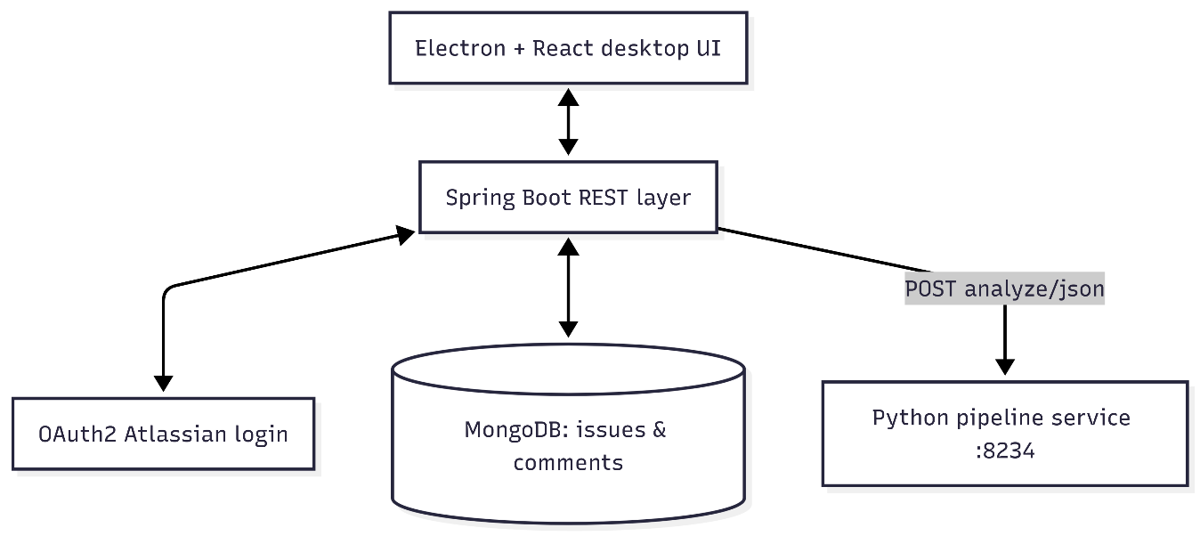
Methodology
Architecture Diagrams
Figure 1. System architecture: Electron client, Spring Boot services with OAuth2 to Atlassian APIs, MongoDB persistence, and a local Python analysis endpoint.

Slide 13
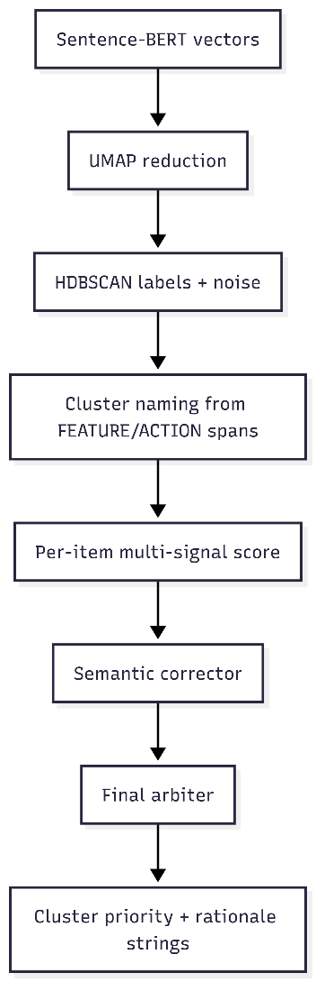
Methodology
Architecture Diagrams
Figure 2. Clustering and prioritisation: dense vectors, density-based cluster formation, then per-cluster aggregation of item-level scores with semantic correction and arbitration

Slide 14
Methodology
Timeline
Phase / Timeline | Activity | Deliverable | Status
Phase 1 (Jan Wk 3 - Feb Wk 1) | Frontend Development | Cross-platform Electron desktop app & React UI for document upload and interactive data visualization. | ✅ Done
Phase 2 (Feb Wk 3 - March Mid) | Backend | Spring Boot REST API, centralized data hub, Atlassian/Jira integration, and Unified Text Formatting module. | ✅ Done
Phase 3 (March End - April Mid) | AI & NLP Processing Layer | Flask Python Microservice, AI NLP preprocessing, NER extraction, classification models, and summarization. | ✅ Done
Phase 4 (April End) | Phase 4 – System Integration & Evaluation | End-to-end system integration, latency/scalability testing, AI metrics validation, and CI/CD deployment. | ✅ Done

Slide 15
Results
Test Cases
Testing Strategy
Multi-layer testing approach:
Unit testing (service logic)
Repository testing (MongoDB persistence)
Controller testing (API behavior)
Security testing (authentication and access)
Integration testing (end-to-end flow)
Approach:
AAA pattern (Arrange – Act – Assert)
Independent and runnable tests
Tools:
JUnit 5
Mockito
MockMvc
Test Coverage
Unit Tests:
Covers happy paths, edge cases, exceptions
Verifies side effects (database writes)
Repository Tests:
Save and fetch using composite IDs
Validates real MongoDB behavior
Controller Tests:
JSON request and response validation
HTTP status and error handling
Security Tests:
OAuth2 login simulation
Unauthorized vs authorized access

Slide 16
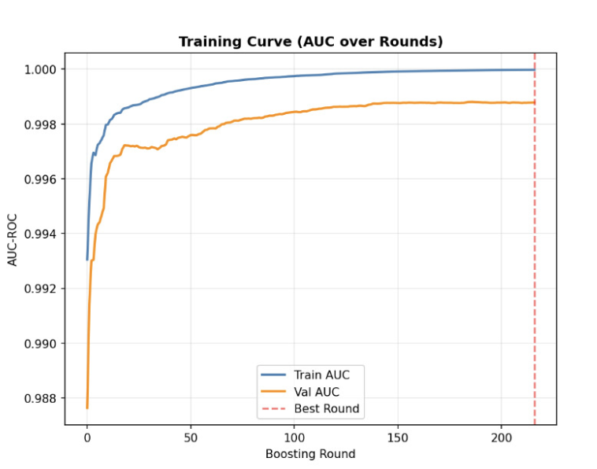
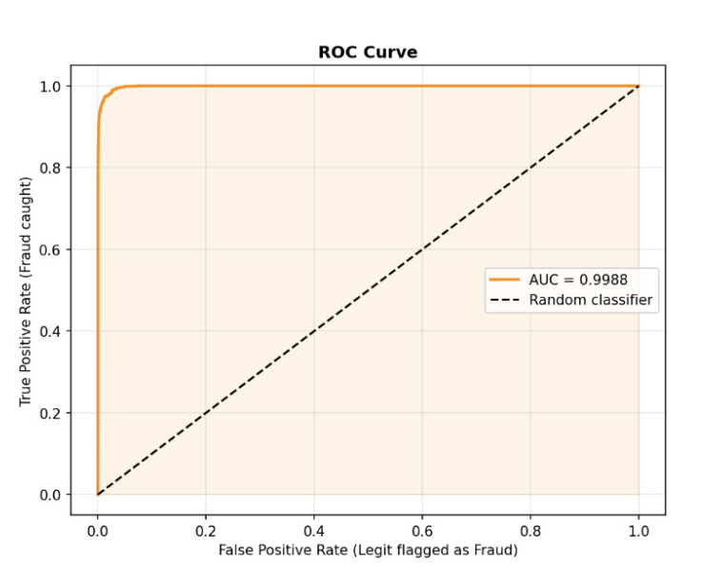
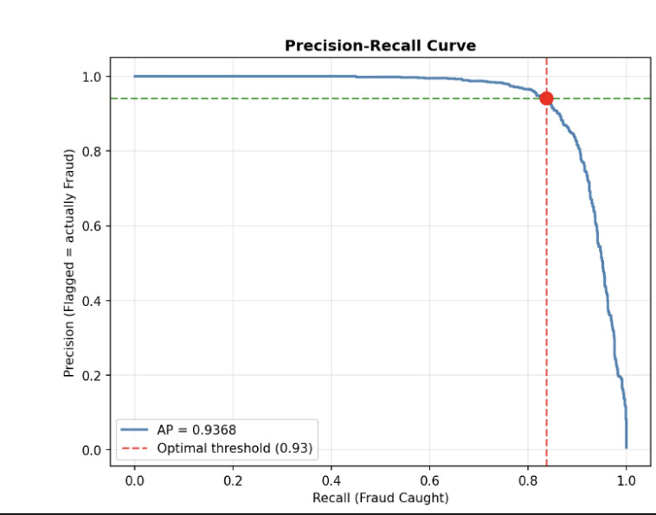
Results
Outcome Graphs

Slide 17
Results
Comparative Studies
Aspect | Traditional RE | Existing AI/ML Approaches | Proposed System (Nexus)
Requirement Extraction | Manual, time-consuming [1][2][12] | Semi-automated (limited NLP) | Fully automated (NLP pipeline)
Input Handling | Structured documents [2][4] | Mostly structured text | Handles unstructured multi-source data
Techniques Used | Manual analysis [1][2] | Basic ML / NLP | Transformer-based models (BERT, T5)
Clustering | Not supported [1][2] | Limited similarity grouping | Semantic clustering (Sentence-BERT)
Prioritization | Human-based [13] | Rule-based or absent | Multi-signal intelligent prioritization
Explainability | Not available [1] | Limited | Full explainability with reasoning
Output Format | Static documents [2] | Partial structuring | Structured SRS (JSON + Markdown)
Integration | Standalone [3] | Limited integration | Seamless Jira/Slack integration
Scalability | Low [3][4] | Moderate | High (automated pipeline)

Slide 18
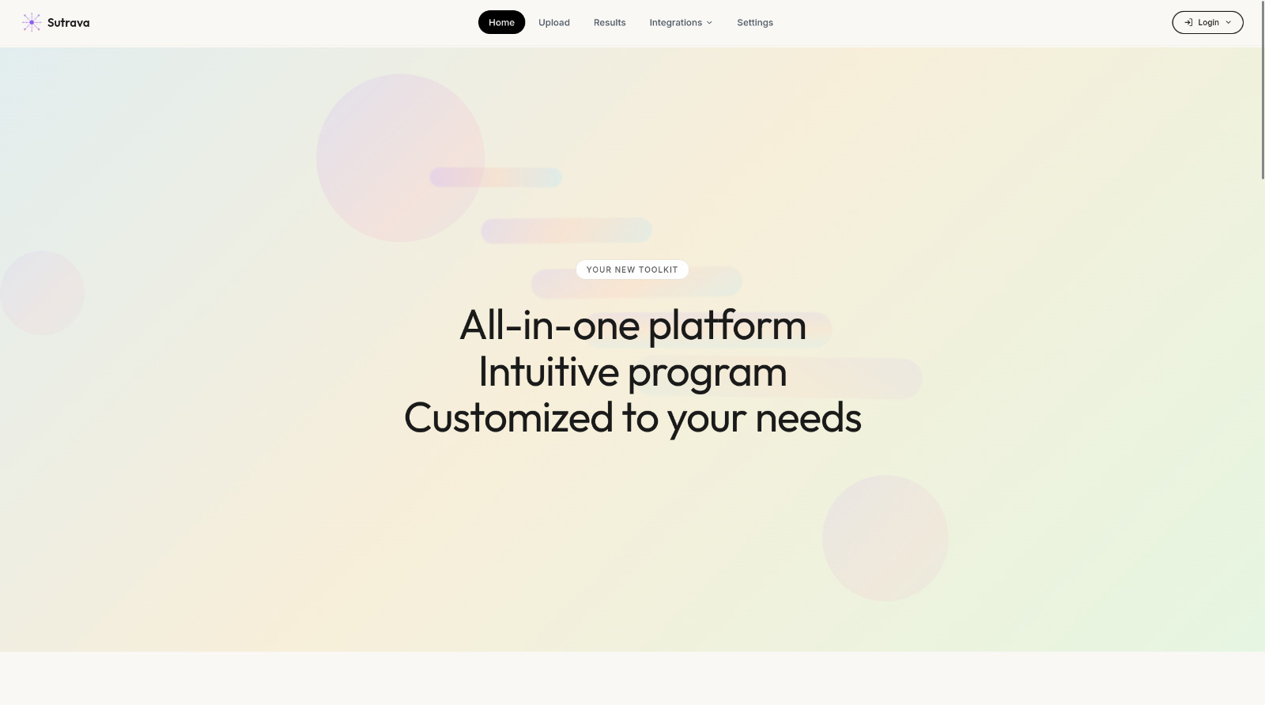
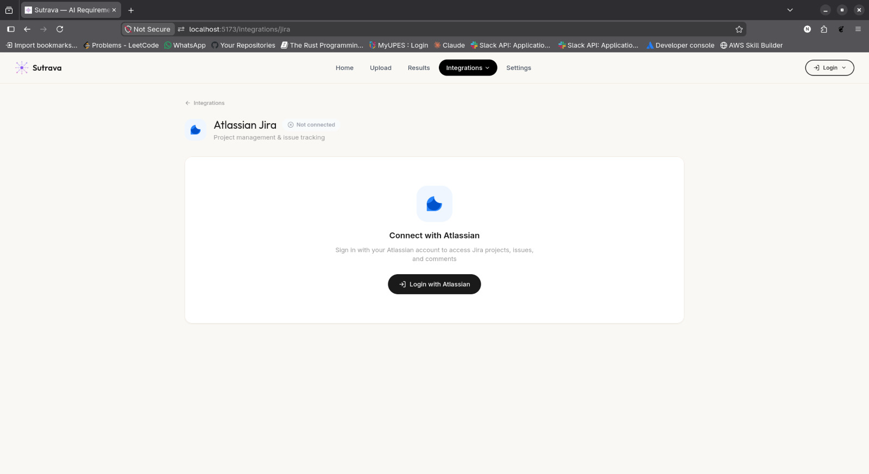
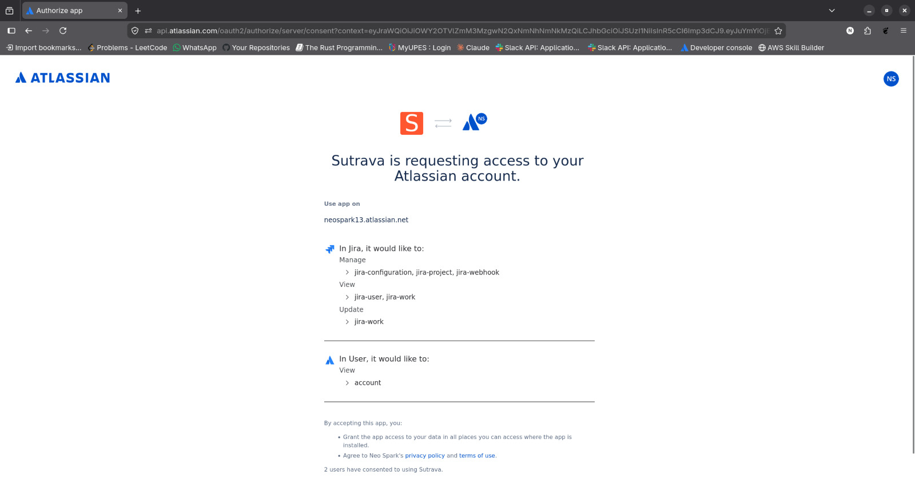
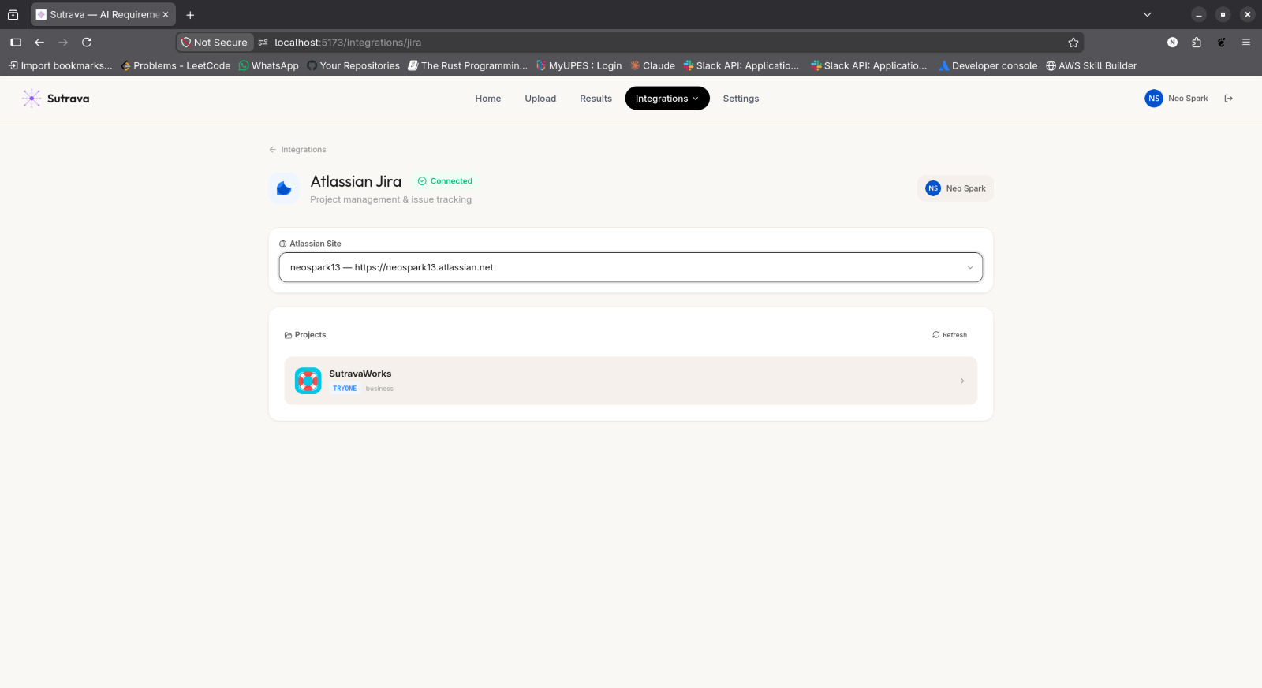
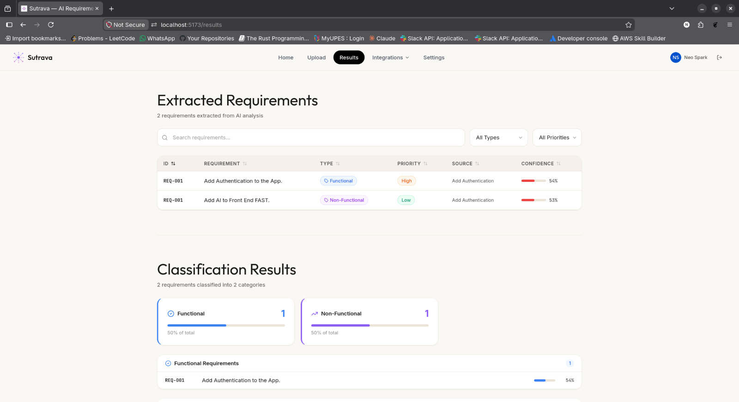
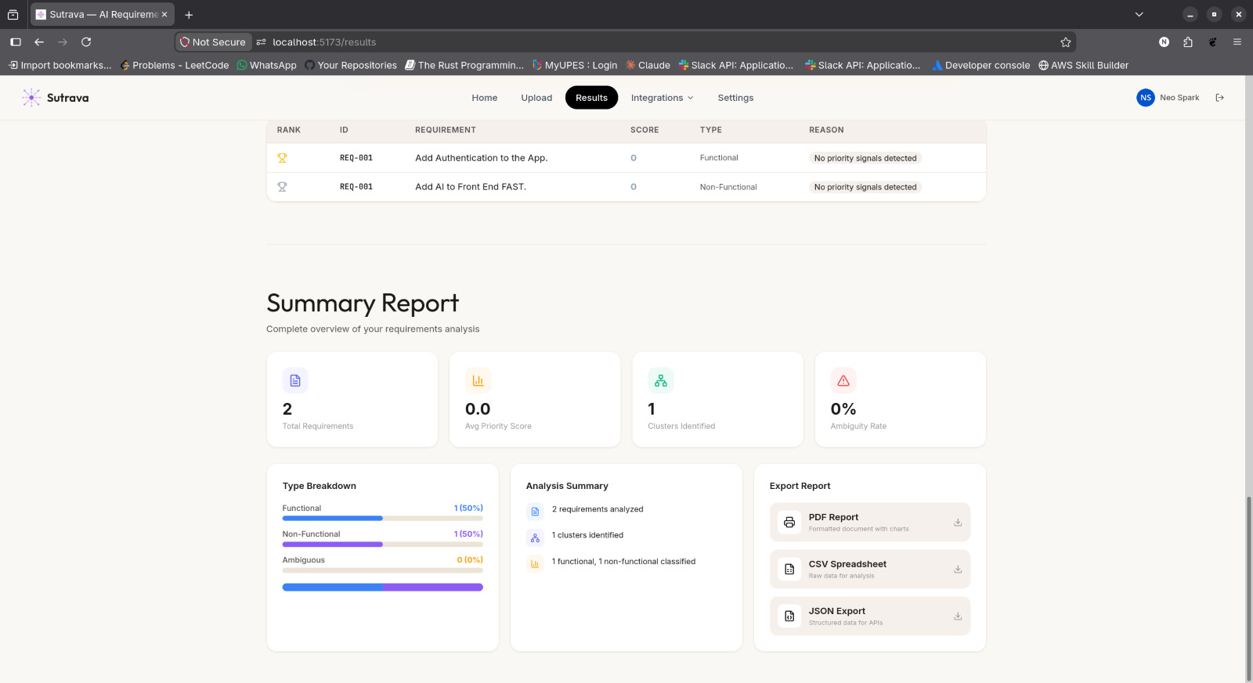
Screenshots

Slide 19
Conclusion
Justification of Objectives
Developed an AI-based pipeline successfully automating the Requirements Engineering process
Extracted requirements from unstructured sources like Jira, Slack, and raw text inputs
Achieved accurate requirement detection using DistilBERT classifier
Extracted key entities (ACTOR, FEATURE, CONSTRAINT, etc.) using NER (spaCy + BERT)
Structured requirements into standardized formats (FR/NFR) for better clarity
Grouped semantically similar requirements using clustering techniques
Prioritized requirements effectively using multi-signal scoring approach
Generated concise summaries along with explainable reasoning
Integrated system with enterprise tools (Jira, Slack) for real-world usability
Validated performance using NLP metrics (accuracy, precision, recall, F1-score)
Future Scope
Extend support to multilingual data for global teams
Integrate real-time processing of live chats and streams
Improve model with larger, domain-specific datasets
Implement learning-based prioritization (ML instead of rules)
Add feedback loop / active learning for continuous improvement

Slide 20
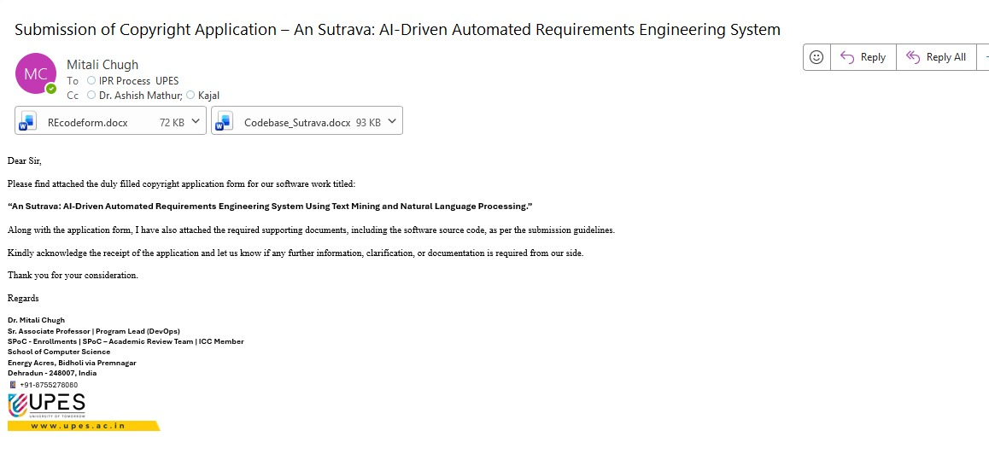
References
Publication Proof
Copyright / acceptance correspondence (see embedded image below).

Slide 21
References
List of Cited Papers
[1] P. Zave, “Classification of research efforts in requirements engineering,” ACM Comput. Surv., vol. 29, no. 4, pp. 315–367, 1997.
[2] K. Pohl, Requirements Engineering: Fundamentals, Principles, and Techniques. Springer, 2010.
[3] L. Cao and B. Ramesh, “Agile requirements engineering practices: Challenges in practice,” IEEE Softw., vol. 25, no. 1, pp. 60–67, 2008.
[4] W. Maalej et al., “Toward data-driven requirements engineering,” IEEE Softw., vol. 33, no. 1, pp. 48–54, 2016.
[5] A. Ferrari et al., “Natural language requirements processing: A four-dimensional view,” IEEE Softw., vol. 34, no. 6, pp. 56–63, 2017.
[6] Z. Kurtanović and W. Maalej, “Automatically classifying functional and non-functional requirements using supervised machine learning,” in Proc. IEEE Int. Conf. Req. Eng. (RE), 2017, pp. 490–495.
[7] S. Siddeshwar, S. Alwidian, and M. Makrehchi, “A systematic review of AI-enabled frameworks in requirements elicitation,” IEEE Access, vol. 12, pp. 154310–154328, 2024, doi: 10.1109/ACCESS.2024.3475293.
[8] M. A. Umar and K. Lano, “Advances in automated support for requirements engineering: A systematic literature review,” Requirements Eng., vol. 29, pp. 177–207, 2024, doi: 10.1007/s00766-023-00411-0.
[9] K. Lam et al., “Co-pilot for project managers: Developing a PDF-driven AI chatbot for facilitating project management,” IEEE Access, vol. 13, pp. 43079–43096, 2025, doi: 10.1109/ACCESS.2025.3548519.
[10] G. Voria et al., “RECOVER: Toward requirements generation from stakeholders’ conversations,” IEEE Trans. Softw. Eng., vol. 51, no. 6, pp. 1912–1927, 2025, doi: 10.1109/TSE.2025.3572056.
[11] C. Arora et al., “RECOVER: Requirements generation from stakeholder conversations,” in Proc. REFSQ, 2023 (conference lineage preceding IEEE TSE journal version).
[12] B. Nuseibeh and S. Easterbrook, “Requirements engineering: A roadmap,” in Proc. ICSE, 2000, pp. 35–46.
[13] B. Ramesh and M. Jarke, “Toward reference models for requirements traceability,” IEEE Trans. Softw. Eng., vol. 27, no. 1, pp. 58–93, 2001.
[14] L. Kof, “Using natural language to support domain knowledge elicitation from text,” in Proc. RE, 2007, pp. 321–322.
[15] S. Abualhaija et al., “Automated unambiguous identification of requirements in textual specifications: A NLP and data mining approach,” in Proc. RE, 2020, pp. 78–88.
[16] J. Cleland-Huang et al., “Automated classification of non-functional requirements,” Requirements Eng., vol. 12, no. 2, pp. 103–114, 2007.
[17] T. Hey, J. Müller, and W. Maalej, “NoRBERT: Transfer learning for requirements classification,” in Proc. RE, 2020, pp. 169–179.
[18] J. Devlin et al., “BERT: Pre-training of deep bidirectional transformers for language understanding,” in Proc. NAACL-HLT, 2019, pp. 4171–4186.
[19] V. Sanh et al., “DistilBERT, a distilled version of BERT: smaller, faster, cheaper and lighter,” arXiv:1910.01108, 2019.
[20] Explosion AI, spaCy: Industrial-strength natural language processing in Python, software v3.x documentation and whitepapers, 2024.
[21] N. Reimers and I. Gurevych, “Sentence-BERT: Sentence embeddings using Siamese BERT-networks,” in Proc. EMNLP, 2019, pp. 3982–3992.
[22] L. McInnes, J. Healy, and J. Melville, “UMAP: Uniform manifold approximation and projection for dimension reduction,” arXiv:1802.03426, 2018.
[23] R. J. Campello, D. Moulavi, and J. Sander, “Density-based clustering based on hierarchical density estimates,” in Proc. PAKDD, 2013, pp. 160–172.
[24] C. Raffel et al., “Exploring the limits of transfer learning with a unified text-to-text transformer,” J. Mach. Learn. Res., vol. 21, no. 140, pp. 1–67, 2020.
[25] S. S. Almalki, “AI-driven decision support systems in agile software project management: Enhancing risk mitigation and resource allocation,” Systems (Basel), MDPI, 2025 (identifier 3228838 in project URL index).
[26] A. R. Hevner et al., “Design science in information systems research,” MIS Quarterly, vol. 28, no. 1, pp. 75–105, 2004.
[27] Supplementary venue pointers bundled with the codebase: IEEE Xplore abstracts 10971718, 11139278, 11052817; MDPI manuscript 3157458; ACM DL 10.1145/3712005 — retrieve full metadata via DOI / document number when citing externally.
[28] https://developer.atlassian.com/cloud/jira/platform/rest/v3/
[29] https://api.slack.com/web
[30] Datasets- https://zenodo.org/records/1414117?utm_source=chatgpt.com (PURE: a Dataset of Public Requirements Documents)
https://www.kaggle.com/datasets/computerscience3/public-requirementspure-dataset?utm_source=chatgpt.com (Public Requirements(PURE) Dataset)
https://zenodo.org/records/12805484?utm_source=chatgpt.com (Promise+: A dataset of labeled software requirements)

