Slide 1

SCHOOL OF ENGINEERING AND RESEARCH
ENGLISH PRESENTATION:
ONLINE GAMING ADDICTION
NAME – SOUMAYE BARNWAL
BCA (CTIS) 4TH SEM
130410424042
GUIDED BY:
MRS.ANAMIKA MAHAPATRA

Slide 2
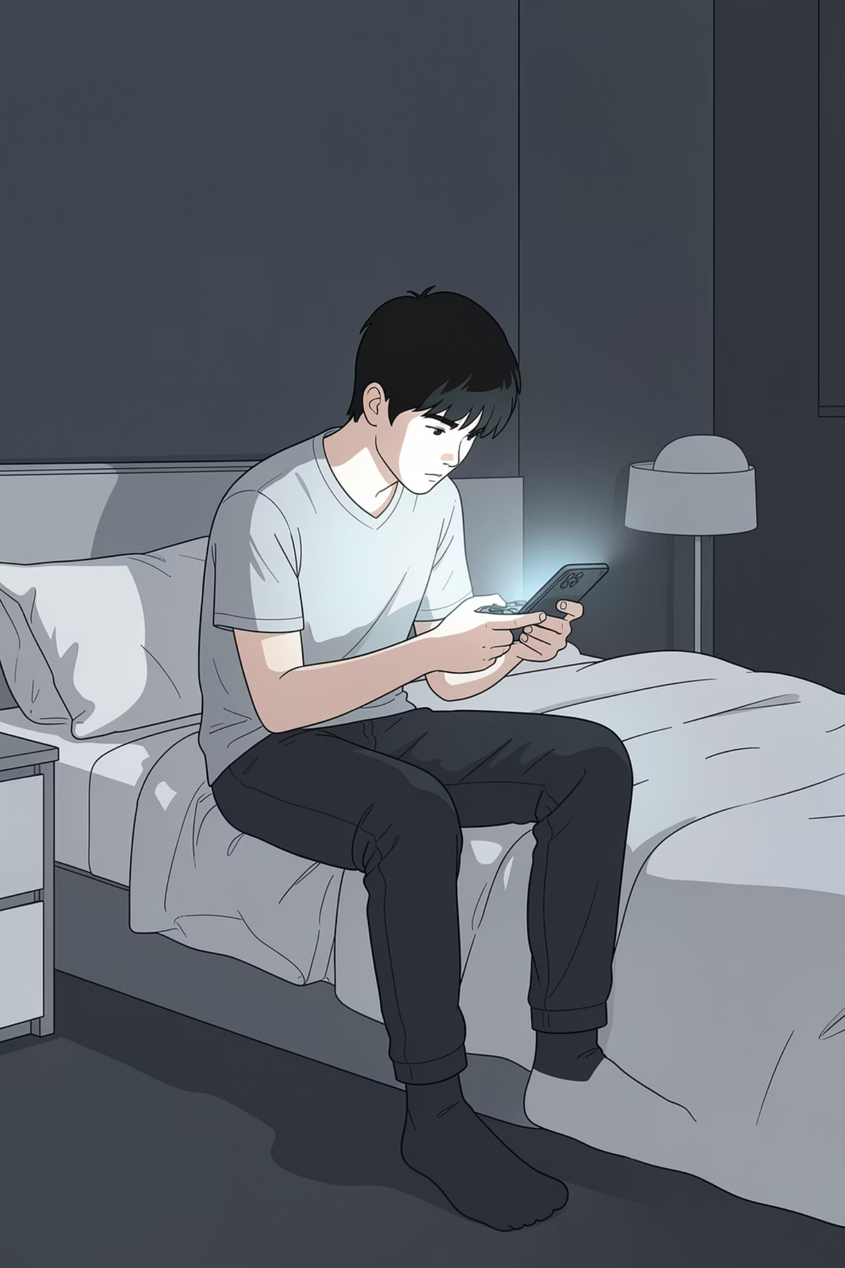
Online Gaming & Addiction
Online gaming — playing video games via the internet — has grown rapidly thanks to smartphones and high-speed connectivity. Popular across all ages, it is especially prevalent among young people. But when gaming becomes compulsive, the consequences can be serious.
AWARENESS GUIDE
FOR PARENTS, EDUCATORS & YOUNG ADULTS

Slide 3
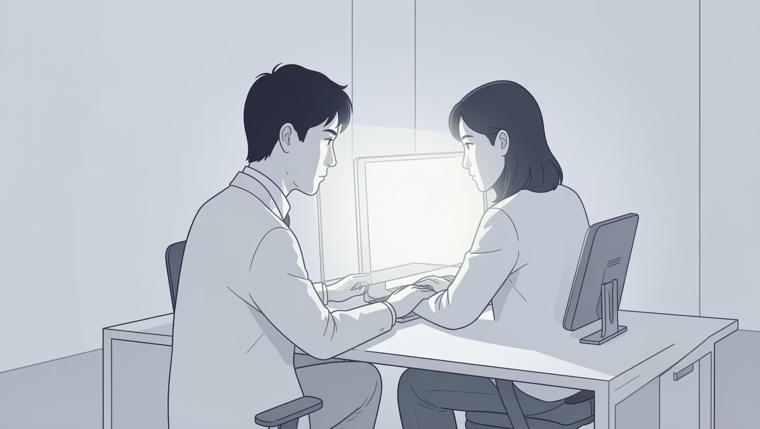
What is Online Gaming Addiction?
Online gaming addiction is a condition where a person becomes excessively involved in playing online video games to the point that it starts negatively affecting their daily life.
Health issues like lack of sleep and eye strain
Poor academic or work performance
Losing interest in other activities or hobbies

Slide 4
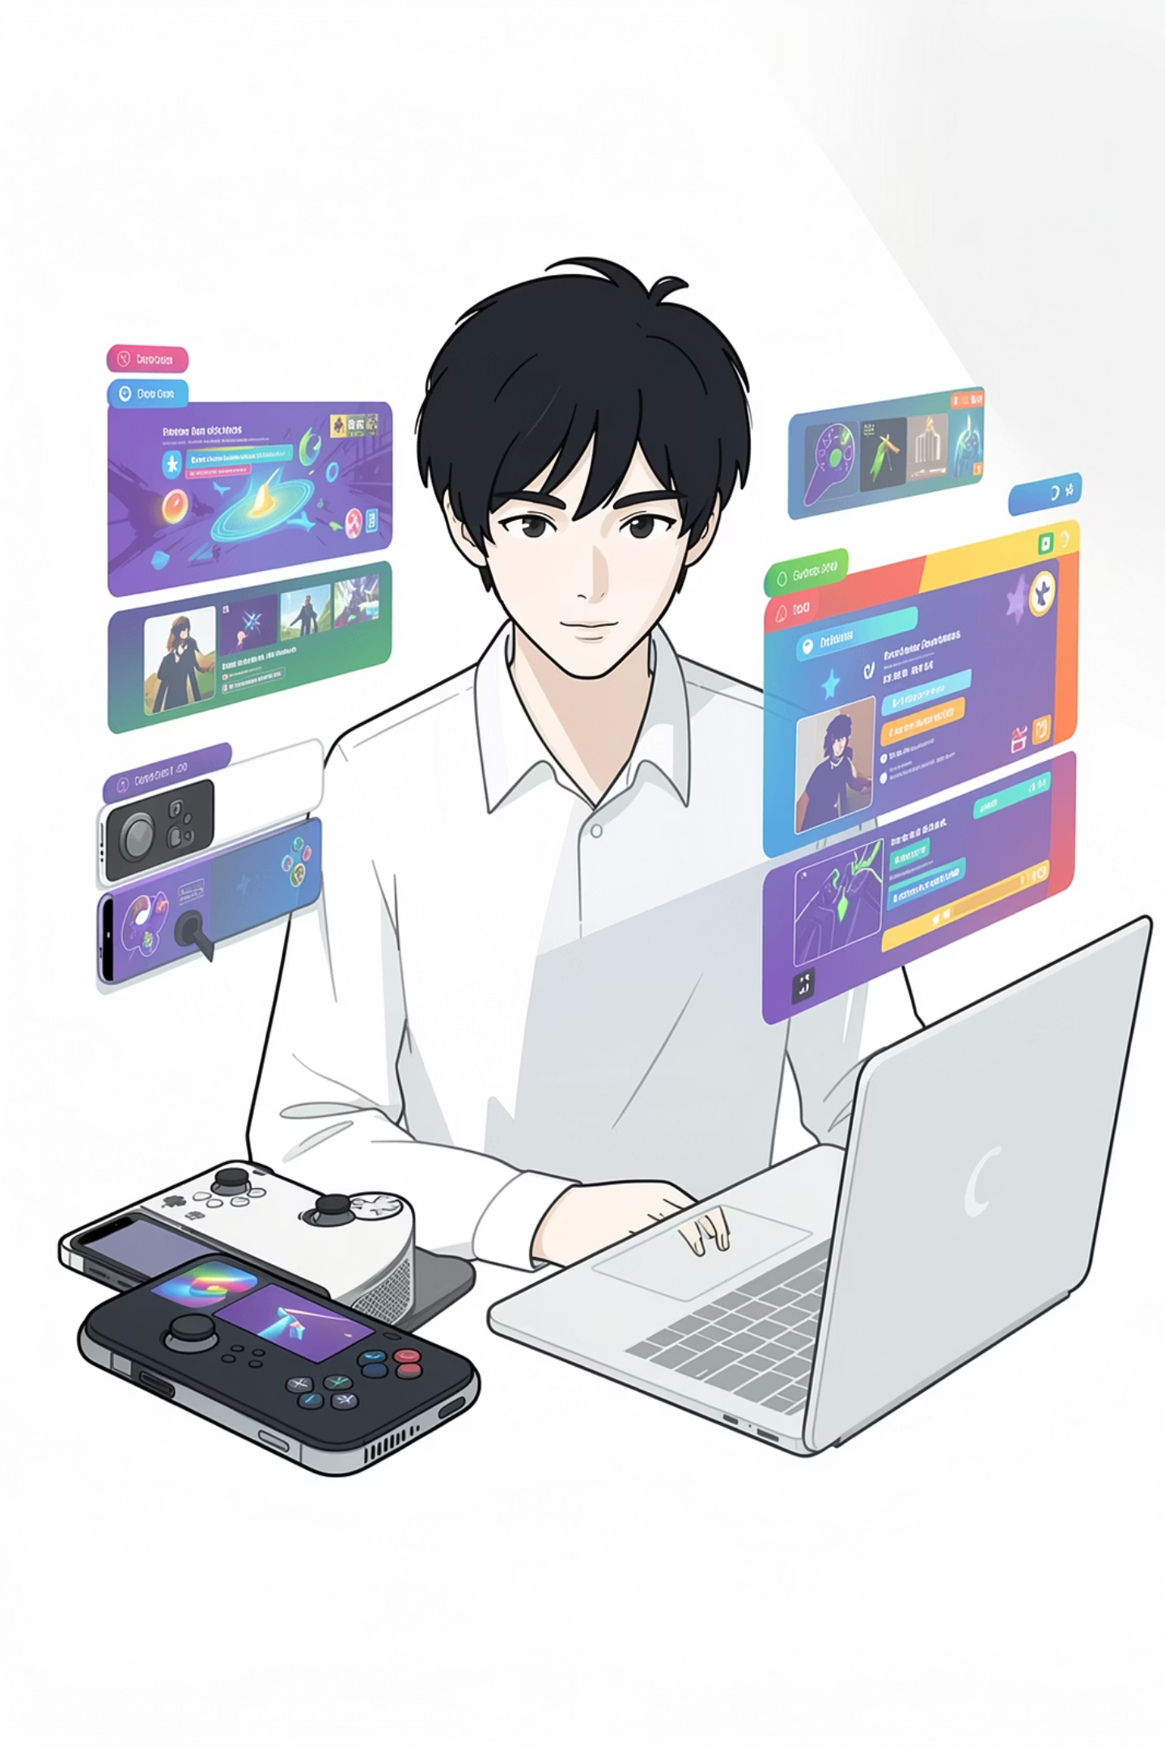
What Drives Gaming Addiction?
Easy Access
Games are available 24/7 on mobile, PC, and consoles — making it easy to play anytime, anywhere.
Social Connection
Multiplayer games offer community, competition, and a sense of belonging that can feel hard to find offline.
Reward Systems
Levels, points, and achievements the urge to keep playing.

Slide 5
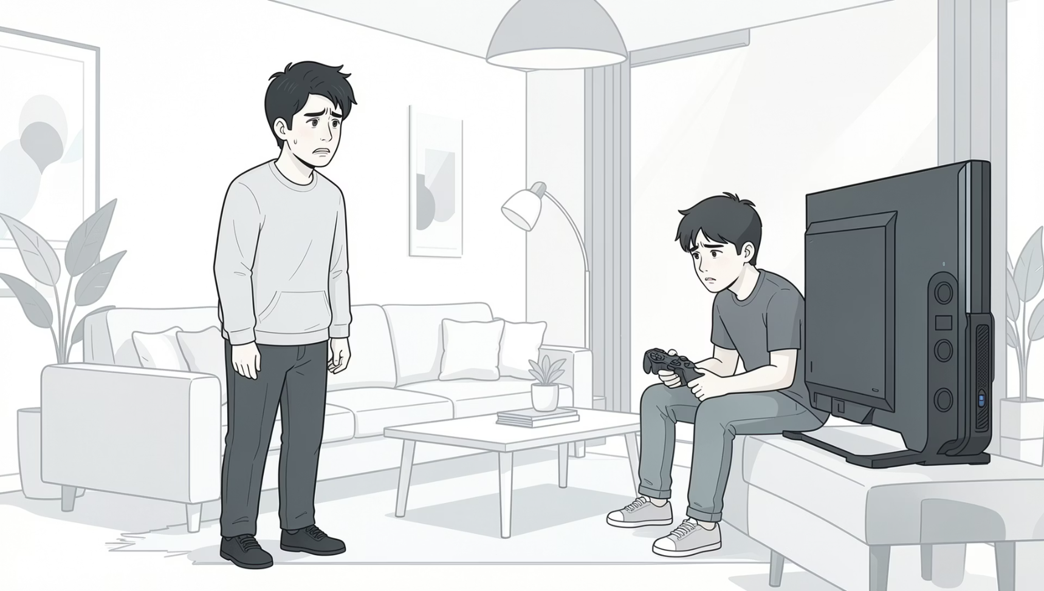
Signs & Symptoms to Watch For
The key signs and symptoms of online
gaming addiction which may indicate a
developing problem:
Excessive screen time
Spending hours gaming, often losing track of time entirely.
Neglecting responsibilities
Studies, work, or household tasks are consistently deprioritized.
Sleep disruption
Staying up late to game, leading to chronic fatigue.
Irritability when offline
Restlessness or anger when unable to access games.

Slide 6
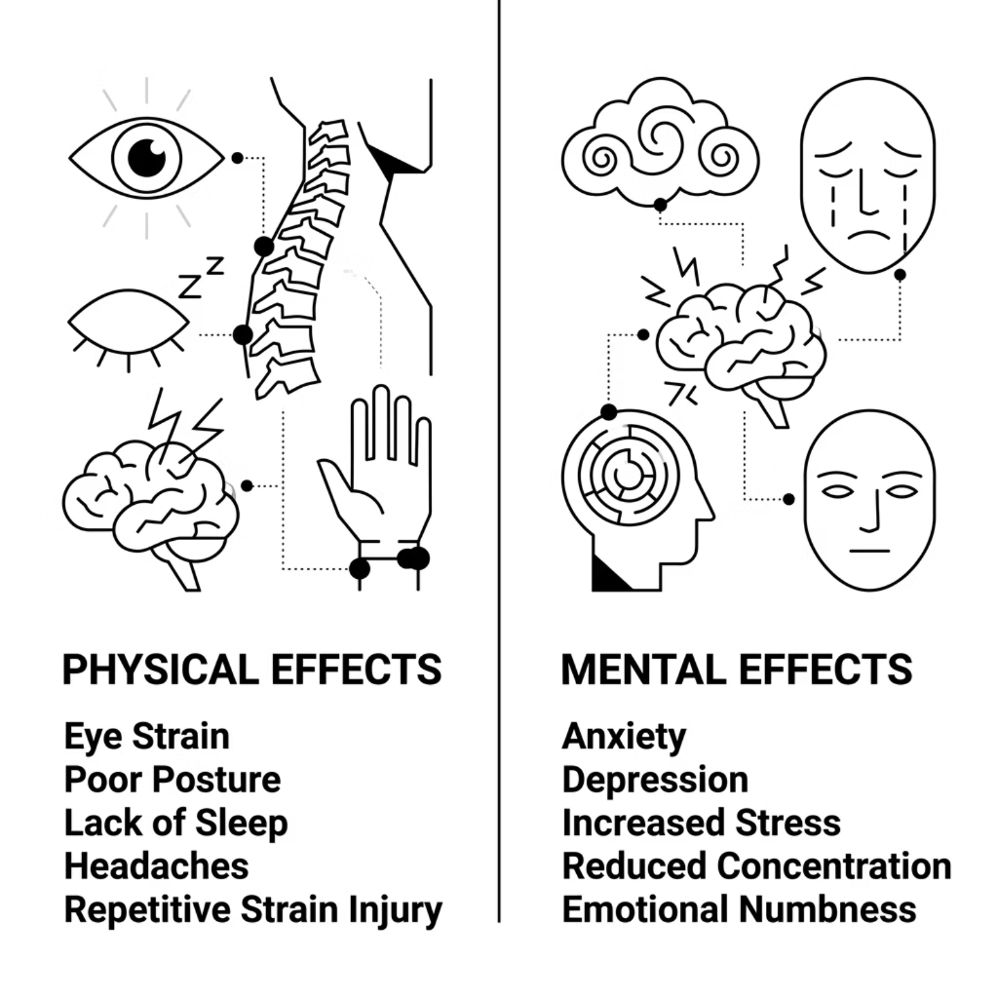

Effects on Health
Physical Effects
Eye strain — Long screen time can cause tired eyes, dryness, blurred vision, and headaches.
Poor posture — Sitting for long periods in same positions can lead to back, neck, and shoulder pain
Sleep deprivation — Late-night gaming disrupts sleep patterns.
Mental Effects
Anxiety & depression — Excessive gaming can increase feelings of stress, sadness, and worry.
Reduced concentration —Difficulty focusing on studies or daily tasks due to constant thoughts about gaming.
Emotional dysregulation — Trouble controlling emotions.

