Slide 1
Pull Request Dashboard
DevOps Project
Devanshu Sharma

Slide 2
Introduction
Web-based dashboard to monitor GitHub pull requests using API.

Slide 3
Objective
• Monitor PRs
• Use GitHub API
• Implement Docker
• Demonstrate DevOps concepts

Slide 4
Technologies Used
Python (Flask)
HTML/CSS
Docker
GitHub API

Slide 5
System Architecture
User → Flask → GitHub API → Response → UI

Slide 6
Features
• Enter repo details
• View PRs
• Shows PR count
• Works for any public repo

Slide 7
Demo Workflow
1. Enter username
2. Enter repo
3. Fetch PRs
4. View results

Slide 8
Docker Implementation
Containerized app
Runs on any system
Easy deployment

Slide 9
Advantages
• Real-time data
• Easy monitoring
• Portable
• Simple UI

Slide 10
Limitations
• Public repos only
• API limits
• No authentication

Slide 11
Future Enhancements
• Add authentication
• Charts
• CI/CD pipeline

Slide 12
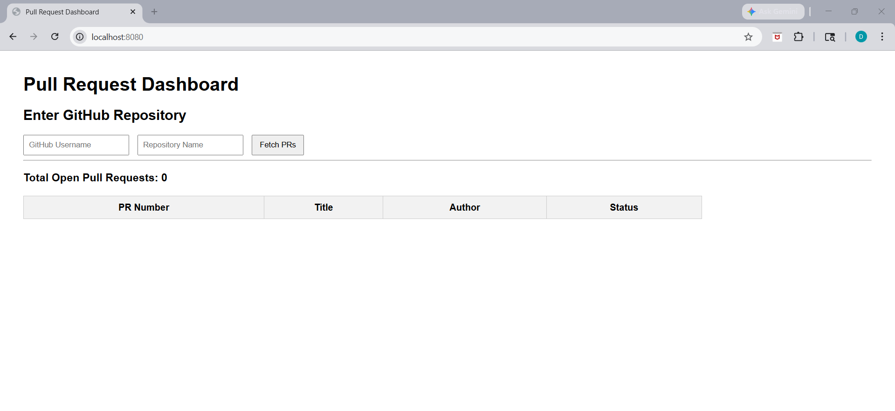
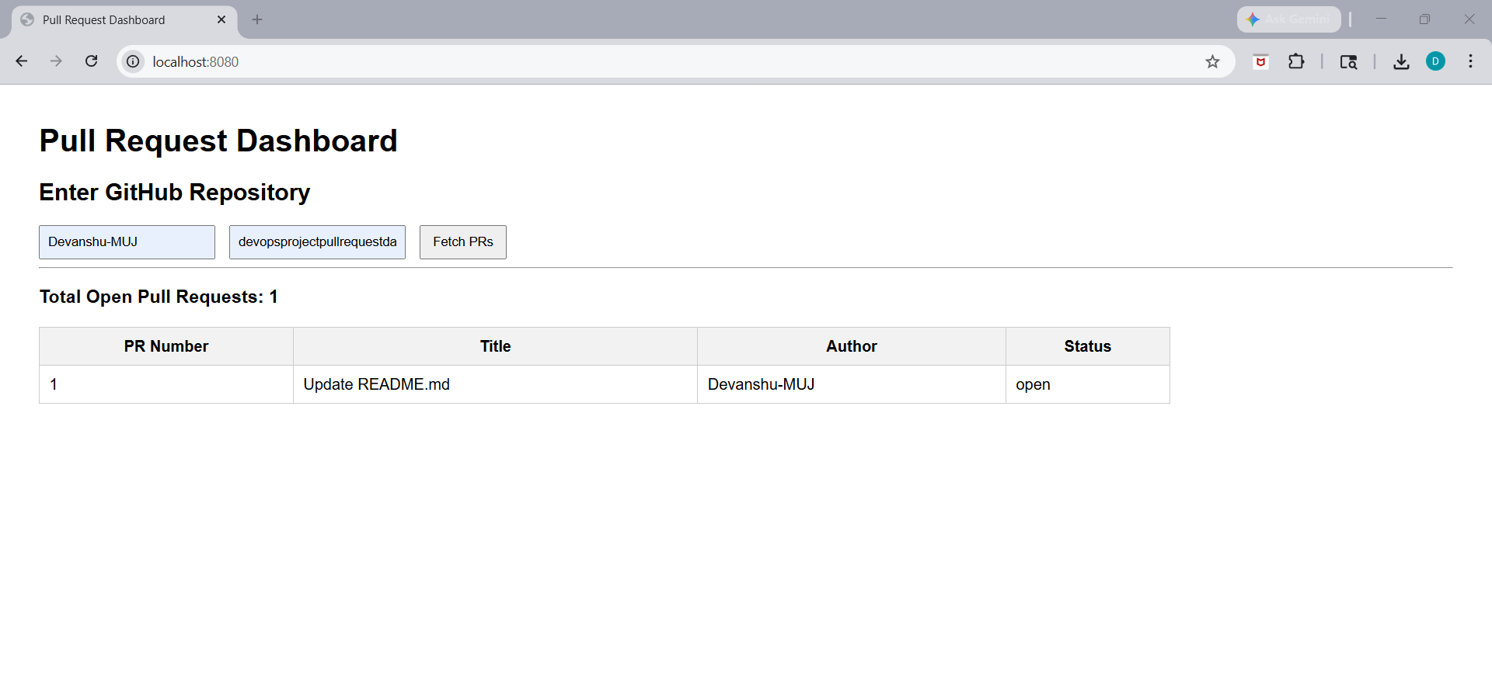
ScreenShots

Slide 13
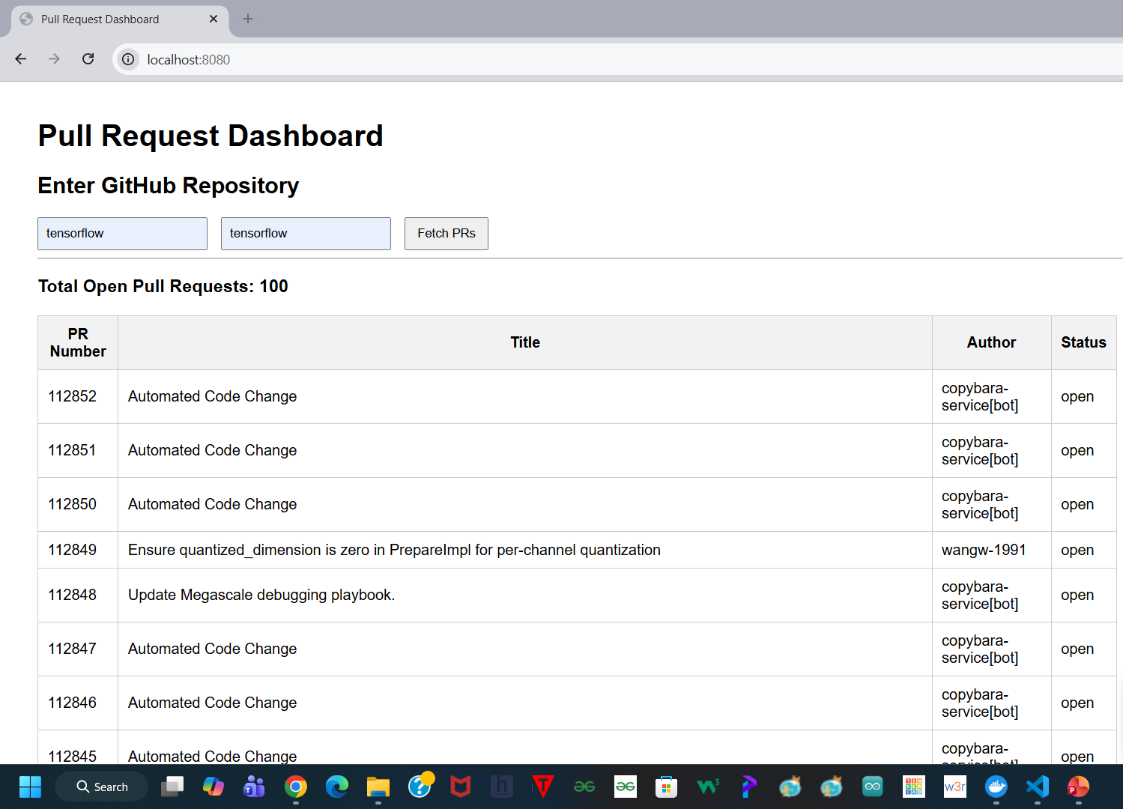

Slide 15
Conclusion
Demonstrates DevOps concepts using real-world GitHub data

