Slide 1
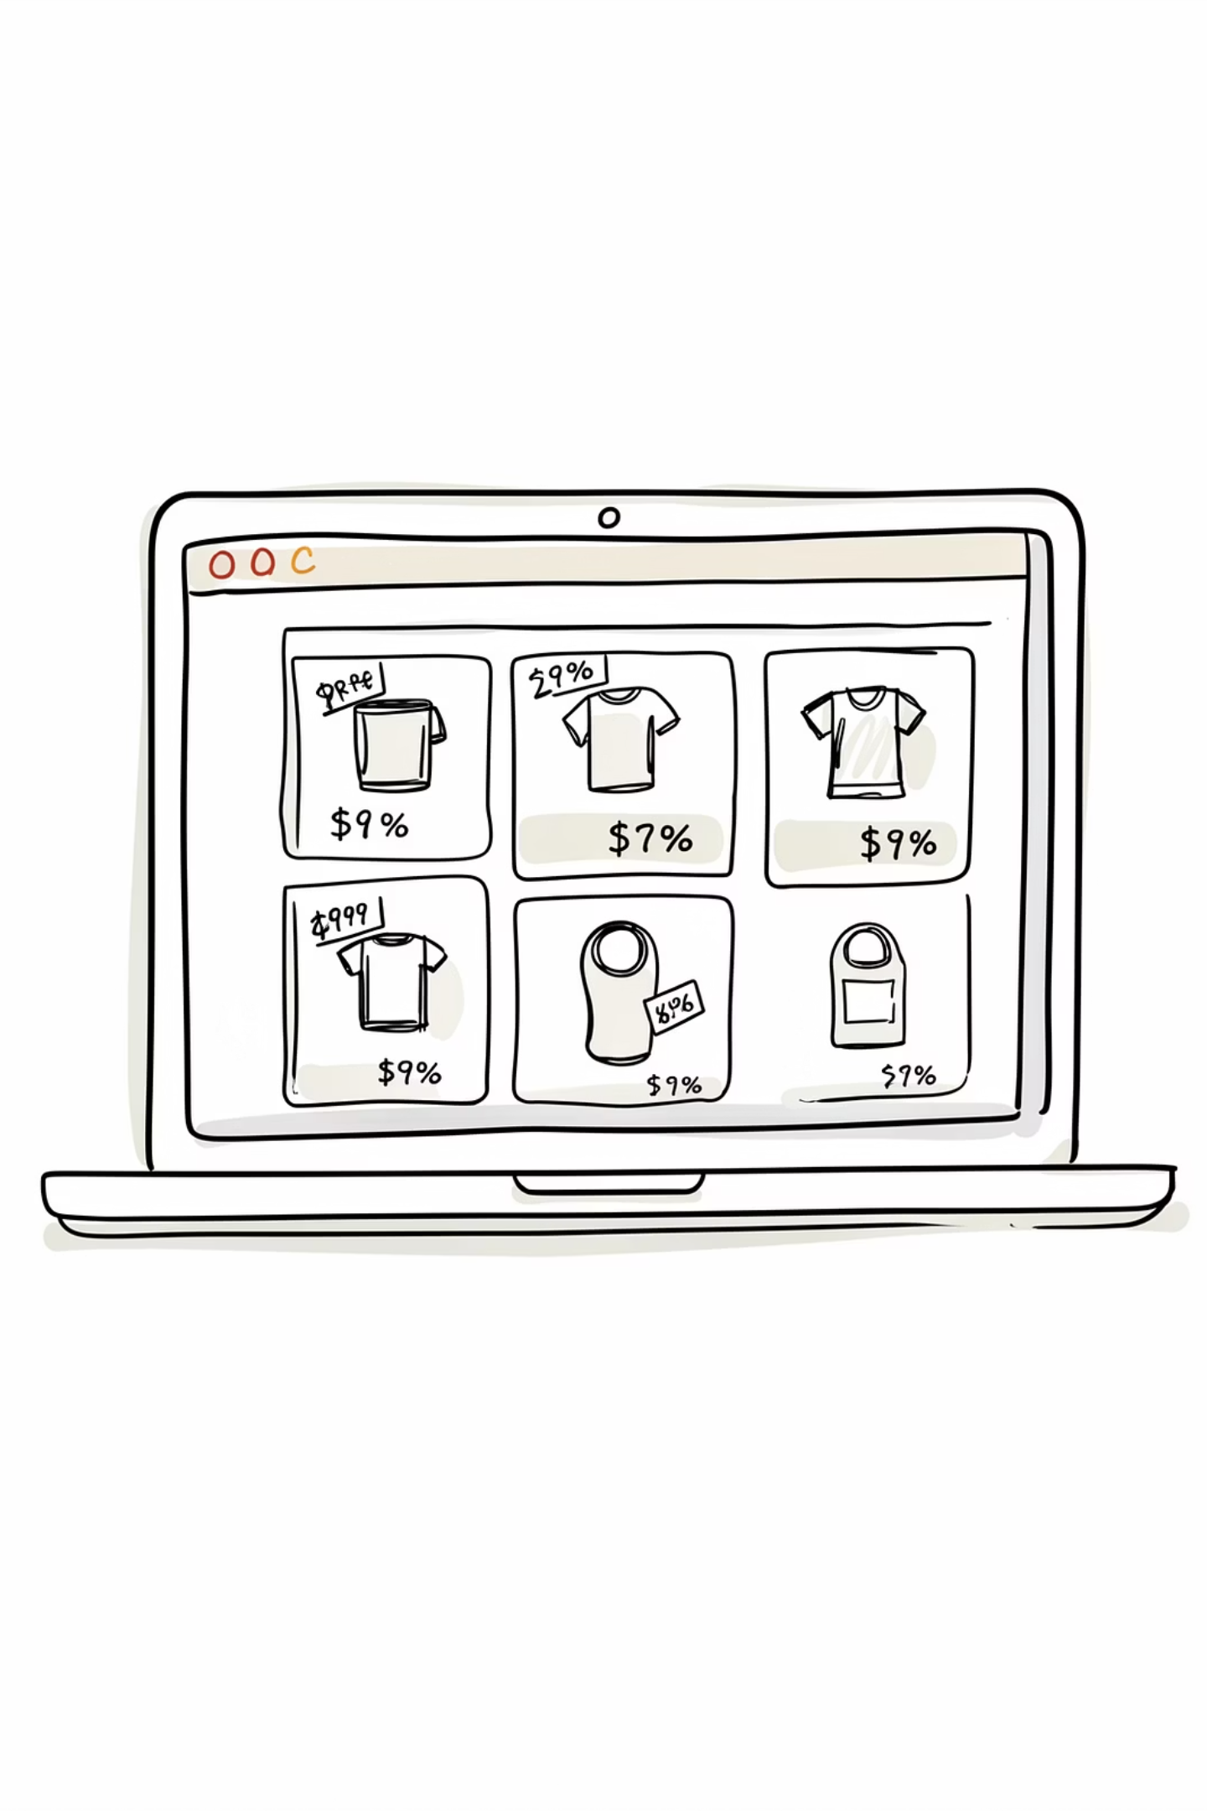
PriceScout
A Multi-Vendor Price Comparison Engine
COMPUTER SCIENCE PROJECT
Devanshu Sharma
23FE10CSE00274

Slide 2

The Problem with Online Shopping
With dozens of e-commerce platforms available, finding the best price for a product is far from straightforward. Shoppers must manually visit each site, compare listings, and evaluate deals — a process that is both time-consuming and error-prone.
Fragmented Market
Manual Effort
Prices vary significantly across platforms for the same product
Users must visit multiple sites and compare by hand
No Unified View
No single place to see all options side by side

Slide 3

Problem Statement
What Users Face Today
Hidden Best Deals
Users often miss better prices because they don't check every platform
No Unified System
There is no centralized tool aggregating prices from multiple vendors in real time
Wasted Time
Manual comparison is inconvenient and impractical for everyday shopping decisions

Slide 4
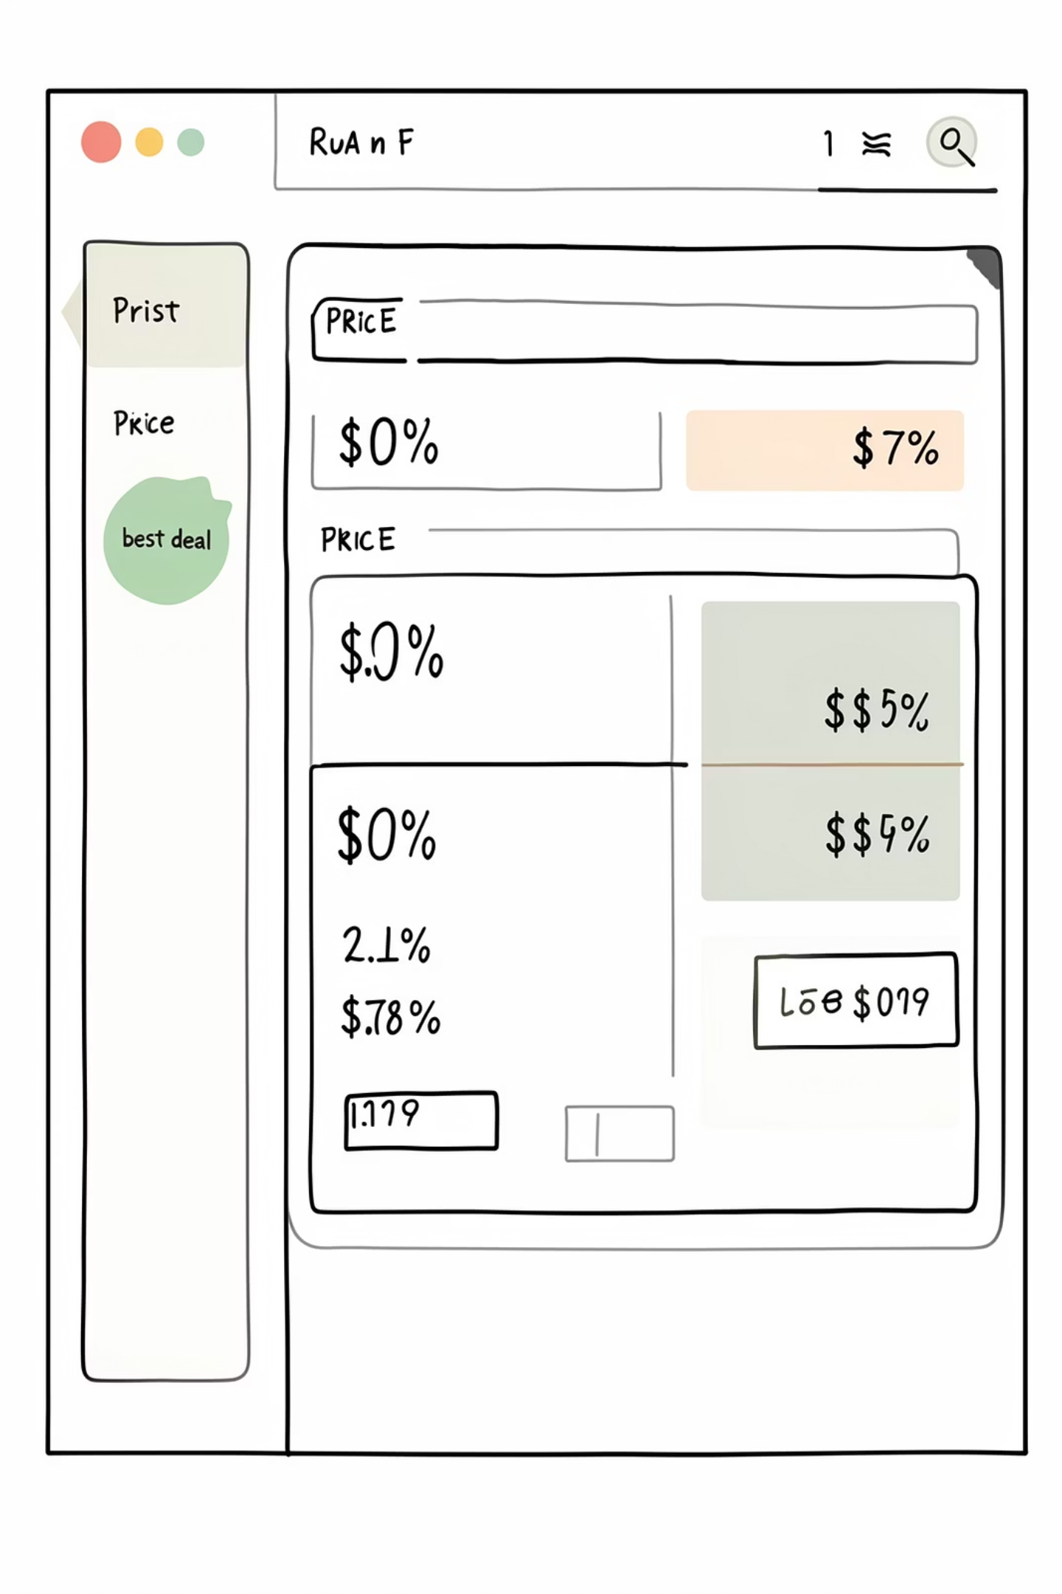

Proposed Solution: PriceScout
A centralized platform that fetches product prices from multiple vendors simultaneously, compares them, and presents the best deal to the user — all in one place.
Single Search
Enter a product query once; PriceScout queries all vendors
Real-Time Fetch
Live data retrieved from vendor APIs on demand
Best Deal Highlighted
Lowest price is automatically identified and highlighted
Simple UI
Clean, intuitive interface designed for quick decision-making

Slide 5

Project Nature: A Working Prototype
What This Project Is
PriceScout is a functional prototype that simulates how a real-world distributed price comparison system operates. Rather than connecting to live e-commerce platforms, it uses mock vendor APIs to demonstrate the full data pipeline — from request to result.
Simulated APIs
Distributed Architecture
Mock endpoints mimic real vendor responses
Models real-world microservices communication
Mock vendors: ElectroStore, QuickShop, and GadgetHub — each returning simulated product and pricing data.
Real-Time Logic
Fetches and compares data on every query

Slide 6
Technologies Used
Frontend
HTML5 & CSS3 — clean, responsive user interface
Backend
Python Flask — lightweight web framework for API handling and business logic
APIs
RESTful mock APIs simulating vendor data responses
Database
MySQL (optional) — for storing query history and cached results
Tools
GitHub for version control, VS Code for development

Slide 7

System Architecture
PriceScout follows a modular, client-server architecture designed for scalability. Each component is loosely coupled, allowing individual vendor APIs to be added or replaced without disrupting the system.
Frontend
Backend
Merge & Compare
Show Results
The modular design ensures that adding new vendor APIs requires minimal changes — simply register a new endpoint and the comparison engine adapts automatically.

Slide 8
How It Works: System Flow
01
02
03
User Enters Query
Backend Dispatches Requests
Data Fetched & Merged
Product name or keyword submitted via the search interface
Flask server sends parallel API calls to all mock vendor endpoints
Responses from ElectroStore, QuickShop, and GadgetHub are collected
04
05
Prices Compared
Results Displayed
Comparison logic identifies the lowest price across all vendors
Sorted list returned to user with the Best Deal clearly highlighted

Slide 9
Backend & Frontend Roles
Backend (Python Flask)
Frontend (HTML / CSS)
Sends API requests to mock vendor endpoints
Merges and normalises incoming data
Executes price comparison logic
Identifies and flags the best deal
Optionally stores results in MySQL
Renders a clean, responsive search interface
Handles user input and form submission
Displays sorted product listings
Visually highlights the best deal with a badge
Provides clear feedback during data loading

Slide 10
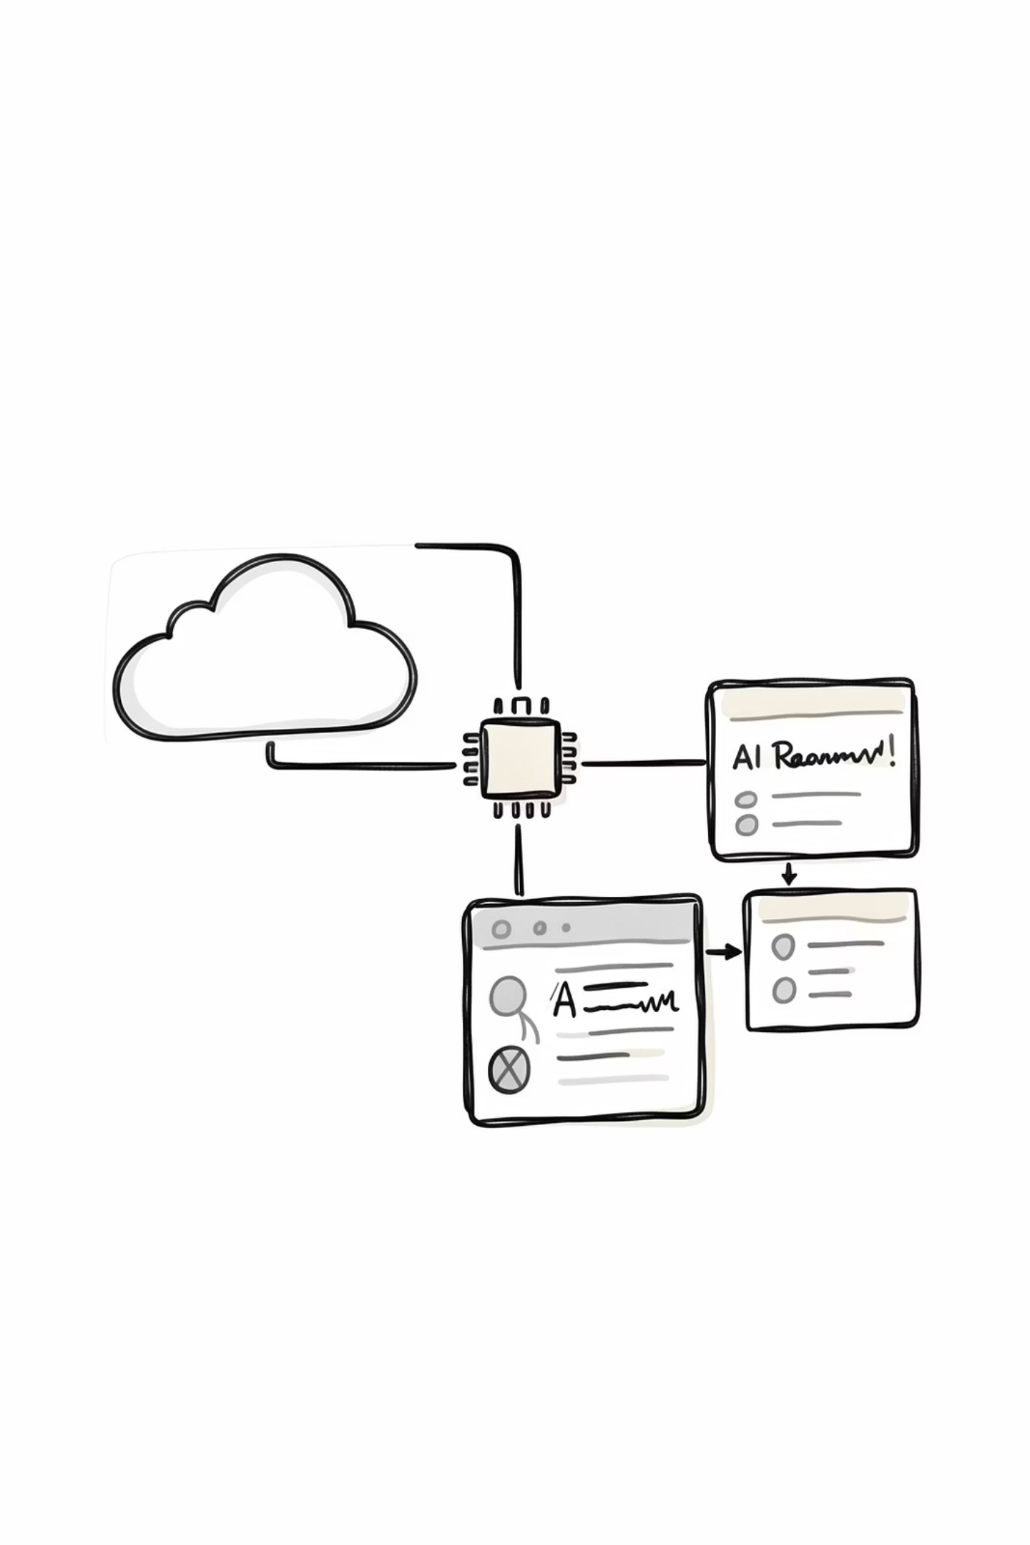

Results, Conclusion & Future Scope
✅ Delivered
🎯 Demonstrated
Successfully compares prices across three mock vendors and highlights the best deal in real time
A working model of distributed system concepts — API integration, data merging, and modular architecture
🔭 Future Scope
Replace mock APIs with real e-commerce APIs, deploy to cloud, and add AI-powered recommendations
PriceScout proves that a well-structured prototype can effectively demonstrate real-world distributed system principles.

