Slide 1

PriceScout
School of Computer Science and Engineering
Department of Computer Science and Engineering
Submitted By: Devanshu Sharma - 23FE10CSE00274
Sudhanshu Mishra – 23FE10CSE00187
Supervised By: Manu Shrivastava

Slide 2
Outline
Introduction
Literature Review
Problem Statement
Proposed Solution
Objectives
Results

Slide 3
Introduction
With the rapid growth of e-commerce, online shopping has become a common practice for consumers. Multiple platforms sell the same product but often at different prices, with varying discounts and offers. This creates confusion for users while selecting the best option. An efficient price comparison system can simplify this process by organizing product information from different sources in one place.

Slide 4
Literature Review
Many online platforms like Google Shopping and PriceDekho provide price comparison services.
These platforms collect product data from multiple vendors.
Most systems depend on official APIs or business partnerships.
Real e-commerce websites restrict public web scraping.
Academic projects often use web scraping techniques for comparison.
However, scraping real websites is legally and technically restricted.
Modern systems use REST APIs for structured data exchange.
Therefore, a mock API-based approach is more practical for academic implementation.

Slide 5
Problem Statement
Online shopping platforms display different prices, offers, and discounts for the same product, making it difficult for users to identify the best deal. Manually visiting multiple websites is time-consuming and inefficient. There is a need for a system that simplifies price comparison in a structured and reliable manner.

Slide 6
Objectives
To develop a centralized system that compares product prices from multiple vendors.
To provide users with clear and structured information about prices, offers, and reviews.
To identify and display the best available deal for a selected product.
To reduce the time and effort required for manual price comparison.

Slide 7
Proposed Methodology
System Architecture
The system is developed using Spring Boot framework following MVC architecture.
It consists of Controller, Repository, and Entity layers.
Product data is managed using JPA (Java Persistence API).
REST APIs are used for communication between vendor modules and the main system.
Frontend is developed using HTML, CSS, and Thymeleaf templates.

Slide 8
Vendor Simulation and Data Flow
Multiple mock vendor pages (ElectroStore, GadgetHub, QuickShop) are created.
Each vendor exposes product data through REST API endpoints.
The main controller sends requests to vendor APIs to fetch product details.
The system retrieves price, offers, and review information.
Data from different vendors is collected in structured format.

Slide 9
Comparison and Output Generation
Retrieved product data is processed and compared based on price.
The system identifies the lowest price among vendors.
Results are displayed in a user-friendly interface.
The best deal is highlighted for easier decision-making.
The application runs locally and is version-controlled using GitHub.

Slide 10
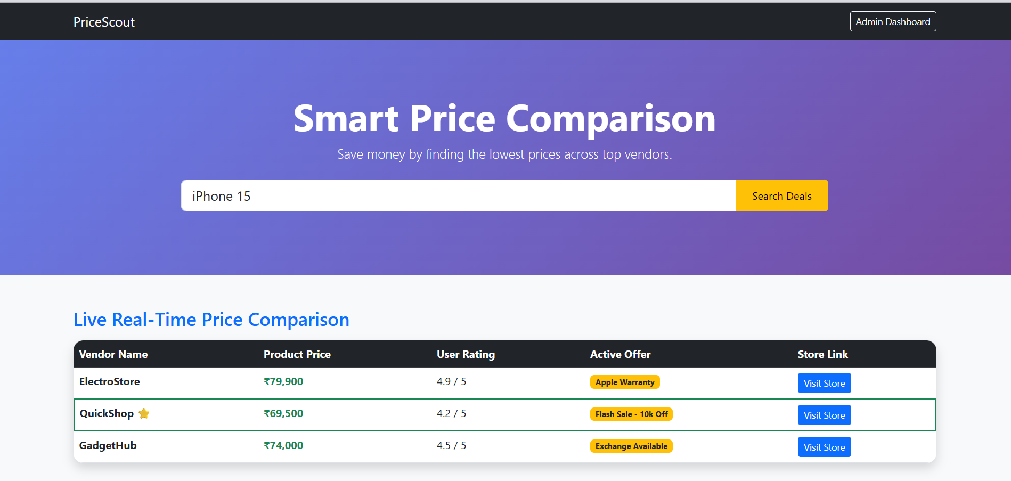
Result

Slide 11
Outcome
A working prototype of the PriceScout price comparison system has been successfully developed and tested locally during the current semester.
Multiple mock vendor APIs were integrated, and dynamic price comparison functionality was achieved.
Achievement Status:
Research Paper: Not Drafted
Patent: Not Applied
Copyright: Not Applied
Real-Time Deployment: Partially Completed (Successfully deployed and tested in local environment)

Slide 12
References
Spring Boot Official Documentation – https://spring.io/projects/spring-boot
Apache Maven Documentation – https://maven.apache.org/
REST API Design Guidelines – https://restfulapi.net/
Thymeleaf Documentation – https://www.thymeleaf.org/
Git & GitHub Documentation – https://docs.github.com/

Slide 13
Thank You

