Slide 1


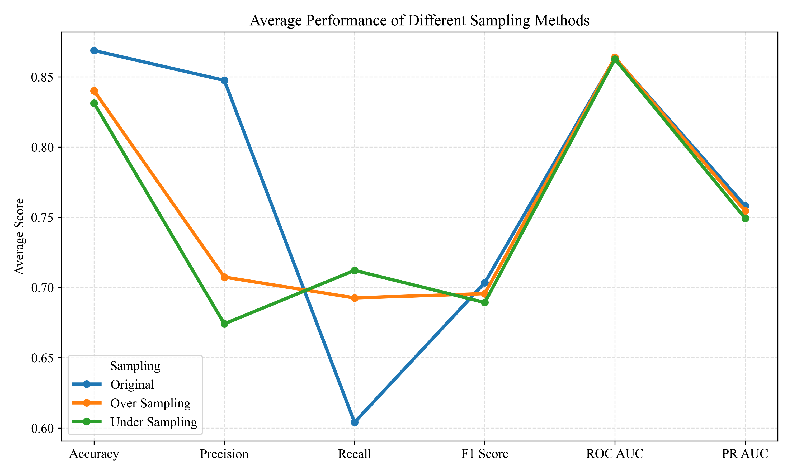
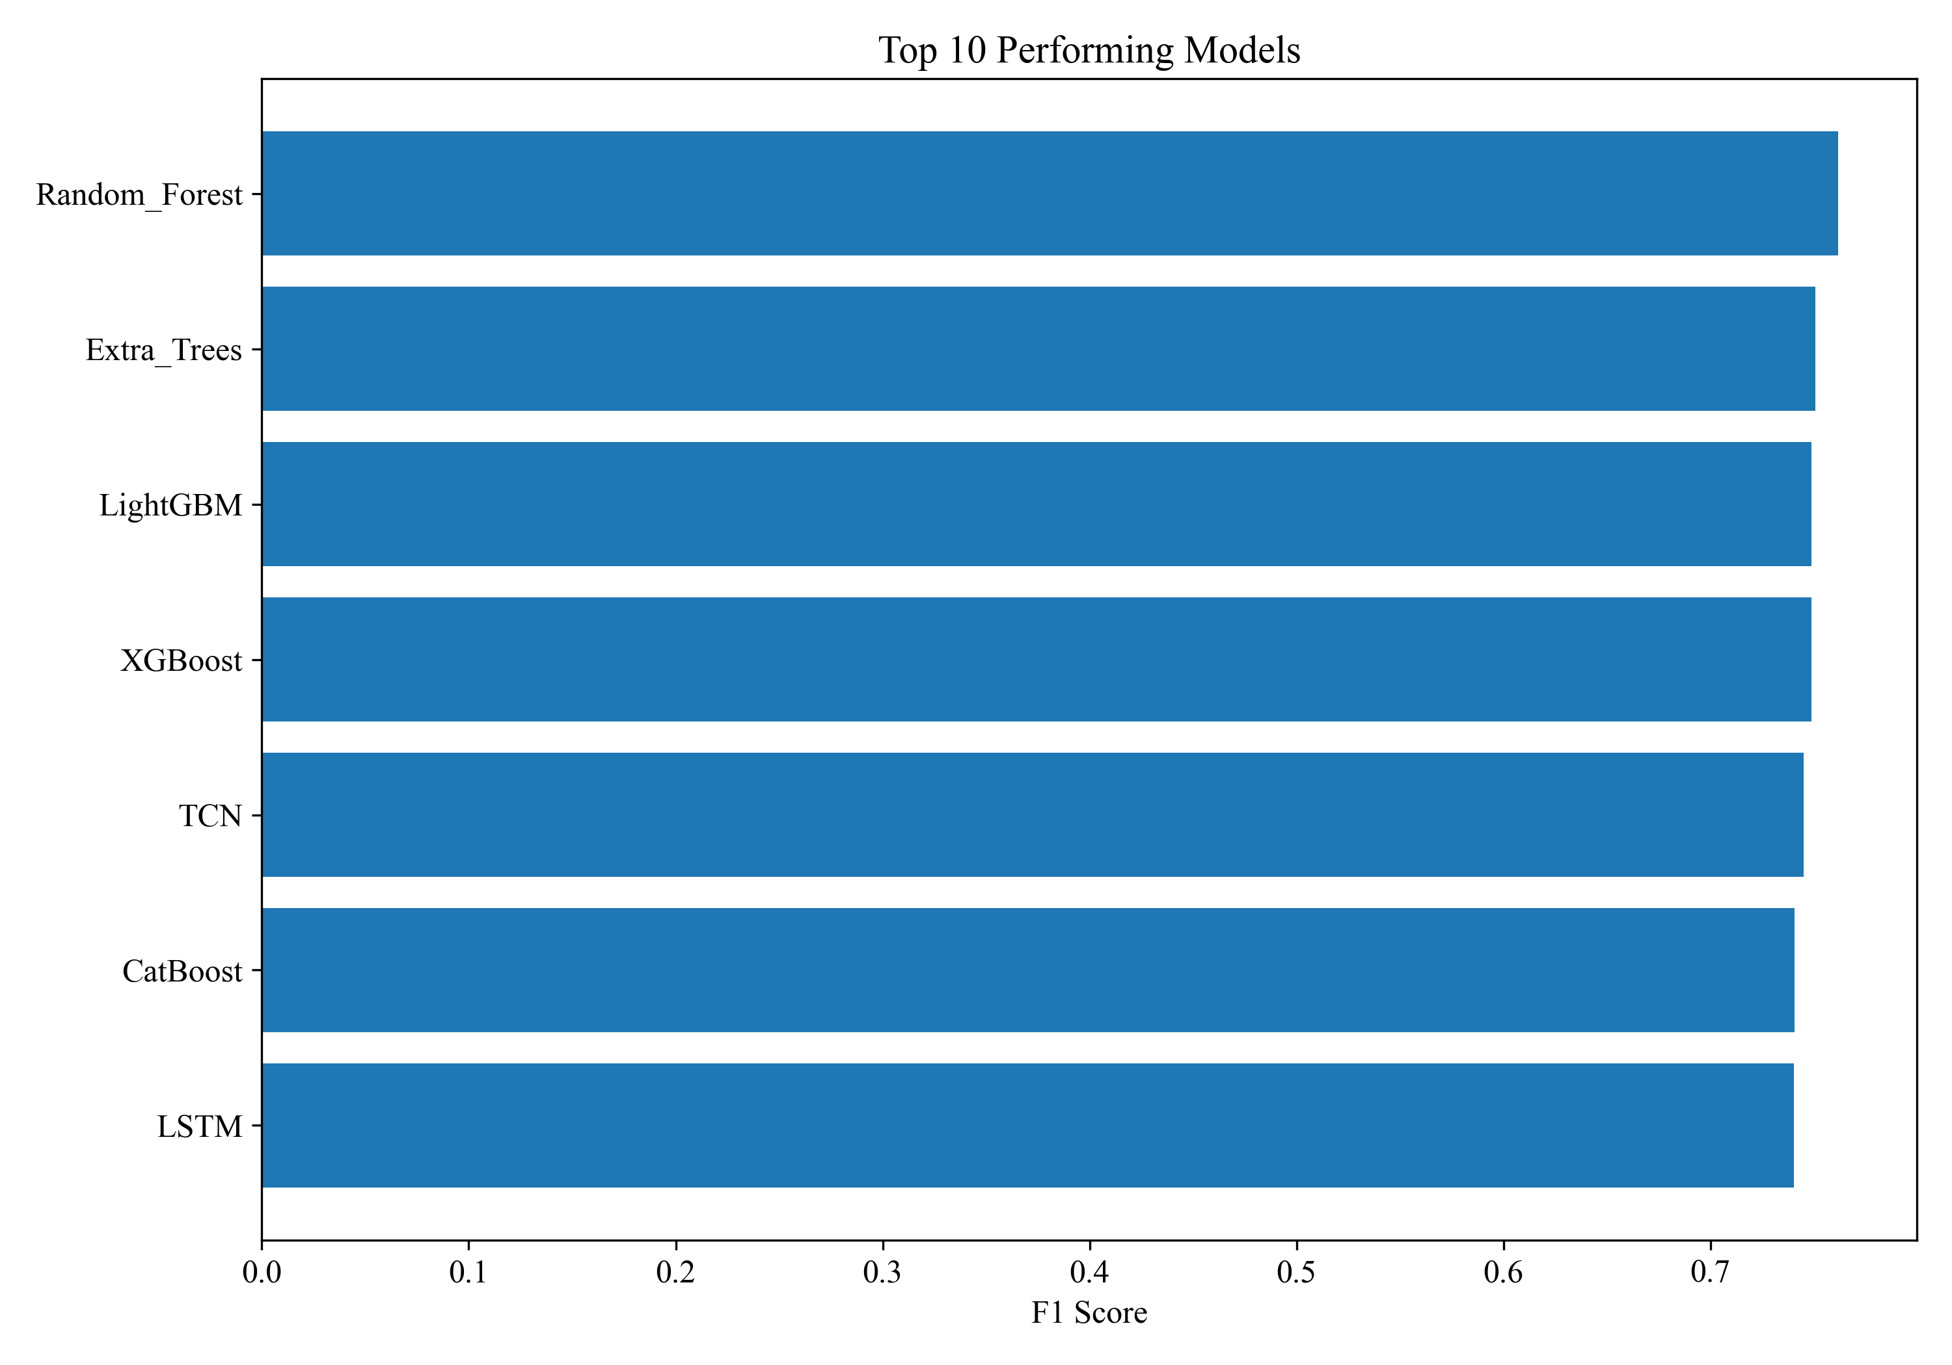
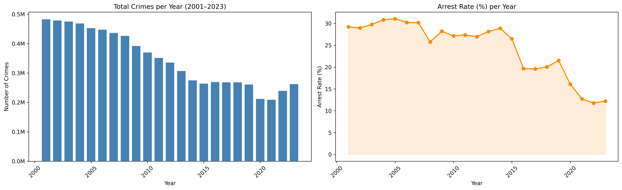
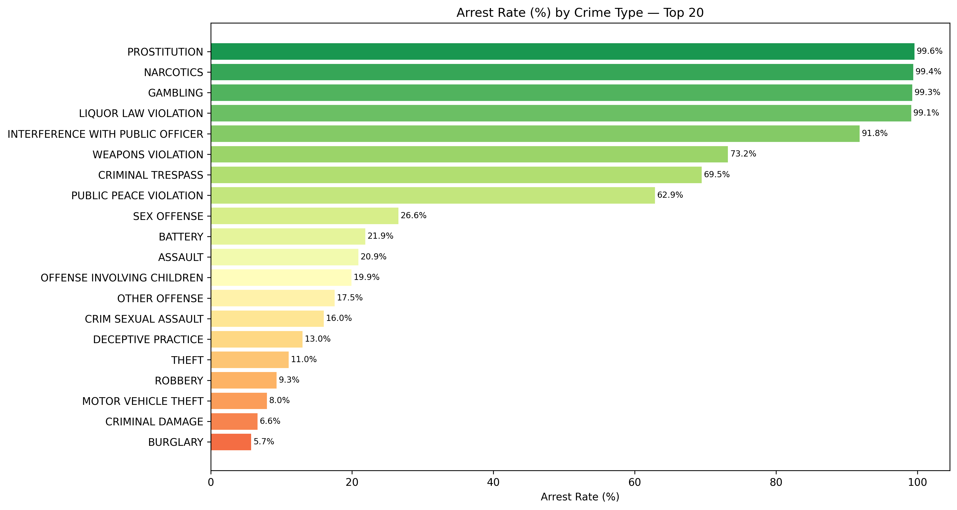
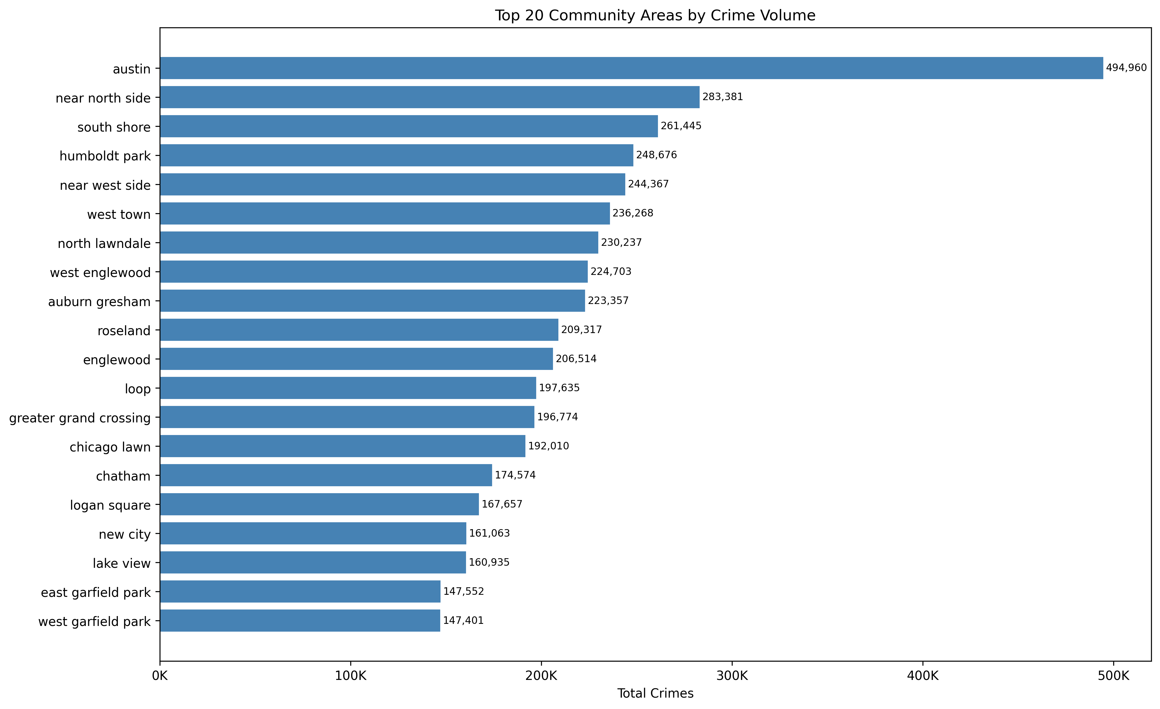
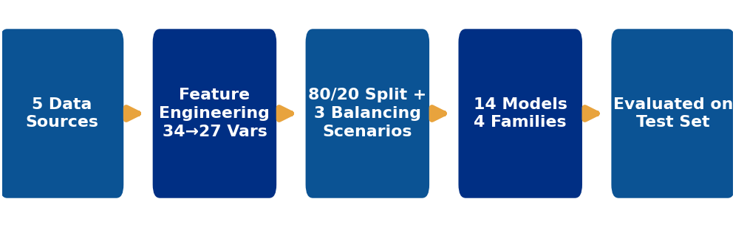
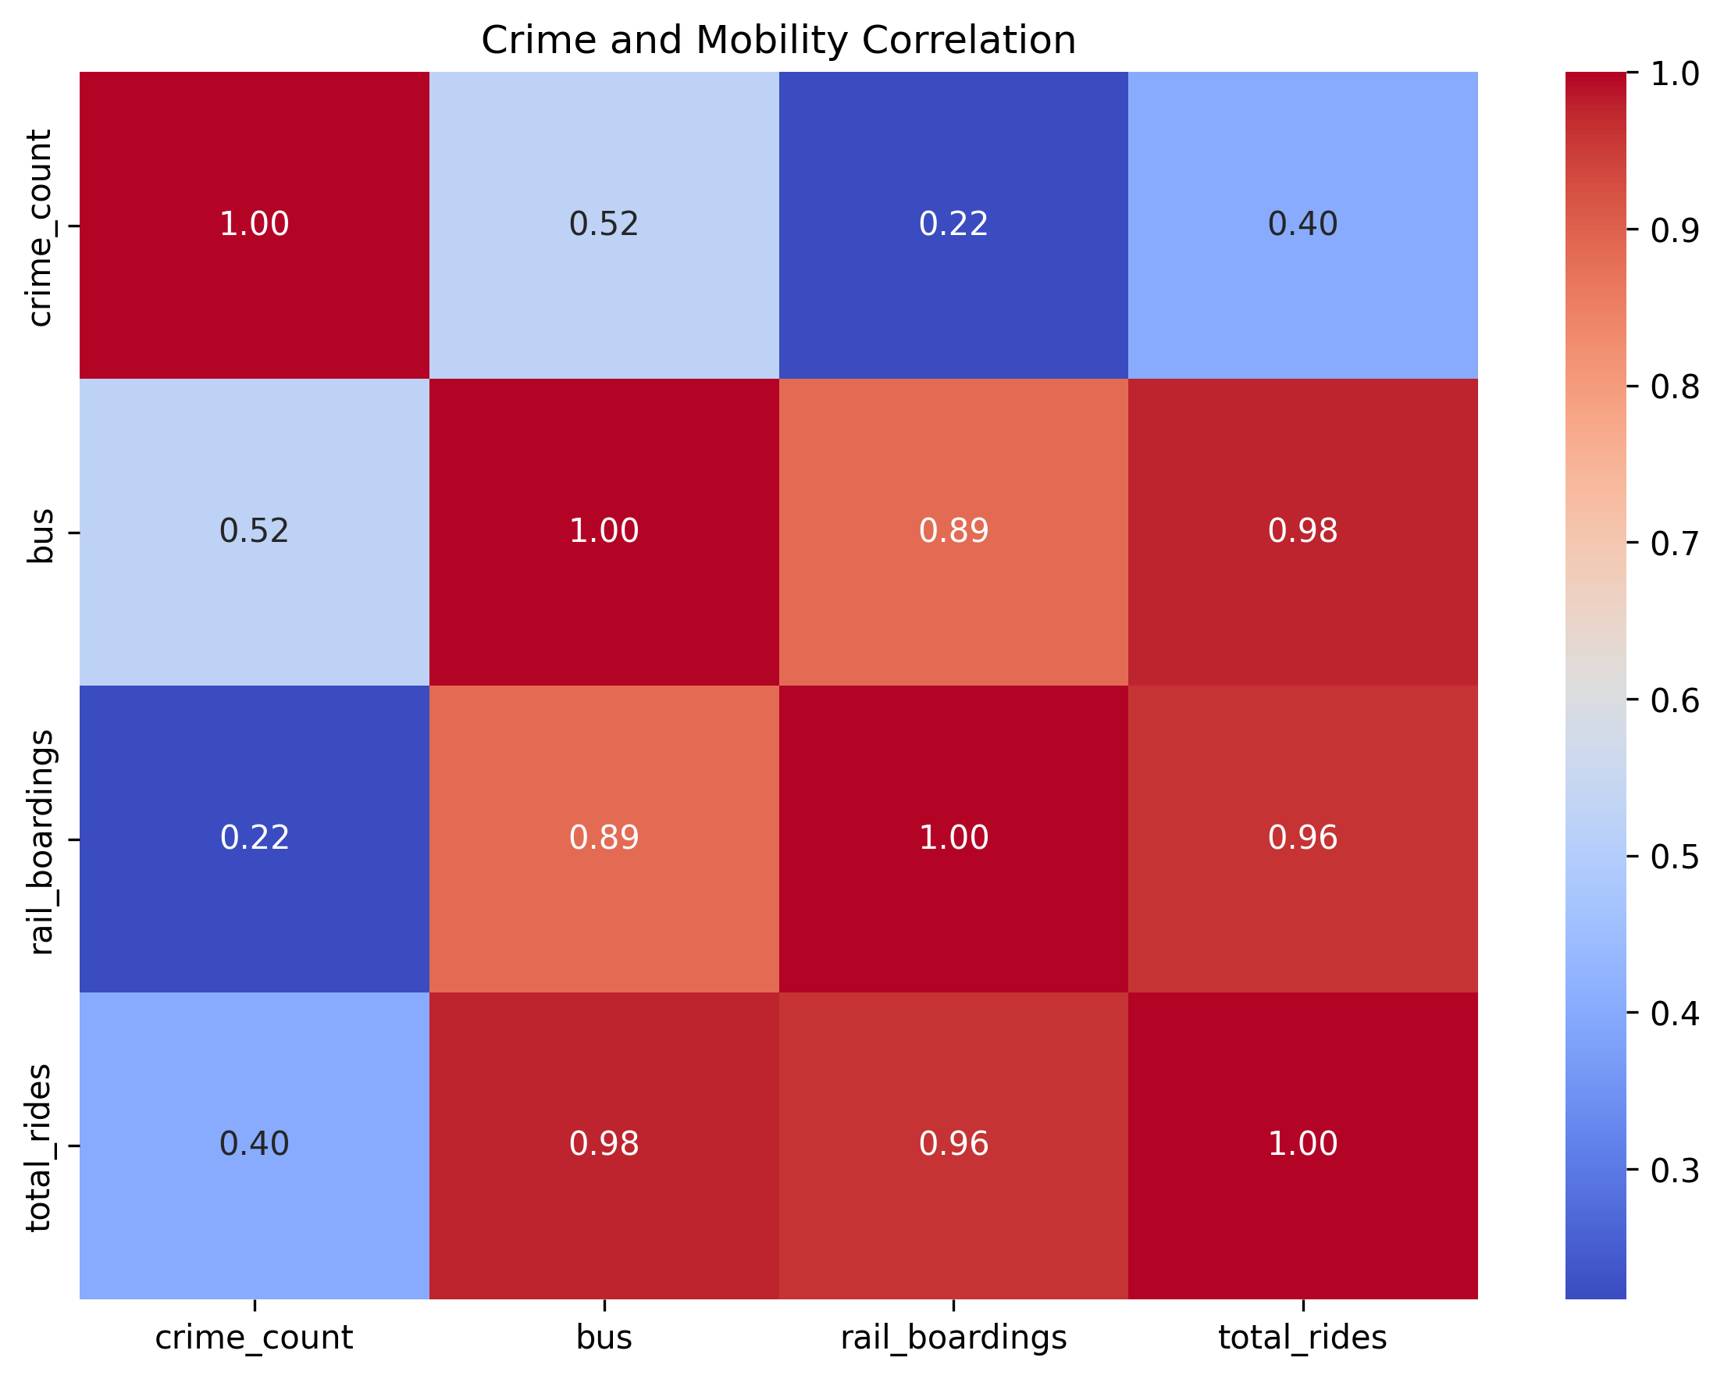
2025-2026 M.Sc. in Data Science and Analytics
Modeling Urban Crime Risk and Arrest Probability Using Spatio-Temporal
Machine Learning Techniques: Evidence from Chicago
Devanshu Dilipkumar Prajapati Supervisor: Dr. Xingwei (Nancy) Yang
Objective
This study develops a machine learning framework for predicting whether a reported Chicago crime incident results in an arrest, by integrating crime records with socio-economic, weather, and public-transit mobility data. Multiple machine learning and deep learning models are evaluated under three class-balancing strategies to determine which models and sampling approaches best handle the severe imbalance between arrest (25.8%) and non-arrest (74.2%) outcomes, in support of evidence-based policing and resource allocation.
Background
Results
Crime remains one of the most persistent challenges facing modern cities, threatening public safety and diminishing quality of life. According to the FBI's Crime Data Explorer, police nationwide cleared only 36.7% of reported violent crimes and just 12.1% of reported property crimes in 2022 — meaning the majority of reported offences never result in an arrest. Crime is shaped by the interaction of spatial, temporal, socio-economic, and environmental factors, making arrest outcomes inherently difficult to predict with traditional statistical approaches.
Machine learning has increasingly been applied to crime analytics, with prior work showing that spatiotemporal deep networks and ensemble methods can uncover complex, nonlinear patterns in crime data. However, most of this research targets crime occurrence or hotspot forecasting rather than arrest outcomes specifically, and few studies integrate socio-economic, weather, and mobility data alongside crime records within a single predictive framework.
This study addresses these gaps by combining five publicly available Chicago datasets — crime incidents (2001–2023), community-level socio-economic indicators, NOAA daily weather records, CTA transit ridership, and community area boundaries — into a single integrated dataset of nearly 8 million records. The analysis is grounded in Routine Activity Theory (Cohen & Felson, 1979), which frames crime as the convergence of a motivated offender, a suitable target, and the absence of a capable guardian — a convergence shaped by mobility, weather, and neighbourhood conditions.
Exploratory analysis confirms this framing: reported crime volume is highly concentrated in a subset of community areas (below), while arrest likelihood varies enormously by offense type — from over 99% for narcotics and gambling offences, typically detected through proactive enforcement, down to under 6% for burglary, which is usually reported only after the fact.
Table 1 summarizes test-set performance for the fourteen models trained on the randomly over-sampled training data — the scenario used for the final model. Random Forest achieved the highest F1-score (0.762), narrowly leading Extra Trees, while ensemble and boosting models (Random Forest, Extra Trees, XGBoost, LightGBM, CatBoost) consistently outperformed the linear baselines and, to a lesser extent, the sequence-based deep learning models (LSTM, GRU, TCN) across every metric.
Model | Accuracy | Precision | Recall | F1 | ROC-AUC | PR-AUC
Random Forest | 0.891 | 0.872 | 0.676 | 0.762 | 0.912 | 0.855
Extra Trees | 0.889 | 0.897 | 0.644 | 0.750 | 0.904 | 0.844
LSTM | 0.871 | 0.771 | 0.711 | 0.740 | 0.905 | 0.844
XGBoost | 0.864 | 0.731 | 0.749 | 0.740 | 0.912 | 0.853
LightGBM | 0.864 | 0.730 | 0.747 | 0.739 | 0.911 | 0.852
TCN | 0.875 | 0.806 | 0.680 | 0.738 | 0.900 | 0.837
Table 1. Top 6 models on the test set — random over-sampling scenario.
Figure 1. Reported crimes and arrest rate by year, 2001–2023.
Figure 6. Average performance by sampling strategy.
Figure 7. Top-performing models by F1-score.
Comparing the three class-balancing strategies shows that training on the original imbalanced data maximizes Accuracy and Precision but minimizes Recall, as models become biased toward the majority non-arrest class. Both random under- and over-sampling substantially raise Recall and F1-score at the cost of Precision, while ROC-AUC and PR-AUC remain broadly stable across all three scenarios — indicating that balancing shifts the Precision–Recall operating point rather than a model's underlying discriminative ability.
Random Forest trained on the randomly over-sampled data was selected as the final model: it achieves the best or near-best F1-score, ROC-AUC, and PR-AUC of any model/sampling combination, with substantially higher Recall than the original-data model (0.676 vs. 0.653) and without the steep Precision loss seen under under-sampling (0.872 vs. 0.714) — while preserving the full training set rather than discarding roughly 3 million majority-class records.
Figure 2. Arrest rate by crime type (top 20).
Figure 3. Top community areas by crime volume.
Methodology
Conclusions
The primary dataset is the City of Chicago Crimes dataset (2001–2023, 8.50M raw incidents), merged with: (1) two Selected Socio-Economic Indicators snapshots (2008–2012 and 2020) covering per-capita income, unemployment, and educational attainment by community area; (2) NOAA daily weather observations (TMAX, TMIN, PRCP, SNOW, AWND); (3) CTA daily ridership (bus, rail, total rides, weekday/weekend indicator); and (4) the official Chicago community area boundary polygons, used to spatially join incidents to community areas.
Arrest prediction proves feasible but only moderately accurate from the crime, socio-economic, weather, and mobility data integrated here. The best configuration discriminates considerably better than chance (ROC-AUC 0.912, PR-AUC 0.855), yet still misses roughly one in three actual arrests (Recall 0.676), and no model/sampling combination exceeded an F1-score of 0.77 — suggesting a meaningful share of arrest outcomes is driven by case-specific factors outside this dataset, such as officer discretion and real-time operational conditions.
Crime type, spatial location, and time of day/week carry the strongest predictive signal — arrest rates range from under 6% for burglary to over 99% for narcotics and gambling offences by crime type alone. Socio-economic, weather, and mobility variables show real but comparatively weak associations (e.g., unemployment rate correlates with community-area crime counts at r = 0.24) and are best understood as complementary context consistent with Routine Activity Theory, rather than dominant predictors.
Tree-based and boosting ensembles consistently outperformed both linear baselines and sequence-based deep learning models across all three sampling scenarios, consistent with the heterogeneous, mixed-type nature of the 27-variable feature set. Random over-sampling was preferred over under-sampling because it preserves the full set of majority-class observations, achieving comparable Recall gains while retaining Precision closer to the original-data level.
This framework was trained and evaluated on a single city (Chicago, 2001–2023), so generalizability to other jurisdictions with different enforcement practices remains untested. All predictors are drawn from retrospective, publicly available sources and cannot capture case-specific operational factors such as officer deployment or evidence strength. Future work should explore explicit spatiotemporal architectures (LSTM-ST-GCN, graph neural networks over community areas), model-agnostic explainability for individual predictions, and integration of real-time operational data to move toward a deployable policing decision-support tool.
1. Integrate five data sources via key-based merges (spatial join, community-area/year join, date join); handle missing values and duplicates, yielding 7,970,658 clean records.
2. Engineer temporal (month, day-of-week, hour), weather (temp_avg, is_rain, is_snow, temp_category), and derived mobility/flag features; label-encode six categorical variables.
3. Select predictors with Random Forest + SHAP importance on a stratified, training-only sample — reducing 34 candidate features to 27 by removing near-zero-importance and redundant variables.
4. Split the data 80/20 (stratified on Arrest) into training (6,376,526) and test (1,594,132) sets; the test set is held out untouched until final evaluation.
5. Apply three class-balancing scenarios to the training data only — original imbalanced, random under-sampling, and random over-sampling — fitting StandardScaler where required.
6. Train and tune 14 models spanning four families (linear, tree-based, boosting, neural/sequence) under each scenario, then evaluate every model on the same untouched, naturally imbalanced test set.
FINAL MODEL — RANDOM FOREST + RANDOM OVER-SAMPLING
0.762
F1-Score
0.912
ROC-AUC
0.855
PR-AUC
0.676
Recall
Figure 4. End-to-end modeling pipeline.

