Slide 1
IMPLEMENTATION OF 3D TIC TAC TOE IN JAVA
Artificial Intelligence Techniques

Slide 2
Problem definition
Implementation of 3D Tic-Tac-Toe using Artificial Intelligence
Minimax Theorem, Alpha-Beta Pruning, Heuristics calculation

Slide 3
SCOPE of project
Selection of 4x4x4 board
Deciding the number of plies to look forward
Implementation of A.I. techniques
Creation of GUI in Java Applet

Slide 4
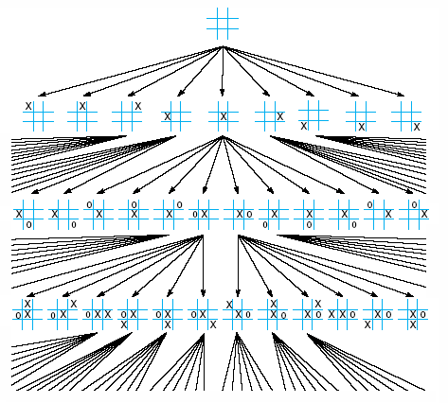
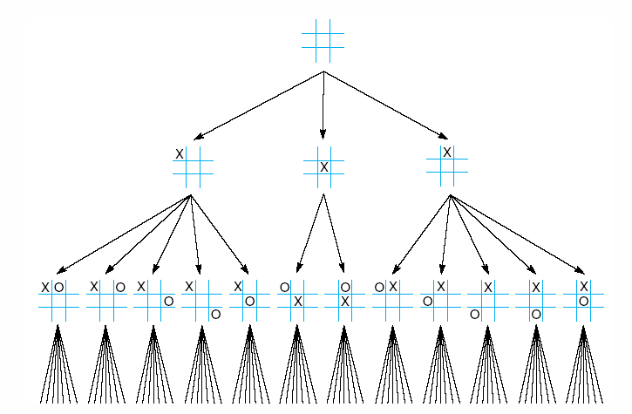
FUTURE OF THE BOARD
Programming decisions taken
Memory available
Waiting time per computer move
2 PLY
4 PLY

Slide 5
Pruning the tree
Alpha cutoff
8
Your move
alpha cutoff
8
1
Opponents move
8
9
1
Your move
8
5
2
9
-3
1

Slide 6
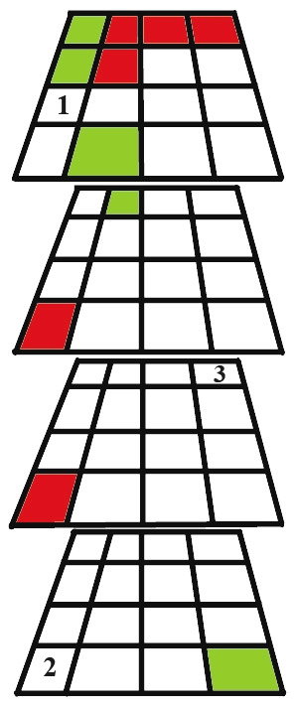
HEURISTICS
Rules for choosing those branches that are most likely to lead to an acceptable problem solution
Heuristics rule used = (9999*3cp+99*2cp+9*1cp)+ (10000*3up+100*2up+10*1up)
POSITION 1
Heuristics =100
POSITION 2
Heuristics = 130
POSITION 3
Heuristics = 20

Slide 7
Tree generation
Your move
8
Opponents move
8
2
9
Your move
8
5
2
9
-3

Slide 8
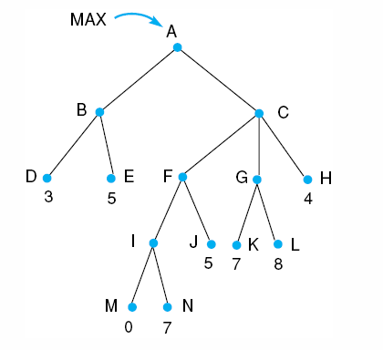
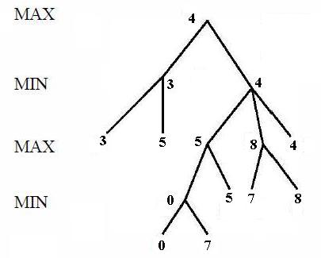
Minimax search algorithm

Slide 9
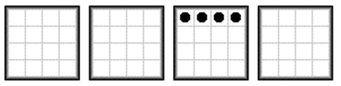
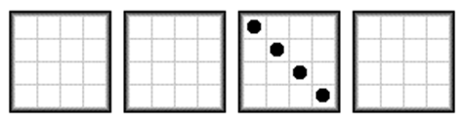






WINNING WAYS
ACROSS 4 PLANES DIAGONALLY (L TO R)
ACROSS 4 PLANES DIAGONALLY (R TO L)
ACROSS 4 PLANES ALONG LONGEST 3D DIAGONAL
ACROSS 4 PLANES STRAIGHT DOWN
DIAGONALLY IN 1 PLANE (R TO L)
DIAGONALLY IN 1 PLANE (L TO R)
HORIZONTALLY IN 1 PLANE
VERTICALLY IN 1 PLANE

Slide 10
WINNING WAYS
BOARD | NO. OF WAYS
HORIZONTALLY | 4 x 4 = 16
VERTICALLY(1 PLANE) | 4 x 4 = 16
DIAGONALLY (L TO R)(1P) | 4 x 1 = 4
DIAGONALLY (R TO L)(1P) | 4 x 1 = 4
VERTICALLY(4P) | 16 x 1 = 16
DIAGONALLY(L TO R)(4P) | 8 x 1 = 8
DIAGONALLY (R TO L)(4P) | 8 x 1 = 8
DIAGONALLY ACROSS(4P) | 4 x 1 = 4

Slide 11
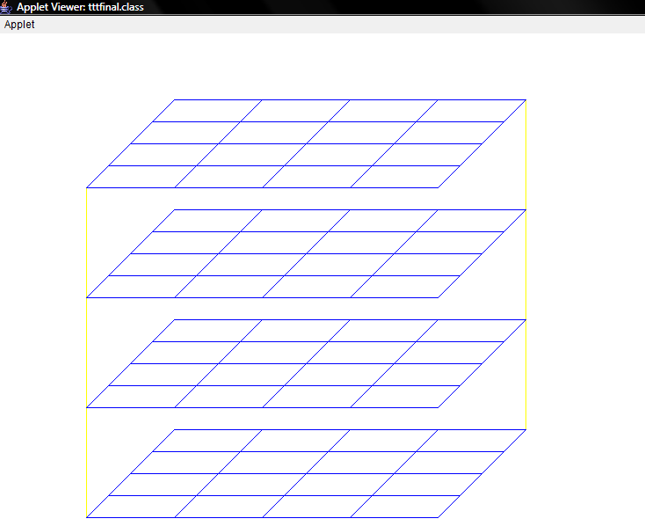
GUI

Slide 12
THANK you
DEVANSHU SAVE (084027)
GAURAV NARANG (084032)

