Slide 1

DeepTumorNet: End-to-End Lung Cancer Classification Using Deep Learning Domain: Deep Learning In-House Project
Names of Students with ERP: Dharmika Tank(01) – 1032210159 Jay Mehta(08) – 1032210499 Devanshu Surana(18) – 1032210755 Tejas Redkar(28) – 1032210937
Name of B.Tech Capstone Project Guide : Prof. Pratvina Talele

Slide 2

Outline
Introduction
Literature Survey
Limitations of Existing Systems
Problem Statement
System Design
Datasets
Requirements Gathering
Implementation of Project
Screenshots and Graphs
Conclusion
Publication Details
References

Slide 3
Introduction
Lung cancer is among the deadliest cancers, often diagnosed late due to its subtle early symptoms. Traditional diagnostic methods are time-consuming and inconsistent, highlighting the need for automated solutions. This study introduces a deep learning-based system using CT scan images for early lung cancer detection, integrating CNN models like ResNet, InceptionV3, and NASNetMobile. These models enhance diagnostic accuracy through advanced feature extraction. The system leverages MLflow for experiment tracking, DVC for dataset versioning, and Flask for deployment, ensuring scalability and real-world usability. The approach aims to improve early diagnosis, reduce errors, and support medical professionals with precise AI-powered tools.

Slide 4
Literature Survey
Sr No | Publication Title with authors [ mention whether Journal or Conference paper] | Publication Year | Positive points of the Publication | Gaps in publication work
1 | Lung Cancer Detection in Radiological Imaging using Deep Learning: A Review [N. S. Jozi and G. A. Al-Suhail, "Lung Cancer Detection in Radiological Imaging using Deep Learning: A Review," 2024 5th International Conference on Communications, Information, Electronic and Energy Systems (CIEES), Veliko Tarnovo, Bulgaria, 2024, pp. 1-8, doi: 10.1109/CIEES62939.2024.10811230.] (Conference) | 2024 | 1. Review state-of-the-art deep learning models for lung cancer detection. 2. Assess performance on different imaging modalities like CT scans and X-rays. 3. Analyze advancements, trends, and challenges in AI-driven lung detection. 4. Explore clinical applications for improved early detection and patient outcomes. 5. Emphasize the need for diverse datasets and model interpretability. 6. Investigate ethical concerns and deployment challenges in AI-based diagnostics. | 1. Limited dataset diversity leading to biases and reduced generalizability. 2. Lack of standardized evaluation metrics for model comparison. 3. Model interpretability issues making AI decisions less transparent. 4. Integration challenges preventing seamless adoption in clinical workflows. 5. High computational costs limiting real-time clinical applicability. 6. Ethical and legal concerns regarding data privacy, accountability, and transparency.

Slide 5
Literature Survey continued…
Sr No | Publication Title with authors [ mention whether Journal or Conference paper] | Publication Year | Positive points of the Publication | Gaps in publication work
2 | Enhancing Predictive Accuracy in Lung Disease Diagnosis Through Hybrid ResNet and Transfer Learning Models [S. Marappan, S. Roy, B. Ankayarkanni, S. Revathy and P. Asha, "Enhancing Predictive Accuracy in Lung Disease Diagnosis Through Hybrid ResNet and Transfer Learning Models," 2024 International Conference on Advances in Modern Age Technologies for Health and Engineering Science (AMATHE), Shivamogga, India, 2024, pp. 1-7, doi: 10.1109/AMATHE61652.2024.10582190.] (Conference) | 2024 | Improve Lung Disease Diagnosis Accuracy: 1. Develop a hybrid model combining ResNet and Transfer Learning to enhance predictive performance in lung disease classification. Utilize Deep Learning for Medical Imaging: 2. Compare multiple deep learning models (CNN, ResNet, Transfer Learning, and a Hybrid ResNet-Transfer Learning Model) for lung disease classification. Benchmark Model Performance: 3. Evaluate model accuracy, sensitivity, and F1-score, demonstrating the superiority of the hybrid approach. | Lack of Explainability Robustness: 1. Deep & learning models in healthcare often struggle with interpretability and robustness when diagnosing complex diseases. 2. The study emphasizes feature extraction and fusion techniques to enhance the model’s understanding of lung disease patterns. Need for Generalized Predictive Models: 3. Prior research often focused on specific lung diseases, limiting applicability. 4. The study extends deep learning across multiple lung conditions, making it more applicable for broad clinical use.

Slide 6
Literature Survey continued…
Sr No | Publication Title with authors [ mention whether Journal or Conference paper] | Publication Year | Positive points of the Publication | Gaps in publication work
3 | Real-time Detection of Lung Cancer Using CNN. [ N. S. Jozi and G. A. Al-Suhail, "Lung Cancer Detection in Radiological Imaging using Deep Learning: A Review," 2024 5th International Conference on Communications, Information, Electronic and Energy Systems (CIEES), Veliko Tarnovo, Bulgaria, 2024, pp. 1-8, doi: 10.1109/CIEES62939.2024.10811230.] (Conference) | 2024 | 1. Preprocessing & Model Optimization – Implements image normalization, resizing, and contrast enhancement for better accuracy. 2. CT Scan-Based Classification – Uses Convolutional Neural Networks (CNNs) to classify malignant vs. non-cancerous cases. 3. Real-time Lung Cancer Detection – Develop a CNN-based model for rapid lung cancer diagnosis. | 1. No Clinical Trials – Model is not tested in hospitals or integrated into radiology workflows. 2. No Multi-Modal Data Integration – Lacks fusion with additional clinical data like blood reports or symptoms. 3. Limited Explainability – No Grad-CAM or SHAP-based interpretability to aid radiologists.

Slide 7
Literature Survey continued…
Sr No | Publication Title with authors [ mention whether Journal or Conference paper] | Publication Year | Positive points of the Publication | Gaps in publication work
4 | Lung Cancer Prediction Model Using Ensemble Learning Techniques and a Systematic Review Analysis. [B. Sumithra, G. Vallathan, M. Raman Kumar and K. Govindharaju, "Deep Learning for Accurate Chest Disease Classification: A CNN-Based Approach for Lung Cancer Subtypes and Normal Cells," 2023 International Conference on System, Computation, Automation and Networking (ICSCAN), PUDUCHERRY, India, 2023, pp. 1-7, doi: 10.1109/ICSCAN58655.2023.10394855.] (Conference) | 2023 | 1. Develop an effective machine learning-based prediction model for lung cancer diagnosis. 2. Applied and compared different ensemble learning techniques such as XGBoost, LightGBM, Bagging, and AdaBoost. 3. Evaluating the models using accuracy, precision, recall, F1-score, and AUC. 4. Use SMOTE (Synthetic Minority Oversampling Technique) to balance the dataset and improve model reliability. | 1. Most past studies focused on single classifiers like SVM, Random Forest, or Naïve Bayes, without leveraging ensemble learning techniques. 2. Many previous models used imbalanced datasets, leading to biased predictions. The study addressed this using SMOTE. 3. Existing models often relied on specific datasets that were not representative. The study highlights the need for larger and more diverse datasets for better generalization.

Slide 8
Literature Survey continued…
Sr No | Publication Title with authors [ mention whether Journal or Conference paper] | Publication Year | Positive points of the Publication | Gaps in publication work
5 | Deep Learning for Accurate Chest Disease Classification: A CNN-Based Approach for Lung Cancer Subtypes and Normal Cells. [I. V. and D. Menaka, "Real-time detection of Lung cancer using CNN," 2023 2nd International Conference on Vision Towards Emerging Trends in Communication and Networking Technologies (ViTECoN), Vellore, India, 2023, pp. 1-6, doi: 10.1109/ViTECoN58111.2023.10157316.] (Conference) | 2023 | 1. Lung Cancer Subtype Classification – Identify Adenocarcinoma, Large Cell Carcinoma, Squamous Cell Carcinoma, and Normal Cells. 2. AI-Powered Diagnosis – Implement CNNs for accurate chest disease classification. 3. High-Performance Model – Optimize accuracy, precision, recall, and AUC-ROC. 4. Clinical Validation – Ensure model aligns with real-world medical diagnostics. 5. Explainability – Use Grad-CAM for visualization of decision-making areas. | 1. Limited Interpretability – Grad-CAM used, but lacks detailed explainability techniques like SHAP/LIME. 2. Lack of Transfer Learning – No use of pre-trained models for enhanced feature learning. 3. No 3D Image Analysis – Model is 2D-based, missing depth details in lung scans.

Slide 9
Literature Survey continued…
Sr No | Publication Title with authors [ mention whether Journal or Conference paper] | Publication Year | Positive points of the Publication | Gaps in publication work
6 | Lung Cancer Detection and Classification Using Deep CNN. [A. Rehman, M. Kashif, I. Abunadi and N. Ayesha, "Lung Cancer Detection and Classification from Chest CT Scans Using Machine Learning Techniques," 2021 1st International Conference on Artificial Intelligence and Data Analytics (CAIDA), Riyadh, Saudi Arabia, 2021, pp. 101-104, doi: 10.1109/CAIDA51941.2021.9425269.] (Journal) | 2021 | 1. Early Cancer Detection using CNN on chest CT scans. 2. Automated Diagnosis with deep learning for benign vs. malignant classification. 3. End-to-End AI Pipeline including preprocessing, segmentation, and classification. 4. Performance Evaluation with metrics like accuracy (96%), precision, recall, etc. | 1. Hyperparameter Tuning Needed – No AutoML/advanced optimizations. 2. No Cloud Deployment – Misses AWS/GCP integration for real-time AI diagnosis. 3. Limited Explainability – No Grad-CAM/SHAP for AI interpretability.

Slide 10
Literature Survey continued…
Sr No | Publication Title with authors [ mention whether Journal or Conference paper] | Publication Year | Positive points of the Publication | Gaps in publication work
7 | Lung Cancer Detection with Machine Learning and Deep Learning: A Narrative Review. [ N. Nawreen, U. Hany and T. Islam, "Lung Cancer Detection and Classification using CT Scan Image Processing," 2021 International Conference on Automation, Control and Mechatronics for Industry 4.0 (ACMI), Rajshahi, Bangladesh, 2021, pp. 1-6, doi: 10.1109/ACMI53878.2021.9528297.] (Conference) | 2021 | 1. AI for Lung Cancer Detection – Explore the role of Machine Learning (ML) and Deep Learning (DL) in improving lung cancer diagnosis. 2. Automated Image Processing – Use AI-based Computer-Aided Detection (CAD) systems for lung nodule detection. | 1. Feature Extraction Needs Improvement – Requires better hybrid AI models (ML + DL) for enhanced performance. 2. Dataset Limitations – Uses small datasets, limiting generalization. 3. No Real-World Clinical Testing – Not validated in hospitals for real time diagnostics.

Slide 11
Literature Survey continued…
Sr No | Publication Title with authors [ mention whether Journal or Conference paper] | Publication Year | Positive points of the Publication | Gaps in publication work
8 | Lung Cancer Detection and Classification from Chest CT Scans Using Machine Learning Techniques [A. Rehman, M. Kashif, I. Abunadi and N. Ayesha, "Lung Cancer Detection and Classification from Chest CT Scans Using Machine Learning Techniques," 2021 1st International Conference on Artificial Intelligence and Data Analytics (CAIDA), Riyadh, Saudi Arabia, 2021, pp. 101-104, doi: 10.1109/CAIDA51941.2021.9425269.] (Conference) | 2021 | 1. Machine Learning-Based Classification – Using Support Vector Machine (SVM) and K-Nearest Neighbors (KNN) for accurate classification. 2. Clinical Impact – Aims to improve cancer detection and assist radiologists diagnosis. 3. Early Lung Cancer Detection – Identify Adenocarcinoma, Large Cell Carcinoma, Squamous Cell Carcinoma from CT scan. | 1. Lack of Clinical Validation – Model is not tested in real-world hospitals or integrated into radiology workflows. 2. Annotation Challenges – Potential noise in labeled datasets affecting accuracy.

Slide 12
Literature Survey continued…
Sr No | Publication Title with authors [ mention whether Journal or Conference paper] | Publication Year | Positive points of the Publication | Gaps in publication work
9 | A. Rehman, M. Kashif, I. Abunadi, and N. Ayesha, "Lung cancer detection and classification from chest CT scans using machine learning techniques," 2021 1st International Conference on Artificial Intelligence and Data Analytics (CAIDA), Riyadh, Saudi Arabia, pp. 101–104, doi: 10.1109/CAIDA51941.2021.9425269. (Conference) | 2021 | Utilizes machine learning techniques for early detection and classification of lung cancer from chest CT scans. Demonstrates the potential of AI to improve diagnostic accuracy compared to traditional methods.Provides experimental validation on CT scan datasets, showing promising accuracy results. Highlights the practical application of ML models in the medical imaging field. | Limited dataset size, raising concerns about model generalizability to larger or more diverse populations. Lack of comparison with deep learning or more advanced CNN-based methods which have shown superior performance in medical imaging tasks. The study does not explore explainability or interpretability of the ML model’s predictions, which is crucial for clinical adoption.Absence of external validation or testing on multi-center datasets.

Slide 13
Literature Survey continued…
Sr No | Publication Title with authors [ mention whether Journal or Conference paper] | Publication Year | Positive points of the Publication | Gaps in publication work
10 | R. D. Karthikeyan, R. G., V. V., G. B. C., and K. M., "A review of lung cancer detection using image processing," 2021 Smart Technologies, Communication and Robotics (STCR), Sathyamangalam, India, 2021, pp. 1–4, doi: 10.1109/STCR51658.2021.9588835. (Conference) | 2021 | Provides a comprehensive review of various image processing techniques applied for lung cancer detection. Summarizes recent advancements and algorithms used in medical image analysis. Highlights the importance of computer-aided diagnosis systems in improving detection accuracy and efficiency. Serves as a useful starting point for researchers entering the field of lung cancer detection. | Focuses mainly on classical image processing techniques; limited discussion of modern deep learning approaches. Lacks a quantitative comparison or evaluation of the reviewed methods’ performance. Does not address challenges such as data imbalance, interpretability, or integration into clinical workflows. The paper could have included more recent references or case studies to strengthen its review.

Slide 14
Literature Survey continued…
Sr No | Publication Title with authors [ mention whether Journal or Conference paper] | Publication Year | Positive points of the Publication | Gaps in publication work
11 | R. D. Karthikeyan, R. G., V. V., G. B. C., and K. M., "A review of lung cancer detection using image processing," 2021 Smart Technologies, Communication and Robotics (STCR), Sathyamangalam, India, 2021, pp. 1–4, doi: 10.1109/STCR51658.2021.9588835. (Conference) | 2021 | Provides an organized survey of various techniques for detecting lung carcinoma. Covers a range of approaches including image processing, machine learning, and computer-aided diagnosis systems. Highlights challenges and opportunities in lung cancer detection using computational methods. Serves as a useful reference for researchers to understand different methodologies and their applications. | Focuses mainly on classical image processing techniques; limited discussion of modern deep learning approaches. Lacks a quantitative comparison or evaluation of the reviewed methods’ performance. Does not address challenges such as data imbalance, interpretability, or integration into clinical workflows. The paper could have included more recent references or case studies to strengthen its review.

Slide 15
Literature Survey continued…
Sr No | Publication Title with authors [ mention whether Journal or Conference paper] | Publication Year | Positive points of the Publication | Gaps in publication work
12 | Deep Learning Methods for Lung Cancer Segmentation in Whole-Slide Histopathology Images [Z. Li et al., "Deep Learning Methods for Lung Cancer Segmentation in Whole-Slide Histopathology Images—The ACDC@LungHP Challenge 2019," in IEEE Journal of Biomedical and Health Informatics, vol. 25, no. 2, pp. 429-440, Feb. 2021, doi: 10.1109/JBHI.2020.3039741.] (Journal) | 2020 | 1. Automated Cancer Segmentation – Develop deep learning methods to accurately segment lung cancer tissues in whole-slide histopathology images (WSI). 2. Challenge Benchmarking – The ACDC@LungHP Challenge 2019 aimed to evaluate different AI-based segmentation methods on lung cancer WSI. 3. Model Evaluation – Assess CNN-based models using metrics like Dice Coefficient (DC), Precision, Sensitivity, and Specificity. 4. Multi-Model vs. Single Model Performance – Compare the effectiveness of multi-model vs. single-model architectures. 5. Enhance Pathologists' Workflow – Use AI to assist in cancer tissue reducing pathologists’ workload. | 1. Lack of Clinical Deployment – Model not tested in real-world pathology labs. 2. Limited Performance on Challenging Cases – Models struggled with complex tumor structures, reducing accuracy. 3. No Integration with Cloud AI – The study does explore not scalable cloud-based implementations for remote pathology.

Slide 16
Literature Survey continued…
Sr No | Publication Title with authors [ mention whether Journal or Conference paper] | Publication Year | Positive points of the Publication | Gaps in publication work
13 | Lung Cancer Detection and Classification using CT Scan Image Processing. [Z. Li et al., "Deep Learning Methods for Lung Cancer Segmentation in Whole-Slide Histopathology Images—The ACDC@LungHP Challenge 2019," in IEEE Journal of Biomedical and Health Informatics, vol. 25, no. 2, pp. 429-440, Feb. 2021, doi: 10.1109/JBHI.2020.3039741] (Journal) | 2020 | 1. To propose a novel approach for lung cancer detection and classification using CT scan image processing. 2. To implement image preprocessing techniques such as smoothing and enhancement for better image quality. 3. To apply thresholding and edge detection methods for segmentation of the lung tumor region from the lung mask. 4. To extract geometrical features like area, perimeter, eccentricity, compactness, and circularity of the segmented tumor regions. 5. To classify the extracted features into benign or malignant tumors using a Support Vector Machine (SVM) classifier. 6. To evaluate the performance of the proposed system in terms of accuracy and detection of lung cancer nodules. | 1. Existing methods for lung cancer detection using CT scans often require prior information, which limits the accuracy and applicability in real-world scenarios. 2. Many current approaches for lung cancer classification focus on only benign or malignant detection but lack clear distinction in the severity stages. 3. Image preprocessing methods, such as filtering and enhancement, have room for optimization to improve segmentation and feature extraction processes. 4. There is a need for more reliable and generalized classification models that can work efficiently across different datasets without manual adjustments. 5. ⁠Current methods lack robustness in handling noise and artifacts in CT images, which can lead to incorrect tumor identification and classification.

Slide 17
Limitations of Existing Systems
Lack of Real-World Validation: Many studies rely on controlled datasets, and while these may show high accuracy in testing environments, real-world validation of these models in diverse, clinical settings remains limited. This poses a risk when applying models in actual healthcare scenarios, where data quality and availability can vary.
Ethical and legal concerns regarding data privacy, accountability, and transparency.
No Multi-Modal Data Integration – Lacks fusion with additional clinical data like blood reports or symptoms.
Limited Explainability – No Grad-CAM or SHAP-based interpretability to aid radiologists.

Slide 18
Problem statement
DeepTumorNet solves this by providing an automated, end-to-end deep learning system that enables early detection, reduces diagnostic errors, and ensures scalable deployment across clinical and low-resource settings using CT scan images.

Slide 19
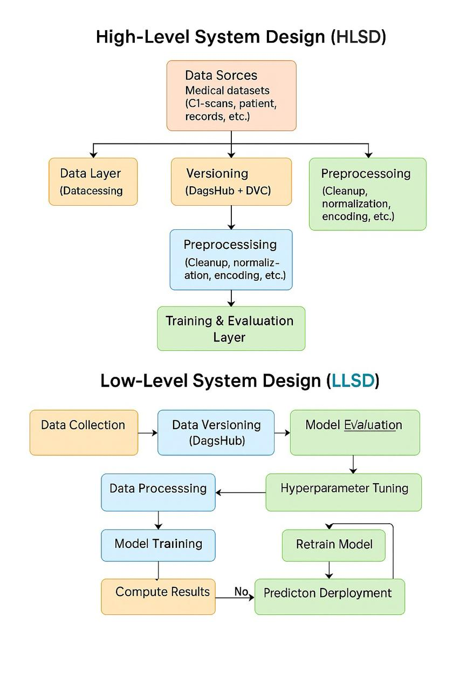
System Design

Slide 20
Datasets
For the lung cancer detection project, we utilized a combination of high-quality medical images sourced from Roboflow and Kaggle. These datasets provide a diverse set of labeled images, which are essential for training deep learning models to accurately identify lung cancer. The images from Roboflow are specifically curated for medical applications, offering a well-annotated and structured dataset. Meanwhile, the Kaggle dataset contributes additional variety and complexity, enhancing the robustness and generalization of our models. By leveraging these resources, we aim to improve the accuracy and efficiency of lung cancer detection using deep learning techniques.

Slide 21
Requirements Gathering
Dataset : https://universe.roboflow.com/lung-cancer-3gsnq/lung-cancer-dataset
Orchestration Tools (Software): MLFlow - https://mlflow.org/
DVC - https://dvc.org/
Hardware - Intel i7 Processor, NVIDIA GPU (GeForce RTX 3050), 16 GB RAM, 512 SSD

Slide 22
Implementation of Project
Algorithms, Techniques & Technologies Used:
1. Algorithms & Deep Learning Models
ResNet, InceptionV3, and NASNetMobile (used with transfer learning)
These CNN architectures are fine-tuned for classifying CT scan images into normal or adenocarcinoma cases.
ResNet: High accuracy and deep feature extraction
InceptionV3: Efficient multi-scale feature recognition
NASNetMobile: Lightweight model for mobile/edge deployments

Slide 23
Implementation of Project
2. Data Handling & Preprocessing
Image Normalization & Resizing
DVC (Data Version Control): Ensures dataset versioning and reproducibility

Slide 24
Implementation of Project
3. Training & Evaluation Techniques
Optimizers: Adam, SGD
Evaluation Metrics: Accuracy, Precision, Recall, F1-score, Specificity
MLflow: Tracks training runs, model performance, and hyperparameters

Slide 25
Implementation of Project
4. Deployment Technologies
Flask: For creating a web-based REST API for model inference
Docker: Containerization for portable and consistent deployment
Real-time & Batch Inference support

Slide 26
Implementation of Project
5. Project Management & Collaboration
DagsHub: Unified platform for managing code, datasets, and models
Version-controlled pipelines for scalable and collaborative ML development

Slide 27
Team Member-1: Jay Mehta
Module 1: Model Architecture and Design – DeepTumorNet Aim: To accurately classify CT scans into tumor and non-tumor categories using a hybrid deep learning model, enabling effective medical image analysis and early tumor detection.
Objective: To implement a robust CNN-based architecture using pretrained models, optimize its structural components, and evaluate its classification performance using comprehensive metrics, establishing a strong baseline for comparison with other diagnostic techniques.

Slide 28
Contribution with Module Design
Module: Model Architecture and Design
Contribution to Module:
Selected suitable CNN models: ResNet50, InceptionV3, NASNetMobile
Modified classification layers using Keras Functional API
Implemented transfer learning and fine-tuned weights
Defined model input/output structure and ensured compatibility with medical image data
Integrated regularization (dropout) and activation functions
Contribution to Overall Project:
Ensured base model reliability and performance
Collaborated with evaluation and deployment teams for smooth integration
Supported debugging during deployment and testing phases

Slide 29
Team Member-2: Tejas Redkar
Module 2: Model Optimization and Training Strategy
Aim: To refine and enhance the performance of deep learning models through targeted optimization techniques and architectural adjustments.
Objective: To apply systematic hyperparameter tuning, activation function selection, dropout regularization, and learning rate scheduling to improve the stability, convergence, and generalization capability of the CNN models used in DeepTumorNet.

Slide 30
Contribution with Module Design
Module: Model Optimization and Training Strategy
Contribution to Module:
Tuned hyperparameters: learning rate, batch size, epochs
Improved model convergence and generalization through structured training logic
Designed training loops to accommodate dynamic dataset sizes
Contributed insights for structural design enhancements
Contribution to Overall Project:
Validated trained models for performance stability
Assisted in finalizing the best model for deployment
Maintained training logs and helped with MLflow experiment tracking

Slide 31
Team Member-3: Dharmika Tank
Module 3: Evaluation and Visualization
Aim: To validate the accuracy and reliability of the DeepTumorNet model through detailed evaluation metrics and intuitive visual representations.
Objective: To use statistical metrics and confusion matrix analysis to measure model performance, detect false positives/negatives, and generate interpretable graphs and visuals that support transparent model assessment for clinical adoption.

Slide 32
Contribution with Module Design
Module: Evaluation and Visualization
Contribution to Module:
Computed metrics: Accuracy, Precision, Recall, F1-score, Specificity
Designed and interpreted confusion matrices
Created visual reports using Matplotlib and Seaborn
Documented evaluation results in technical format for paper and report
Detected and analyzed model misclassifications for further tuning
Contribution to Overall Project:
Ensured model reliability through metric-based validation
Collaborated with training and deployment modules to ensure consistent performance
Contributed visuals for the research paper and PPT

Slide 33
Team Member-4: Devanshu Surana
Module 4: System Integration and Deployment
Aim: To create a scalable, reproducible, and accessible deployment pipeline for DeepTumorNet using modern ML Ops tools and backend infrastructure.
Objective: To orchestrate the entire ML workflow using DVC and MLflow, develop a secure Flask API for real-time predictions, and containerize the system using Docker to ensure seamless deployment in clinical and edge environments.

Slide 34
Contribution with Module Design
Module: System Integration and Deployment
Contribution to Module:
Set up DVC for dataset versioning
Integrated MLflow for experiment tracking and model registry
Developed Flask API for real-time inference
Containerized the system using Docker for reproducible deployment
Ensured API security and performance (input validation, response handling)
Contribution to Overall Project:
Enabled smooth end-to-end execution of the ML pipeline
Led deployment testing and debugging
Maintained overall project folder structure, code modularity, and documentation flow

Slide 35
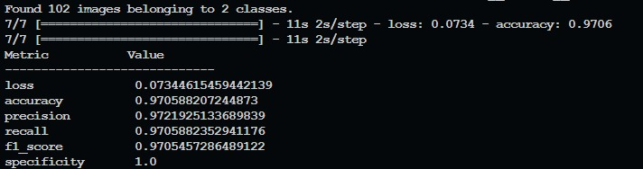
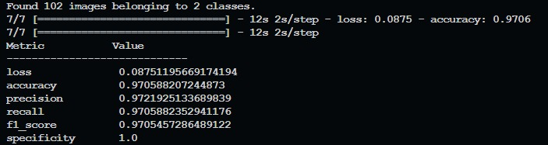
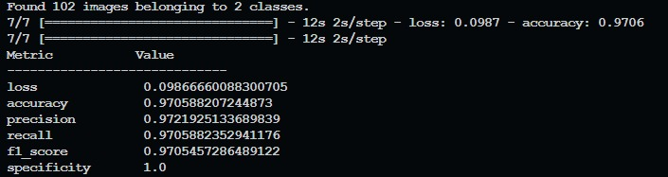
Screenshots of Implementation
ResNet Performance Parameters
InceptionV3 Performance Parameters
NASNetMobile Performance Parameters

Slide 36
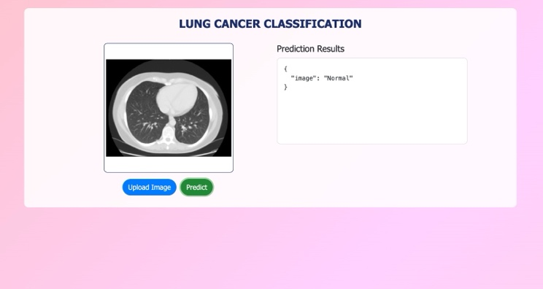
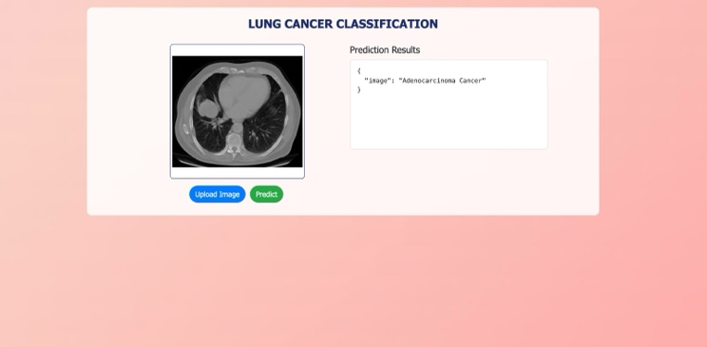
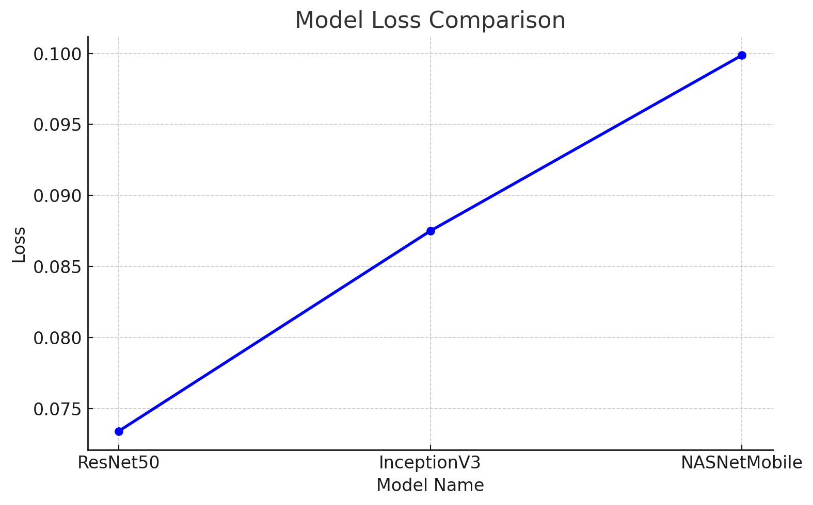
Screenshots of Implementation
Prediction of Normal CT-Scan
Prediction of Cancerous CT-Scan
Comparative Analysis of Deep Learning Models
for Lung Cancer Classification

Slide 37
Conclusion
The DeepTumorNet project successfully delivers an end-to-end lung cancer classification system
using deep learning techniques. By leveraging Convolutional Neural Networks (CNNs) and transfer
learning, the project achieved high accuracy (97.06%) and demonstrated strong reliability across
multiple models.
Key accomplishments include:
• Development of a reproducible and scalable AI pipeline
• Evaluation of three CNN architectures (ResNet, InceptionV3, NASNetMobile)
• Integration of MLflow, DVC, and Flask for deployment, tracking, and versioning
• Real-time prediction through a REST API
• Consistent performance across precision, recall, F1-score, and specificity
The project not only meets its technical objectives but also provides a practical and deployable
solution to support early-stage lung cancer detection. With further tuning and clinical validation,
DeepTumorNet has the potential to become an integral part of AI-powered medical diagnostics in the
near future.

Slide 38
Publication Details
Paper titled “DeepTumorNet: End-to-End Lung Cancer
Classification Using Deep Learning” submitted at International Journal of Electrical and Computer Engineering Systems

Slide 39
References
P. Keerthi, S. S. S. Y., and I. S., "Lung cancer classification using deep neural networks," 2025 AI-Driven Smart Healthcare for Society 5.0, Kolkata, India, 2025, pp. 1–6, doi: 10.1109/IEEECONF64992.2025.10963162.
N. S. Jozi and G. A. Al-Suhail, "Lung cancer detection in radiological imaging using deep learning: A review," 2024 5th International Conference on Communications, Information, Electronic and Energy Systems (CIEES), Veliko Tarnovo, Bulgaria, 2024, pp. 1–8, doi: 10.1109/CIEES62939.2024.10811230.
S. Marappan, S. Roy, B. Ankayarkanni, S. Revathy, and P. Asha, "Enhancing predictive accuracy in lung disease diagnosis through hybrid ResNet and transfer learning models," 2024 International Conference on Advances in Modern Age Technologies for Health and Engineering Science (AMATHE), Shivamogga, India, 2024, pp. 1–7, doi: 10.1109/AMATHE61652.2024.10582190.
O. Khouadja and M. S. Naceur, "Lung cancer detection with machine learning and deep learning: A narrative review," 2023 IEEE International Conference on Advanced Systems and Emergent Technologies (IC_ASET), Hammamet, Tunisia, 2023, pp. 1–8, doi: 10.1109/IC_ASET58101.2023.10150913.
I. V. and D. Menaka, "Real-time detection of lung cancer using CNN," 2023 2nd International Conference on Vision Towards Emerging Trends in Communication and Networking Technologies (ViTECoN), Vellore, India, 2023, pp. 1–6, doi: 10.1109/ViTECoN58111.2023.10157316.
B. Sumithra, G. Vallathan, M. Raman Kumar, and K. Govindharaju, "Deep learning for accurate chest disease classification: A CNN-based approach for lung cancer subtypes and normal cells," 2023 International Conference on System, Computation, Automation and Networking (ICSCAN), Puducherry, India, 2023, pp. 1–7, doi: 10.1109/ICSCAN58655.2023.10394855.

Slide 40
References
M. Mamun, A. Farjana, M. Al Mamun, and M. S. Ahammed, "Lung cancer prediction model using ensemble learning techniques and a systematic review analysis," 2022 IEEE World AI IoT Congress (AIIoT), Seattle, WA, USA, 2022, pp. 187–193, doi: 10.1109/AIIoT54504.2022.9817326.
N. Nawreen, U. Hany, and T. Islam, "Lung cancer detection and classification using CT scan image processing," 2021 International Conference on Automation, Control and Mechatronics for Industry 4.0 (ACMI), Rajshahi, Bangladesh, 2021, pp. 1–6, doi: 10.1109/ACMI53878.2021.9528297.
A. Rehman, M. Kashif, I. Abunadi, and N. Ayesha, "Lung cancer detection and classification from chest CT scans using machine learning techniques," 2021 1st International Conference on Artificial Intelligence and Data Analytics (CAIDA), Riyadh, Saudi Arabia, 2021, pp. 101–104, doi: 10.1109/CAIDA51941.2021.9425269.
R. D. Karthikeyan, R. G., V. V., G. B. C., and K. M., "A review of lung cancer detection using image processing," 2021 Smart Technologies, Communication and Robotics (STCR), Sathyamangalam, India, 2021, pp. 1–4, doi: 10.1109/STCR51658.2021.9588835.
A. Yadav and R. Badre, "Lung carcinoma detection techniques: A survey," 2020 12th International Conference on Computational Intelligence and Communication Networks (CICN), Bhimtal, India, 2020

Slide 41
Thank You

Slide 42
Any questions?

