Slide 1
Transactions Management & Concurrency Control
Transaction Concept
Transaction State
Implementation of Atomicity and Durability
Concurrent Executions
Serializability
Recoverability

Slide 2
Transaction Concept
A transaction is a unit of program execution that accesses and possibly updates various data items.
A transaction must see a consistent database.
During transaction execution the database may be inconsistent.
When the transaction is committed, the database must be consistent.
Two main issues to deal with:
  Failures of various kinds, such as hardware failures and system crashes
  Concurrent execution of multiple transactions

Slide 3
ACID Properties
To preserve integrity of data, the database system must ensure:
Atomicity. Either all operations of the transaction are properly reflected in the database or none are.
Consistency. Execution of a transaction in isolation preserves the consistency of the database.
Isolation. Although multiple transactions may execute concurrently, each transaction must be unaware of other concurrently executing transactions. Intermediate transaction results must be hidden from other concurrently executed transactions.
  That is, for every pair of transactions T_{i} and T_{j}, it appears to T_{i} that either T_{j}, finished execution before T_{i} started, or T_{j} started execution after T_{i} finished.
Durability. After a transaction completes successfully, the changes it has made to the database persist, even if there are system failures.

Slide 4
Example of Fund Transfer
Transaction to transfer $50 from account A to account B:
  1. read(A)
  2. A := A – 50
  3. write(A)
  4. read(B)
  5. B := B + 50
  6. write(B)
Consistency requirement – the sum of A and B is unchanged by the execution of the transaction.
Atomicity requirement — if the transaction fails after step 3 and before step 6, the system should ensure that its updates are not reflected in the database, else an inconsistency will result.

Slide 5
Example of Fund Transfer (Cont.)
Durability requirement — once the user has been notified that the transaction has completed (i.e., the transfer of the $50 has taken place), the updates to the database by the transaction must persist despite failures.
Isolation requirement — if between steps 3 and 6, another transaction is allowed to access the partially updated database, it will see an inconsistent database
(the sum A + B will be less than it should be).
Can be ensured trivially by running transactions serially, that is one after the other. However, executing multiple transactions concurrently has significant benefits, as we will see.

Slide 6
Transaction State
Active, the initial state; the transaction stays in this state while it is executing
Partially committed, after the final statement has been executed.
Failed, after the discovery that normal execution can no longer proceed.
Aborted, after the transaction has been rolled back and the database restored to its state prior to the start of the transaction. Two options after it has been aborted:
  restart the transaction – only if no internal logical error
  kill the transaction
Committed, after successful completion.

Slide 7

Transaction State (Cont.)

Slide 8
Implementation of Atomicity and Durability
The recovery-management component of a database system implements the support for atomicity and durability.
The shadow-database scheme:
  assume that only one transaction is active at a time.
  a pointer called db_pointer always points to the current consistent copy of the database.
  all updates are made on a shadow copy of the database, and db_pointer is made to point to the updated shadow copy only after the transaction reaches partial commit and all updated pages have been flushed to disk.
  in case transaction fails, old consistent copy pointed to by db_pointer can be used, and the shadow copy can be deleted.

Slide 9
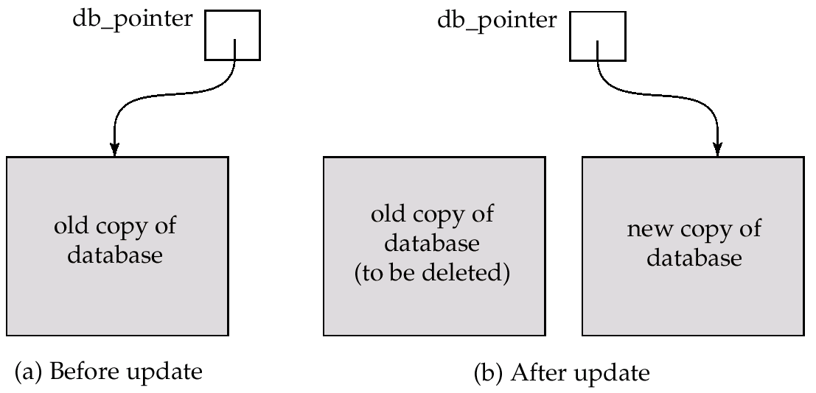
Implementation of Atomicity and Durability (Cont.)
The shadow-database scheme:
Assumes disks to not fail
Useful for text editors, but extremely inefficient for large databases: executing a single transaction requires copying the entire database. Will see better schemes in Chapter 17.

Slide 10
Concurrent Executions
Multiple transactions are allowed to run concurrently in the system. Advantages are:
  increased processor and disk utilization, leading to better transaction throughput: one transaction can be using the CPU while another is reading from or writing to the disk
  reduced average response time for transactions: short transactions need not wait behind long ones.
Concurrency control schemes – mechanisms to achieve isolation, i.e., to control the interaction among the concurrent transactions in order to prevent them from destroying the consistency of the database
  Will study in Chapter 14, after studying notion of correctness of concurrent executions.

Slide 11
Schedules
Schedules – sequences that indicate the chronological order in which instructions of concurrent transactions are executed
  a schedule for a set of transactions must consist of all instructions of those transactions
  must preserve the order in which the instructions appear in each individual transaction.

Slide 12

Example Schedules
Let T₁ transfer $50 from A to B, and T₂ transfer 10% of the balance from A to B. The following is a serial schedule (Schedule 1 in the text), in which T₁ is followed by T₂.

Slide 13

Example Schedule (Cont.)
Let T₁ and T₂ be the transactions defined previously. The following schedule (Schedule 3 in the text) is not a serial schedule, but it is equivalent to Schedule 1.
In both Schedule 1 and 3, the sum A + B is preserved.

Slide 14

Example Schedules (Cont.)
The following concurrent schedule (Schedule 4 in the text) does not preserve the value of the the sum A + B.

Slide 15
Serializability
Basic Assumption – Each transaction preserves database consistency.
Thus serial execution of a set of transactions preserves database consistency.
A (possibly concurrent) schedule is serializable if it is equivalent to a serial schedule. Different forms of schedule equivalence give rise to the notions of:
  1. conflict serializability
  2. view serializability
We ignore operations other than read and write instructions, and we assume that transactions may perform arbitrary computations on data in local buffers in between reads and writes. Our simplified schedules consist of only read and write instructions.

Slide 16
Conflict Serializability
Instructions l_{i} and l_{j} of transactions T_{i} and T_{j} respectively, conflict if and only if there exists some item Q accessed by both l_{i} and l_{j}, and at least one of these instructions wrote Q.
1. l_{i} = read(Q), l_{j} = read(Q). l_{i} and l_{j} don’t conflict.
2. l_{i} = read(Q), l_{j} = write(Q). They conflict.
3. l_{i} = write(Q), l_{j} = read(Q). They conflict
4. l_{i} = write(Q), l_{j} = write(Q). They conflict
Intuitively, a conflict between l_{i} and l_{j} forces a (logical) temporal order between them. If l_{i} and l_{j} are consecutive in a schedule and they do not conflict, their results would remain the same even if they had been interchanged in the schedule.

Slide 17
Conflict Serializability (Cont.)
If a schedule S can be transformed into a schedule S´ by a series of swaps of non-conflicting instructions, we say that S and S´ are conflict equivalent.
We say that a schedule S is conflict serializable if it is conflict equivalent to a serial schedule
Example of a schedule that is not conflict serializable:
T₃ T₄
read(Q)
write(Q)
write(Q)
We are unable to swap instructions in the above schedule to obtain either the serial schedule < T₃, T₄ >, or the serial schedule < T₄, T₃ >.

Slide 18

Conflict Serializability (Cont.)
Schedule 3 below can be transformed into Schedule 1, a serial schedule where T₂ follows T₁, by series of swaps of non-conflicting instructions. Therefore Schedule 3 is conflict serializable.

Slide 19
View Serializability
Let S and S´ be two schedules with the same set of transactions. S and S´ are view equivalent if the following three conditions are met:
  1. For each data item Q, if transaction T_{i} reads the initial value of Q in schedule S, then transaction T_{i} must, in schedule S´, also read the initial value of Q.
  2. For each data item Q if transaction T_{i} executes read(Q) in schedule S, and that value was produced by transaction T_{j} (if any), then transaction T_{i} must in schedule S´ also read the value of Q that was produced by transaction T_{j} .
  3. For each data item Q, the transaction (if any) that performs the final write(Q) operation in schedule S must perform the final write(Q) operation in schedule S´.
As can be seen, view equivalence is also based purely on reads
and writes alone.

Slide 20
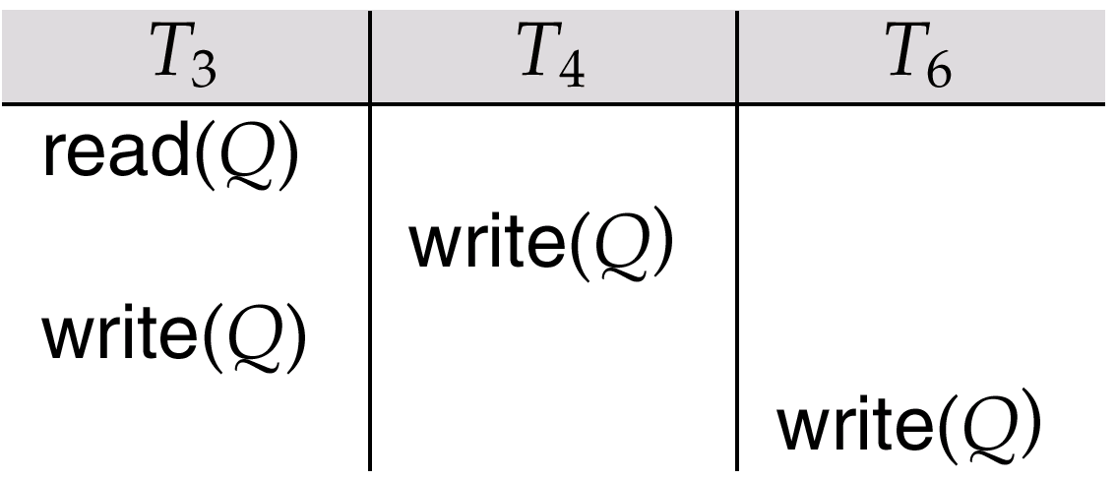
View Serializability (Cont.)
A schedule S is view serializable it is view equivalent to a serial schedule.
Every conflict serializable schedule is also view serializable.
Schedule 9 (from text) — a schedule which is view-serializable but not conflict serializable.
Every view serializable schedule that is not conflict
serializable has blind writes.

Slide 21
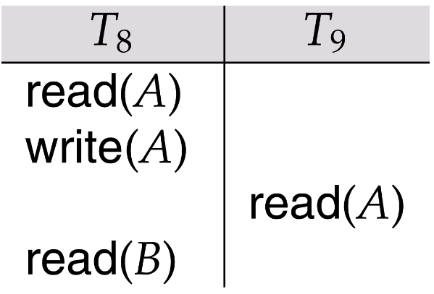
Recoverability
Need to address the effect of transaction failures on concurrently
running transactions.
Recoverable schedule — if a transaction T_{j} reads a data items previously written by a transaction T_{i} , the commit operation of T_{i} appears before the commit operation of T_{j}.
The following schedule (Schedule 11) is not recoverable if T₉ commits immediately after the read
If T₈ should abort, T₉ would have read (and possibly shown to the user) an inconsistent database state. Hence database must ensure that schedules are recoverable.

Slide 22
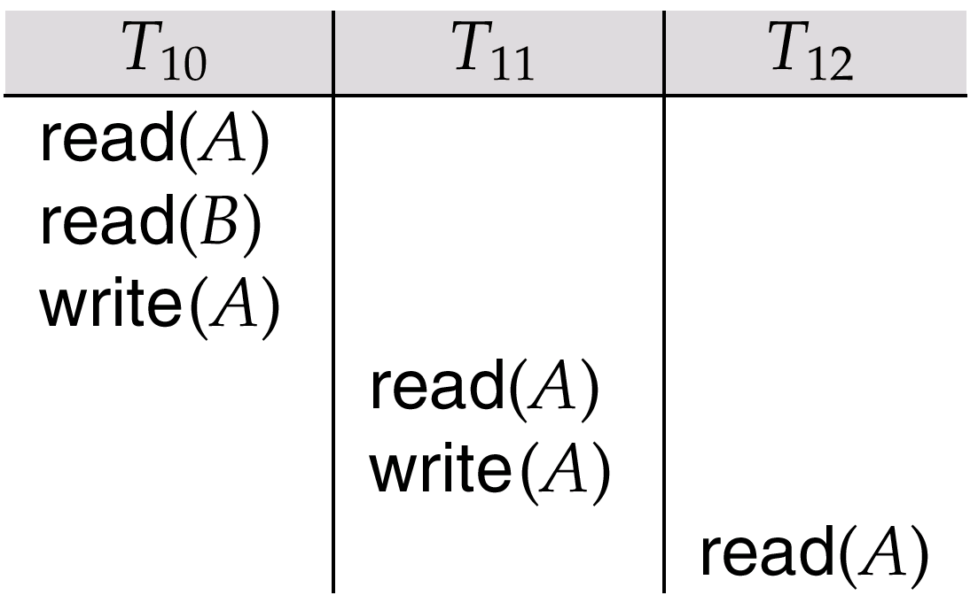
Recoverability (Cont.)
Cascading rollback – a single transaction failure leads to a series of transaction rollbacks. Consider the following schedule where none of the transactions has yet committed (so the schedule is recoverable)
If T₁₀ fails, T₁₁ and T₁₂ must also be rolled back.
Can lead to the undoing of a significant amount of work

Slide 23
Recoverability (Cont.)
Cascadeless schedules — cascading rollbacks cannot occur; for each pair of transactions T_{i} and T_{j} such that T_{j} reads a data item previously written by T_{i}, the commit operation of T_{i} appears before the read operation of T_{j}.
Every cascadeless schedule is also recoverable
It is desirable to restrict the schedules to those that are cascadeless

Slide 24
Concurrency Control
Lock-Based Protocols
Deadlock Handling

Slide 25
Lock-Based Protocols
A lock is a mechanism to control concurrent access to a data item
Data items can be locked in two modes :
1. exclusive (X) mode. Data item can be both read as well as
written. X-lock is requested using lock-X instruction.
2. shared (S) mode. Data item can only be read. S-lock is
requested using lock-S instruction.
Lock requests are made to concurrency-control manager. Transaction can proceed only after request is granted.

Slide 26

Lock-Based Protocols (Cont.)
Lock-compatibility matrix
A transaction may be granted a lock on an item if the requested lock is compatible with locks already held on the item by other transactions
Any number of transactions can hold shared locks on an item, but if any transaction holds an exclusive on the item no other transaction may hold any lock on the item.
If a lock cannot be granted, the requesting transaction is made to wait till all incompatible locks held by other transactions have been released. The lock is then granted.

Slide 27
Lock-Based Protocols (Cont.)
Example of a transaction performing locking:
T₂: lock-S(A);
read (A);
unlock(A);
lock-S(B);
read (B);
unlock(B);
display(A+B)
Locking as above is not sufficient to guarantee serializability — if A and B get updated in-between the read of A and B, the displayed sum would be wrong.
A locking protocol is a set of rules followed by all transactions while requesting and releasing locks. Locking protocols restrict the set of possible schedules.

Slide 28

Pitfalls of Lock-Based Protocols
Consider the partial schedule
Neither T₃ nor T₄ can make progress — executing lock-S(B) causes T₄ to wait for T₃ to release its lock on B, while executing lock-X(A) causes T₃ to wait for T₄ to release its lock on A.
Such a situation is called a deadlock.
  To handle a deadlock one of T₃ or T₄ must be rolled back
  and its locks released.

Slide 29
Pitfalls of Lock-Based Protocols (Cont.)
The potential for deadlock exists in most locking protocols. Deadlocks are a necessary evil.
Starvation is also possible if concurrency control manager is badly designed. For example:
  A transaction may be waiting for an X-lock on an item, while a sequence of other transactions request and are granted an S-lock on the same item.
  The same transaction is repeatedly rolled back due to deadlocks.
Concurrency control manager can be designed to prevent starvation.

Slide 30
The Two-Phase Locking Protocol
This is a protocol which ensures conflict-serializable schedules.
Phase 1: Growing Phase
  transaction may obtain locks
  transaction may not release locks
Phase 2: Shrinking Phase
  transaction may release locks
  transaction may not obtain locks
The protocol assures serializability. It can be proved that the transactions can be serialized in the order of their lock points (i.e. the point where a transaction acquired its final lock).

Slide 31
The Two-Phase Locking Protocol (Cont.)
Two-phase locking does not ensure freedom from deadlocks
Cascading roll-back is possible under two-phase locking. To avoid this, follow a modified protocol called strict two-phase locking. Here a transaction must hold all its exclusive locks till it commits/aborts.
Rigorous two-phase locking is even stricter: here all locks are held till commit/abort. In this protocol transactions can be serialized in the order in which they commit.

Slide 32
The Two-Phase Locking Protocol (Cont.)
There can be conflict serializable schedules that cannot be obtained if two-phase locking is used.
However, in the absence of extra information (e.g., ordering of access to data), two-phase locking is needed for conflict serializability in the following sense:
Given a transaction T_{i} that does not follow two-phase locking, we can find a transaction T_{j} that uses two-phase locking, and a schedule for T_{i} and T_{j} that is not conflict serializable.

Slide 33
Deadlock Handling
Consider the following two transactions:
T₁: write (X) T₂: write(Y)
write(Y) write(X)
Schedule with deadlock
T₁
T₂
lock-X on X
write (X)
lock-X on Y
write (X)
wait for lock-X on X
wait for lock-X on Y

Slide 34
Deadlock Handling
System is deadlocked if there is a set of transactions such that every transaction in the set is waiting for another transaction in the set.
Deadlock prevention protocols ensure that the system will never enter into a deadlock state. Some prevention strategies :
  Require that each transaction locks all its data items before it begins execution (predeclaration).
  Impose partial ordering of all data items and require that a transaction can lock data items only in the order specified by the partial order (graph-based protocol).

Slide 35
More Deadlock Prevention Strategies
Following schemes use transaction timestamps for the sake of deadlock prevention alone.
wait-die scheme — non-preemptive
  older transaction may wait for younger one to release data item. Younger transactions never wait for older ones; they are rolled back instead.
  a transaction may die several times before acquiring needed data item
wound-wait scheme — preemptive
  older transaction wounds (forces rollback) of younger transaction instead of waiting for it. Younger transactions may wait for older ones.
  may be fewer rollbacks than wait-die scheme.

Slide 36
Deadlock prevention (Cont.)
Both in wait-die and in wound-wait schemes, a rolled back transactions is restarted with its original timestamp. Older transactions thus have precedence over newer ones, and starvation is hence avoided.
Timeout-Based Schemes :
  a transaction waits for a lock only for a specified amount of time. After that, the wait times out and the transaction is rolled back.
  thus deadlocks are not possible
  simple to implement; but starvation is possible. Also difficult to determine good value of the timeout interval.

Slide 37
Deadlock Detection
Deadlocks can be described as a wait-for graph, which consists of a pair G = (V,E),
  V is a set of vertices (all the transactions in the system)
  E is a set of edges; each element is an ordered pair T_{i} →T_{j}.
If T_{i} → T_{j} is in E, then there is a directed edge from T_{i} to T_{j}, implying that T_{i} is waiting for T_{j} to release a data item.
When T_{i} requests a data item currently being held by T_{j}, then the edge T_{i} T_{j} is inserted in the wait-for graph. This edge is removed only when T_{j} is no longer holding a data item needed by T_{i}.
The system is in a deadlock state if and only if the wait-for graph has a cycle. Must invoke a deadlock-detection algorithm periodically to look for cycles.

Slide 38


Deadlock Detection (Cont.)
Wait-for graph without a cycle
Wait-for graph with a cycle

Slide 39
Deadlock Recovery
When deadlock is detected :
  Some transaction will have to rolled back (made a victim) to break deadlock. Select that transaction as victim that will incur minimum cost.
  Rollback -- determine how far to roll back transaction
    Total rollback: Abort the transaction and then restart it.
    More effective to roll back transaction only as far as necessary to break deadlock.
  Starvation happens if same transaction is always chosen as victim. Include the number of rollbacks in the cost factor to avoid starvation

Slide 40
Recovery System
Failure Classification
Storage Structure
Recovery and Atomicity
Log-Based Recovery
Shadow Paging

Slide 41
Failure Classification
Transaction failure :
  Logical errors: transaction cannot complete due to some internal error condition
  System errors: the database system must terminate an active transaction due to an error condition (e.g., deadlock)
System crash: a power failure or other hardware or software failure causes the system to crash.
  Fail-stop assumption: non-volatile storage contents are assumed to not be corrupted by system crash
    Database systems have numerous integrity checks to prevent corruption of disk data
Disk failure: a head crash or similar disk failure destroys all or part of disk storage
  Destruction is assumed to be detectable: disk drives use checksums to detect failures

Slide 42
Recovery Algorithms
Recovery algorithms are techniques to ensure database consistency and transaction atomicity and durability despite failures
  Focus of this chapter
Recovery algorithms have two parts
  Actions taken during normal transaction processing to ensure enough information exists to recover from failures
  Actions taken after a failure to recover the database contents to a state that ensures atomicity, consistency and durability

Slide 43
Recovery and Atomicity
Modifying the database without ensuring that the transaction will commit may leave the database in an inconsistent state.
Consider transaction T_{i} that transfers $50 from account A to account B; goal is either to perform all database modifications made by T_{i} or none at all.
Several output operations may be required for T_{i} (to output A and B). A failure may occur after one of these modifications have been made but before all of them are made.

Slide 44
Recovery and Atomicity (Cont.)
To ensure atomicity despite failures, we first output information describing the modifications to stable storage without modifying the database itself.
We study two approaches:
  log-based recovery, and
  shadow-paging
We assume (initially) that transactions run serially, that is, one after the other.

Slide 45
Log-Based Recovery
A log is kept on stable storage.
  The log is a sequence of log records, and maintains a record of update activities on the database.
When transaction T_{i} starts, it registers itself by writing a
<T_{i} start>log record
Before T_{i} executes write(X), a log record <T_{i}, X, V₁, V₂> is written, where V₁ is the value of X before the write, and V₂ is the value to be written to X.
  Log record notes that T_{i} has performed a write on data item X_{j} X_{j} had value V₁ before the write, and will have value V₂ after the write.
When T_{i} finishes it last statement, the log record <T_{i} commit> is written.
We assume for now that log records are written directly to stable storage (that is, they are not buffered)
Two approaches using logs
  Deferred database modification
  Immediate database modification

Slide 46
Deferred Database Modification
The deferred database modification scheme records all modifications to the log, but defers all the writes to after partial commit.
Assume that transactions execute serially
Transaction starts by writing <T_{i} start> record to log.
A write(X) operation results in a log record <T_{i}, X, V> being written, where V is the new value for X
  Note: old value is not needed for this scheme
The write is not performed on X at this time, but is deferred.
When T_{i} partially commits, <T_{i} commit> is written to the log
Finally, the log records are read and used to actually execute the previously deferred writes.

Slide 47
Deferred Database Modification (Cont.)
During recovery after a crash, a transaction needs to be redone if and only if both <T_{i} start> and<T_{i} commit> are there in the log.
Redoing a transaction T_{i} ( redoT_{i}) sets the value of all data items updated by the transaction to the new values.
Crashes can occur while
  the transaction is executing the original updates, or
  while recovery action is being taken
example transactions T₀ and T₁ (T₀ executes before T₁):
T₀: read (A) T₁ : read (C)
A: - A - 50 C:- C- 100
Write (A) write (C)
read (B)
B:- B + 50
write (B)

Slide 48

Deferred Database Modification (Cont.)
Below we show the log as it appears at three instances of time.
If log on stable storage at time of crash is as in case:
(a) No redo actions need to be taken
(b) redo(T₀) must be performed since <T₀ commit> is present
(c) redo(T₀) must be performed followed by redo(T₁) since
<T₀ commit> and <T_{i} commit> are present

Slide 49
Immediate Database Modification
The immediate database modification scheme allows database updates of an uncommitted transaction to be made as the writes are issued
  since undoing may be needed, update logs must have both old value and new value
Update log record must be written before database item is written
  We assume that the log record is output directly to stable storage
  Can be extended to postpone log record output, so long as prior to execution of an output(B) operation for a data block B, all log records corresponding to items B must be flushed to stable storage
Output of updated blocks can take place at any time before or after transaction commit
Order in which blocks are output can be different from the order in which they are written.

Slide 50
Immediate Database Modification Example
Log Write Output
<T₀ start>
<T₀, A, 1000, 950>
T_{o}, B, 2000, 2050
A = 950
B = 2050
<T₀ commit>
<T₁ start>
<T₁, C, 700, 600>
C = 600
B_{B}, B_{C}
<T₁ commit>
B_{A}
Note: B_{X} denotes block containing X.
x₁

Slide 51
Immediate Database Modification (Cont.)
Recovery procedure has two operations instead of one:
  undo(T_{i}) restores the value of all data items updated by T_{i} to their old values, going backwards from the last log record for T_{i}
  redo(T_{i}) sets the value of all data items updated by T_{i} to the new values, going forward from the first log record for T_{i}
Both operations must be idempotent
  That is, even if the operation is executed multiple times the effect is the same as if it is executed once
    Needed since operations may get re-executed during recovery
When recovering after failure:
  Transaction T_{i} needs to be undone if the log contains the record
  <T_{i} start>, but does not contain the record <T_{i} commit>.
  Transaction T_{i} needs to be redone if the log contains both the record <T_{i} start> and the record <T_{i} commit>.
Undo operations are performed first, then redo operations.

Slide 52

Immediate DB Modification Recovery Example
Below we show the log as it appears at three instances of time.
Recovery actions in each case above are:
(a) undo (T₀): B is restored to 2000 and A to 1000.
(b) undo (T₁) and redo (T₀): C is restored to 700, and then A and B are
set to 950 and 2050 respectively.
(c) redo (T₀) and redo (T₁): A and B are set to 950 and 2050
respectively. Then C is set to 600

Slide 53
Checkpoints
Problems in recovery procedure as discussed earlier :
  searching the entire log is time-consuming
  we might unnecessarily redo transactions which have already
  output their updates to the database.
Streamline recovery procedure by periodically performing checkpointing
  Output all log records currently residing in main memory onto stable storage.
  Output all modified buffer blocks to the disk.
  Write a log record < checkpoint> onto stable storage.

Slide 54
Checkpoints (Cont.)
During recovery we need to consider only the most recent transaction T_{i} that started before the checkpoint, and transactions that started after T_{i}.
  Scan backwards from end of log to find the most recent <checkpoint> record
  Continue scanning backwards till a record <T_{i} start> is found.
  Need only consider the part of log following above start record. Earlier part of log can be ignored during recovery, and can be erased whenever desired.
  For all transactions (starting from T_{i} or later) with no <T_{i} commit>, execute undo(T_{i}). (Done only in case of immediate modification.)
  Scanning forward in the log, for all transactions starting from T_{i} or later with a <T_{i} commit>, execute redo(T_{i}).

Slide 55
Example of Checkpoints
T_{c}
T_{f}
T₁ can be ignored (updates already output to disk due to checkpoint)
T₂ and T₃ redone.
T₄ undone
T₁
T₂
T₃
T₄
checkpoint
system failure

Slide 56
Shadow Paging
Shadow paging is an alternative to log-based recovery; this scheme is useful if transactions execute serially
Idea: maintain two page tables during the lifetime of a transaction –the current page table, and the shadow page table
Store the shadow page table in nonvolatile storage, such that state of the database prior to transaction execution may be recovered.
  Shadow page table is never modified during execution
To start with, both the page tables are identical. Only current page table is used for data item accesses during execution of the transaction.
Whenever any page is about to be written for the first time
  A copy of this page is made onto an unused page.
  The current page table is then made to point to the copy
  The update is performed on the copy

Slide 57

Sample Page Table

Slide 58

Example of Shadow Paging
Shadow and current page tables after write to page 4

Slide 59
Shadow Paging (Cont.)
To commit a transaction :
1. Flush all modified pages in main memory to disk
2. Output current page table to disk
3. Make the current page table the new shadow page table, as follows:
  keep a pointer to the shadow page table at a fixed (known) location on disk.
  to make the current page table the new shadow page table, simply update the pointer to point to current page table on disk
Once pointer to shadow page table has been written, transaction is committed.
No recovery is needed after a crash — new transactions can start right away, using the shadow page table.
Pages not pointed to from current/shadow page table should be freed (garbage collected).

Slide 60
Show Paging (Cont.)
Advantages of shadow-paging over log-based schemes
  no overhead of writing log records
  recovery is trivial
Disadvantages :
  Copying the entire page table is very expensive
    Can be reduced by using a page table structured like a B⁺-tree
      No need to copy entire tree, only need to copy paths in the tree that lead to updated leaf nodes
  Commit overhead is high even with above extension
    Need to flush every updated page, and page table
  Data gets fragmented (related pages get separated on disk)
  After every transaction completion, the database pages containing old versions of modified data need to be garbage collected
  Hard to extend algorithm to allow transactions to run concurrently
    Easier to extend log based schemes

