Slide 1
AI
WasteWise
A responsible-AI assistant for better decisions at the moment of disposal.
AI FOR SUSTAINABILITY VIRTUAL INTERNSHIP
In collaboration with IBM SkillsBuild and AICTE
Presented by Devarapalli Sravani · Lakireddy Bali Reddy College of Engineering
Computer Science and Engineering

Slide 2


Waste is easy to mis-sort at the moment of disposal
The decision is small. The uncertainty is real.
DESIGN QUESTION
Packaging
Food waste
How might AI identify common waste and guide correct segregation?
Plastic packaging can look recyclable—but local streams may differ.
Organic material needs a different path from dry recyclables.
Special items
SDG 12 connection · responsible consumption, production, disposal, and recycling awareness.
Batteries and e-waste need extra care and should not enter ordinary bins.

Slide 3




Accessible guidance matters wherever people throw something away
Students
Households
Office users
Campus staff and communities
Quick answers in classrooms, hostels, and campus spaces.
Simple help for everyday packaging and food waste.
Clearer choices at shared disposal points.
A common language for better waste awareness.
Why now: categories are confusing; incorrect segregation creates downstream difficulty; AI can provide decision support at the point of action.

Slide 4
A simple assistant can turn uncertainty into the next right action
01
02
Identify
Classify
Text-based waste identification
AI classification and conversational questions
03
04
Recommend
Verify
AI WasteWise identifies the likely waste category, explains the reasoning, and gives a practical disposal recommendation without pretending local rules are universal.
Disposal recommendations with confidence or uncertainty
Local-rules reminder before the final decision

Slide 5
From item description to a locally aware recommendation
The workflow keeps the model useful—and keeps the final responsibility visible.
1
2
3
User input
AI analysis
Classification
Text or image describing the item.
Identify the likely item and material.
Determine the appropriate waste category.
4
5
Knowledge and guidance
Recommendation
Retrieve relevant disposal information.
Return category, action, and reason, then prompt local verification when needed.
Example: Used plastic water bottle → Recyclable → follow local plastic or recyclable collection rules.

Slide 6
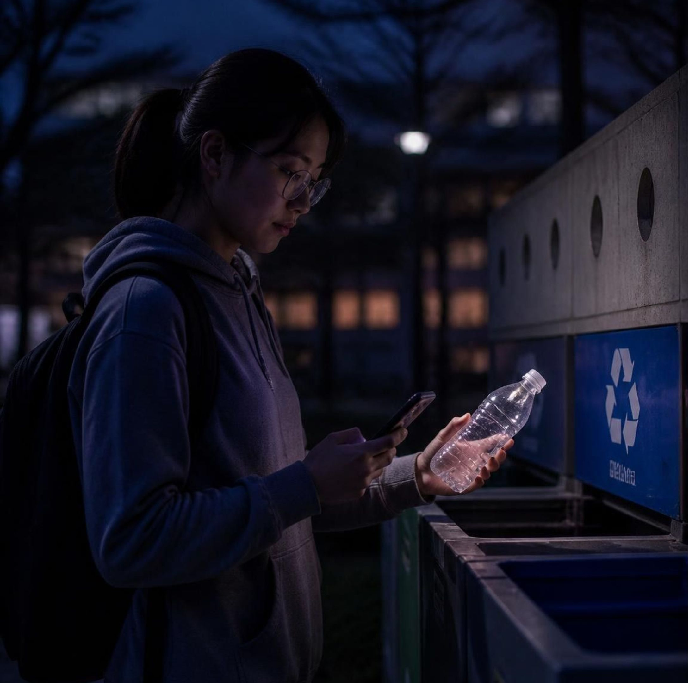
PROTOTYPE INTERACTION
The prototype answers the everyday question people actually ask
“I have an empty plastic water bottle. Where should I put it?”
Likely category: Recyclable plastic
Recommended action: Empty the bottle and use the locally designated recyclable or plastic waste stream.
Reason: It is commonly made from recyclable plastic.
Confidence: Medium
Safeguard: local waste-management rules may differ.

Slide 7
Five design moves keep the solution human-centered
The method starts with people’s confusion—not with the technology.
01
02
03
04
05
Empathize
Define
Ideate
Prototype
Test and refine
Understand where people struggle with waste segregation.
Focus on confusion at the point of disposal.
Explore chatbot, classification, image recognition, and RAG approaches.
Build the AI workflow and sample interactions.
Improve accuracy, clarity, usefulness, and responsible-AI safeguards.

Slide 8






Trust is part of the product, not a footnote
A useful recommendation must also be explainable, cautious, and accountable.
Fairness
Transparency
Ethics
Test varied descriptions and avoid biased assumptions.
Explain the reason behind a recommendation and show uncertainty.
Avoid harmful, misleading, or discriminatory guidance.
Privacy
Local variation
Human oversight
Avoid collecting personal or sensitive information.
Remind users that waste rules differ by location.
Support decisions without replacing official authorities.

Slide 9
Impact begins with better decisions, then scales through better systems
EXPECTED IMPACT
FUTURE SCOPE
Build the system around verified context.
Environmental | Improve segregation awareness, encourage responsible disposal, and support recycling practices.
Social | Make sustainability guidance easier to access for students and communities.
Resource and economic | Support more efficient downstream waste handling.
Image-based recognition, verified local-policy RAG, multilingual support, location-specific guidance, waste analytics, and campus waste-management integration.

Slide 10
AI + Sustainability
+ Responsible Design
= Positive Impact
If implemented, AI WasteWise could provide quick, understandable support at the moment people decide where an item should go.
Students + households | Easier disposal decisions.
Institutions + communities | Stronger waste-awareness programs and practices.
Environment | Support for more responsible waste management.
AI for Sustainability Virtual Internship · Devarapalli Sravani · Lakireddy Bali Reddy College of Engineering

