Slide 1
CSE523 Machine Learning
ADVISOR
Computer Science, SEAS
Prof. Mehul Raval
Heart Attack Analysis & Prediction
Name | Roll No
Devarsh Sheth | AU1940189
Shivam Thakker | AU1940193
Meet Jhaveri | AU1940284
Pranav Gandhi | AU1940313

Slide 2

INTRODUCTION
The project involved analysis of the heart disease patient dataset with proper data preprocessing.
Different models will be trained and predictions will be made with different algorithms like KNN, Logistic Regression, LDA and SVM.
5

Slide 3

Problem Statement
Predict whether a patient has risk developing coronary heart disease.
3

Slide 4
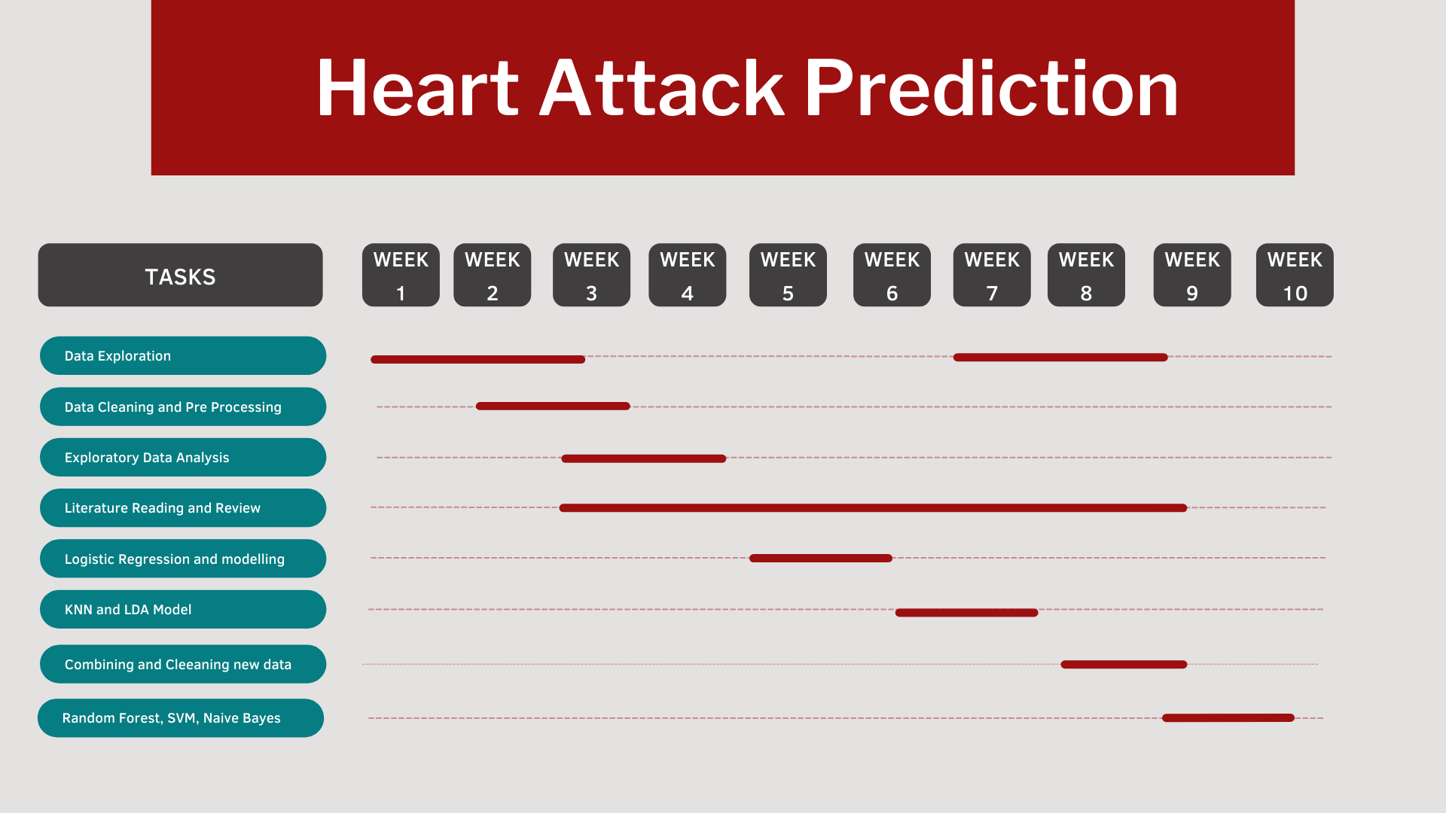

Gantt Chart

Slide 5


Existing body Of Work
The paper named “Towards comparing and using Machine Learning techniques for detecting and predicting Heart attack and disease” uses three different techniques which are Logistic regression, Random forest and Naives bayes classifier for the prediction.They uses different 18 features for the prediction.
The paper named “Application of Machine Learning for the Detection of Heart disease” uses three different techniques which are Logistic Regression, K-NN and Naives bayes classifier for prediction. They uses different 13 features for the prediction.
4

Slide 6
Data Preprocessing
3 Datasets.
Kaggle Dataset (303 rows 13 columns)
Kaggle Dataset (917 rows 13 columns)
Research Paper Dataset (271 rows 15 columns)
2. Combining and understanding.
3. Changing feature values.
4. Removed columns which are not common.
5. Cleaning the combined dataset.
a. Removed Null Values.
b. Removed duplicate values and rows. (250 duplicate values)
i) Used the excel COUNTIFS function to find duplicate values
=COUNTIFS(criteria_range1, criteria1, [criteria_range2, criteria2], ...)
6. Created the final dataset.
a. 1221 rows
b. 12 columns.
5

Slide 7
Data Preprocessing
7.Python Libraries
8. Missing Value Analysis
We were not having any missing values in the entire data set.
9. Unique Value Analysis
While doing this we come to know that there were some data which was not unique.
10.Categorical Value Analysis
The features which were included in this are sex, cp, fbs, restecg, exng, slp, caa, thaal, output.
11.Numerical Value Analysis
The features which were included in this are age, trtbps, chol, thalachh, olpeak, output.
6

Slide 8
Data Preprocessing
12.Standardization
The goal of this is to bring down all the features to a common scale.
13.Correlation Analysis
The goal is to find which features are highly correlated and which are not.
14.Outlier Detection
Removed the outliers from the data
15.Modelling
Logistic Regression
Random Forest
Support Vector Machines
7

Slide 9
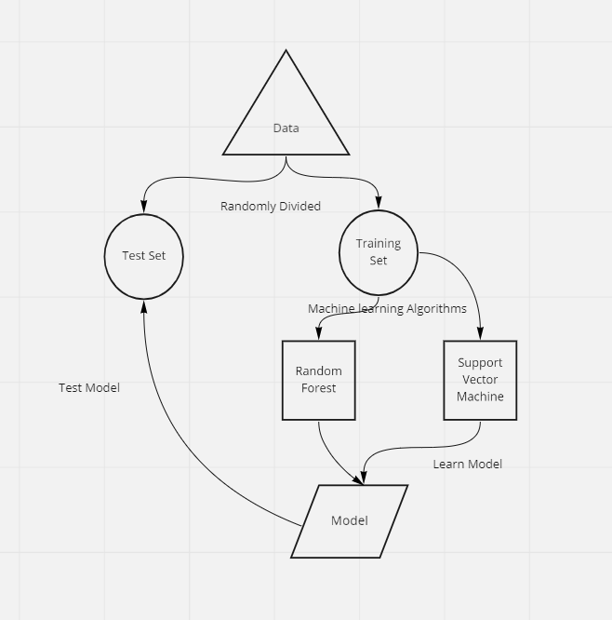
Approaches
8

Slide 10

Approaches
Support Vector Machines:
The goal of the SVM algorithm is to discover a hyperplane in an N-dimensional space that categorises the data point clearly.
Random Forest:
Random forest is used in remote sensing to predict the accuracy of the data.
6

Slide 11
Algorithms | Accuracy
Logistic Regression | 80%
Linear Discriminant Analysis | 80%
Support Vector Machines | 78%
Random Forest | 75%
Final Results

Slide 12
Explanations for the Results:-
Logistic Regression depends on a calculation based on ‘weights’, numerical encoding of categorical variables can lead the algorithm to treat certain categories are of higher importance compared to others, depending on the number assigned. Which in our case is not problematic because there is only one variable which has class values upto 3.
Logistic regression performs better when the number of noise variables(Variables that are difficult or impossible to control at the design and production level) is less than or equal to the number of explanatory variables.
Also logistic regression works best for Binary class classification problem because it gives a linear decision boundary. Logistic regression performs well when the dataset is linearly separable.
Logistic Regression requires average or no multicollinearity between independent variables. There would not be multicollinearity between our variables because we removed the correlated variables.
Overall saying Random Forest Classifier performs better with more categorical data than numeric and logistic regression is a little confusing when comes to only categorical data. So, if the dataset has more Categorical data and consists of outliers it is better to use Random Forest Classifier.

Slide 13
Contribution
Model Implementation and comparison | Meet Jhaveri, Devarsh Sheth
Data Pre-processing | Shivam Thakker, Pranav Gandhi
Code and Understanding | All group members contributed equally.

Slide 14
References
(PDF) Improvement of heart attack prediction by the feature selection methods. (2018, January 1). ResearchGate. https://www.researchgate.net/publication/322956561_Improvement_of_heart_attack_prediction_by_the_feature_selection_methods
Heart disease prediction - dataset by informatics-edu. (2019, August 20). data.world | The Cloud-Native Data Catalog. https://data.world/informatics-edu/heart-disease-prediction
Heart failure prediction dataset. (n.d.). Kaggle: Your Machine Learning and Data Science Community. https://www.kaggle.com/datasets/fedesoriano/heart-failure-prediction
https://ieeexplore.ieee.org/abstract/document/9005488?casa_token=GfM9hJ_sOaMAAAAA:cwt34WxnCIMSZUOyNVumKmwRK-neQ5gNgXezcLb6JFh7drFzLJTkTdL3MOTOSG5V_TlEFLUXX8nrNT0
Application of machine learning for the detection of heart disease. (n.d.). IEEE Xplore. https://ieeexplore.ieee.org/abstract/document/9074954?casa_token=XNLNtj1jfhIAAAAA:DOreikdAvgJW5g2UaJpGbP59CbZseIYoCtaFjY_Mlmyr7wNdKtNlMT40m2OwEbb6AM5pzZ3FFS8C5Fg
https://medium.com/@bemali_61284/random-forest-vs-logistic-regression-16c0c8e2484c
https://www.linkedin.com/pulse/logistic-regression-vs-random-forest-classifier-chintan-chitroda

