Slide 1
Heart Analysis and Prediction
Group3
Name | Roll No.
Shivam Thakker | AU1940193
Devarsh Sheth | AU1940189
Pranav Gandhi | AU1940313
Meet Jhaveri | AU1940284

Slide 2
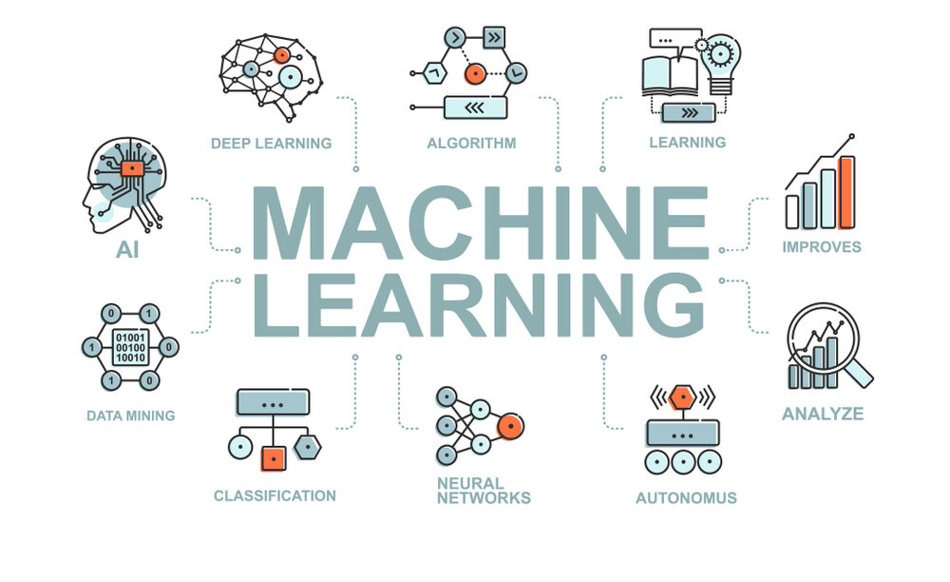
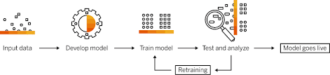
Introduction
The project involved analysis of the heart disease patient dataset with proper data preprocessing.
Different models will be trained and predictions will be made with different algorithms like KNN, Logistic Regression and linear discriminant analysis.
https://www.eurixgroup.com/eurix-machine-learning-2/
https://archive.org/details/machine-learning-collection-pdf/Machine%20Learning%20Collection%20PDF.jpg

Slide 3
Problem Statement
Decisions are often made based on doctors intuition and experience rather than on the knowledge rich data hidden in the data set and databases.
This practice leads to unwanted biases, errors and excessive medical costs which affects the quality of service provided to patients.
To reduce this cost we are trying to build a model that is reliable and can predict the heart attack on the basis of certain data and features.

Slide 4
Existing Body of Work
The paper named “Towards comparing and using Machine Learning techniques for detecting and predicting Heart attack and disease” uses three different techniques which are Logistic regression, Random forest and Naives bayes classifier for the prediction.They uses different 18 features for the prediction.[3]
The paper named “Application of Machine Learning for the Detection of Heart disease” uses three different techniques which are Logistic Regression, K-NN and Naives bayes classifier for prediction. They uses different 13 features for the prediction.[4]

Slide 5
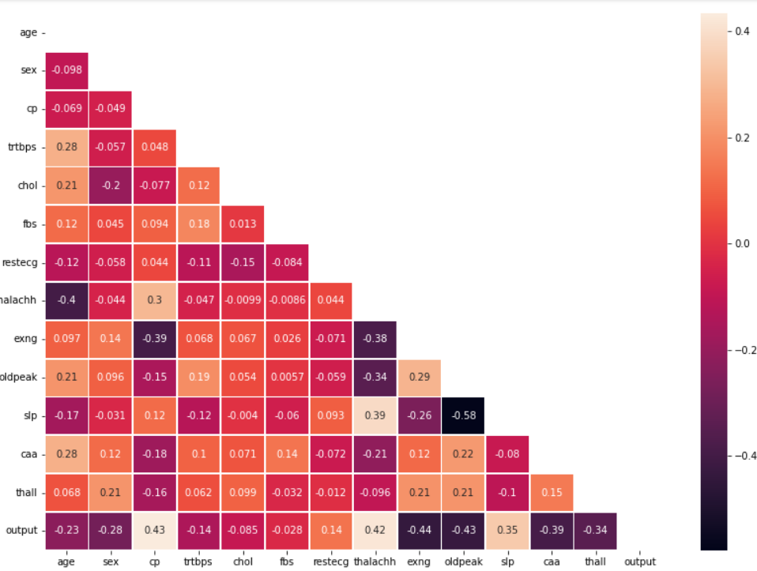
Data Preprocessing
Python Libraries
Data Content
Our data set includes different 13 features.
Read and Analyse Data
We were having total 303 rows
Missing Value Analysis
We were not having any missing values in the entire data set.
Unique Value Analysis
While doing this we come to know that there were some data which was not unique.
Correlation Analysis with all 13 features.

Slide 6
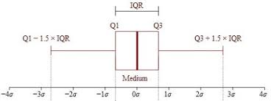
Data Preprocessing
Categorical Value Analysis
The features which are included in this are sex, cp, fbs, restecg, exng, slp, caa, thaal, output
Numeric Value Analysis
The features which are included in this are age, trtbps, chol, thalachh, oldpeak, output
Standardization
The goal of doing this is to bring down all the features to a common scale.
Correlation Analysis
Outlier Detection
Modelling
Linear Discriminant Analysis
KNN
Logistic Regression

Slide 7
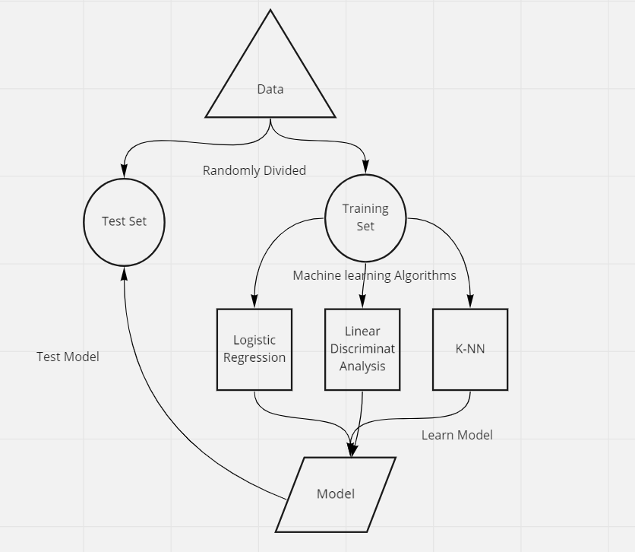
Approaches

Slide 8
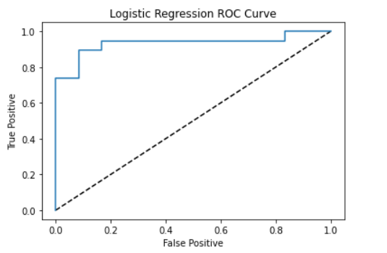
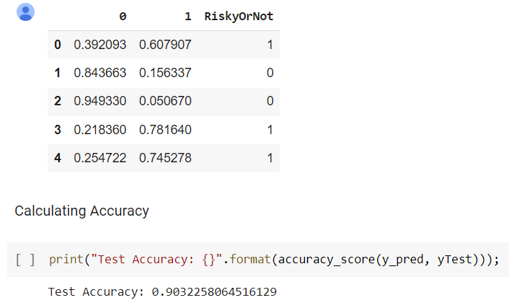
Approaches
LOGISTIC REGRESSION:
It is a Supervised Learning Algorithm used for predicting the categorical dependent variable using a given set of independent variables.
On the basis of the features whether the person is at “Risk=1” or “Not Risk=0” is predicted.
The accuracy of this model is 90% which is quite good.
The reason we selected logistic regression is that it is used for Binary classification problem.

Slide 9
Approaches
2. K-NN:
KNN is a Supervised Learning Algorithm used to solve both classification and regression problem. The number of nearest neighbour to a test data point that has to be predicted or classified is denoted by ‘K’.
The accuracy of this model is 83%.

Slide 10
Approaches
3. Linear Discriminant Analysis:
Linear discriminant analysis (LDA), normal discriminant analysis (NDA), is used to find a linear combination of features that characterizes or separates two or more classes of objects or events. The resulting combination may be used as a linear classifier, or, more commonly, for dimensionality reduction before later classification.
The accuracy of this model is 87%.

Slide 11
Results
Algorithms | Accuracy
Logistic Regression | 90%
K-NN | 83%
Linear Discriminant Analysis | 87%

Slide 12
Future Works:
Contribution:
We will try to generate more data using generative model as we think that our model has overfitted due to less data.
We will try to implement Logistic Regression from scratch and compare the accuracy of our model with the inbuilt model.
We will try to implement Random Forest and SVM.
Model implementation and comparison | Devarsh Sheth, Meet Jhaveri
Data Pre-processing | Shivam Thakker, Pranav Gandhi
Code and Understanding | All group members contributed equally.

Slide 13
References:
Hidayet, Takci. (2018). Improvement of Heart Attack Prediction by the Feature Selection Methods. Turk J Elec Eng & Comp Sci, 26, 1-10.
Sharma, H., & Rizvi, M. A. (2017). Prediction of heart disease using machine learning algorithms: A survey. International Journal on Recent and Innovation Trends in Computing and Communication, 5(8), 99-104.
T. Obasi and M. Omair Shafiq, "Towards comparing and using Machine Learning techniques for detecting and predicting Heart Attack and Diseases," 2019 IEEE International Conference on Big Data (Big Data), 2019, pp. 2393-2402, doi: 10.1109/BigData47090.2019.9005488.
S. S. Yadav, S. M. Jadhav, S. Nagrale and N. Patil, "Application of Machine Learning for the Detection of Heart Disease," 2020 2nd International Conference on Innovative Mechanisms for Industry Applications (ICIMIA), 2020, pp. 165-172, doi: 10.1109/ICIMIA48430.2020.9074954.

