Slide 1
Video Game Trend and Analysis
Author: Devarsh Sheth
GWID: G33776499
Guided by: Prof. Reza Jafari
Visualization of Complex Data
Term Project Presentation

Slide 2
Introduction: Dataset Selection
Fascinated with the growth of the Gaming Industry.
Steam is the leading platform in the gaming industry.
The dataset I chose was from Kaggle. (Around 71k rows)
Understand the aspects of price, leading developers, and revenue.
Notes:
Vast library of games
Active user base
Robust Infrastructure
The data consists of 71K rows which includes features like Developers Game names Year they are released in Number of Users Revenue

Slide 3

Data Cleaning & Pre-Processing:
Majority of the data has the presence of outlier and was found to be Non-Gaussian or Non-Ideal through Shapiro-Wilk Test.
Notes:
This statistic is calculated based on the deviation of the observed data from the expected data if it were normally distributed. The Value is 0.009854735016788796. the p-value is 3.3291742282117616e-236, which is very close to zero, indicating strong evidence against the null hypothesis.

Slide 4
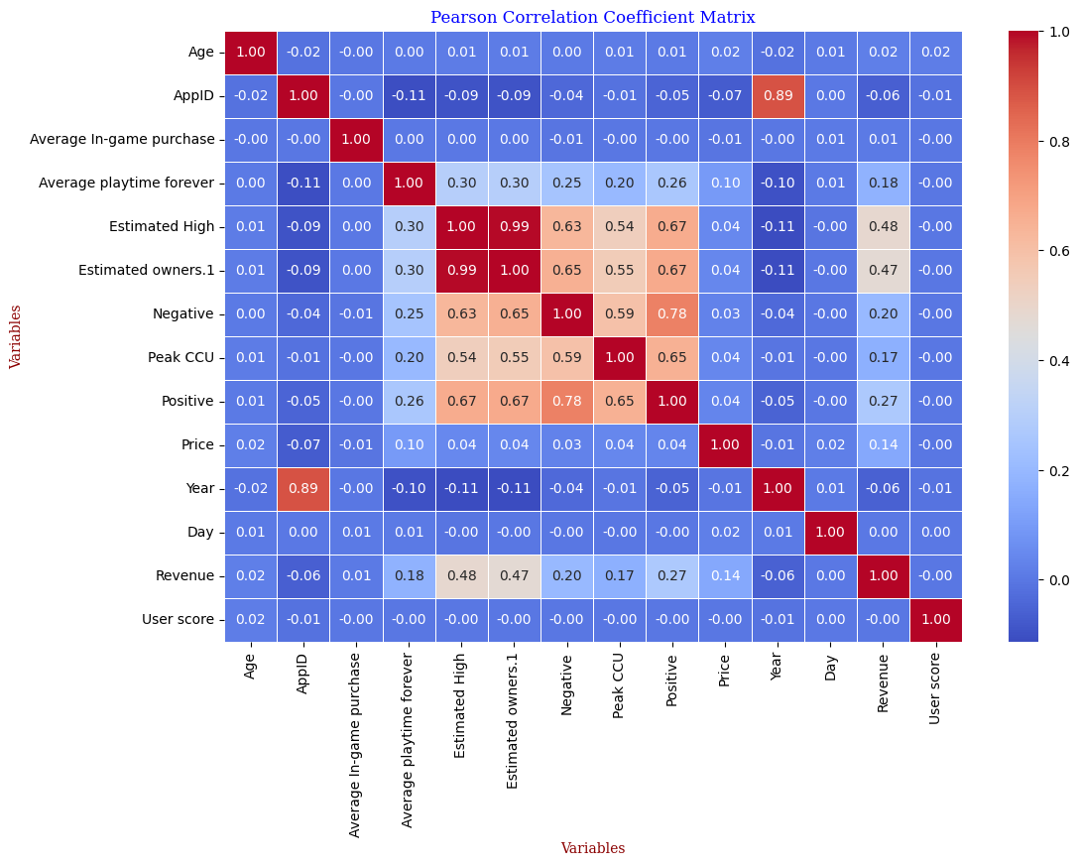
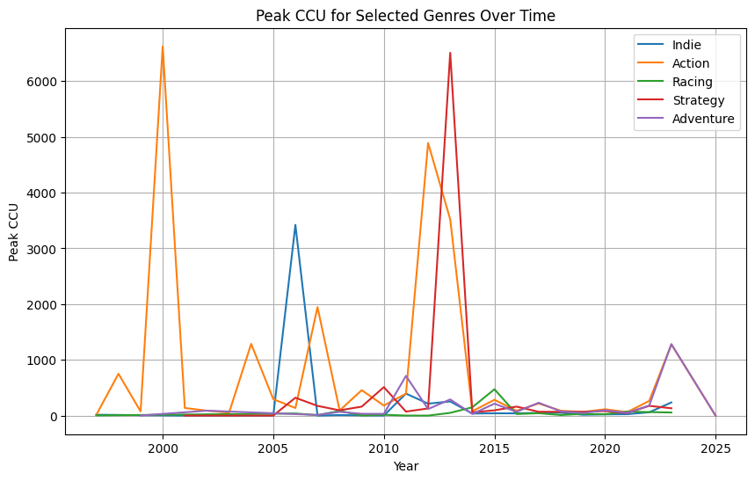
Explanatory Data Analysis:
Average Playtime and Positive Reviews
Revenue and Estimated High
Price and Average Playtime
Age and User Score
Notes:
This means that games with longer average playtime tend to also have more positive reviews. Revenue is generated from the estimated high owners, so obv reason they will be highly correlated Price and Average Playtime show a decent correlation imply that players are more inclined to invest time in games they perceive as offering good value for money. how old a game is and how users rate it.

Slide 5
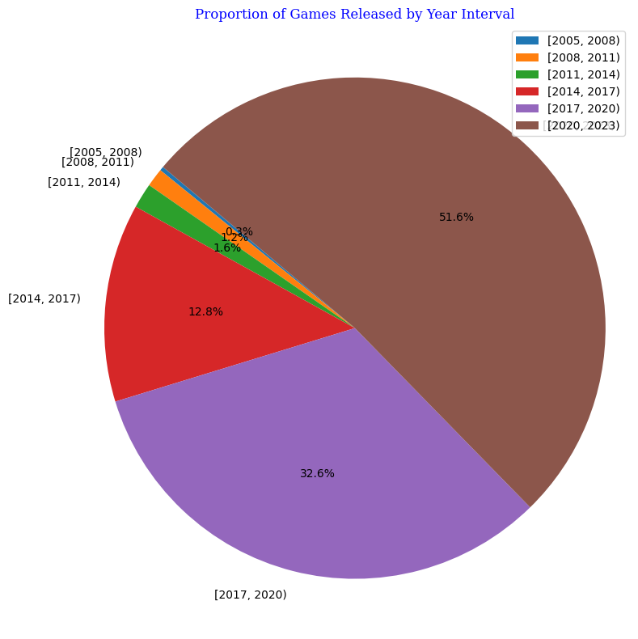
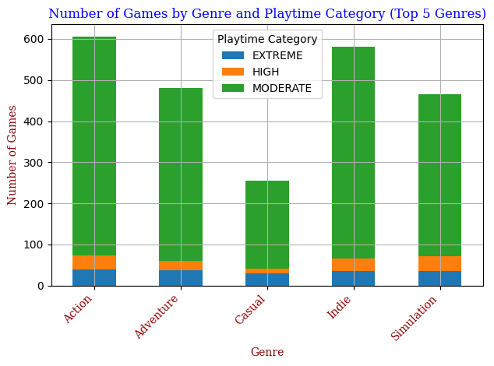
Explanatory Data Analysis:

Slide 6
Interactive Application
https://projectapp-6hhyh57hba-ue.a.run.app/

Slide 7
Thank you

