Slide 1

Stars and their evolution
-Aman Agarwal
Notes:
Whenever we look into the night sky filled with stars, our mind is filled with wonderment. It starts from a very early age when we beautifully ask the star in the nursery rhyme what is it? Is it a diamond, why is it twinkling and where is it; all such questions plague our mind. In this program, we will delve into the topic of stars with precisely these questions which are borne out of natural inquisitiveness even at a small age.
Disclaimer: 1) I have tried to credit each information to its source. Wherever not mentioned the information has been taken from IGNOU self learn material.
2)This will be more of an information packed talk rather than theory and derivation based.
3)The questions can be typed in the chat and we can discuss them during the break or after the kahoot quiz.

Slide 2
Our Quest
What are stars made of?
How do we observe them?
Where are they twinkling?
How are they formed?
How do they die?
How many types of stars are there?
And so on…..
Notes:
So some of the questions which naturally arise are- What are stars made of?.... We will answer three of them in this talk

Slide 3
Our Quest
What are stars made of? Star Formation
How do we observe them? Astronomy and Stellar spectra
Where are they twinkling? Sky surveys
How are they formed? Gravitational collapse and stellar nurseries
How do they die? Supernovae, compact stars, gravitational waves physics
How many types of stars are there? Stellar evolution and structure
And so on…..
Notes:
In this slide I will discuss about the related fields to some of the questions

Slide 4
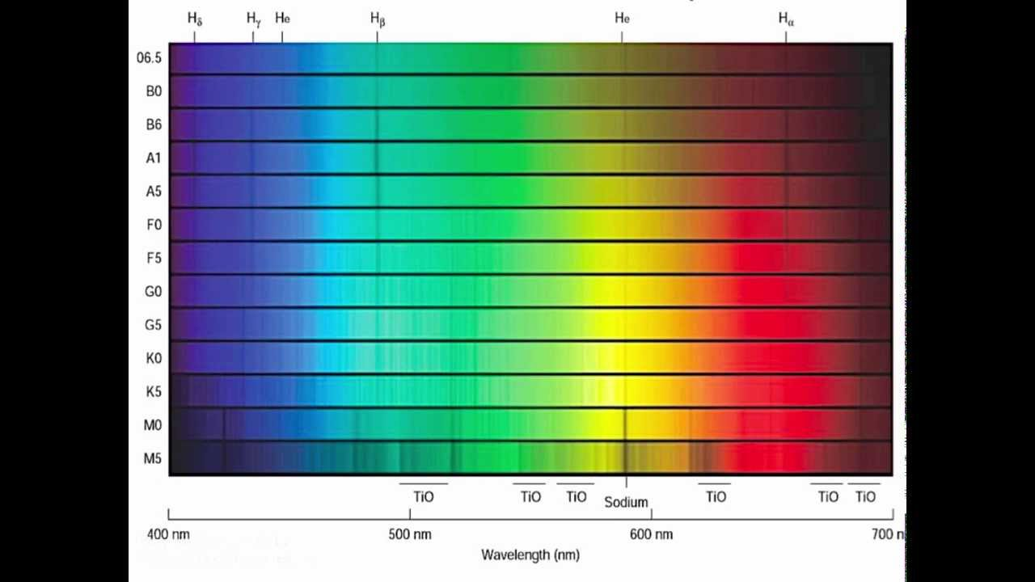
How do we observe stars?
Stellar Spectra
Notes:
Stars emit radiation not only in visible range but all kinds of wavelengths. Even in visible range, all stars do not look the same. Some are reddish and some look blue. Spectroscopy refers to the analysis of light in terms of its wavelength and it is extensively used to obtain information regarding temperature, composition etc. of stars. Image Source-https://www.youtube.com/watch?v=gXsnPthnMnI&ab_channel=KurtisWilliams

Slide 5
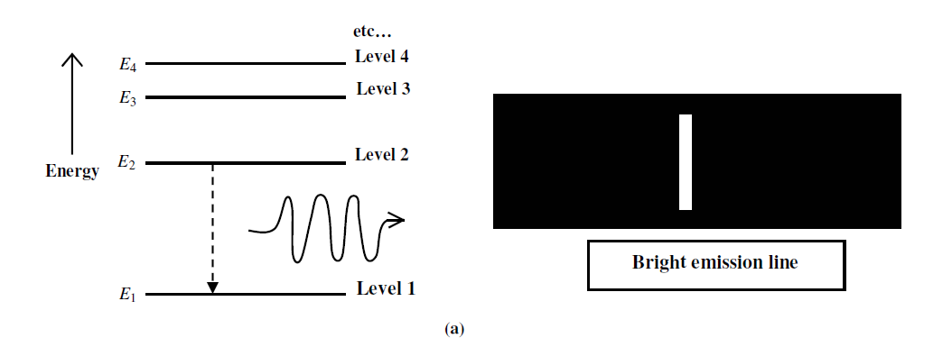
Emission Spectra
Notes:
When an electron makes a transition from a higher energy level to a lower energy level, radiation is emitted. Hotter astrophysical objects radiate energy and produce emission spectra.

Slide 6
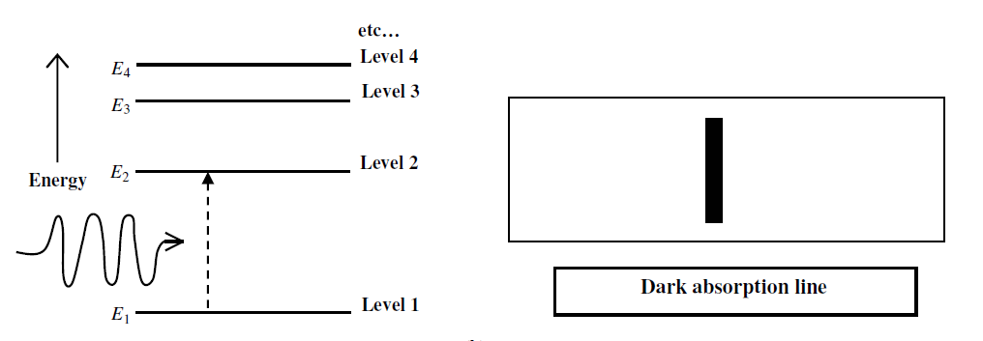
Absorption Spectra
Notes:
An electron goes from a lower energy level to a higher energy level when it absorbs energy and vice-versa. Such transitions follow certain selection rules and are always accompanied by the emission/absorption of radiation. When light from a continuous spectrum passes through a relatively cooler astrophysical gas, we get absorption spectrum. Spectrum is the fingerprint of atoms and are unique. Hence they tell us about the composition of the stars.

Slide 7
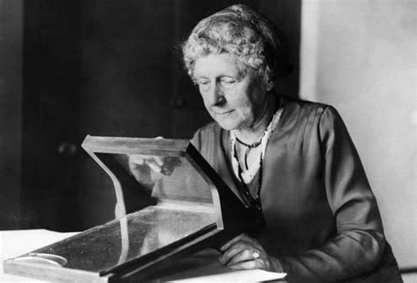
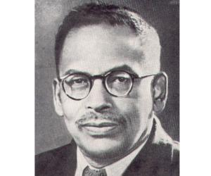
How many types of stars are there?
Notes:
The stars can be classified on the basis of their spectra. The earliest classification was done by Annie J. Cannon. She classified more than 2, 50,000 stars by observing the strength of absorption lines, particularly, the hydrogen Balmer lines. In this way stars have been classified into seven major spectral types, namely, O, B, A, F, G, K and M. . It was shown by M.N. Saha, an Indian scientist, that Cannon’s spectral classification can be explained primarily on the basis of the temperatures of stars because the intensities of spectral lines depend on the surface temperature of a star.

Slide 8
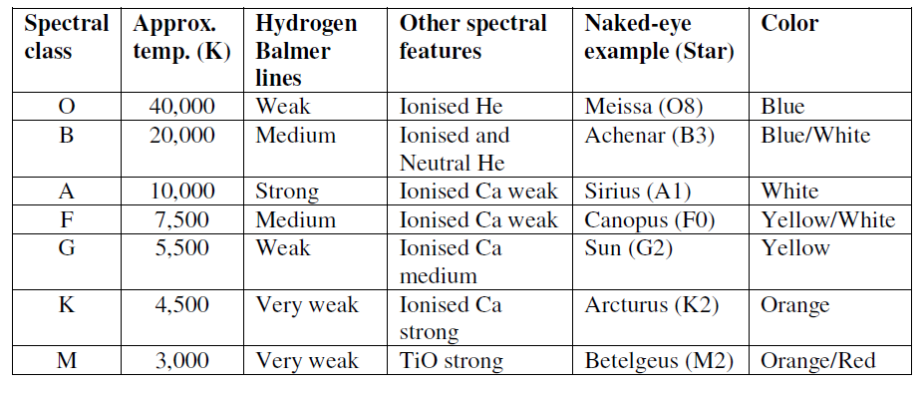
Spectral Types and their parameters
Notes:
For greater precision, astronomers have divided each of the main spectral types into 10 sub-spectral types. For example, spectral type A consists of sub-spectral types A0, A1, A2.... A8, A9. . The advantage of the finer division is to estimate the star's temperature to accuracy within about 5 percent. The Sun, for example, is not just a G star, but a G2 star, with a surface temperature of about 5800 K

Slide 9
Black Body approximation
λ_{max}T=0.0029mK
Notes:
It has been observed that the outer envelope of a star’s spectrum is quite similar to a black body spectrum at a certain temperature. Thus, a stellar spectrum can be
approximated to a black body spectrum. However, note that the absorption features of stellar spectra distinguish it from the black body spectrum.

Slide 10

Luminosity
The luminosity (L) of a star is defined as the total energy radiated by it, in one second, consisting of radiations of all wavelengths.
We observe the apparent magnitude of the star in visible range. From parallax we can calculate the distance of the star and the absolute visual magnitude. We need to make corrections for radiations emitted at other wavelengths. The correction is called Bolometric correction.
M^{bol}_{star} -M^{bol} _{sun} =-2.5 Log(L_{star} /L_{sun})
L=4 π R² σ T⁴
Notes:
The absolute magnitude, M, of an astronomical object is defined as its apparent magnitude if it were at a distance of 10 pc from us.
The apparent magnitude is the measure of brightness of the star with respect to sun.
The absolute luminosity formula comes from black body approximation and Stefan’s law.

Slide 11
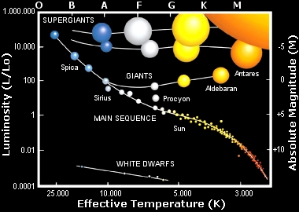
Hertzsprung-Russel Diagram
Notes:
Image Source- https://www.astronomytrek.com/essential-astronomical-systems-of-measurement/
A very important diagram in astronomy and astrophysics, the HR diagram classifies stars on the basis of their luminosity and effective temperature. the distribution of stars follows a pattern such that a majority of stars fall along a central diagonal called the main sequence. The main sequence stars account for nearly 90 per cent of all stars. The other types of stars such as giants, supergiants, white dwarfs populate other regions.
The giant stars (named so because of their big size) located at the top right of the H-R diagram have low temperature but high luminosity. When we move further up in the H-R diagram (Fig. 7.12), we find super giants. These high luminosity and low temperature stars must be extraordinarily big in size. It has been estimated that the diameters of super giants are roughly 100 to 1000 times the diameter of the Sun! Further, when we come to the bottom left (below the main sequence), we come across stars known as white dwarfs ¾ stars which are very hot but their luminosity is very low.

Slide 12
Hertzsprung-Russel Diagram
Notes:
The spectrum of an isolated atom differs from that of the gas of such atoms. The difference is manifested in the form of broadening of spectral lines of the atom in the latter case due to collision between atoms. For frequent collisions, a denser gas provides a better environment than a rarer gas. Therefore, if the spectral lines in stellar spectra are broadened, we can safely conclude that the density of the star is high. Examples of such stars are the main sequence stars. On the basis of
the width of their spectral lines, they are categorized into various luminosity classes.(I to V) Sun is a G2V star. This is spectro-luminosity classification.

Slide 13



Notes:
Break

Slide 14
Information from HR diagram
Age
Size
Luminosity
Mass
Spectral Type
Absolute Magnitude
Surface Temperatute
Notes:
The H-R diagram separates the effects of temperature and surface area on the luminosity of the stars because the brightness of two stars at the same temperature is proportional to their radii. This feature enables us to classify stars in terms of their diameters. The Location of the star in a diagram changes with age. Depending on luminosity class we know size. Rest three are obtained directly from the diagram.

Slide 15
Stellar Evolution
Notes:
Lets look at the video
.This is the answer to our question that how are stars formed and how do they die?

Slide 16
Nucleosynthesis and Cosmic Abundances
A stable star is formed when an equilibrium between gravitational force in the collapsing cloud and the radiation pressure due to nuclear energy generated in its core is attained.
Interestingly, all the stars produce the same elements which we find on the Earth. Further, we find the same elements everywhere in the universe and more or less in the same proportion. The relative proportion of these elements in the Universe is called cosmic abundances.
From solar spectrum, meteorites and cosmic rays we gauge the relative abundances of different atoms in the universe
We observe that abundances generally increase with mass number up to the mass number around 60. This is in the neighbourhood of iron (Fe56). Around this mass number, there is a broad peak.
Apart from H and He, most of the heavy elements synthesized in stars.
Notes:
A protostar is formed from a collapsing cloud of gas and after contracting sufficiently, it reaches ZAMS line and hydrogen fusion stars except brown dwarfs.
An interesting approach to understand stellar evolution is to ask ourselves: How did the ninety-three natural (chemical) elements, which are the building blocks of all living and non-living matter around us, come into existence?

Slide 17
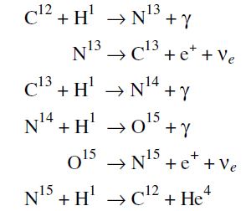
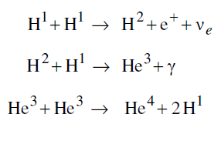
Main Sequence stars
Notes:
When a star arrives on the main sequence, it is said to have been born. That is why the main sequence is called zero-age main sequence (ZAMS). While the star is on the main sequence, it burns hydrogen either through pp-chain(left) or through CN-cycle(right). Luminosity \propto M^(3.5) ; Time in Main sequence \propto M^(-2.5)
Obviously, for this reaction, it is necessary that the stars have some carbon to begin with. Such stars are called the second generation stars. The stars which start life with only hydrogen and helium are called first generation stars

Slide 18
After main sequence
When hydrogen is burnt up, radiation pressure decreases, core contracts and temperature increases sometimes leading to heavier element synthesis.
For low mass stars the helium rich core contracts and the hydrogen in a thin shell around the core starts burning quickly. The helium made in the shell adds to the mass of the core whose contraction is accelerated. The energy produced in the shell and the gravitational energy due to the contracting core push out the envelope of the star due to radiation pressure. As a result, the star expands in size. Its surface becomes cooler but its luminosity increases enormously because of increased surface area. It becomes a giant star.
For heavier stars, this cycle of contraction and heavier element synthesis continues till all the nuclei in the core have become iron nuclei. Elements heavier than iron require more extreme conditions to be synthesized.
Notes:
The average binding energy per nucleon increases with mass number till we reach the mass number of iron. This means that with increasing mass number, the nuclei are more tightly bound and are more stable.

Slide 19
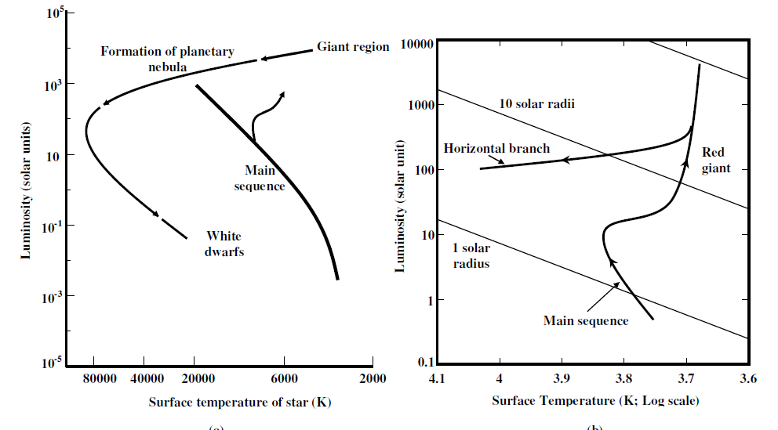
Evolution of solar mass stars
Notes:
If the mass of the star is approximately 1 MQ, the helium burning is rather abrupt and a large amount of energy is suddenly released. This phenomenon is called a helium flash. Several circumstances, some not yet completely understood, combine at this stage to force the star to throw away its outer envelope. The ejected matter surrounds the star. This object is called a planetary nebula. In a small telescope, it appears like a planet, hence the name planetary nebula.
Within a short time, the gas surrounding the star vanishes due to interaction with the interstellar medium. Simultaneously, the core again begins to contract and becomes very dense and the matter in the core becomes a degenerate gas. Degenerate gas is a particular configuration of a gas composed of fermions (electrons,
neutrons, etc.) whose behaviour is regulated by a set of quantum mechanical laws.
Pauli’s exclusion principle, no more than two fermions (of opposite spin) can occupy the same quantum state of a system.
energy.
This process of gradually filling in the higher-energy states increases the pressure of the electron gas. The pressure of the degenerate gas depends only on the density of the gas and is independent of its temperature.

Slide 20

White Dwarfs
Notes:
In stars of mass ~ 1 solar mass , only the electron component of the matter becomes degenerate. The pressure of degenerate electrons is sufficient to halt the contraction of the star. A state of equilibrium is established. The star is then called a white dwarf star. The maximum mass of a white dwarf star is ~ 1.4 MQ. This limit on the mass of a white dwarf star was predicted theoretically by S. Chandrasekhar, an Indian astrophysicist. It is, therefore, called the Chandrasekhar limit.
Beyond the Chandrashekar limit, the electron degeneracy pressure cannot hold the gravitational collapse of the star.

Slide 21
Massive Stars
Iron nuclei is formed in massive stars and nuclear reactions halt.
Thus, the core is forced to contract. The gravitational energy heats the core resulting in the disintegration of iron nuclei into nuclei of helium. The break up of iron is an endothermic process, that is, the reaction absorbs energy rather than giving it out.
To feed this process, the only source of energy is the gravitational collapse. As a result, the collapse of the core is accelerated. Faster release of gravitational energy due to collapse gives rise to further break up of iron nuclei into helium nuclei. This, in turn, accelerates the collapse. As the density of the core continues to increase, even the helium nuclei cannot remain intact as nuclei. They break up into protons and neutrons

Slide 22
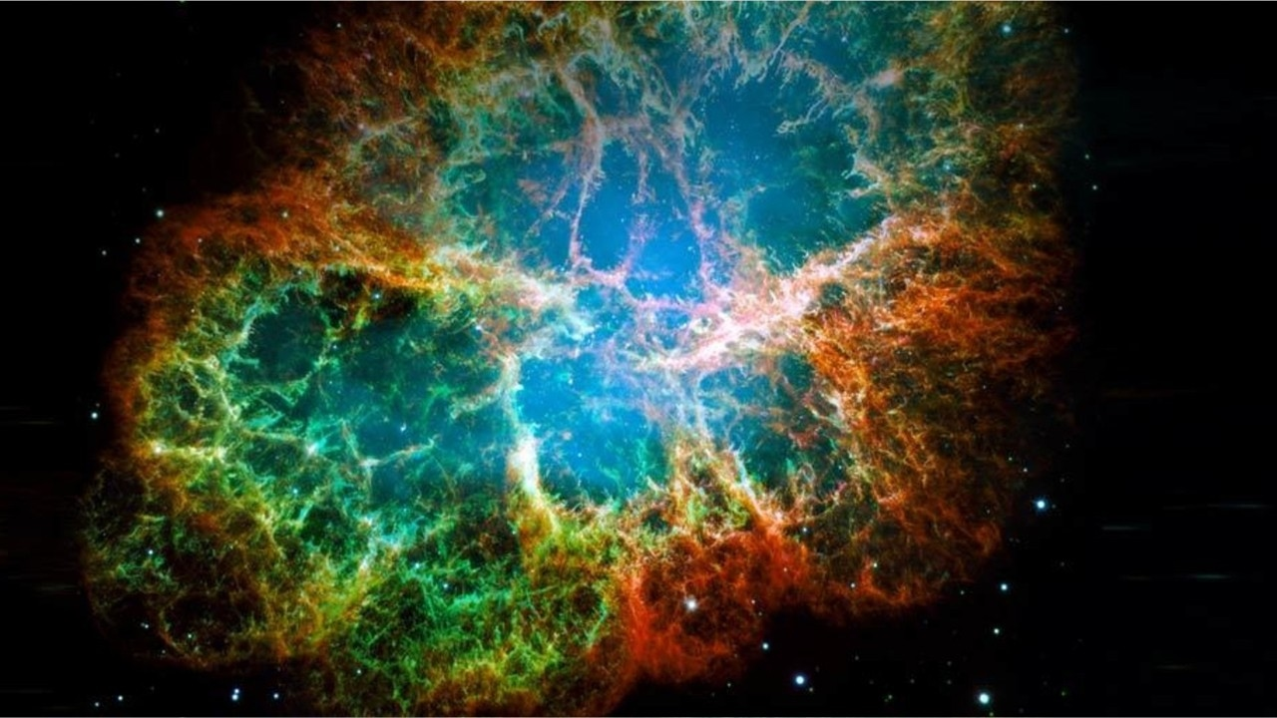
Supernovae
Notes:
Due to transfer of energy from the core to the envelope, very high temperatures are produced in the envelope and nuclear reactions in various layers of the envelope are ignited. The energy released due to these reactions heats the envelope so much that it becomes prone to explosive disintegration in a matter of seconds. In this short time before explosion, nuclear reactions produce heavy nuclei all the way up to the iron group. Finally, the envelope explodes. The explosion is called a supernova.

Slide 23
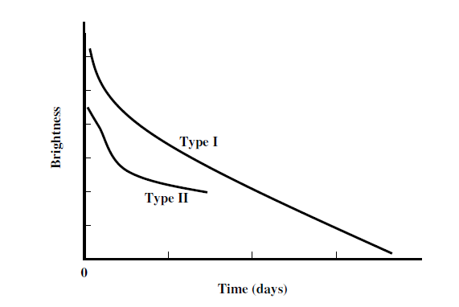
Supernovae Types
Notes:
The luminosity of a supernova is of the order of the luminosity of a whole galaxy. The variation of the brightness of an object with time is called the light curve of the object. Based on the type of light curves, supernovae have been classified as type I and type II.
Explosion of white dwarfs causes supernovae of Type Ia. As its mass increases beyond 1.4 Msolar due to accretion, it explodes as a supernova. Since all stars have the same mass at the time of explosion, it is possible that supernovae Ia reach the same brightness or absolute magnitude.
Type Ib supernovae are thought to be due to carbon burning in the degenerate core of a star. Carbon burning in this situation is abrupt and very rapid. It is called a carbon flash. It generates so much energy that the star explodes. The stars which explode to become supernovae of type II have usually masses higher than 10 MQ. Their light curves are all distinct. These supernovae leave behind neutron stars or black holes, which are detected several years after the explosion.

Slide 24
Compact Stars
Remember the supernovae is about the star’s envelope. The core is contracting while all this is happening.
The core keeps collapsing. According to our present knowledge, if the initial mass of the star is up to about 12 Msolar, then the core is left with a mass of about 2 Msolar to 3 Msolar. The matter in such stars is mostly neutrons.
If the initial mass of the exploding star is close to 15 Msolar or more, the core that is left behind has a mass more than 3 Msolar. A core of this mass cannot attain equilibrium of any kind. It keeps contracting. Eventually, its gravitational field becomes so strong that even light cannot escape it. It becomes a black hole.
Notes:
Like electrons, neutrons also obey Pauli’s exclusion principle. At the extremely high density which exists in the core, neutrons become degenerate. The pressure exerted by the degenerate neutrons is sufficiently high to halt the collapse of the core. The core stabilises in the form of a neutron star

Slide 25
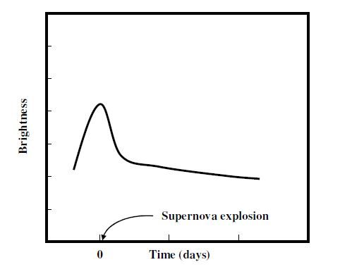
Quiz!!
Notes:
Please visit joinmyquiz.com and enter the code which I will provide in the live chat

Slide 26
Thank You

