Slide 1
Introduction to LISA and its primary sources of Gravitational Waves
Manas Vishal, IISER Kolkata.
Mini-Astro Workshop, October 6th , 2020

Slide 2
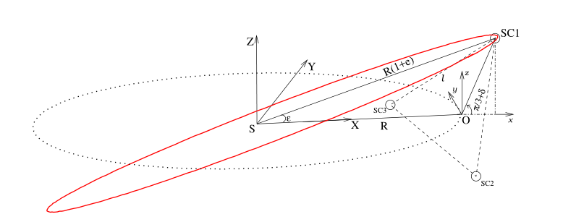
Part 1
LISA stands for Laser Inteferometer Space Antenna
An array of 3 spacecrafts in equilateral triangle.
The CoM is in heliocentric orbit 20° behind the Earth.
Calculations done in Clohessy Wiltshire frame.
Credits : K. Rajesh Nayak , S. Koshti , S. V. Dhurandhar and J-Y. Vinet

Slide 3
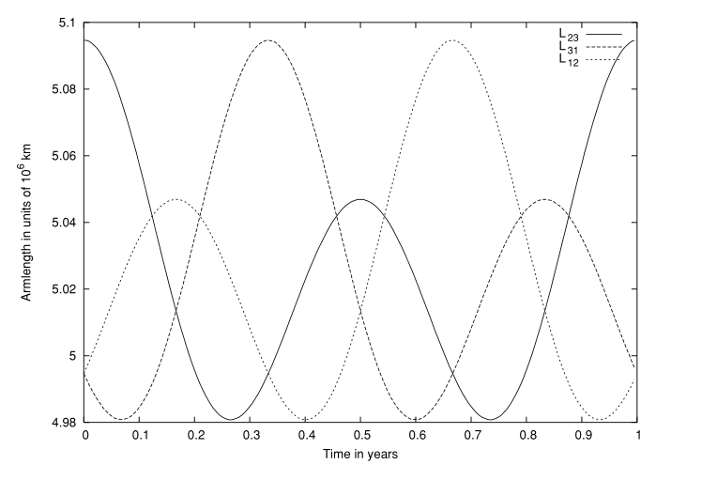
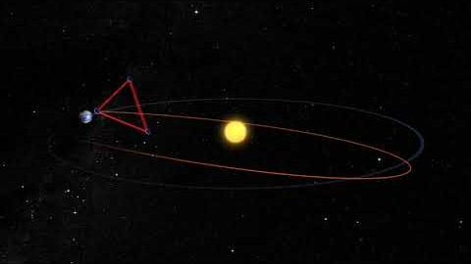
Fig. Breathing modes of different arms

Slide 4
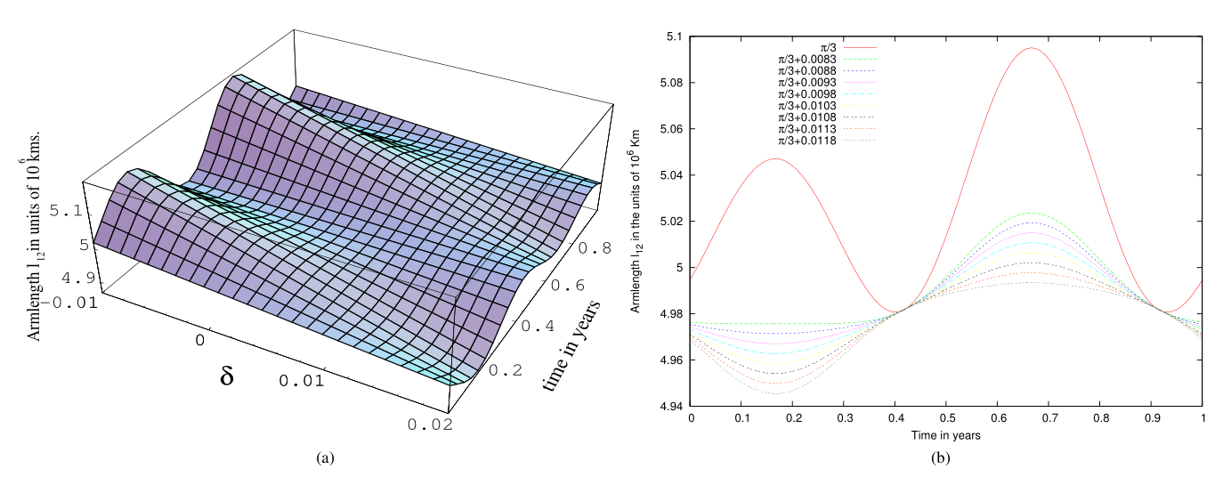
Fig. Breathing modes and its dependence over time and delta

Slide 5
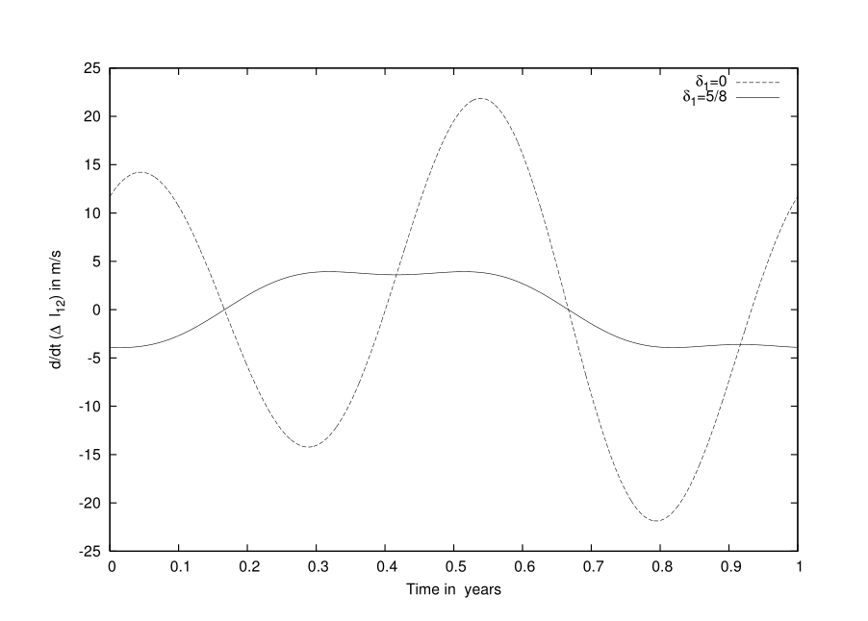
By introducing a slight tilting in the plane of spacecrafts, the flexing can be reduced up to a factor of 2.4 (from 115,000 Km to 48,000 Km)
Upon consideration of corresponding Doppler shifts the reduction factor can be achieved up to a value of 6.
Fig. Perturbing the orbit and stabilizing the flexing in the arms

Slide 6
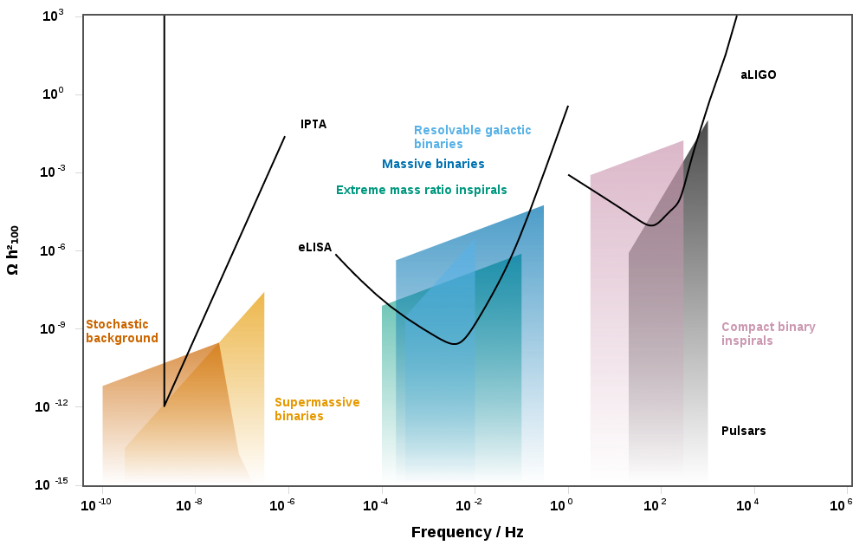
Part 2
LISA is sensitive in mHz to a few Hz regime.
Primary sources are Extreme Mass Ratio black hole Binaries.
Modelled using Black Hole Perturbation Theory
I used Teukolsky formalism.
Fig. Gravitational-wave sensitivity-curve plot using the energy density that cosmologists love. The quantity on the Y-axis is the critical energy density per logarithmic frequency interval multiplied by the reduced Hubble constant squared. Credits : Christopher J. Moore, Robert H. Cole, Christopher P. L. Berry (arXiv:1408.0740)

Slide 7
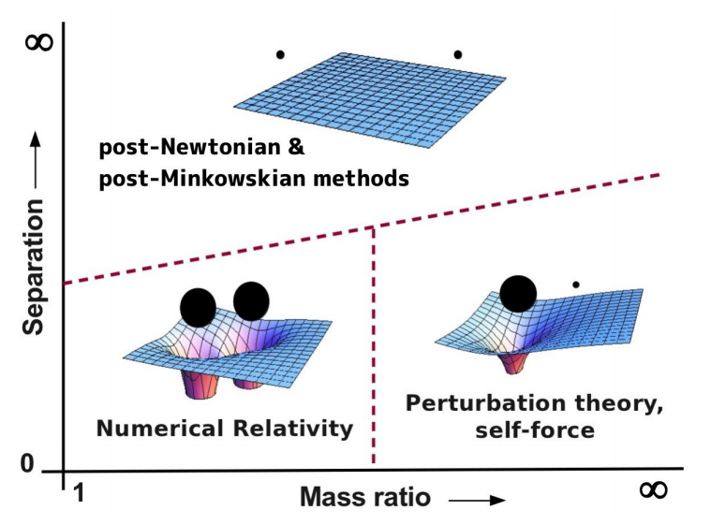
Figure credits : Leor Barack , GR21

Slide 8


Our final goal is to solve a wave equation which is a hyperbolic PDE
We can also have a PDE with a potential term for a more realistic situation.

Slide 9
The difficulties
Shocks solution not smooth
Multiple time scales
Long time evaluation for better Physics
Change of geometry (merger, black hole formation, explosion)
Multiphysics (GR, hydro, MHD, neutrinos, nuclear reactions,…)

Slide 10
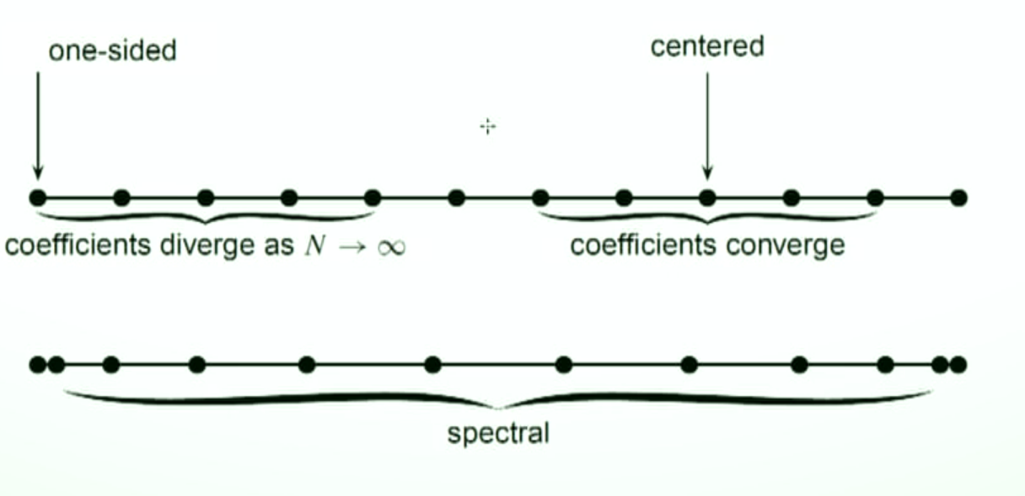
dG method vs other known algorithms
Figure credits : Saul Teukolsky

Slide 11
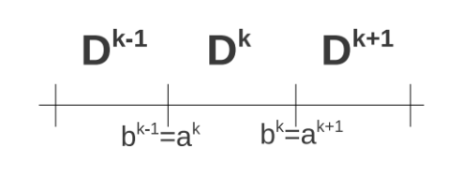
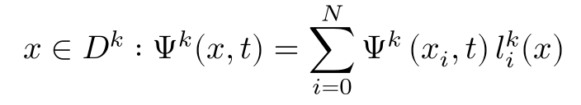

The grid is unstructured. We choose lines, triangles, and tetrahedrons for 1D, 2 D, and 3D respectively.
The local solution is given as the sum of polynomials of degree at most N.
The global solution is the direct sum of local solutions

Slide 12
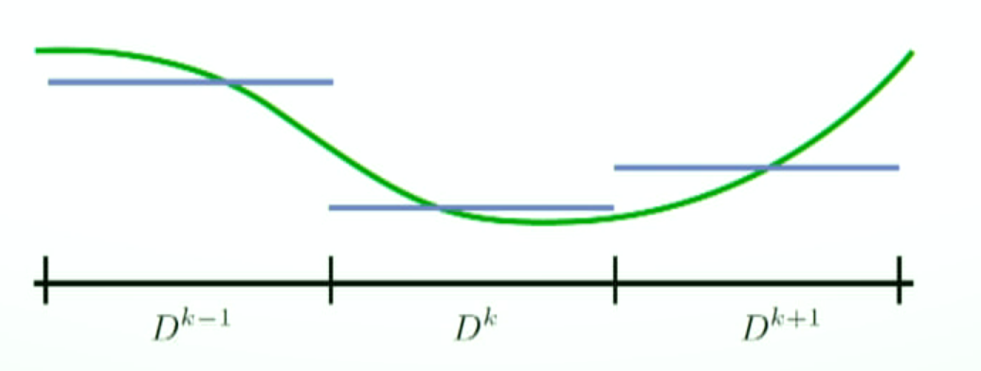
Finite Volume/Difference Methods
Solution represented by cell averages
Flux reconstruction can handle shocks
Higher order requires wide stencils
Figure credits : Francois Hebert

Slide 13
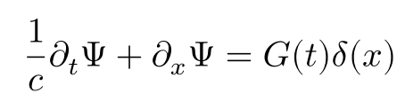
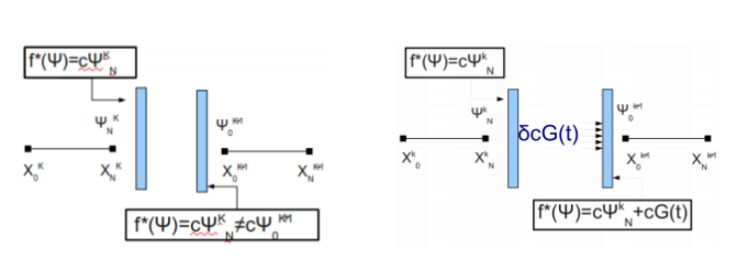
But what about a Black Hole?
The secondary black hole is represented by a delta function.
Consider a simple hyperbolic PDE with a delta source term :
The delta term only shows up as an extra term in the flux. The extra amount is added to the flux at the boundary.

Slide 14
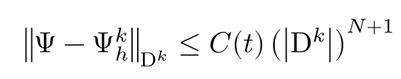
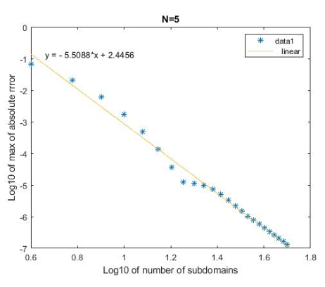
The Error
For sufficiently smooth solutions the error decay like :

Slide 15
Tutorial Time!

Slide 16
Thanks!
Any questions? You can find me at:
Twitter @manas_vishal
vishalmanas28@gmail.com

