Slide 1

Software Carpentry Workshop
Jasmine Kirby, Erin Thomas, Arne Grimstrup and Devasena Inupakutika
18–19 March 2019
@Iowa State University

Slide 2
Software Carpentry
“Teaching researchers the computing skills they need to get more done in less time and with less pain”
27,000 + Researchers taught since 1998 in 35 Countries
Materials are freely reusable (CCA license)
Source: Partially collected from https://github.com/southampton-rsg

Slide 3
First Things First
Please ensure you’ve installed the software prerequisites
https://bit.ly/2UFPm2L
Follow the instructions on the Etherpad to download the repository for data:
https://bit.ly/2W46mzN

Slide 4
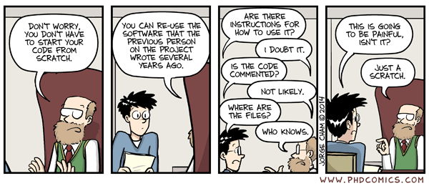
Why are we here?
Notes:
We care about writing a good code / software. Best practices to writing a code.

Slide 5
Bash Shell
Day 1: Morning Session
Devasena Inupakutika
Automation with shell scripting

Slide 6
Python
Day 1: Afternoon Session & Day 2: Afternoon Session
Arne Grimstrup/ Devasena Inupakutika
Writing Python programs step-by-step, Analysing data and advanced programming (if time permits)

Slide 8
Version Control (Git)
Day 2 – Morning Session
Arne Grimstrup
How has this code changed?
Who made this change?
Which version of this code was used to generate this result?
Reproducibility

Slide 9
Let’s get started!

