Slide 1



AW_Report_Final_v2
View in Power BI
Last data refresh:
6/16/2022 8:44:58 AM UTC
Downloaded at:
6/16/2022 5:11:46 PM UTC

Slide 2
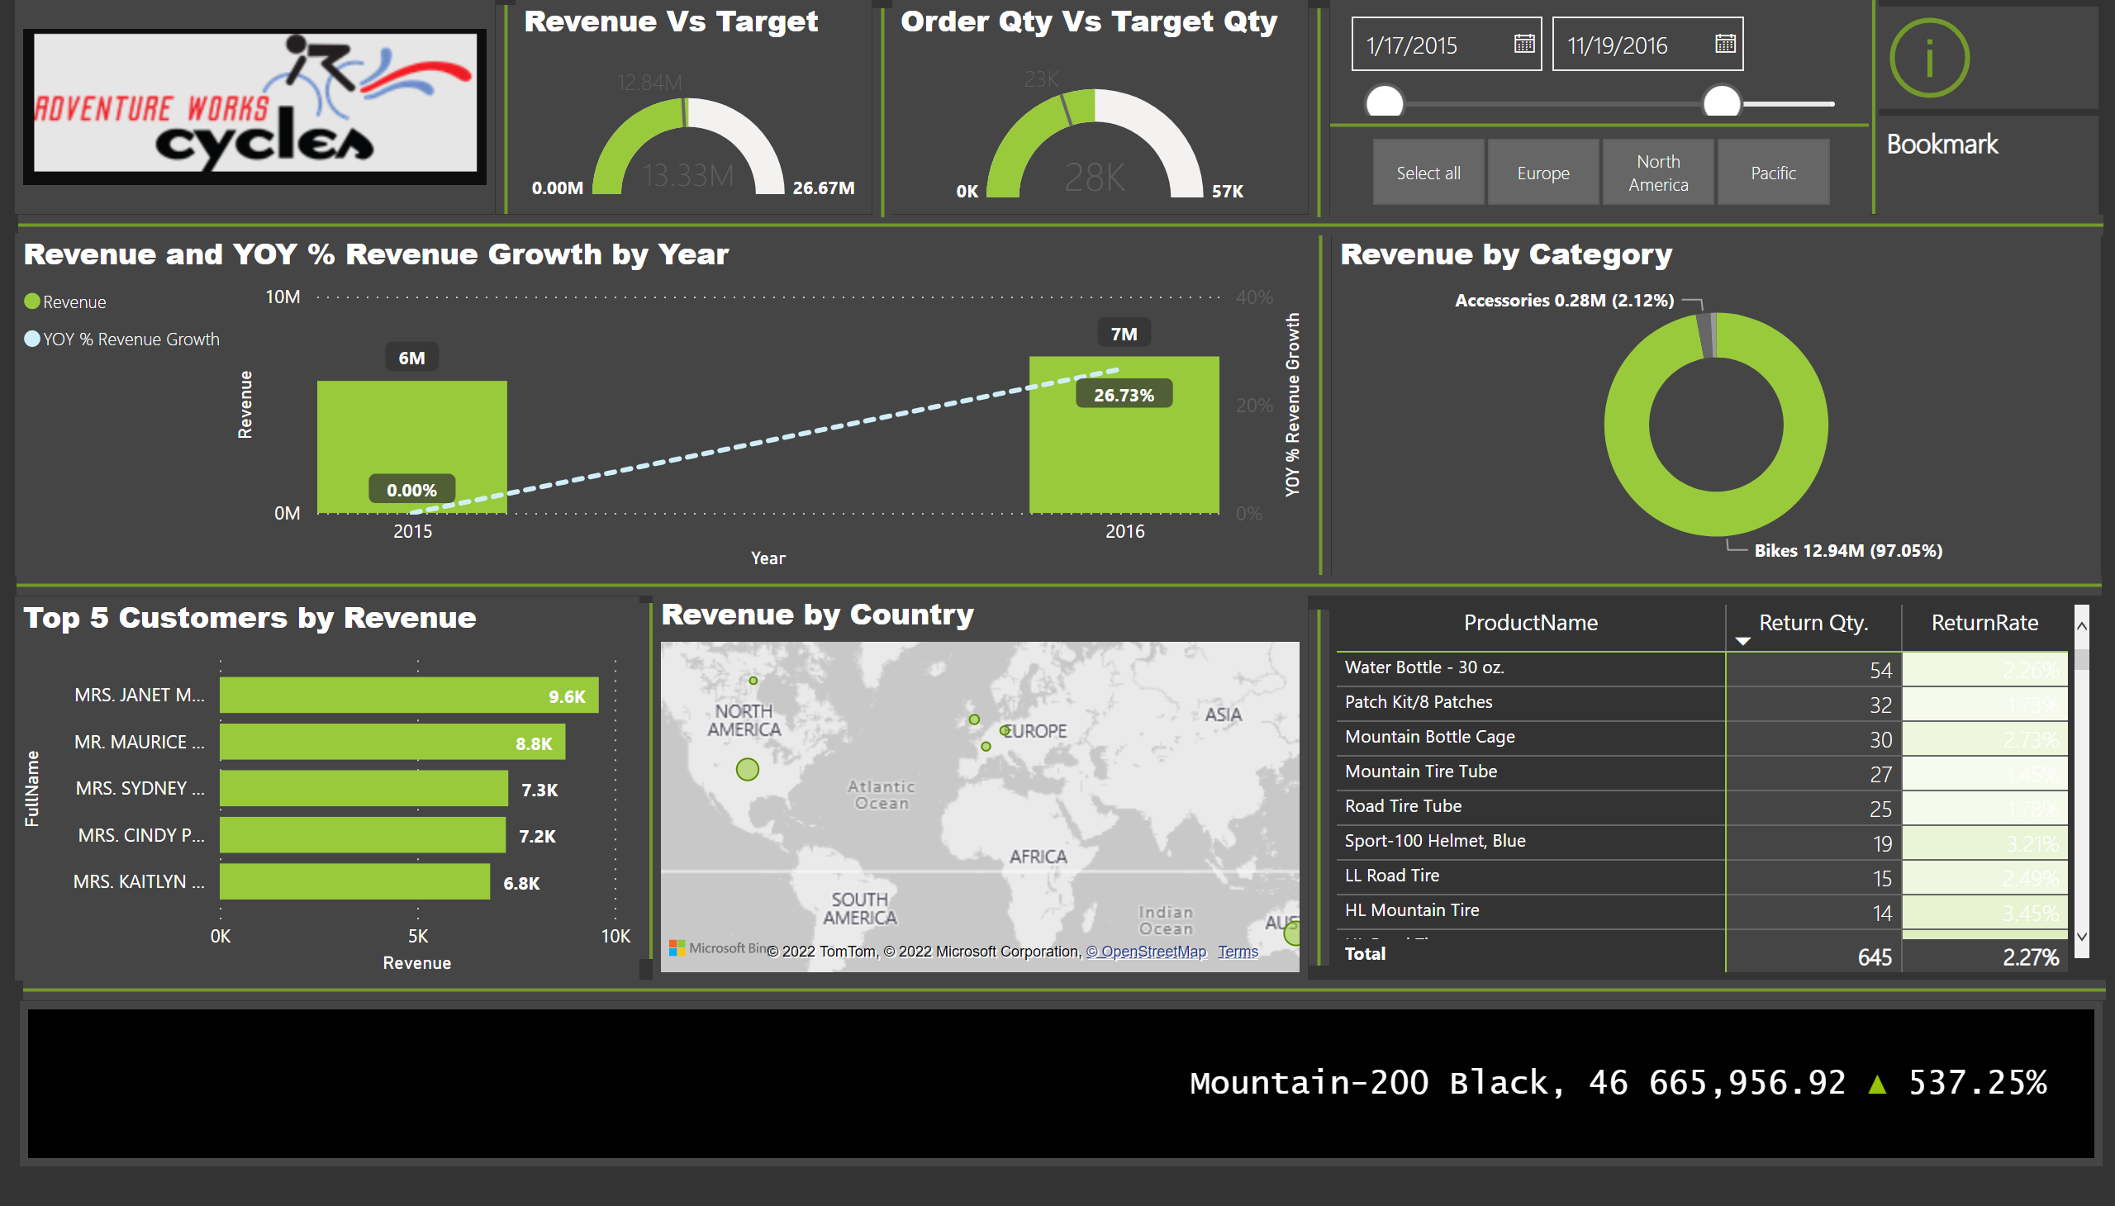
Top Line Report
Notes:
image
No alt text provided
lineStackedColumnComboChart
No alt text provided
Revenue by Category
No alt text provided
shape
No alt text provided
shape
No alt text provided
shape
No alt text provided
Top 5 Customers by Revenue
No alt text provided
shape
No alt text provided
shape
No alt text provided
map
No alt text provided
shape
No alt text provided
pivotTable
No alt text provided
Revenue Vs Target
No alt text provided
shape
No alt text provided
shape
No alt text provided
Order Qty Vs Target Qty
No alt text provided
shape
No alt text provided
slicer
No alt text provided
shape
No alt text provided
slicer
No alt text provided
ScrollingTextVisual1448795304508
No alt text provided
shape
No alt text provided
actionButton
No alt text provided
textbox
No alt text provided

Slide 3
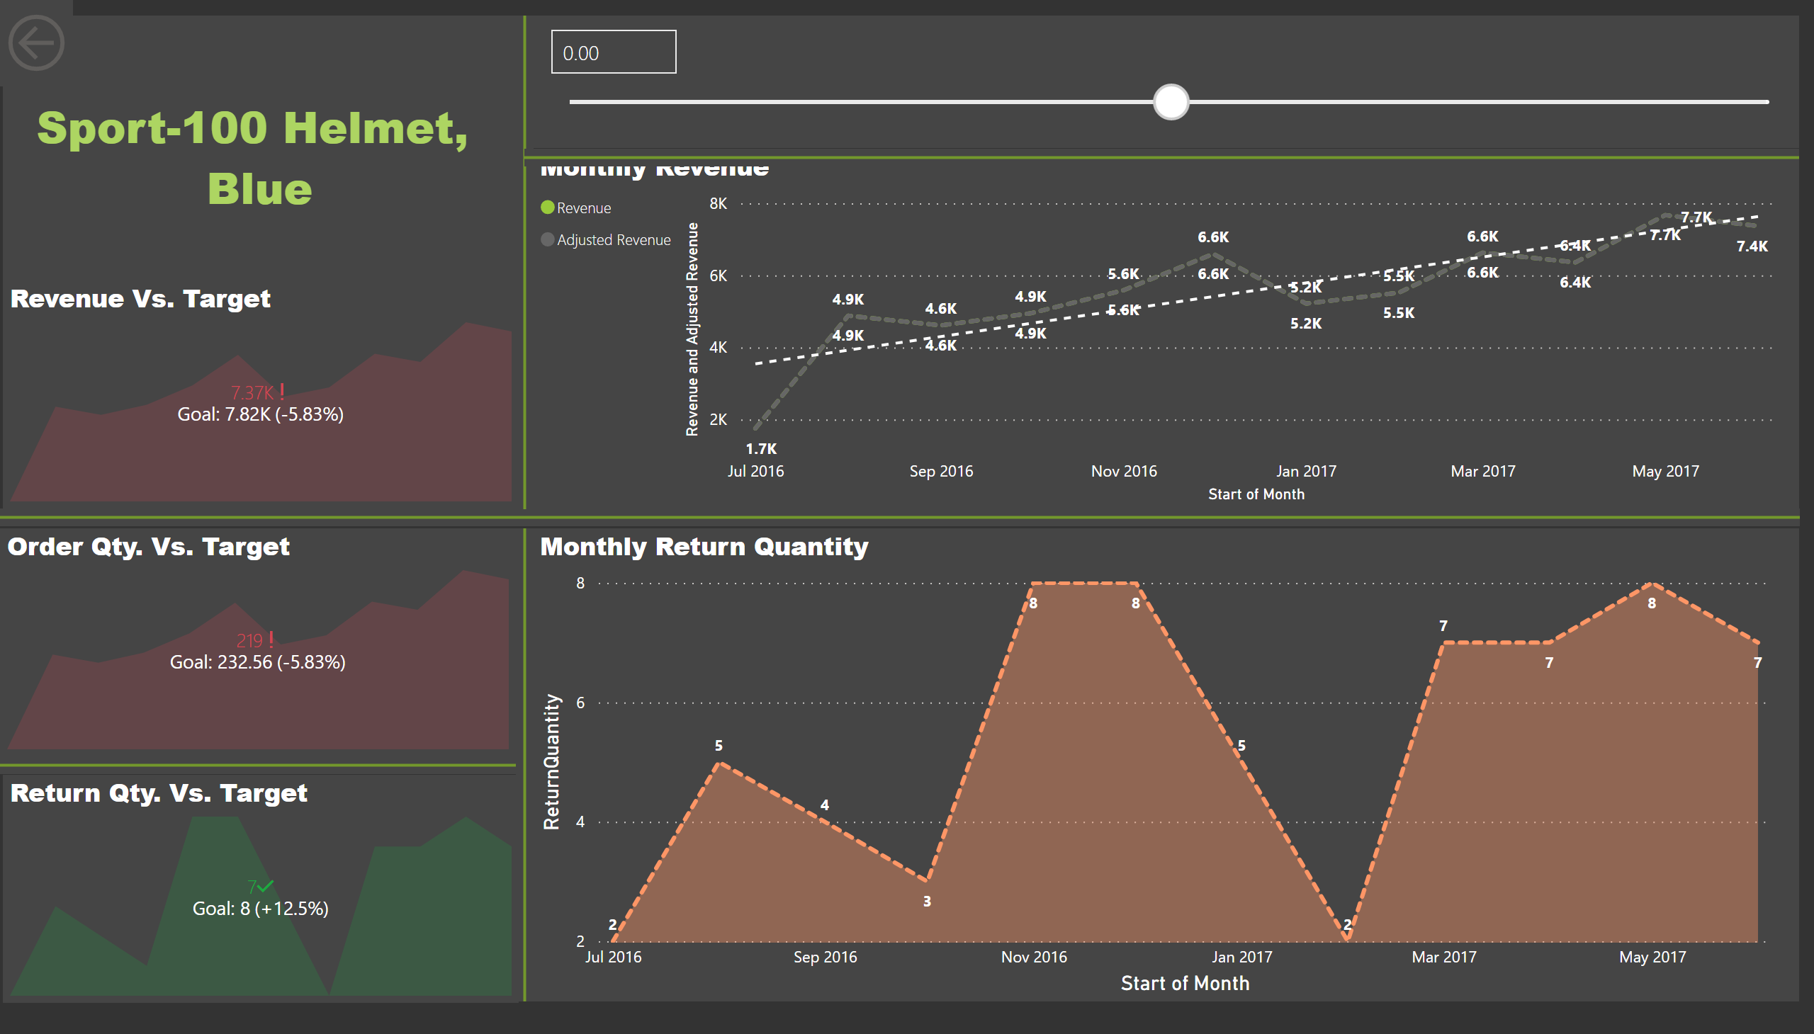
Product Details
Notes:
Monthly Revenue
No alt text provided
shape
No alt text provided
Monthly Return Quantity
No alt text provided
shape
No alt text provided
Revenue Vs. Target
No alt text provided
shape
No alt text provided
Order Qty. Vs. Target
No alt text provided
shape
No alt text provided
Return Qty. Vs. Target
No alt text provided
actionButton
No alt text provided
card
No alt text provided
slicer
No alt text provided
shape
No alt text provided

Slide 4
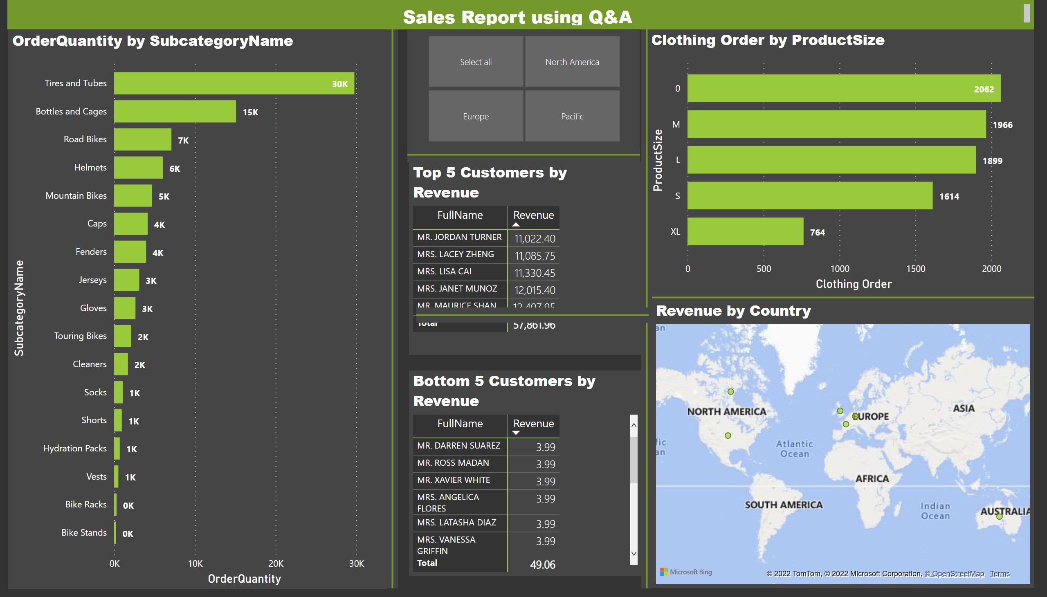
NLQ
Notes:
clusteredBarChart
No alt text provided
clusteredBarChart
No alt text provided
Top 5 Customers by Revenue
No alt text provided
Bottom 5 Customers by Revenue
No alt text provided
shape
No alt text provided
shape
No alt text provided
shape
No alt text provided
shape
No alt text provided
Revenue by Country
No alt text provided
textbox
No alt text provided
shape
No alt text provided
slicer
No alt text provided

Slide 5
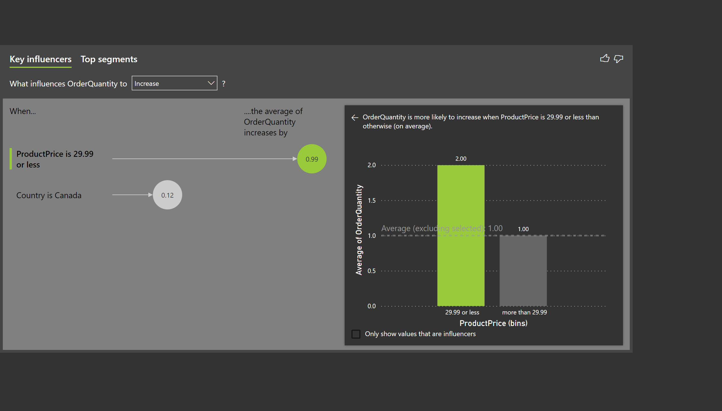
KI
Notes:
keyDriversVisual
No alt text provided

Slide 6
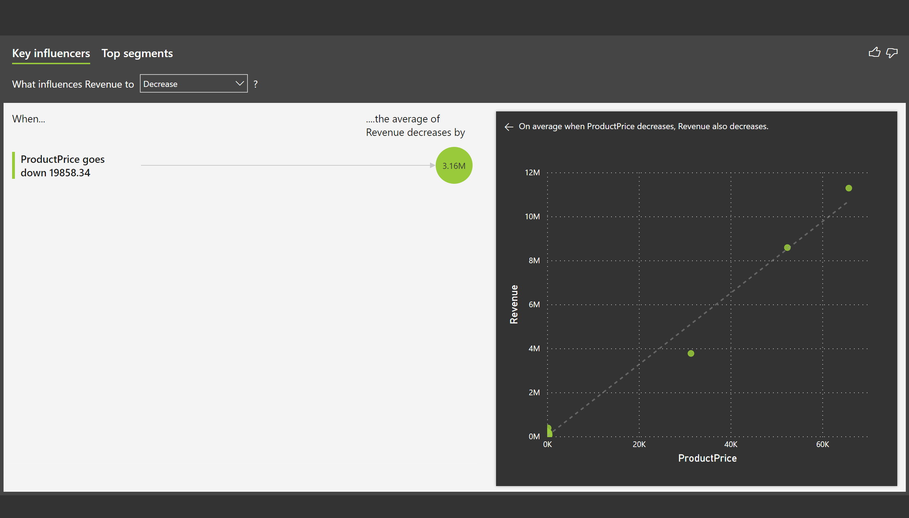
KI2
Notes:
keyDriversVisual
No alt text provided

Slide 7
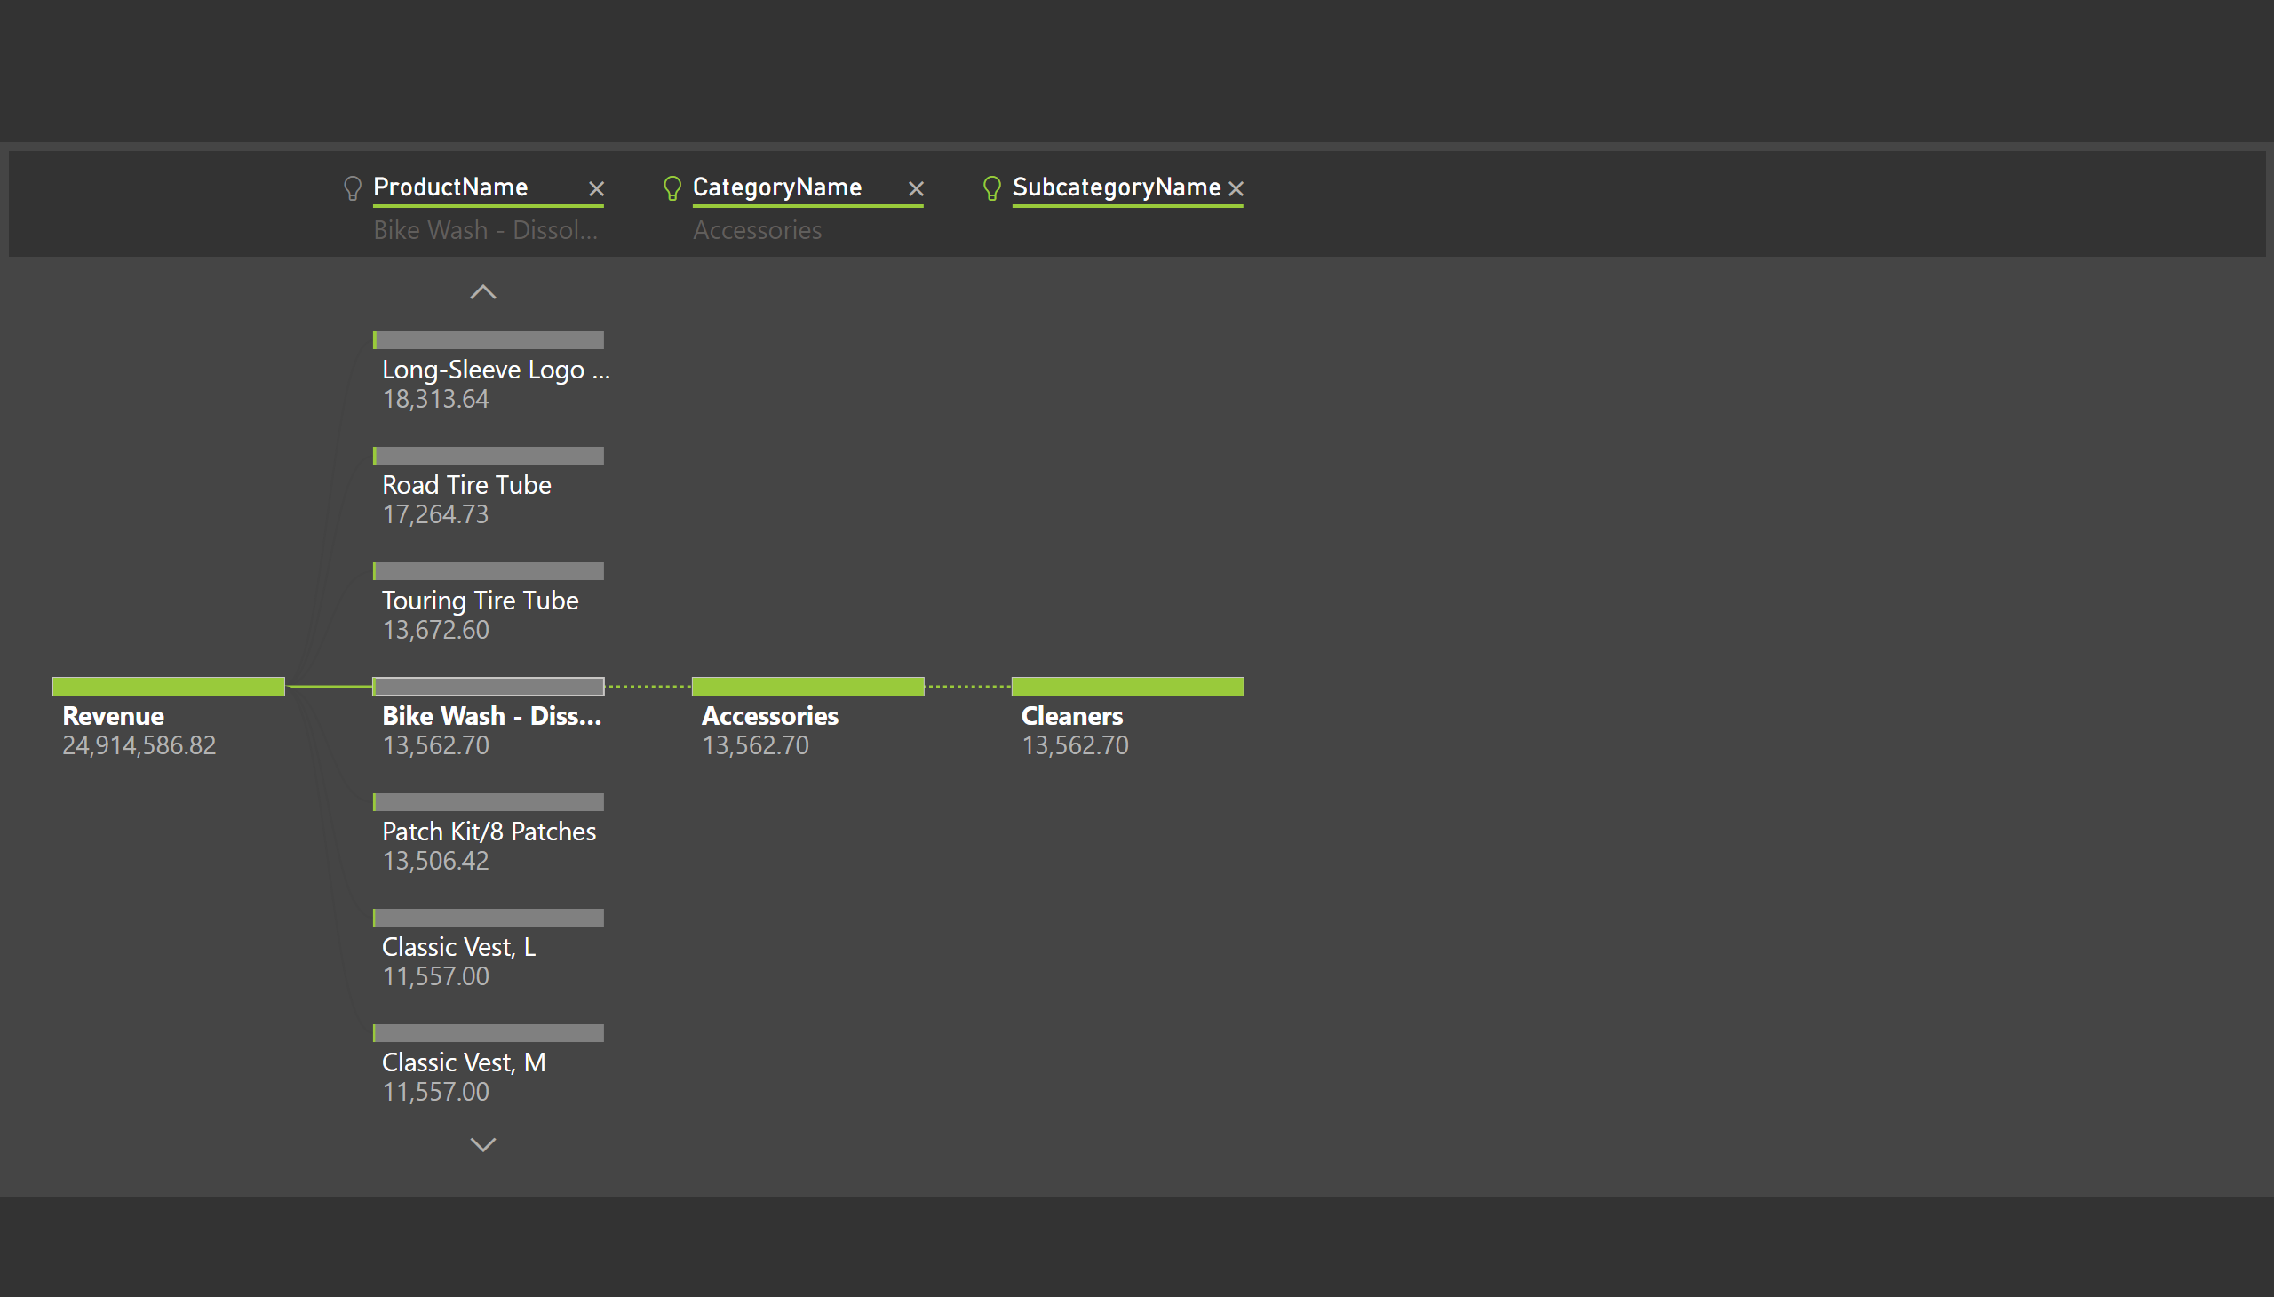
D Tree
Notes:
decompositionTreeVisual
No alt text provided

Slide 8
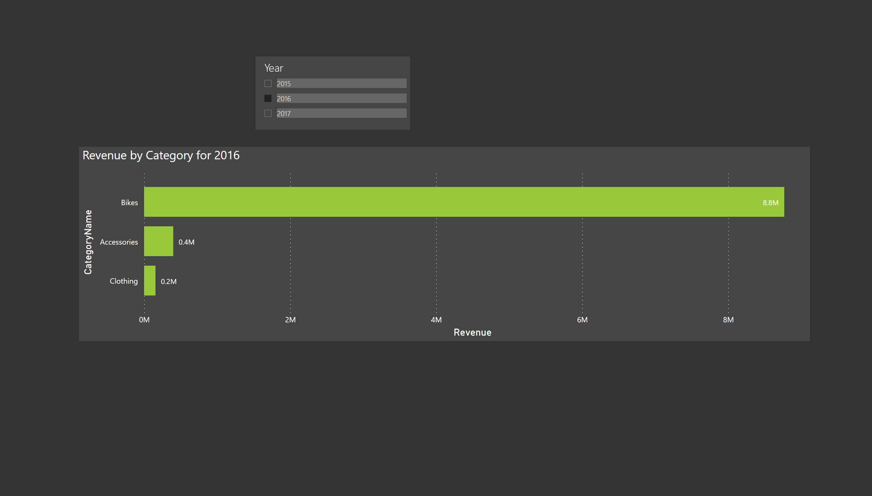
Titles
Notes:
Revenue by Category for 2016
No alt text provided
slicer
No alt text provided

