Slide 1

Principal Component Analysis (PCA)
A powerful dimensionality reduction technique that transforms complex data into simpler, more manageable forms while preserving essential information.

Slide 2
What is PCA?
Definition
Purpose
Applications
A dimensionality reduction technique that reduces the number of features while keeping the most important information.
Creates new uncorrelated features (principal components) that capture the maximum variance in the data.
Data preprocessing, removing redundancy, improving computational efficiency, and making data easier to visualize.
PCA is especially valuable when dealing with high-dimensional data that would otherwise be difficult to analyze or visualize.

Slide 3
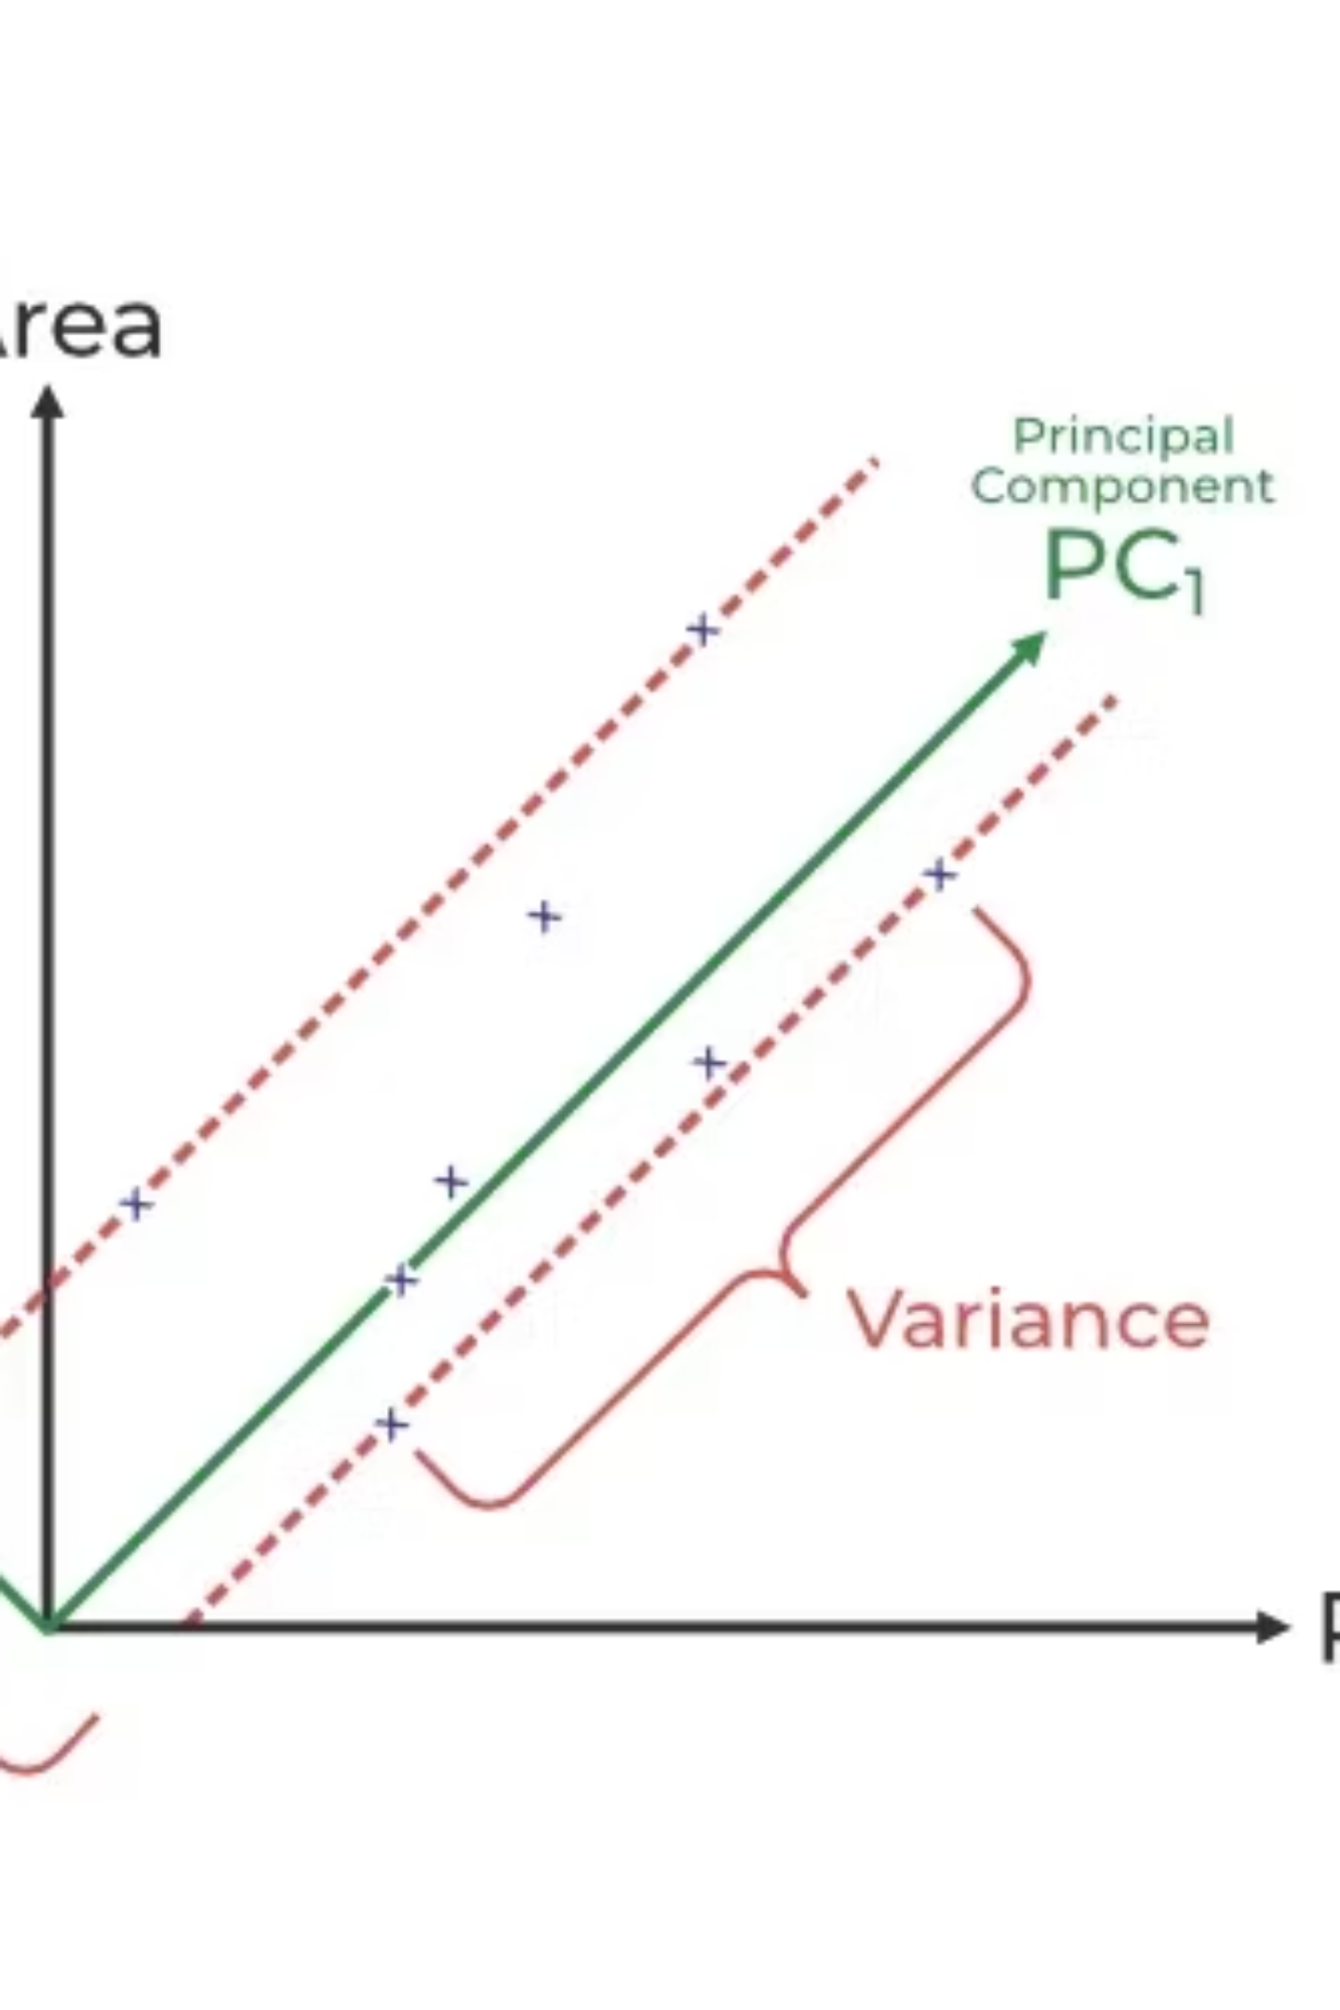
How PCA Works
Step 1: Standardize Data
Step 3: Find Principal Components
Transform features to have mean = 0 and standard deviation = 1
Calculate eigenvectors (directions) and eigenvalues (importance)
Step 2: Calculate Covariance Matrix
Step 4: Transform Data
Measure how features relate to each other
Select top components and project data onto them
In this example, PC₁ captures maximum variance, allowing us to transform 2D data into 1D while preserving important patterns.

Slide 4



Advantages of PCA
Handles Multicollinearity
Data Compression
Noise Reduction
Creates new, uncorrelated variables when original features are highly correlated.
Represents data with fewer components, reducing storage needs and speeding up processing.
Eliminates components with low variance to enhance data clarity.
PCA also helps with outlier detection by identifying data points that deviate significantly in the reduced space.

Slide 5

Limitations of PCA
Interpretation Challenges: New components are combinations of original variables, making them difficult to explain.
Scaling Sensitivity: Requires proper data scaling or results may be misleading.
Information Loss: May lose important information if too few components are kept.
PCA also assumes linear relationships between variables and can be computationally intensive for very large datasets.

