Slide 1
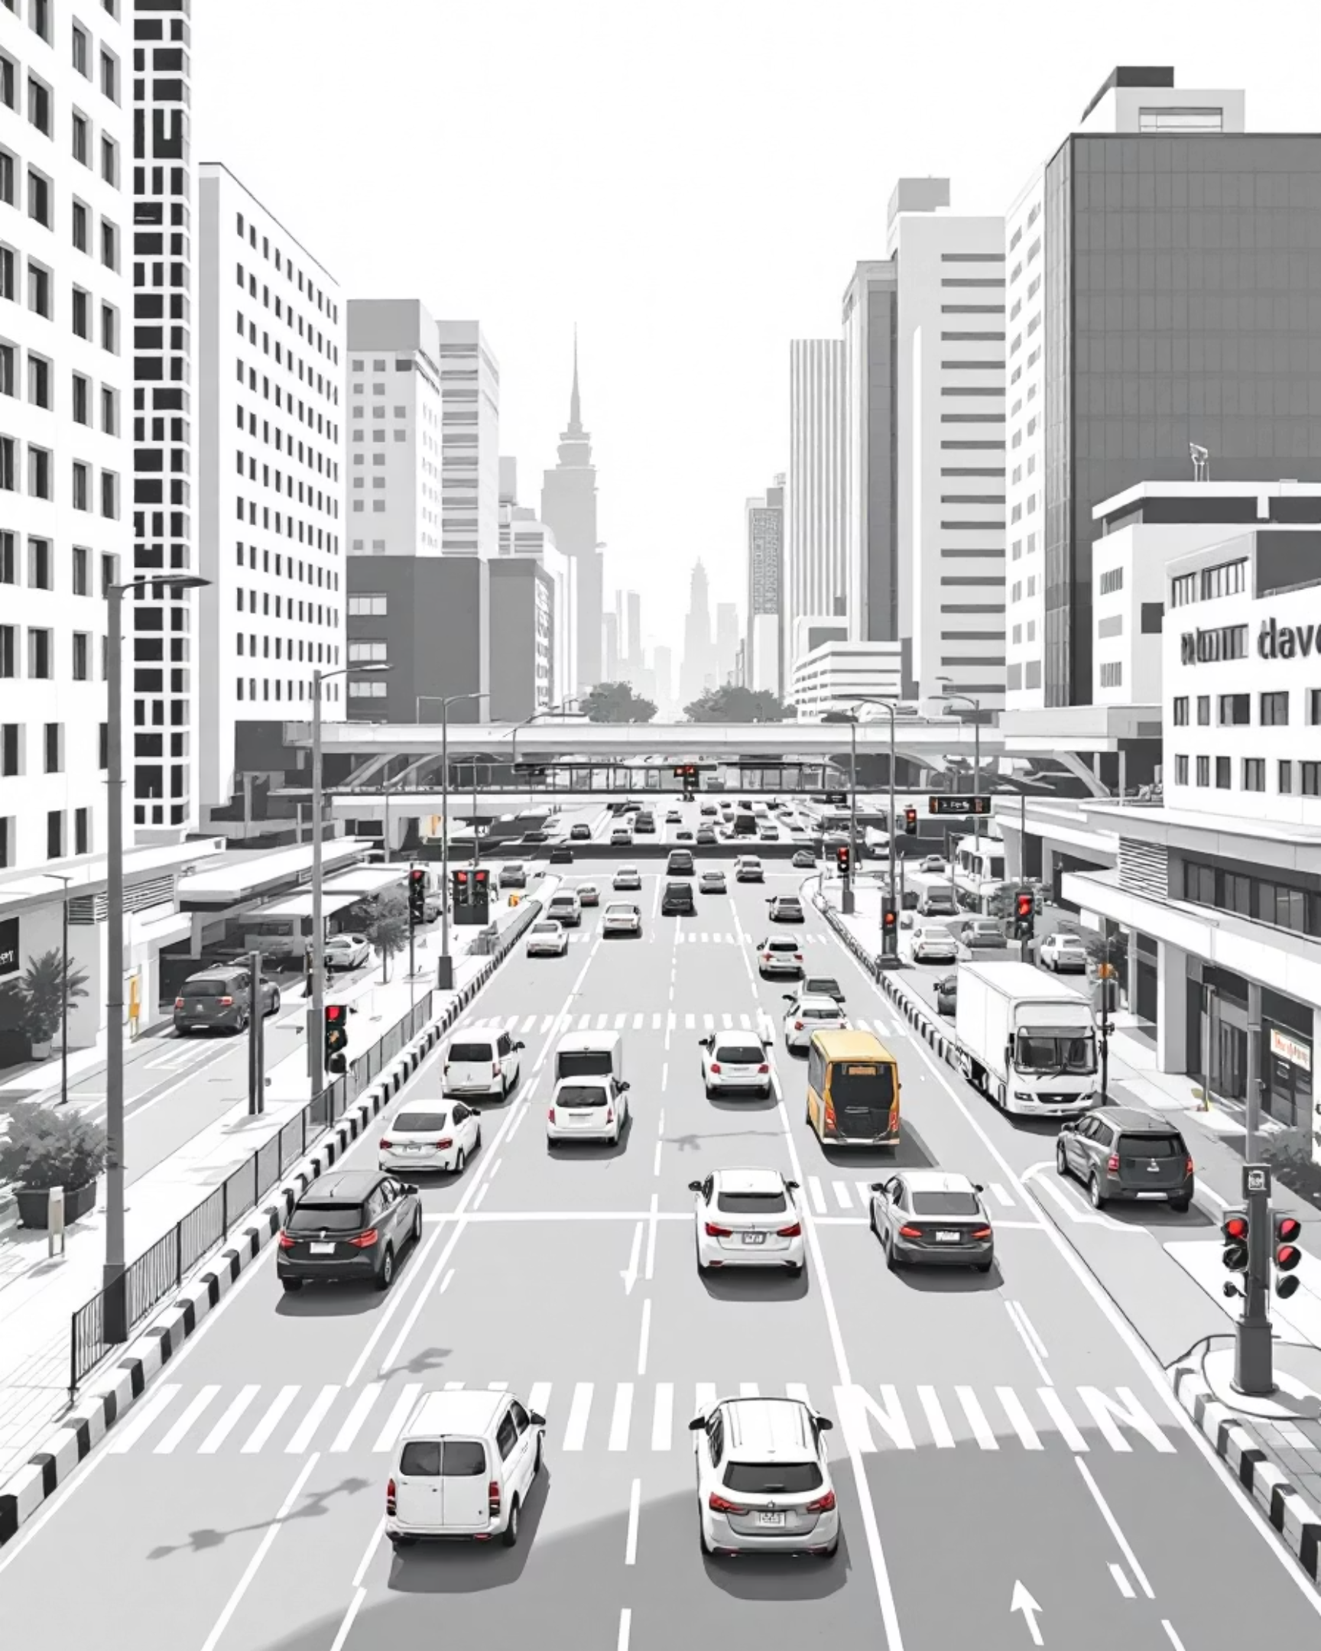
Traffic Flow Optimization(LSTM & XGBoost)
Predicting Traffic Congestion Levels in Bengaluru
By: Devashish Rawat

Slide 2
The Challenge
Problem Statement
Rapid urbanization → growing traffic congestion
Existing systems are reactive, not predictive
Leads to longer commute times, fuel waste, and high pollution
Need a predictive ML system that forecasts congestion in advance
Helps city planners and drivers make better route decisions

Slide 3
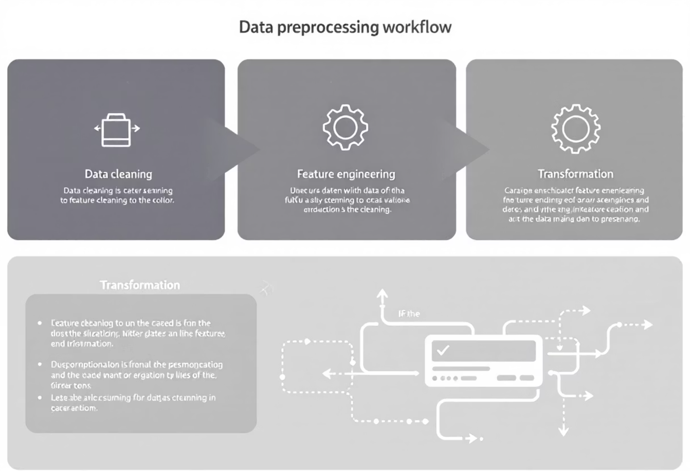
Dataset Overview
Bangalore Traffic Dataset
Dataset Scale
Preprocessing:
8,936 records, 16 features
Missing value handling
Encoding weather & area
Key features:
Time-based feature creation (day, month, weekend)
Traffic Volume
Lag & rolling features
Average Speed
Congestion Level
Travel Time Index
Road Capacity Utilization
Incident Reports
Weather Conditions
Pedestrian/Cyclist Count

Slide 4
Why We Use LSTM (Long Short-Term Memory)
Traffic is a time-series problem → depends on previous time steps
LSTM captures:
✔ Temporal dependencies✔ Rush hour cycles✔ Weekly patterns✔ Long-term and short-term traffic trends
LSTM memory cells learn:
LSTM is suitable when historical behavior strongly influences future conditions
If congestion rises for some time → likely to continue
Regular morning/evening peaks

Slide 5




Why We Use XGBoost
Dataset contains strong tabular patterns, not only sequences
XGBoost advantages:
Feature Engineering Power
✔ Excellent for structured/tabular data✔ Learns complex non-linear relationships✔ Robust to missing values & outliers✔ Faster training than deep learning✔ Provides feature importance → interpretability
Works extremely well with engineered features (lag values, rolling means, weather, incidents, time features)

Slide 6

Why XGBoost Outperformed LSTM
Actual Results:
-0.0287
0.9995
LSTM R²
XGBoost R²
(underfitting)
(near-perfect fit)
Reasons:
01
02
Dataset is small (8,936 rows) → not enough for LSTM
Features are mostly tabular, not purely sequential
03
04
Feature engineering greatly helps XGBoost
LSTM needs heavy tuning (window size, scaling, architecture)
05
06
Traffic patterns are non-linear → XGBoost captures better
XGBoost handles sudden spikes/drops effectively
Conclusion: XGBoost fits this dataset better due to its structure and size.

Slide 7
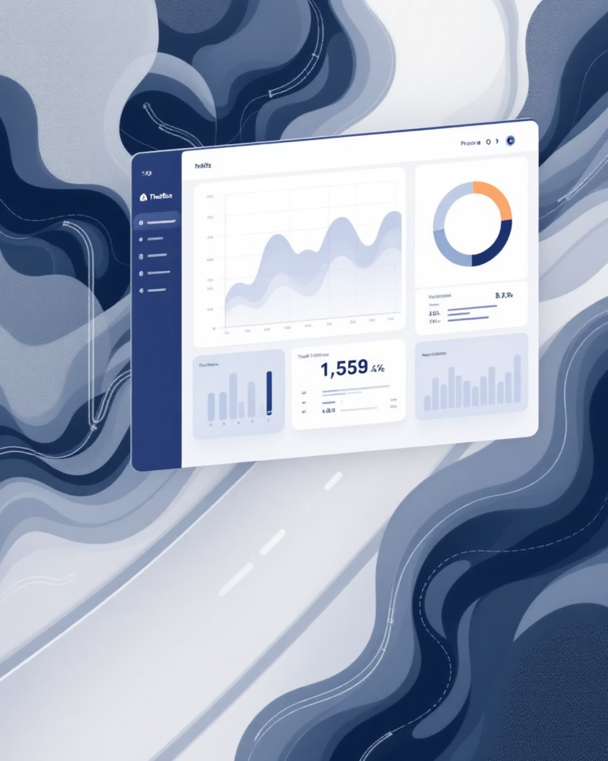
Streamlit Application
Built an interactive web app using Streamlit
Features:
✔ User inputs traffic parameters
✔ Model selection (LSTM / XGBoost)
✔ Predicts congestion level
✔ Visualizes results with charts
Helps users:
Understand traffic conditions
Make informed travel decisions
Explore congestion patterns in real-time

Slide 8
Conclusion & Future Scope
Conclusion:
Future Scope:
Developed a traffic congestion prediction system using LSTM & XGBoost
Integrate real-time live traffic APIs
Improve LSTM with bigger datasets
XGBoost achieved much stronger performance on this dataset
Develop a mobile version
Build a hybrid ensemble model
Streamlit app offers an intuitive and interactive interface
Add route optimization with Google Maps API

