Slide 1
Dependency Risk Analyzer
Project overview
Software Supply Chain Security using C++ Data Structures and OSV
Course project: dependency graph analysis, vulnerability lookup, and risk prioritization
Stack: C++17 • Flask • HTML/CSS/JavaScript • OSV API • curl.exe

Slide 2
Problem & Motivation
Modern software projects depend on third-party packages.
Developers need to inspect dependency relationships and known vulnerability records.
The project combines graph traversal, package lookups, and a browser dashboard in one workflow.

Slide 3
Objectives
Model dependency relationships as a directed graph.
Run BFS and DFS to explore the dependency graph.
Query OSV for supplied ecosystem/package/version tuples.
Demonstrate heap-based prioritization plus sorting, searching, hashing, stack, and queue.
Provide a usable web interface with upload validation and report output.

Slide 4
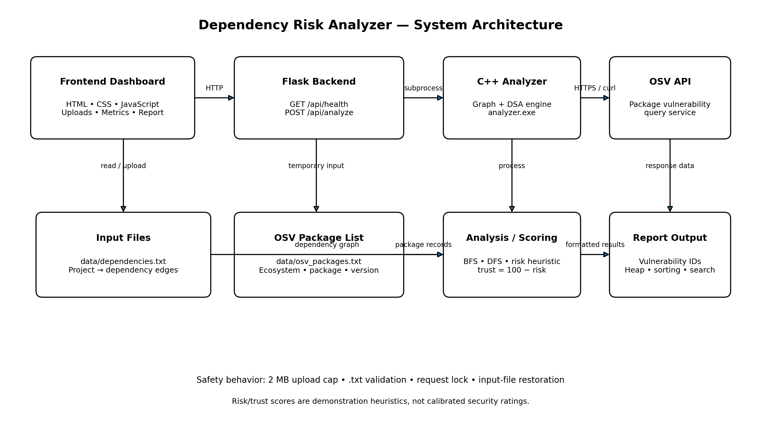
System Architecture

Slide 5
Core Data Structures
Directed graph: stores dependency edges.
BFS / DFS: traverse dependencies from the project node.
Max-heap: prioritizes scored packages by risk.
Hash table: package lookup; sorting and searching: organize and find package records.
Stack (LIFO) and queue (FIFO): demonstrate fundamental operations.

Slide 6
OSV Integration
The C++ OSV client builds a package query and invokes curl.exe over HTTPS.
Observed run: lodash 4.17.20 → 5 records; axios 0.21.0 → 25; express 4.17.1 → 2.
Total in that run: 32 records; 3 successful queries; 0 failed queries.
OSV data may change; records must be checked against affected-version ranges and applicability.

Slide 7
Risk & Trust Scoring
Risk = min(100, vulnerability_count × 25 + dependency_depth × 5)
Trust = 100 − risk
The scores are demonstration heuristics, not calibrated security ratings.
The max-heap ranks packages that received scores; failed queries are excluded from scored packages.

Slide 8
Frontend & Backend
Frontend: file upload controls, metrics, package risk table, and full report.
Flask GET /api/health reports backend and file/executable availability.
Flask POST /api/analyze invokes analyzer.exe and returns JSON report data.
The backend temporarily swaps uploaded inputs and restores original files in a finally block.

Slide 9
Testing Evidence
Passed: default C++ analysis, BFS/DFS, OSV lookups, and DSA output.
Passed: dashboard upload, direct analysis API, and health endpoint.
Passed: invalid dependency lines, blank lines, empty-file validation, invalid extension, and >2 MB upload rejection.
Passed: original input-file restoration and an OSV HTTP 400 failure-handling test.
Not yet tested: genuine network outage, timeout behavior end-to-end, and concurrency stress.

Slide 10
Limitations & Future Work
Current scoring is illustrative; not for production security decisions.
Add ecosystem lockfile parsers and richer severity / affected-version / remediation details.
Test network timeouts, malformed responses, and simultaneous requests.
Add dependency-path visualization, report export, and automated CI tests.

Slide 11
Conclusion & Demo Plan
Demonstrate graph edges → BFS/DFS → OSV results → heap ranking → dashboard report.
Explain why a vulnerability record count alone does not prove exploitability.
Keep the original data files for the live demo and start Flask from the project root.
Key takeaway: a data-structures project integrated with a real vulnerability-data source and a web UI.

