Slide 1

Dashboard
Presented By :- Devashish Jadoun In Guidance Of
Mr.Divakar kushwaha

Slide 2
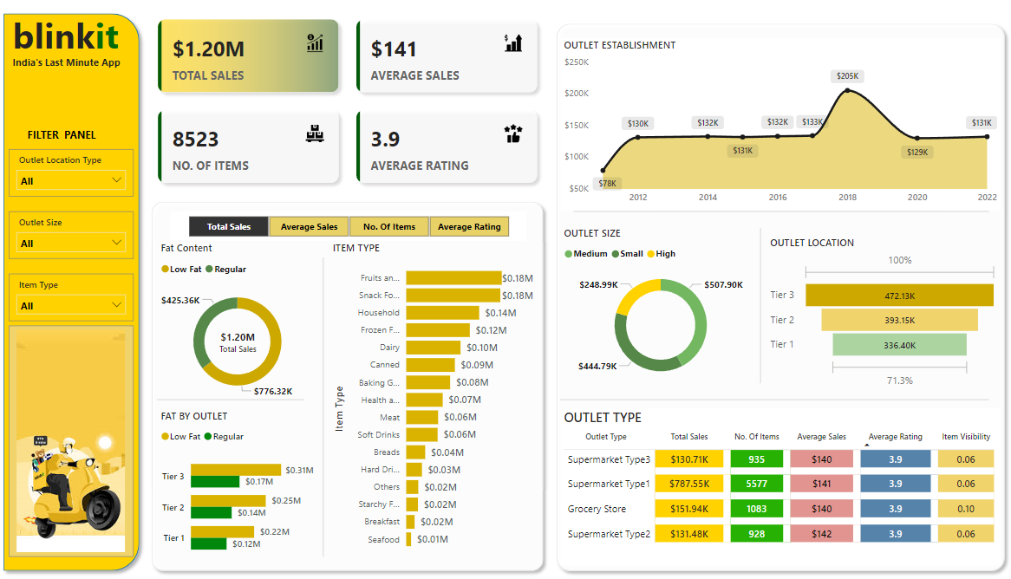
How the Dashboard looks

Slide 3
STEPS IN PROJECT
Requirement Gathering / Business Requirements
Data Walkthrough
Data Connection
Data Cleaning / Quality Check
Data Modeling
Data Processing
DAX Calculations
Dashboard Layouting
Charts Development and Formatting
Dashboard / Report Development
Insights Generation

Slide 4
BUSINESS REQUIREMENT
To conduct a comprehensive analysis of Blinkit's sales performance, customer satisfaction, and inventory distribution to identify key insights and opportunities for optimization using various KPIs and visualizations in Power BI.
Total Sales: The overall revenue generated from all items sold.
Average Sales: The average revenue per sale.
Number of Items: The total count of different items sold.
Average Rating: The average customer rating for items sold.

Slide 5
BUSINESS REQUIREMENT
Chart’s Requirements
1. Total Sales by Fat Content:
- Objective: Analyze the impact of fat content on total sales.
- Additional KPI Metrics: Assess how other KPIs (Average Sales, Number of Items, Average Rating) vary with fat content.
- Chart Type: Donut Chart.
2. Total Sales by Item Type:
- Objective: Identify the performance of different item types in terms of total sales.
- Additional KPI Metrics: Assess how other KPIs (Average Sales, Number of Items, Average Rating) vary with fat content.
- Chart Type: Bar Chart.

Slide 6
BUSINESS REQUIREMENT Chart’s Requirements
3. Fat Content by Outlet for Total Sales :
- Objective: Compare total sales across different outlets segmented by fat content.
- Additional KPI Metrics: Assess how other KPIs (Average Sales, Number of Items, Average Rating) vary with fat content.
- Chart Type: Stacked Column Chart.
4. Total Sales by Outlet Establishment :
- Objective: Evaluate how the age or type of outlet establishment influences total sales.
- Chart Type: Line Chart.
5. Sales by Outlet Size:
- Objective: Analyze the correlation between outlet size and total sales.
- Chart Type: Donut/ Pie Chart.

Slide 7
BUSINESS REQUIREMENT Chart’s Requirements
6. Sales by Outlet Location:
- Objective: Assess the geographic distribution of sales across different locations.
- Chart Type: Funnel Map.
7. All Metrics by Outlet Type:
- Objective: Provide a comprehensive view of all key metrics (Total Sales, Average Sales, Number of Items, Average Rating) broken down by different outlet types.
- Chart Type: Matrix Card.

