Slide 1


ONLINE INSURANCE PORTAL
:- DEVASHISH PARAS
SAGE University Indore

Slide 2


Why Insurance ?
Reduces financial risk and uncertainty.
Protects individuals and families from unexpected losses.
Acts as a safety net against high-cost events that can otherwise create significant financial burden.

Slide 3
PROBLEM STATEMENT
Traditional insurance processes are often time-consuming and require customers to visit offices or contact agents for policy information, purchases, and claim updates.

Slide 4
OBJECTIVE
To develop a user-friendly Online Insurance Portal.
To allow users to view policy details online
To calculate estimated insurance premiums.
To create a responsive website accessible on desktop and mobile devices.

Slide 5
INSURANCE PLANS
Life Insurance
Health Insurance
Vehicle Insurance
Travel Insurance

Slide 6
TECHNOLOGIES USED
Visual Studio Code
HTML5
CSS3
JavaScript
Google Chrome Browser

Slide 7

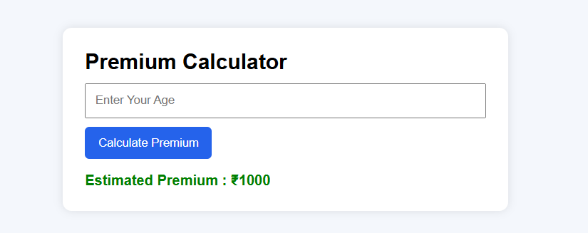

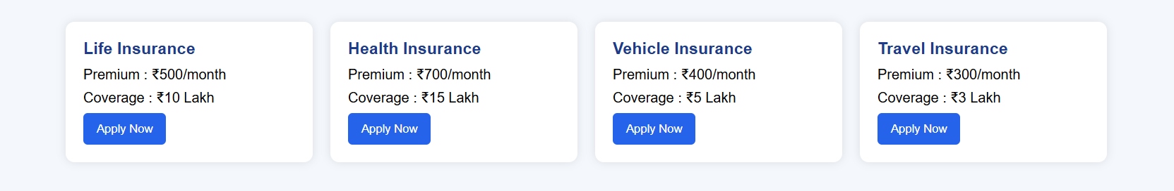
WEBPAGE FEATURES

Slide 8
FUTURE SCOPE
Backend
Database
Payment Gateway
Mobile Application

Slide 9
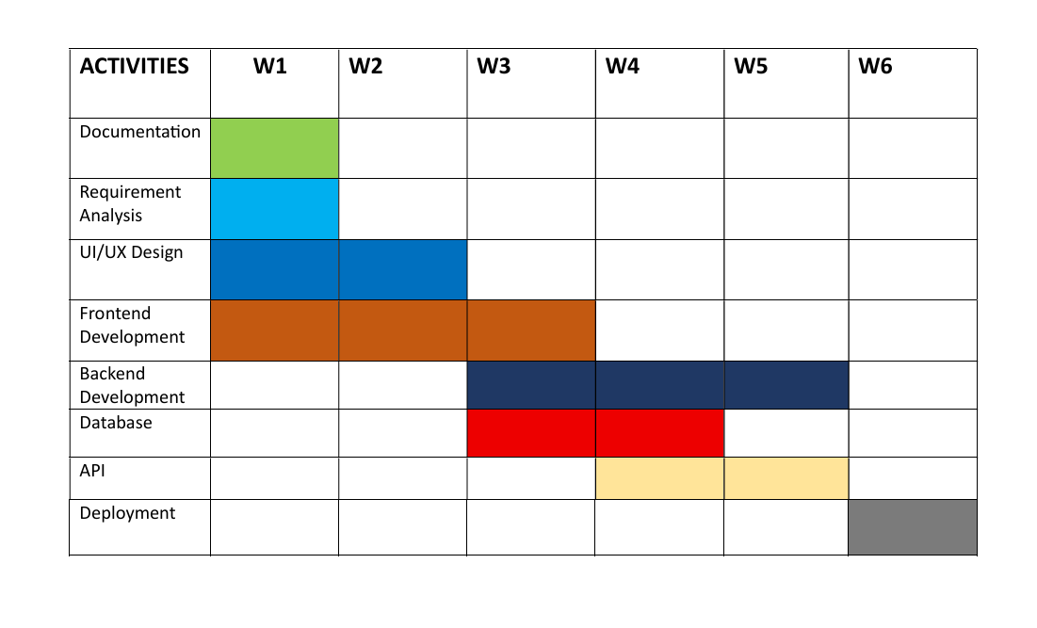
GANTT CHART

Slide 10
THANK YOU
WE WOULD BE HAPPY TO
ANSWER ANY QUESTIONS.

