Slide 1

WELCOME
Appropriate Institute of Rural Development (AIRD)
A group of people and institutions committed for strengthening people’s governance “Gram Swaraj”

Slide 2
Don’t believe on God come and see it.
Lord Buddha
Life is nothing but a bundle of thoughts.
Swami Vivekananda

Slide 3
Arise! Awake! and Stop not till the goal of soul is reached.
Soul
Energy
Goal
Salvation

Slide 4



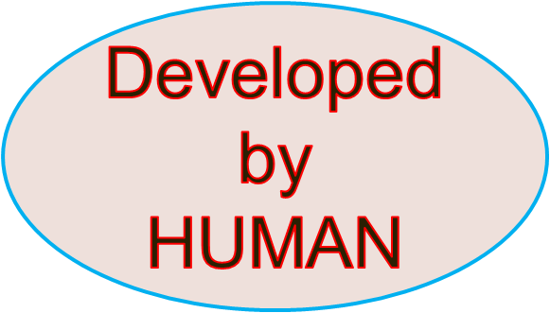
ENERGY
is nothing but power that makes nature and things
FUNCTIONAL

Slide 5


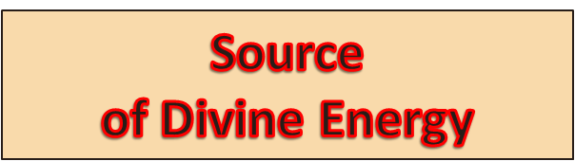
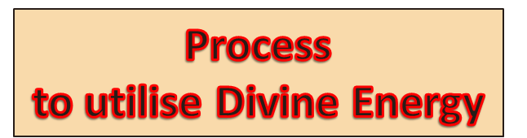

Slide 6

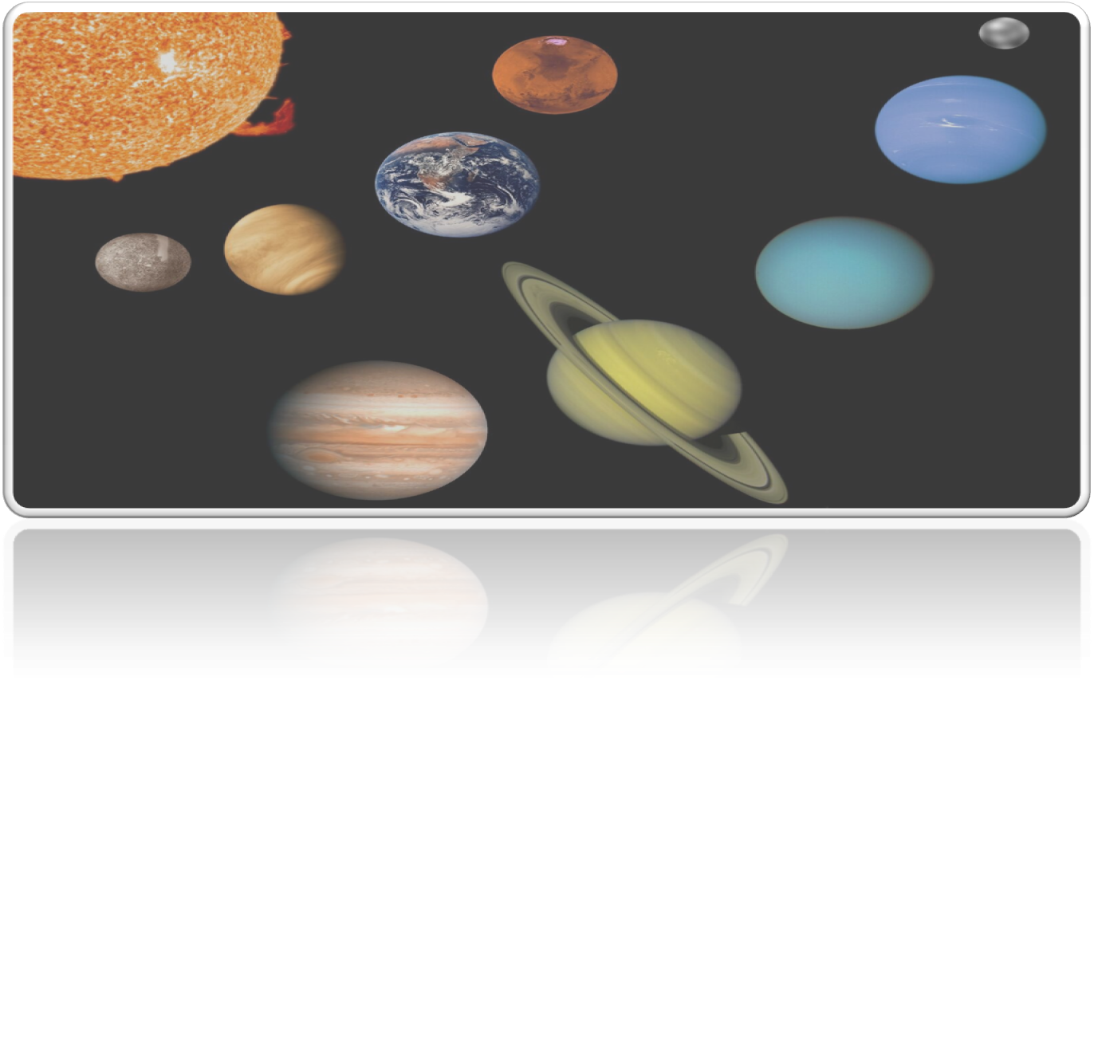
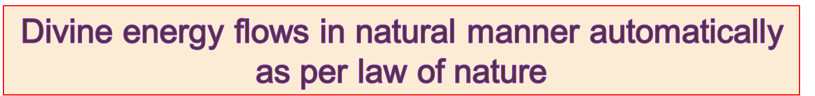

Slide 7
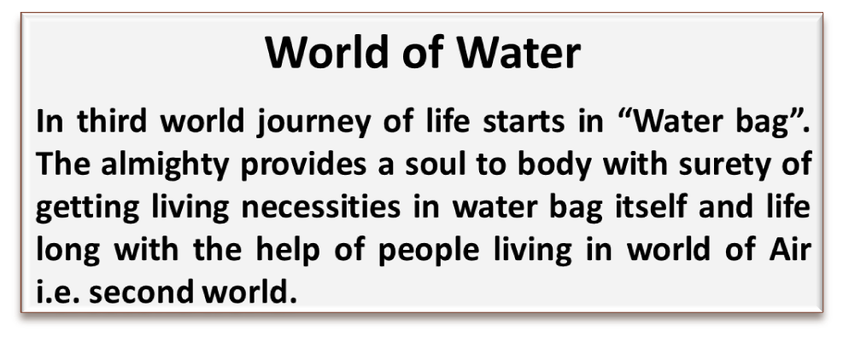
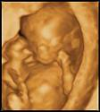



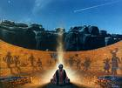

Soul rotate in three worlds
World of Air
People grows living materials for self consumption and for the body developing in third world. In second world mother provides food and drink through navel card to develop body in third world.
World of Ether
The first world provides rain, sun, gas etc. to let the people grow living materials and save life in both the worlds on earth planet.

Slide 8

The second world, where we live,
is an opportunity
to prepare ourselves for the first world.
Work in second world
Indifferent or
Blessings or
Curse
Work carefully to earn Blessings not the Curse

Slide 9

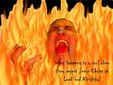


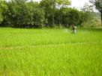



Moksha Salvation Satvi Jannat
Nark Hell Dozkh
Evaluation Zone After death on earth planet
Swarg Heaven Jannat
Automatic recording system of invisible power in invisible zone documenting our THOUGHT behind our work on EARTH PLANET

Slide 10
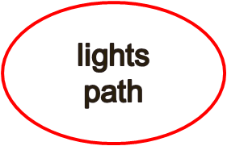



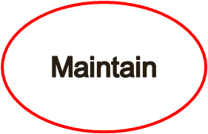

We pass time of earth planet as per our Choice and Perception
Based on our knowledge and wisdom.
To practice meditation for achieving goal of soul.
Spiritual science
To gain wisdom for understanding secret of life and work to achieve goal of soul.
Meditation
Wisdom
“Development Car “ to cover return journey of soul from visible to invisible zone.
.

Slide 11

Religious Teachings
Generator
Operator
Destroyer
GOD is invisible
The GOD is one

Slide 12

SOUL
Death
Journey of soul by DC from invisible to visible zone
F
A
T
H
E
R
Creation &
Development
M
O
T
H
E
R
Birth
Our Life on earth
for a certain period

Slide 13
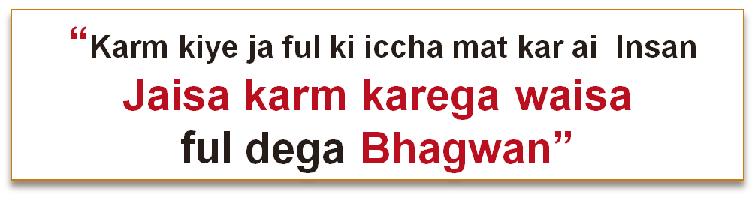

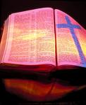


Religion and our Duties
Shrimad Bhawat Geeta:
Bible
“As you sow so you reap”
“Qyamat ke din hoga hisab”
dahine hath pe likhy kam se milage Jannat
aur bai hath pe likhy kam se milaga Dojhakh.”
A day is fixed for examination of our thought behind the works we did on earth planet.
Nothing can be hidden from the super power (Bhagwan, GOD, Allah)
The thought of serving other without temptation of getting benefits can only
empower us to enjoy MOKSHYA/SALVATION/SATVI JANNAT
Therefore, always work with a positive thought only.

Slide 14


Slide 15

AIRD is open for all
Contact
K. C. Tripathi
Registered office 46-A, Nai Basti Babu Ganj, Lucknow U. P. India 226020
Mobile: 9169888444 E-mail: aird.up.india@gmail.com or ngikctripathi.india@gmail.com

