Slide 1
CS276
Information Retrieval and Web Search
Pandu Nayak and Prabhakar Raghavan
Lecture 17: Crawling and web indexes

Slide 2
Today’s lecture
Crawling

Slide 3
Basic crawler operation
Sec. 20.2
Begin with known “seed” URLs
Fetch and parse them
  Extract URLs they point to
  Place the extracted URLs on a queue
Fetch each URL on the queue and repeat

Slide 4

Crawling picture
Sec. 20.2
URLs crawled
and parsed
Unseen Web
Seed
pages
URLs frontier
Web

Slide 5
Simple picture – complications
Sec. 20.1.1
Web crawling isn’t feasible with one machine
  All of the above steps distributed
Malicious pages
  Spam pages
  Spider traps – incl dynamically generated
Even non-malicious pages pose challenges
  Latency/bandwidth to remote servers vary
  Webmasters’ stipulations
    How “deep” should you crawl a site’s URL hierarchy?
  Site mirrors and duplicate pages
Politeness – don’t hit a server too often

Slide 6
What any crawler must do
Sec. 20.1.1
Be Polite: Respect implicit and explicit politeness considerations
  Only crawl allowed pages
  Respect robots.txt (more on this shortly)
Be Robust: Be immune to spider traps and other malicious behavior from web servers

Slide 7
What any crawler should do
Sec. 20.1.1
Be capable of distributed operation: designed to run on multiple distributed machines
Be scalable: designed to increase the crawl rate by adding more machines
Performance/efficiency: permit full use of available processing and network resources

Slide 8
What any crawler should do
Sec. 20.1.1
Fetch pages of “higher quality” first
Continuous operation: Continue fetching fresh copies of a previously fetched page
Extensible: Adapt to new data formats, protocols

Slide 9
Updated crawling picture
Sec. 20.1.1
URLs crawled
and parsed
Unseen Web
Seed
Pages
URL frontier
Crawling thread

Slide 10
URL frontier
Sec. 20.2
Can include multiple pages from the same host
Must avoid trying to fetch them all at the same time
Must try to keep all crawling threads busy

Slide 11
Explicit and implicit politeness
Sec. 20.2
Explicit politeness: specifications from webmasters on what portions of site can be crawled
  robots.txt
Implicit politeness: even with no specification, avoid hitting any site too often

Slide 12
Robots.txt
Sec. 20.2.1
Protocol for giving spiders (“robots”) limited access to a website, originally from 1994
  www.robotstxt.org/wc/norobots.html
Website announces its request on what can(not) be crawled
  For a server, create a file /robots.txt
  This file specifies access restrictions

Slide 13
Robots.txt example
Sec. 20.2.1
No robot should visit any URL starting with
"/yoursite/temp/", except the robot called “searchengine":
User-agent: *
Disallow: /yoursite/temp/
User-agent: searchengine
Disallow:

Slide 14
Basic crawl architecture
Sec. 20.2.1
WWW
DNS
Doc
FP’s
robots
filters
URL
set
Parse
Fetch
Content
seen?
URL
filter
Dup
URL
elim
URL Frontier

Slide 15
Processing steps in crawling
Sec. 20.2.1
Pick a URL from the frontier
Fetch the document at the URL
Parse the URL
  Extract links from it to other docs (URLs)
Check if URL has content already seen
  If not, add to indexes
For each extracted URL
  Ensure it passes certain URL filter tests
  Check if it is already in the frontier (duplicate URL elimination)
Which one?
E.g., only crawl .edu, obey robots.txt, etc.

Slide 16
DNS (Domain Name Server)
Sec. 20.2.2
A lookup service on the internet
  Given a URL, retrieve its IP address
  Service provided by a distributed set of servers – thus, lookup latencies can be high (even seconds)
Common OS implementations of DNS lookup are blocking: only one outstanding request at a time
Solutions
  DNS caching
  Batch DNS resolver – collects requests and sends them out together

Slide 17
Parsing: URL normalization
Sec. 20.2.1
When a fetched document is parsed, some of the extracted links are relative URLs
E.g., http://en.wikipedia.org/wiki/Main_Page has a relative link to /wiki/Wikipedia:General_disclaimer which is the same as the absolute URL http://en.wikipedia.org/wiki/Wikipedia:General_disclaimer
During parsing, must normalize (expand) such relative URLs

Slide 18
Content seen?
Sec. 20.2.1
Duplication is widespread on the web
If the page just fetched is already in the index, do not further process it
This is verified using document fingerprints or shingles

Slide 19
Filters and robots.txt
Sec. 20.2.1
Filters – regular expressions for URL’s to be crawled/not
Once a robots.txt file is fetched from a site, need not fetch it repeatedly
  Doing so burns bandwidth, hits web server
Cache robots.txt files

Slide 20
Duplicate URL elimination
Sec. 20.2.1
For a non-continuous (one-shot) crawl, test to see if an extracted+filtered URL has already been passed to the frontier
For a continuous crawl – see details of frontier implementation

Slide 21
Distributing the crawler
Sec. 20.2.1
Run multiple crawl threads, under different processes – potentially at different nodes
  Geographically distributed nodes
Partition hosts being crawled into nodes
  Hash used for partition
How do these nodes communicate and share URLs?

Slide 22
Communication between nodes
Sec. 20.2.1
Output of the URL filter at each node is sent to the Dup URL Eliminator of the appropriate node
WWW
DNS
To
other
nodes
URL
set
Parse
Doc
FP’s
robots
filters
Fetch
Content
seen?
URL
filter
Host
splitter
Dup
URL
elim
From
other
nodes
URL Frontier

Slide 23
URL frontier: two main considerations
Sec. 20.2.3
Politeness: do not hit a web server too frequently
Freshness: crawl some pages more often than others
  E.g., pages (such as News sites) whose content changes often
These goals may conflict each other.
(E.g., simple priority queue fails – many links out of a page go to its own site, creating a burst of accesses to that site.)

Slide 24
Politeness – challenges
Sec. 20.2.3
Even if we restrict only one thread to fetch from a host, can hit it repeatedly
Common heuristic: insert time gap between successive requests to a host that is >> time for most recent fetch from that host

Slide 25
URL frontier: Mercator scheme
Sec. 20.2.3
URLs
Prioritizer
K front queues
Biased front queue selector
Back queue router
B back queues
Single host on each
Back queue selector
Crawl thread requesting URL

Slide 26
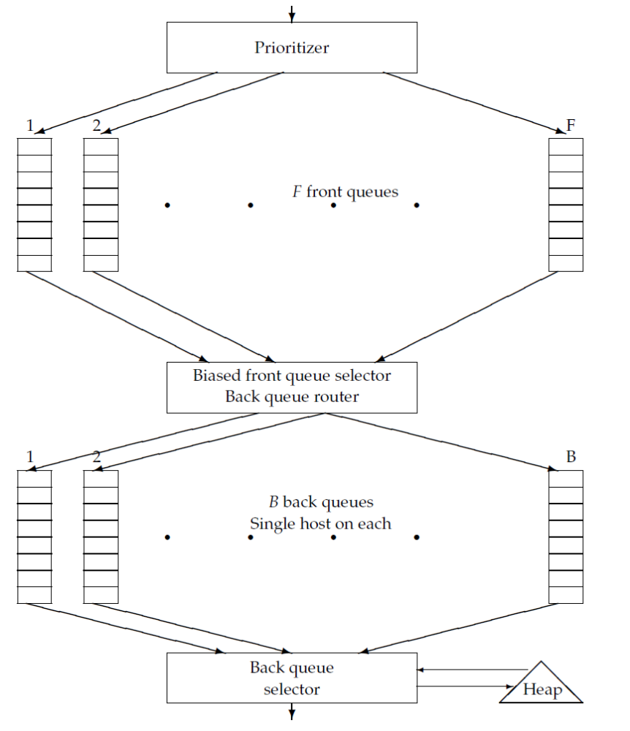

Slide 27
Mercator URL frontier
Sec. 20.2.3
URLs flow in from the top into the frontier
Front queues manage prioritization
Back queues enforce politeness
Each queue is FIFO

Slide 28
Front queues
Sec. 20.2.3
Prioritizer
1
K
Biased front queue selector
Back queue router

Slide 29
Front queues
Sec. 20.2.3
Prioritizer assigns to URL an integer priority between 1 and K
  Appends URL to corresponding queue
Heuristics for assigning priority
  Refresh rate sampled from previous crawls
  Application-specific (e.g., “crawl news sites more often”)

Slide 30
Biased front queue selector
Sec. 20.2.3
When a back queue requests a URL (in a sequence to be described): picks a front queue from which to pull a URL
This choice can be round robin biased to queues of higher priority, or some more sophisticated variant
  Can be randomized

Slide 31
Back queues
Sec. 20.2.3
Biased front queue selector
Back queue router
1
B
Heap
Back queue selector

Slide 32
Back queue invariants
Sec. 20.2.3
Each back queue is kept non-empty while the crawl is in progress
Each back queue only contains URLs from a single host
  Maintain a table from hosts to back queues
Host name | Back queue
… | 3
 | 1
 | B

Slide 33
Back queue heap
Sec. 20.2.3
One entry for each back queue
The entry is the earliest time t_{e} at which the host corresponding to the back queue can be hit again
This earliest time is determined from
  Last access to that host
  Any time buffer heuristic we choose

Slide 34
Back queue processing
Sec. 20.2.3
A crawler thread seeking a URL to crawl:
Extracts the root of the heap
Fetches URL at head of corresponding back queue q (look up from table)
Checks if queue q is now empty – if so, pulls a URL v from front queues
  If there’s already a back queue for v’s host, append v to q and pull another URL from front queues, repeat
  Else add v to q
When q is non-empty, create heap entry for it

Slide 35
Number of back queues B
Sec. 20.2.3
Keep all threads busy while respecting politeness
Mercator recommendation: three times as many back queues as crawler threads

Slide 36
Resources
IIR Chapter 20
Mercator: A scalable, extensible web crawler (Heydon et al. 1999)
A standard for robot exclusion

