Slide 1
Bio-Energy

Slide 2
Biomass Conversion Technologies
(1) Wet Processes-Biochemical
(a) Anaerobic Digestion
(b) Fermentation
(c) Chemical Reduction
(2) Dry Processes-Thermochemical
(a) Liquefaction
(b) Gasification
(c) Steam Gasification
(d) Hydrogenation
(3) Oil-extraction

Slide 3
Anaerobic Digestion
It involves micro-organism that can live and grow without air or Oxygen.
It gets its Oxygen from decomposition of matter containing it.
Low temperature process up to 65 degree Celsius.
Requires 80 % moisture content.
Process generates CH₄ and CO₂ and minimum impurities like Hydrogen sulphide.
The gas can be directly burned or upgraded to premium fuel by removal of CO_{2.}

Slide 4
Fermentation
It is the process of breakdown of complex molecules in organic compound under the influence of a ferment such as yeast, bacteria, enzymes.
Used for conversion of grains and sugar crops into ethanol.
Then they are been grounded or pulped and then cooked with enzymes to release the starch and convert it to fermentable sugars.
The end product of fermentation contains high protein content and it is useful in cattle feed supplement.

Slide 5
Chemical Reduction
It is the least developed conversion process.
It involves pressure-cooking animal wastes or plant cellulosic slurry with an alkaline catalyst in the presence of carbon monoxide at temperature between 250 degree to 400 degree Celsius.
Under these conditions the organic material is converted into a mixture of oils with 50 % yield.
If the pressure is reduced and temperature increases, the product is high calorific value.

Slide 6
Pyrolysis
It is the process at high temperature and in the absence of Air.
Roasting dry woody matter like straw and wood chips are fed into a reactor vessel and in a pulverized form and heated in the absence of air.
As temperature rises, the cellulose and lignin brake down to simple substances.
Char residue remains behind after the process.
The end product depends on the process temperature.
If temp. is around 500 ⁰C - Organic liquid predominate.
If temperature is 1000 ⁰C - Combustible mixture with result.

Slide 7
Liquefaction
Liquid yields are maximized by rapid heating of feedstock to comparative low temperature.
Vapor is condensed from the gas stream and these separate into two phase liquor. The aqueous phase contains the soup of water soluble organic material like acetic acid, acetone and methanol.
Non-aqueous phase consists of oils and tars.
These crude products can be burnt but it is more profitable to upgrade them in premium fuels by further refinement.

Slide 8
Gasification
Pyrolysis of wet biomass produces fuel gas and very little liquid.
An alternative technique for maximizing gas yields is to blow small quantities of air or oxygen into the reactor vessel and to increase the temperatures to over 1000 ⁰ C.
Fuel gas from air-blown gasifiers have low calorific value (5 MJ/m³) and oxygen fed systems has a medium (5 to 15 MJ/m³) calorific value.
This gas can either be burnt or provide to IC Engine coupled with generator for electricity generation.

Slide 9
Steam Gasification
Instead of air, steam is taken as an oxidizer.
The hydrogen and carbon monoxide can be added or more commonly generated in the reactor vessel from carbon dioxide and steam.
Ideal when high yield of hydrogen is required for applications such as fuel cell, etc.

Slide 10
Hydrogenation
Under less severe conditions of pressure and temperature (300-400⁰C and 100 atm) carbon monoxide and steam react with cellulose to produce heavy oils which can be separated and refined to premium fuels.

Slide 11
Bio-Mass Conversion Technologies
Conversion Process | Solids | Principle Products (Liquids) | Gases | Further Treatment | Premium Fuels
Anaerobic Digestion | - | - | Methane and Carbon dioxide | CO₂ removal | Methane
Fermentation | - | Ethanol | - | Distillation | Ethanol
Chemical Reduction | - | Mixture of Oils | - | Fractional Distillation | Hydrocarbon Liquids
Liquefaction Gasification Steam- Gasification | CHAR | Pyro- ligneous Acid oils and tars | Fuel Gas Fuel Gas Methane | Steam Reforming & Shift reaction | Methane , Methanol or higher hydrocarbons
Hydrogenation | - | Oil mixture | - | Distillation | HC liquids
Oil-extraction | - | Veg. Oil |  | Esterification | Diesel Substitute

Slide 12
Bio-Gas Plants
Classification of Bio-gas Plant
(1) Continuous and Batch types
(a) Continuous- (I) Single stage (II) Double stage
(b) The batch Plant
(2) The dome and the drum type
(a) Floating Gas holder plant
(b) Fixed dome digester
(3) Different Variations in the drum type.
(a) With water seal
(b) Without water seal

Slide 13
Continuous Type Single Process Plant
Entire Conversion process of complex organic compound takes place in single chamber.
The chamber is regularly fed with
raw material while the spent
residue keeps moving out.
Gas Storage
Gas Outlet
Scum Layer
Supernatant Layer
Supernatant
Outlet
Sludge Inlet
Actively Digesting Slurry
Digested Sludge
Sludge Outlet

Slide 14
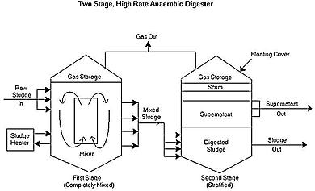
Two Stage Digester
The acedogenic stage and the
methenogenic stage are physi-
cally separated into two
chambers.
The first stage of acid product-
ion is carried out in first cham-
ber and diluted acids are fed
to the second chamber.
The plant will generate gas
continuously and requires small digestion chambers.
It needs less period of digestion.
Less problems compared to batch type and easier in operation.

Slide 15
The Batch type Plant
The feeding is between intervals.
The plant is emptied after the process of digestion is complete.
In this type the battery of digester is charged along with lime and allowed to produce gas for 40-50 days. These are charged and emptied one by one in synchronous manner which maintains regular supply of gas.
It needs several chambers for continuous gas production.
Good for fibrous material.
This plant needs additional fermented slurry to start the digestion process.
It is comparatively expensive and having problems comparatively.
It is expensive to install and unless operated in large scale, it would not be economical.

Slide 16
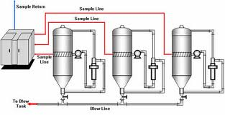
The Batch type Plant

Slide 17
The Dome and Drum type Digesters and its different Variations
There are numerous models available in the market.
The fixed dome digester is known as Chinese Plant.
The floating gas holder digester used in India is known as KVIC plant.
KVIC can be constructed in different designs, shapes, vertical or horizontal or it may be above or underneath the ground.
In fixed dome type plant, the gas holder and the digester are combined.
Fixed dome is best suited for batch process.
It is usually built under ground level and suitable for cooler region.
Two main variations in floating drum is with water seal and without water seal.
Water sealing makes the plant completely anaerobic and corrosion of the gas holder drum is also reduced.
The other variations are the material of construction of digester and the gas holder.

Slide 18
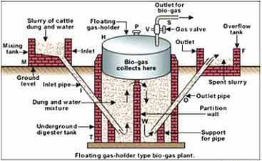
KVIC(Khadi and Village Industries Commission) Plant
Separate gas holder
Steel drum or
floating gas holder design.
Digestion takes place in
masonry well.
As the gas collects, drum
tends to float.
Cost of m.s Gas holder is the
main drawback of this plant.
Design available in 1 cum to
140 cum per day.
10 cm of water column pressure lifts the drum up to 20 m to 100 m.

Slide 19
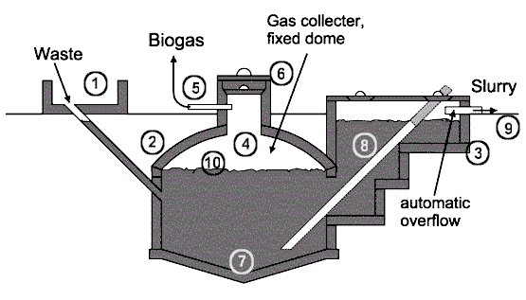
Fixed Dome (Janta) type Chinese Plant
Combined gas holder and digester.
Steel dome is replaced by fixed
dome roof of masonry construction.
Dome roof requires specialized skills
and design.
Construction requires skilled
masons which is scarce in rural area.
It is cheaper than KVIC plant for the
same capacity.
Pressure up to 70 cm of water is the important characteristic of the plant.
1. Mixing tank with inlet pipe and sand trap. 2. Digester. 3. Compensation and removal tank. 4. Gasholder. 5. Gas pipe. 6. Entry hatch, with gastight seal. 7. Accumulation of thick sludge. 8. Outlet pipe. 9. Reference level. 10. Supernatant scum, broken up by varying level.

Slide 20
Advantages/Disadvantages
Advantages of Floating Drum Plant:
Less scum troubles because of constantly submerged solid.
Danger of mixing oxygen with gas is minimum to prevent explosion.
Higher gas production per cum of digester volume.
No problem of gas leakage.
Constant gas pressure.
No separate pressure equalizer is needed.
Disadvantages of Floating Drum Plant:
Higher cost due to steel and cement.
Heat lost is more due to metal gas holder.
Gas holder requires painting for corrosion prevention from moisture.
Higher maintenance.

Slide 21
Advantages/Disadvantages
Advantages of Fixed dome type plant:
Low cost compared to floating dome type.
No corrosion trouble due to absence of metal parts.
Better heat insulation as it is constructed beneath the ground.
No maintenance.
Cattle and human waste can be fed with fibrous stalks.
Disadvantages of Fixed dome type plant
Its construction requires skilled masons who are scarce in rural areas.
Gas production per cum of digester volume is less.
Variable gas pressure.
Scum formation is the problem.
Separate pressure equalizer is needed.

Slide 22
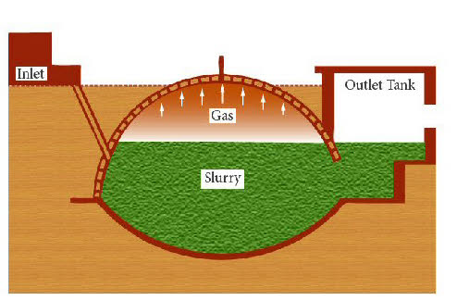
Deen bandhu Bio-gas Plant
It is a fixed dome plant.
(Developed by Action for Food production, New Delhi)
Same working principle like Janta model.
Digester, gas portion and dome are in the same unit.
Higher compressive strength of masonry and concrete makes it a safe structure. A window opening is kept at the top of the foundation.

Slide 23
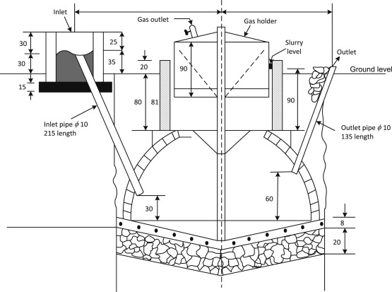
Pragati design Bio-gas Plant
It is a cheaper floating drum type bio-gas plant developed by UNDARP
(United Socio-Economic development and research program).
Cost is 20% less than KVIC.
Depth of pit is less than KVIC so can be constructed in hilly areas.
Constructed at the base of the pit with cement, sand and concrete so it can bear the load due to weight of slurry.
The wall thickness is kept 75 mm.

Slide 24
Factors affecting the Bio digestion or Gas generation
Bio-gas is a mixture containing 55-65 % methane, 30-40 % Carbon dioxide and the rest being the impurities (H₂, H₂S, N₂) can be produced from the decomposition of animal, Plant and Human waste. It is a clean but slow burning gas and usually has a calorific value between 5000 to 5500 kcal/kg.
pH or the Hydrogen ion Concentration | Temperature
Total Solid Content of the feed material | Loading rate
Seeding | Uniform feeding
Diameter to Depth Ratio | Carbon to Nitrogen Ratio
Nutrients | Mixing or Stirring of the contents
Retention time or Rate of Feeding | Type of Feed stock
Toxicity due to end Product | Pressure
Acid accumulation inside the digester

Slide 25
Site Selection
Distance
Minimum Gradient
Open Space
Water Table
Seasonal run off
Distance from wells
Space requirements
Availability of water
Source of cow dung/material for biogas generation

Slide 26
Fuel properties of biogas
CH₄ : 50 to 65%
CO₂ : 30 to 45%
H₂ & N₂: <1%
H₂S & O₂: very small amount
Energy Density: 22.35 to 24.22 MJ/m3
Octane Rating = 110
Ignition Temperature = 650°C

Slide 27
Gasification
Its is the process converting solid biomass into gaseous fuel without leaving any solid carbonaceous residue.
It is an equipment which can gasify variety of biomass such as wood waste, agriculture waste like stalks, and roots of various crops, maize cobs etc.
It is essentially a chemical reactor where various complex physical and chemical processes take place.
Biomass gets dried, heated, pyrolysed, partially oxidised and reduced, as it flow through it.
The gas produced in the gasifier is clean burning fuel having heating value of about 950-1200 kcal/m3.
Hydrogen (18-20%) and carbon-monoxide (18-24%) are the main constitute of the gas.

Slide 28
Classification
Types of bed
Fixed bed
Fluidised bed
As per the direction of gas flow
Downdraft
Updraft
Cross draft
Output of the gasifiers
Small size
Medium size
Large size

Slide 29
Different Types of Gasifiers
Up-draft or counter current Gasifier:

Slide 30
Various Gasification Processes

Slide 31
Different Types of Gasifiers
Down draft or co-current gasifier:

Slide 32
Different Types of Gasifiers
Cross draft gasifier:

Slide 33
Different Types of Gasifiers
Fluidized bed gasifier:

Slide 34
Application of Fuel gas
Heating applications such as furnace, kiln etc.
Electricity generation from IC Engine coupled with generator
Electricity generation from gas turbine

