Slide 1
CS276: Information Retrieval and Web Search
Pandu Nayak and Prabhakar Raghavan
Lecture 3: Dictionaries and tolerant retrieval

Slide 2
Recap of the previous lecture
Ch. 2
The type/token distinction
  Terms are normalized types put in the dictionary
Tokenization problems:
  Hyphens, apostrophes, compounds, CJK
Term equivalence classing:
  Numbers, case folding, stemming, lemmatization
Skip pointers
  Encoding a tree-like structure in a postings list
Biword indexes for phrases
Positional indexes for phrases/proximity queries

Slide 3
This lecture
Ch. 3
Dictionary data structures
“Tolerant” retrieval
  Wild-card queries
  Spelling correction
  Soundex

Slide 4
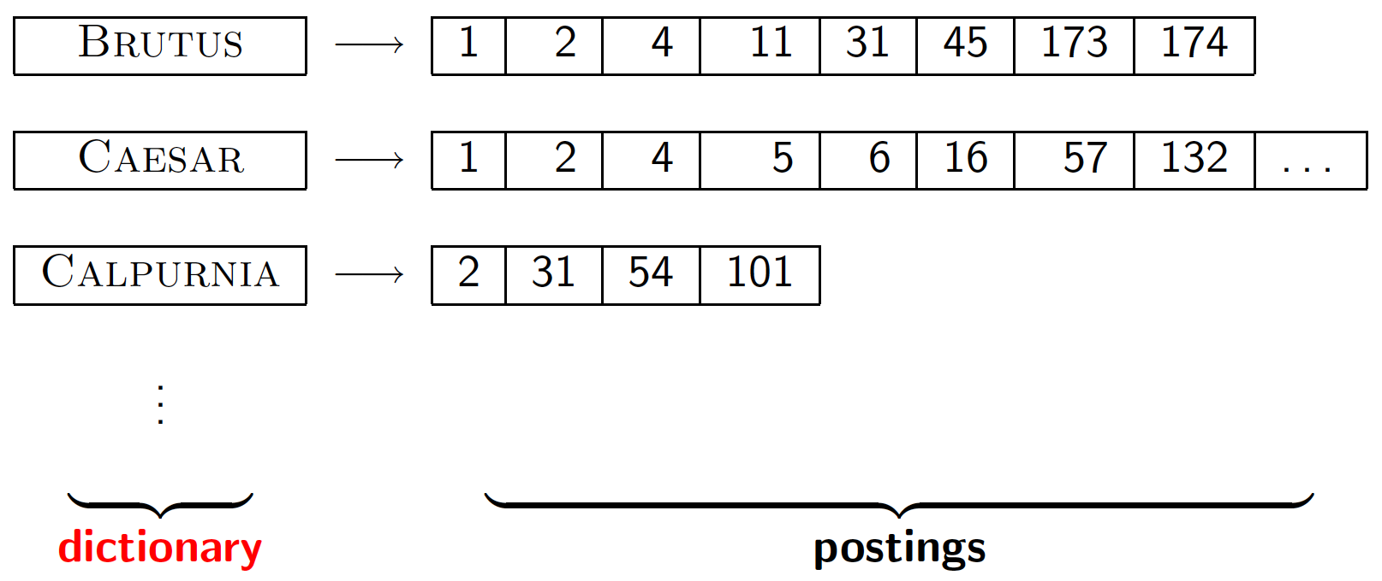
Dictionary data structures for inverted indexes
Sec. 3.1
The dictionary data structure stores the term vocabulary, document frequency, pointers to each postings list … in what data structure?

Slide 5
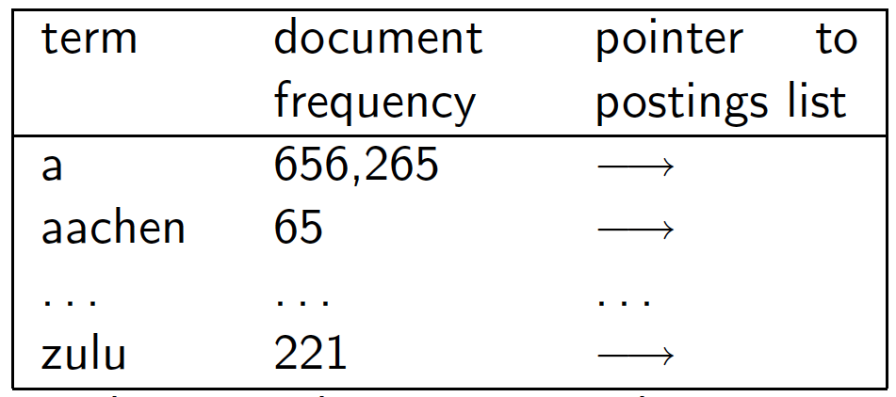
A naïve dictionary
Sec. 3.1
An array of struct:
char[20] int Postings *
20 bytes 4/8 bytes 4/8 bytes
How do we store a dictionary in memory efficiently?
How do we quickly look up elements at query time?

Slide 6
Dictionary data structures
Sec. 3.1
Two main choices:
  Hashtables
  Trees
Some IR systems use hashtables, some trees

Slide 7
Hashtables
Sec. 3.1
Each vocabulary term is hashed to an integer
  (We assume you’ve seen hashtables before)
Pros:
  Lookup is faster than for a tree: O(1)
Cons:
  No easy way to find minor variants:
    judgment/judgement
  No prefix search [tolerant retrieval]
  If vocabulary keeps growing, need to occasionally do the expensive operation of rehashing everything

Slide 8
Tree: binary tree
Sec. 3.1
Root
a-m
n-z
a-hu
hy-m
n-sh
si-z
huygens
sickle
zygot
aardvark

Slide 9
Strings starting from a or b or c to m
All strings starting from n to z are stored in right subtree.
Everything of the left of this node corresponds to string string from a and going up to string starting with hu
At leaf level actual term . Extract posting list
B tree is used for this purpose

Slide 10
Tree: B-tree
Sec. 3.1
a-hu
n-z
hy-m
  Definition: Every internal nodel has a number of children in the interval [a,b] where a, b are appropriate natural numbers, e.g., [2,4].

Slide 11
Trees
Sec. 3.1
Simplest: binary tree
More usual: B-trees
Trees require a standard ordering of characters and hence strings … but we typically have one
Pros:
  Solves the prefix problem (terms starting with hyp)
Cons:
  Slower: O(log M) [and this requires balanced tree]
  Rebalancing binary trees is expensive
    But B-trees mitigate the rebalancing problem

Slide 12
WILD-CARD QUERIES

Slide 13
Wildcard queries are used in any of the following situations
(1) the user is uncertain of the spelling of a query term (e.g., Sydney vs. Sidney, which leads to the wildcard query S*dney);
(2) the user is aware of multiple variants of spelling a term and (consciously) seeks documents containing any of the variants (e.g., color vs. colour);

Slide 14
(3) the user seeks documents containing variants of a term that would be caught by stemming, but is unsure whether the search engine performs stemming (e.g., judicial vs. judiciary, leading to the wildcard query judicia*);
(4) the user is uncertain of the correct rendition of a foreign word or phrase (e.g., the query Universit* Stuttgart).

Slide 15
Wild-card queries: *
Sec. 3.2
mon*: find all docs containing any word beginning with “mon”.
Easy with binary tree (or B-tree) lexicon: retrieve all words in range: mon ≤ w < moo
*mon: find words ending in “mon”: harder
  Maintain an additional B-tree for terms backwards.
  Can retrieve all words in range: nom ≤ w < non.
Exercise: from this, how can we enumerate all terms
meeting the wild-card query pro*cent ?

Slide 16
Query processing
Sec. 3.2
At this point, we have an enumeration of all terms in the dictionary that match the wild-card query.
We still have to look up the postings for each enumerated term.
E.g., consider the query:
se*ate AND fil*er
This may result in the execution of many Boolean AND queries.

Slide 17
B-trees handle *’s at the end of a query term
Sec. 3.2
How can we handle *’s in the middle of query term?
  co*tion
We could look up co* AND *tion in a B-tree and intersect the two term sets
  Expensive
The solution: transform wild-card queries so that the *’s occur at the end
This gives rise to the Permuterm Index.

Slide 18
Permuterm index
Sec. 3.2.1
For term hello, index under:
  hello$, ello$h, llo$he, lo$hel, o$hell, $hello
  where $ is a special symbol.
Queries:
  X lookup on X$ X* lookup on $X*
  *X lookup on X$* *X* lookup on X*
  X*Y lookup on Y$X* X*Y*Z ??? Exercise!
Query = hel*o
X=hel, Y=o
Lookup o$hel*

Slide 19
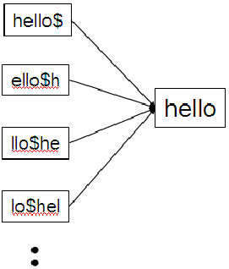
Our first special index for general wildcard queries is the permuterm index into our character set, to mark the end of a term. Thus, the term hello is shown here as the augmented term hello$.
Next, we construct a permuterm index, in which the various rotations of each term (augmented with $) all link to the original vocabulary term.
permuterm index entry for the term hello.

Slide 20
We refer to the set of rotated terms in the permuterm index as the permuterm vocabulary.
How does this index help us with wildcard queries? Consider the wildcard query m*n. The key is to rotate such a wildcard query so that the * symbol appears at the end of the string - thus the rotated wildcard query becomes n$m*.
Next, we look up this string in the permuterm index, where seeking n$m* (via a search tree) leads to rotations of (among others) the terms man and moron.
Now that the permuterm index enables us to identify the original vocabulary terms matching a wildcard query, we look up these terms in the standard inverted index to retrieve matching documents.

Slide 21
We can thus handle any wildcard query with a single * symbol. But what about a query such as fi*mo*er?
In this case we first enumerate the terms in the dictionary that are in the permuterm index of er$fi*. Not all such dictionary terms will have the string mo in the middle - we filter these out by exhaustive enumeration, checking each candidate to see if it contains mo.
In this example, the term fishmonger would survive this filtering but filibuster would not. We then run the surviving terms through the standard inverted index for document retrieval.
One disadvantage of the permuterm index is that its dictionary becomes quite large, including as it does all rotations of each term.

Slide 22
Permuterm query processing
Sec. 3.2.1
Rotate query wild-card to the right
Now use B-tree lookup as before.
Permuterm problem: ≈ quadruples lexicon size
Empirical observation for English.

Slide 23
Bigram (k-gram) indexes
Sec. 3.2.2
Enumerate all k-grams (sequence of k chars) occurring in any term
e.g., from text “April is the cruelest month” we get the 2-grams (bigrams)
  $ is a special word boundary symbol
Maintain a second inverted index from bigrams to dictionary terms that match each bigram.
$a,ap,pr,ri,il,l$,$i,is,s$,$t,th,he,e$,$c,cr,ru,
ue,el,le,es,st,t$, $m,mo,on,nt,h$

Slide 24
Bigram index example
Sec. 3.2.2
The k-gram index finds terms based on a query consisting of k-grams (here k=2).
$m
mace
madden
mo
among
amortize
on
along
among

Slide 25
Processing wild-cards
Sec. 3.2.2
Query mon* can now be run as
  $m AND mo AND on
Gets terms that match AND version of our wildcard query.
But we’d enumerate moon.
Must post-filter these terms against query.
Surviving enumerated terms are then looked up in the term-document inverted index.
Fast, space efficient (compared to permuterm).

Slide 26
Processing wild-card queries
Sec. 3.2.2
As before, we must execute a Boolean query for each enumerated, filtered term.
Wild-cards can result in expensive query execution (very large disjunctions…)
  pyth* AND prog*
If you encourage “laziness” people will respond!
Which web search engines allow wildcard queries?
Search
Type your search terms, use ‘*’ if you need to.
E.g., Alex* will match Alexander.

Slide 27
SPELLING CORRECTION

Slide 28
Spell correction
Sec. 3.3
Two principal uses
  Correcting document(s) being indexed
  Correcting user queries to retrieve “right” answers
Two main flavors:
  Isolated word
    Check each word on its own for misspelling
    Will not catch typos resulting in correctly spelled words
    e.g., from → form
  Context-sensitive
    Look at surrounding words,
    e.g., I flew form Heathrow to Narita.

Slide 29
Document correction
Sec. 3.3
Especially needed for OCR’ed documents
  Correction algorithms are tuned for this: rn/m
  Can use domain-specific knowledge
    E.g., OCR can confuse O and D more often than it would confuse O and I (adjacent on the QWERTY keyboard, so more likely interchanged in typing).
But also: web pages and even printed material have typos
Goal: the dictionary contains fewer misspellings
But often we don’t change the documents and instead fix the query-document mapping

Slide 30
Query mis-spellings
Sec. 3.3
Our principal focus here
  E.g., the query Alanis Morisett
We can either
  Retrieve documents indexed by the correct spelling, OR
  Return several suggested alternative queries with the correct spelling
    Did you mean … ?

Slide 31
Isolated word correction
Sec. 3.3.2
Fundamental premise – there is a lexicon from which the correct spellings come
Two basic choices for this
  A standard lexicon such as
    Webster’s English Dictionary
    An “industry-specific” lexicon – hand-maintained
  The lexicon of the indexed corpus
    E.g., all words on the web
    All names, acronyms etc.
    (Including the mis-spellings)

Slide 32
Isolated word correction
Sec. 3.3.2
Given a lexicon and a character sequence Q, return the words in the lexicon closest to Q
What’s “closest”?
We’ll study several alternatives
  Edit distance (Levenshtein distance)
  Weighted edit distance
  n-gram overlap

Slide 33
Edit distance
Sec. 3.3.3
Given two strings S₁ and S₂, the minimum number of operations to convert one to the other
Operations are typically character-level
  Insert, Delete, Replace, (Transposition)
E.g., the edit distance from dof to dog is 1
  From cat to act is 2 (Just 1 with transpose.)
  from cat to dog is 3.
Generally found by dynamic programming.
See http://www.merriampark.com/ld.htm for a nice example plus an applet.

Slide 34
Weighted edit distance
Sec. 3.3.3
As above, but the weight of an operation depends on the character(s) involved
  Meant to capture OCR or keyboard errors
  Example: m more likely to be mis-typed as n than as q
  Therefore, replacing m by n is a smaller edit distance than by q
  This may be formulated as a probability model
Requires weight matrix as input
Modify dynamic programming to handle weights

Slide 35
Using edit distances
Sec. 3.3.4
Given query, first enumerate all character sequences within a preset (weighted) edit distance (e.g., 2)
Intersect this set with list of “correct” words
Show terms you found to user as suggestions
Alternatively,
  We can look up all possible corrections in our inverted index and return all docs … slow
  We can run with a single most likely correction
The alternatives disempower the user, but save a round of interaction with the user

Slide 36
Edit distance to all dictionary terms?
Sec. 3.3.4
Given a (mis-spelled) query – do we compute its edit distance to every dictionary term?
  Expensive and slow
  Alternative?
How do we cut the set of candidate dictionary terms?
One possibility is to use n-gram overlap for this
This can also be used by itself for spelling correction.
Notes:
Alternative is to generate everything up to edit distance k and then intersect. Fine for distance 1; okay for distance 2. This is generally enough (Norvig).

Slide 37
Spelling correction using k-gram overlap
While the minimum edit distance discussed provides a good list of possibly correct words, there are far too many words in the English dictionary to consider finding the edit distance between all pairs.
To simplify the list of candidate words, the k-gram overlap is used in typical IR and NLP systems.
K-grams are k-length subsequences of a string. Here, k can be 1, 2, 3 and so on. For k=1, each resulting subsequence is called a “unigram”; for k=2, a “bigram”; and for k=3, a “trigram”. These are the most widely used k-grams for spelling correction, but the value of k really depends on the situation and context.

Slide 38
As an example, consider the string “catastrophic”. In this case,
Unigrams: [“c”, “a”, “t”, “a”, “s”, “t”, “r”, “o”, “p”, “h”, “i”, “c”]
Bigrams: [“ca”, “at”, “ta”, “as”, “st”, “tr”, “ro”, “op”, “ph”, “hi”, “ic”]
Trigrams: [“cat”, “ata”, “tas”, “ast”, “str”, “tro”, “rop”, “oph”, “phi”, “hic”]
K-Gram Index
A k-gram index maps a k-gram to a postings list of all possible vocabulary terms that contain it. The figure below shows the k-gram postings list corresponding to the bigram “ur”.

Slide 39
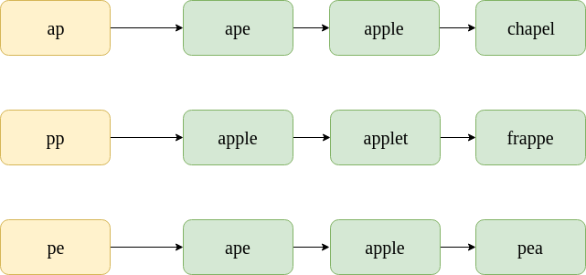
It is noteworthy that the postings list is sorted alphabetically.
Spelling Correction
While creating the candidate list of possible corrected words, we can use the “k-gram overlap” to find the most likely corrections.
Consider the misspelt word: “appe”. The postings lists for the bigrams contained in it are shown below.

Slide 40
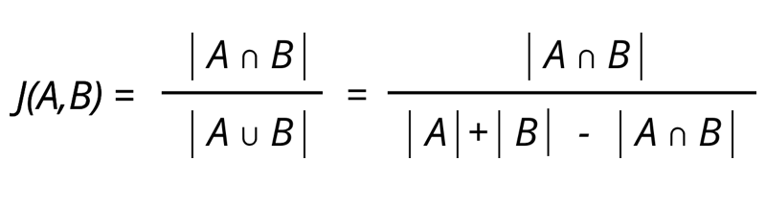
To find the k-gram overlap between two postings list, we use the Jaccard coefficient. Here, A and B are two sets (postings lists), A for the misspelt word and B for the corrected word.
Now, consider some candidate terms for spelling correction, namely “ape” and “apple”.
To find the Jaccard coefficient, simply scan through the postings lists of all bigrams of “appe” and count the instances where “ape” appears.

Slide 41

In the first postings list, “ape” appears 1 time. In the second postings list, “ape” appears 0 times. In the third postings list, “ape” appears 1 time.
Now, the no. of bigrams in “appe” is 3, and the no. of bigrams in “ape” is 2. Therefore,
J(A, B) = 2/3 = 0.67.

Slide 42

Example
“apple”
Now, the no. of bigrams in “appe” is 3, and the no. of bigrams in “apple” is 4. Therefore,
J(A, B) = 3/4 = 0.75.
This suggests that “apple” is a more plausible correction. Practically, this method is used to filter out unlikely corrections.

Slide 43
The steps involved for spelling correction are:
Find the k-grams of the misspelled word.
For each k-gram, linearly scan through the postings list in the k-gram index.
Find k-gram overlaps after having linearly scanned the lists (no extra time complexity because we are finding the Jaccard coefficient).
Return the terms with the maximum k-gram overlaps.

Slide 44
Context-sensitive spell correction
Sec. 3.3.5
Text: I flew from Heathrow to Narita.
Consider the phrase query “flew form Heathrow”
We’d like to respond
Did you mean “flew from Heathrow”?
because no docs matched the query phrase.

Slide 45
Context-sensitive correction
Sec. 3.3.5
Need surrounding context to catch this.
First idea: retrieve dictionary terms close (in weighted edit distance) to each query term
Now try all possible resulting phrases with one word “fixed” at a time
  flew from heathrow
  fled form heathrow
  flea form heathrow
Hit-based spelling correction: Suggest the alternative that has lots of hits.

Slide 46
Exercise
Sec. 3.3.5
Suppose that for “flew form Heathrow” we have 7 alternatives for flew, 19 for form and 3 for heathrow.
How many “corrected” phrases will we enumerate in this scheme?

Slide 47
Another approach
Sec. 3.3.5
Break phrase query into a conjunction of biwords (Lecture 2).
Look for biwords that need only one term corrected.
Enumerate only phrases containing “common” biwords.

Slide 48
General issues in spell correction
Sec. 3.3.5
We enumerate multiple alternatives for “Did you mean?”
Need to figure out which to present to the user
  The alternative hitting most docs
  Query log analysis
More generally, rank alternatives probabilistically
  argmax_{corr} P(corr | query)
  From Bayes rule, this is equivalent to
  argmax_{corr} P(query | corr) * P(corr)
Noisy channel
Language model

Slide 49
SOUNDEX

Slide 50
Soundex
Sec. 3.4
Class of heuristics to expand a query into phonetic equivalents
  Language specific – mainly for names
  E.g., chebyshev → tchebycheff
  During the linguistic phase there will be a Soundex module that will take every token that needs to be indexed and map it or transform it into a 4-character term. Do the same thing for the words in the document and for the words in the query and then the term that actually forms an inverted index will be this 4 character of the token

Slide 51
Soundex – typical algorithm
Sec. 3.4
Turn every token to be indexed into a 4-character reduced form
Do the same with query terms
Build and search an index on the reduced forms
  (when the query calls for a soundex match)
http://www.creativyst.com/Doc/Articles/SoundEx1/SoundEx1.htm#Top

Slide 52
Soundex – typical algorithm
Sec. 3.4
Retain the first letter of the word.
Change all occurrences of the following letters to '0' (zero):
'A', E', 'I', 'O', 'U', 'H', 'W', 'Y'.
Change letters to digits as follows:
B, F, P, V → 1
C, G, J, K, Q, S, X, Z → 2
D,T → 3
L → 4
M, N → 5
R → 6

Slide 53
Soundex continued
Sec. 3.4
Remove all pairs of consecutive digits.
Remove all zeros from the resulting string.
Pad the resulting string with trailing zeros and return the first four positions, which will be of the form <uppercase letter> <digit> <digit> <digit>.
E.g., Herman becomes H655.
Will hermann generate the same code?

Slide 54
Soundex
Sec. 3.4
Soundex is the classic algorithm, provided by most databases (Oracle, Microsoft, …)
How useful is soundex?
Not very – for information retrieval
Okay for “high recall” tasks (e.g., Interpol), though biased to names of certain nationalities
Zobel and Dart (1996) show that other algorithms for phonetic matching perform much better in the context of IR

Slide 55
What queries can we process?
We have
  Positional inverted index with skip pointers
  Wild-card index
  Spell-correction
  Soundex
Queries such as
(SPELL(moriset) /3 toron*to) OR SOUNDEX(chaikofski)

Slide 56
Exercise
Draw yourself a diagram showing the various indexes in a search engine incorporating all the functionality we have talked about
Identify some of the key design choices in the index pipeline:
  Does stemming happen before the Soundex index?
  What about n-grams?
Given a query, how would you parse and dispatch sub-queries to the various indexes?
Notes:
Exercise on this slide:
Is the beginning of “what do we we need in our search engine?”
Even if you’re not building an engine (but instead use someone else’s toolkit), it’s good to have an understanding of the innards

Slide 57
Resources
Sec. 3.5
IIR 3, MG 4.2
Efficient spell retrieval:
  K. Kukich. Techniques for automatically correcting words in text. ACM Computing Surveys 24(4), Dec 1992.
  J. Zobel and P. Dart. Finding approximate matches in large lexicons. Software - practice and experience 25(3), March 1995. http://citeseer.ist.psu.edu/zobel95finding.html
  Mikael Tillenius: Efficient Generation and Ranking of Spelling Error Corrections. Master’s thesis at Sweden’s Royal Institute of Technology. http://citeseer.ist.psu.edu/179155.html
Nice, easy reading on spell correction:
  Peter Norvig: How to write a spelling corrector
  http://norvig.com/spell-correct.html

