Slide 1



ONLINE RENTAL HOUSE WEB PORTAL paper id- 139
Devavrat singh bisht
Nitisha pradhan
EMPLOYABILITY SKILL DEVELOPMENT (ESD) PROGRAM

Slide 2


Flow of Presentation
Introduction
Problem Statement
Description
Implementation
Discussion
Conclusion
EMPLOYABILITY SKILL DEVELOPMENT (ESD) PROGRAM

Slide 3
Introduction
Online Rental House Web Portal is an internet portal dedicated to meet the consumers' needs in the Real Estate industry.
The portal is designed to support both tenants and landlords by giving them the ability to upload or find information about house on rent.
The goal of the portal is to create a better approachable environment between tenants and landlord.
EMPLOYABILITY SKILL DEVELOPMENT (ESD) PROGRAM

Slide 4
Problem Statement
A majority of unpleasant issues faced by landlords and tenants seem to grow due to lack of communication.
Many a time landlord can’t find a suitable tenant or tenants can’t find a suitable house and landlord.
The aim is to make a web portal that can act as an medium or interface for the landlords and the tenants to connect.
EMPLOYABILITY SKILL DEVELOPMENT (ESD) PROGRAM

Slide 5
description
It is a portal where Property Owners, Brokers, Tenants and Investors can exchange information and get in touch with other interested parties.
It features commercial and residential properties for sale, rent and lease.
The properties, rates, locations, property news and also major events and happenings are also featured on the portal.
EMPLOYABILITY SKILL DEVELOPMENT (ESD) PROGRAM

Slide 6
description
Rent House
View Houses
Apply Filters
Login
Option
Add house
Enter details
EMPLOYABILITY SKILL DEVELOPMENT (ESD) PROGRAM

Slide 7
implementation
Program used: Eclipse Integrated Environment
Front-End: HTML, CSS
Server-side Script: Java Server Pages (JSP)
Programming Languages: Java
Server: Apache Tomcat Server
Database: MariaDB
EMPLOYABILITY SKILL DEVELOPMENT (ESD) PROGRAM

Slide 8
implementation
JSPs are used to send various requests to the Servlets.
Servlets contain the necessary Java program to connect the web portal to the database.
There are jar files that contain SQL connectors and other related extensions that do the work at the backend.
When a user interacts with the web page, the data is stored in variables inside the JSPs and then these JSPs send the data to Servlets and depending on the received data Servlets take appropriate actions.
EMPLOYABILITY SKILL DEVELOPMENT (ESD) PROGRAM

Slide 9
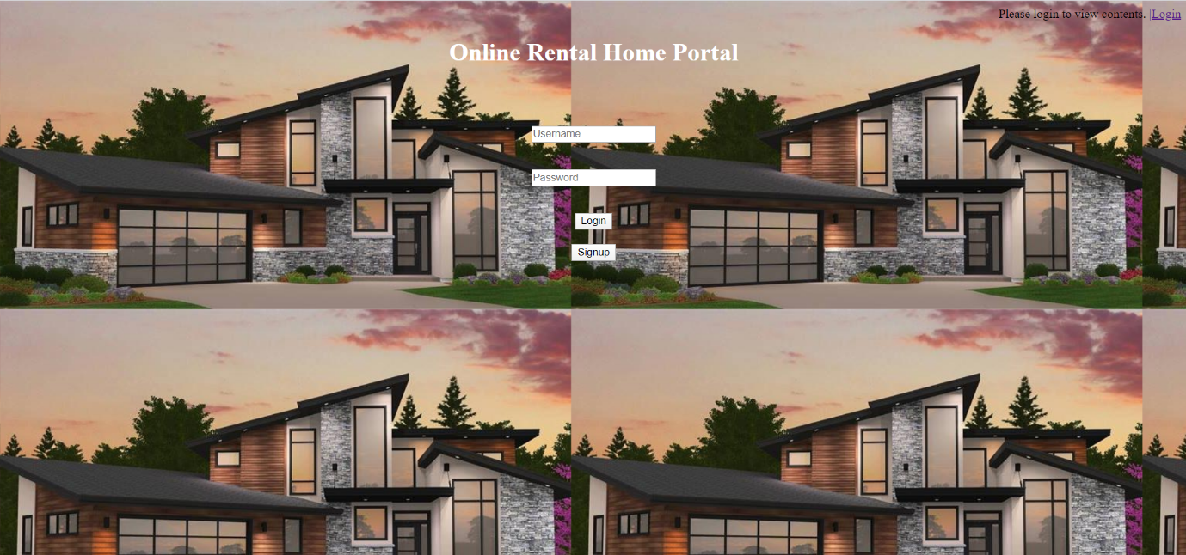
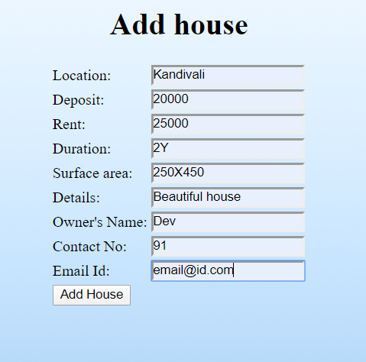
EMPLOYABILITY SKILL DEVELOPMENT (ESD) PROGRAM

Slide 10
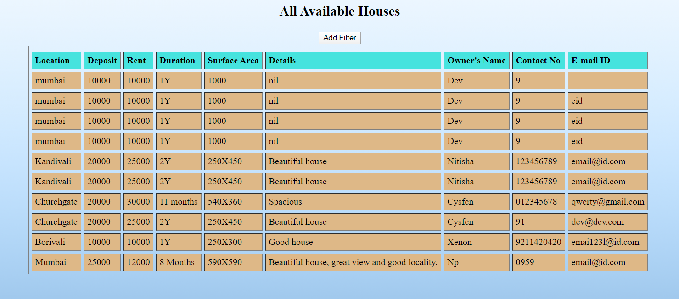
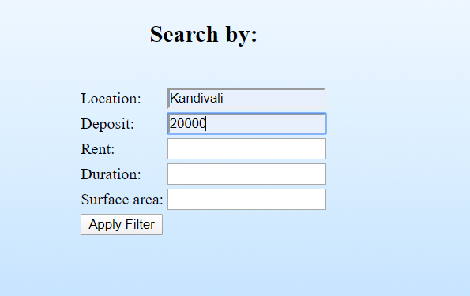
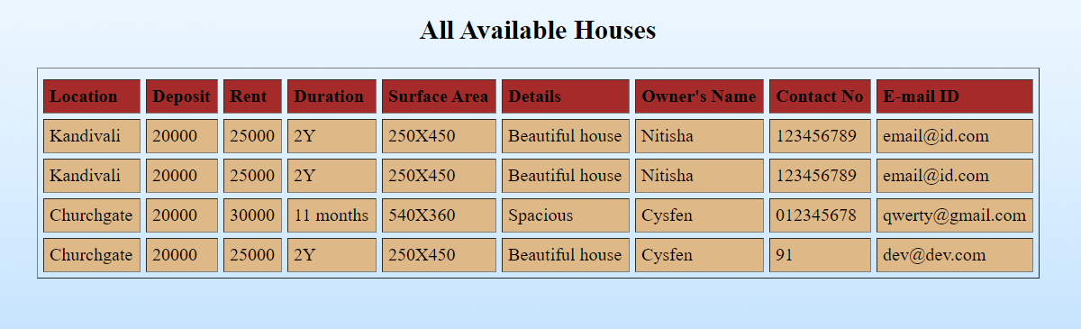
EMPLOYABILITY SKILL DEVELOPMENT (ESD) PROGRAM

Slide 11
discussion
Limitations
No direct contact between the owners and customers
Future Scope
Chatting Feature
Statistics on viewer interests
Direct online payment through the web portal
EMPLOYABILITY SKILL DEVELOPMENT (ESD) PROGRAM

Slide 12
Conclusion
The project Online Rental House Web Portal has been made using JSP Servlets, Tomcat Server and MariaDB in Eclipse.
The web portal acts like an interface between the broker/owner and the potential buyers.
The details of the owner and the house to be rented are stored in the database and displayed to the buyers who can then communicate with the owner for further discussion.
This project helps users to find house of their choice and necessity, also it enables them to bypass the brokers and thus save money.
EMPLOYABILITY SKILL DEVELOPMENT (ESD) PROGRAM

