Slide 1
Employee Data Analysis using Excel
STUDENT NAME: DEVAYANI. VM
REGISTER NO: 312216921
DEPARTMENT: B.COM(GENERAL)
COLLEGE: SHRI KRISHNASWAMY COLLEGE FOR WOMEN

Slide 2

PROJECT TITLE
Employee Performance Analysis using Excel

Slide 3


AGENDA
Problem Statement
Project Overview
End Users
Our Solution and Proposition
Dataset Description
Modelling Approach
Results and Discussion
Conclusion
3/21/2024 Annual Review

Slide 4

PROBLEM STATEMENT
To analyze the salary and compensation structure of employees in a company, identify disparities, and provide actionable insights for optimizing compensation packages based on various factors such as job role, department, experience, performance, and market trends.
It covers the necessary data, analytical approaches, and expected deliverables, giving a clear direction for tackling the problem.

Slide 5

PROJECT OVERVIEW
The goal of this project is to analyze the salary and compensation structure within the organization using Excel data modeling techniques. The analysis aims to ensure equitable and competitive compensation practices by identifying any disparities, aligning with market standards, and optimizing overall salary structures.

Slide 6

WHO ARE THE END USERS?
Human Resources (HR) Department: Primary users responsible for managing employee compensation, benefits, and ensuring fair and equitable pay practices.
Executive Management (C-Suite):Decision-makers including CEOs, CFOs, and COOs.
External Consultants (If Engaged): Third-party experts brought in for additional analysis or to validate the findings.They may use the data and models to provide recommendations and ensure the analysis is robust and aligns with best practices.

Slide 7

OUR SOLUTION AND ITS VALUE PROPOSITION
This solution will integrate various data sources, apply analytical techniques, and produce actionable insights that help ensure equitable, competitive, and performance-aligned compensation practices.
Value proposition: →Improved decision making
→cost effective and accessible
→Enhanced fairness and transparency
→Risk mitigation

Slide 8
Dataset Description
well-structured dataset is essential. Below is a detailed description of the dataset components typically required for this analysis:
Employee InformationEmployee ID: Unique identifier for each employee (e.g., E12345).
Salary and Compensation DetailsBase Salary: Fixed annual salary (e.g., ₹12,00,000 or $80,000).Bonuses: Annual or periodic bonus amounts (e.g., ₹1,50,000 or $10,000).
Performance DataPerformance Rating: Annual performance rating (e.g., 4.5 out of 5).Promotion History: Details of promotions (dates and new titles).

Slide 9

THE "WOW" IN OUR SOLUTION
Customizable Interactive dashboardWow Factor: designed a highly interactive Excel dashboard that allows users to visualize salary distributions, performance correlations, and market benchmarks in real-time
Automated Reporting and AlertsWow Factor: built-in automation for generating detailed reports on salary equity, performance alignment, and market competitiveness.
Seamless Integration with Market DataWow Factor: integrates external market data directly into the Excel model, allowing for real-time comparison of internal salary
3/21/2024 Annual Review
9

Slide 10
MODELLING
Compensation Data: Gather information on base salary, bonuses, allowances, total compensation, stock options, and other benefits.
Data Integration: Consolidate all data sources into a single Excel workbook, organized into different sheets.
Descriptive Analytics: Use Excel formulas, pivot tables, and charts to describe and summarize salary distributions.
This comprehensive approach to salary and compensation analysis through Excel data modeling provides a powerful tool for organizations looking to optimize their compensation strategies, ensure fairness, and remain competitive in the market.
10

Slide 11
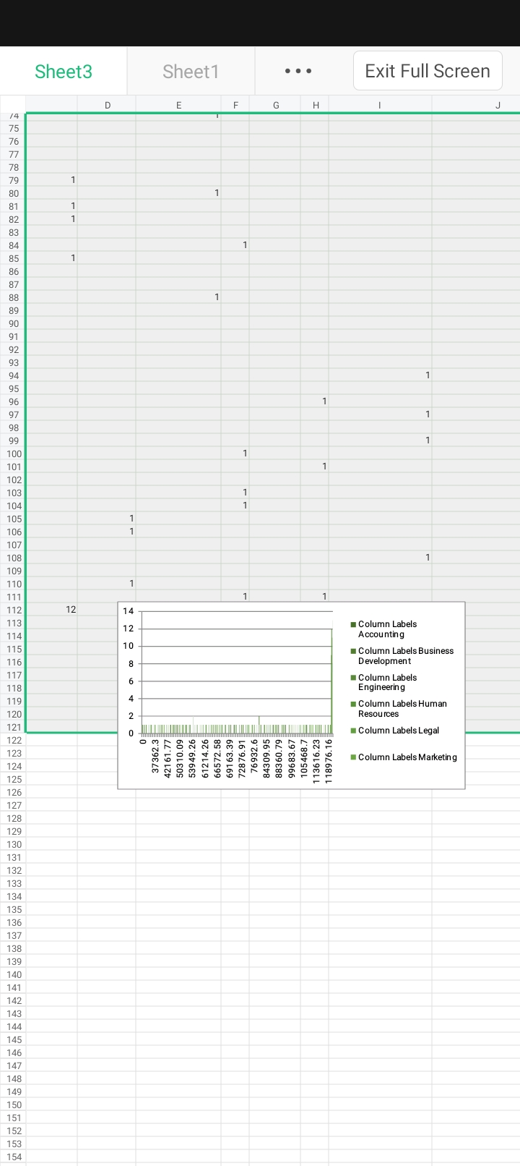
RESULTS
11

Slide 12
conclusion
The Salary and Compensation Analysis conducted using Excel data modeling has provided meticulously analyzing salary distributions, performance correlations, and market competitiveness, the study has revealed both strengths and areas for improvement within the organization’s compensation strategies.
This analysis not only addresses immediate concerns but also establishes a robust framework for future compensation strategy development, making it a cornerstone of the organization’s efforts to maintain a motivated, satisfied, and high-performing workforce.

Slide 13
