Slide 1
Under Optimized smart COntracts
Notes:
In this short presentation I want to show you a summary of my reading of an article “Under Estimated contracts Devour your Money”. The goal of this article is to present a tool called GASPER developed with the goal to detect abnormal coding patterns which can lead to useless money waste.

Slide 2
Smart Contract Cost
Deploying and Executing smart contracts in Ethereum Virtual Machine (EVM) has a financial cost, used to reward the miners, payed in the ether crypto-currency.
Smart contracts != Normal programs
➔ You cannot patch their code
➔ Written in a new language
Solidity != JavaScript
Serpent != Python
➔ You have to pay for deploying them into the blockchain
➔ You have to pay for executing all/part of their methods
To mention a few…
That supports the fact that development of code for the EVM is a touchy software development activity
Notes:
Lets go quickly through some reminders about deployment and execution costs of smart contracts. You probably known that the deployment and execution of smart contracts has a financial cost payed in ethers. But to which extend and how...?

Slide 3
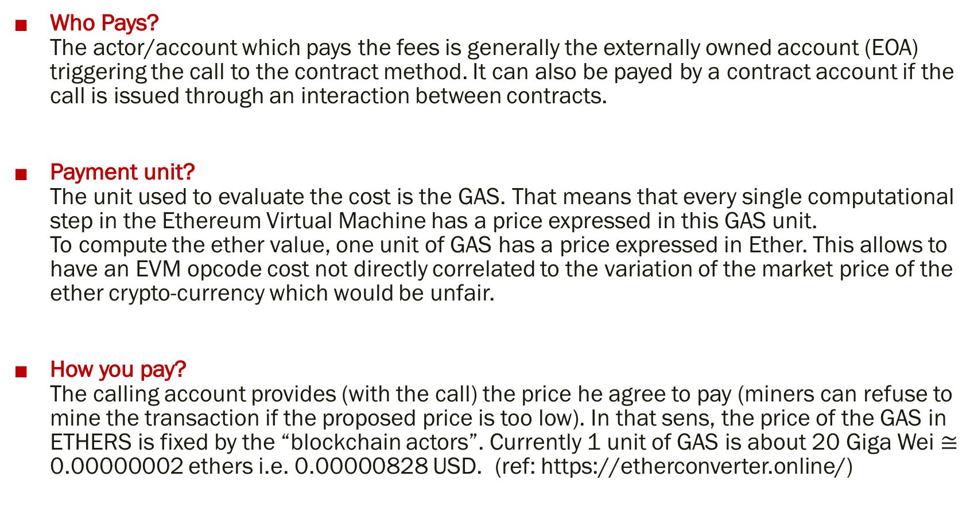
Smart Contracts Cost
Who Pays? The actor/account which pays the fees is generally the externally owned account (EOA) triggering the call to the contract method. It can also be payed by a contract account if the call is issued through an interaction between contracts.
Payment unit? The unit used to evaluate the cost is the GAS. That means that every single computational step in the Ethereum Virtual Machine has a price expressed in this GAS unit. To compute the ether value, one unit of GAS has a price expressed in Ether. This allows to have an EVM opcode cost not directly correlated to the variation of the market price of the ether crypto-currency which would be unfair.
How you pay? The calling account provides (with the call) the price he agree to pay (miners can refuse to mine the transaction if the proposed price is too low). In that sens, the price of the GAS in ETHERS is fixed by the “blockchain actors”. Currently 1 unit of GAS is about 20 Giga Wei $≅$ 0.00000002 ethers i.e. 0.00000828 USD. (ref: https://etherconverter.online/)
Notes:
The fees payment unit, GAS .... Ether,....

Slide 4
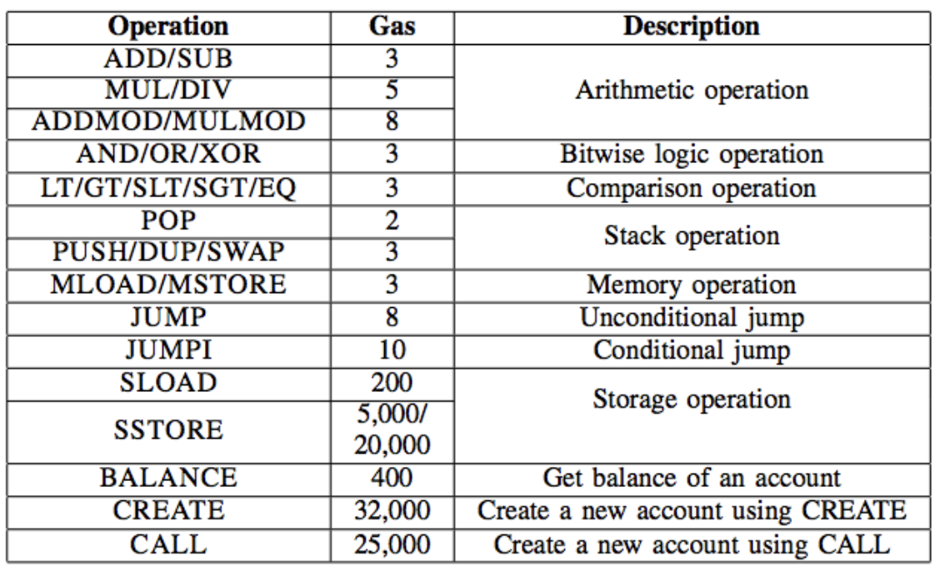
Smart Contracts Cost
Computing the cost of an EVM operation depends on two factors
The price of one unit of gas : gasPrice [eth/gas unit]
The amount of gas needed to execute this operation : gasUsed [gas units]
➔ Total price in ethers of an operation is : gasUsed * gasPrice [eth]
Notes:
Look at the SSTORE, SLOAD, Create and CALL prices…
0x54 SLOAD Load word from storage
0x55 SSTORE Save word to storage
0xf0 CREATE Create a new account

Slide 5
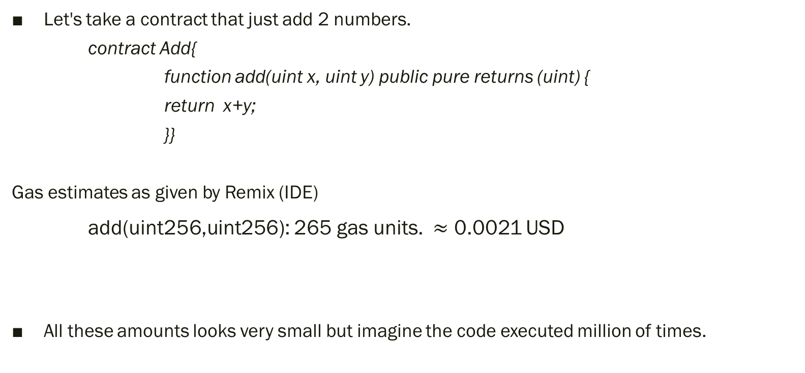
Smart Contracts Cost
Let's take a contract that just add 2 numbers.
contract Add{
function add(uint x, uint y) public pure returns (uint) {
return x+y;
}}
Gas estimates as given by Remix (IDE)
add(uint256,uint256): 265 gas units. $≈$ 0.0021 USD
All these amounts looks very small but imagine the code executed million of times.
Notes:
Note that it’s the price of the function call globally. If you take only the EVM ADD instruction its less expensive.

Slide 6
Smart Contracts Cost
Where gas is spent?
Essentially when doing operations modifying the blockchain storage area
We have two main zones of storage used by the execution of smart contract
➔ Short term storage, volatile zone i.e. MEMORY : not expensive
➔ Long term storage, persistence zone i.e. STORAGE : expensive

Slide 7
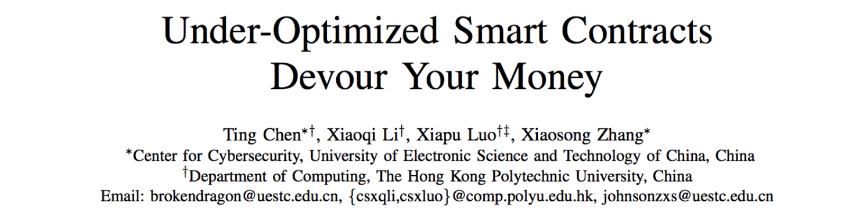
GASPER tool and Solidity optimization
Solidity, the recommended compiler for the EVM seems to fail optimizing the gas-costly programming patterns in smart contracts.
GASPER Is a recently developed tool, still experimental, able to identify gas-costly patterns in the contract bytecode generated by the Solidity compiler
2 categories of patterns currently discovered:
Category 1: useless-code
Category 2: loop-expensive

Slide 8
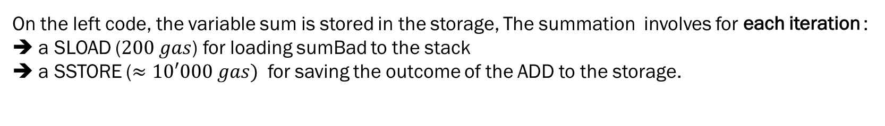
Example: LOOP RELATED PATTERN
Expensive operations in a loop.
uint public sum=0; function loopBad () public returns ( uint ){ for ( uint i = 1 ; i <= 100 ; i++) sum += i; return sum; } | function loopGood () public returns ( uint ){ uint sum=0; for ( uint i = 1 ; i <= 100 ; i++) sum += i; return sum; }
On the left code, the variable sum is stored in the storage, The summation involves for each iteration : ➔ a SLOAD ($200 gas$) for loading sumBad to the stack ➔ a SSTORE ($≈10′000 gas)$ for saving the outcome of the ADD to the storage.
Storage-related operations are very expensive. An advanced compiler should assign sumBad to a local variable that resides in the stack, then add i to tmp inside the loop, and finally assign tmp to sumBad after the loop. Such optimization reduces the storage-related operations from MANY to just 2, i.e., one SLOAD and one SSTORE.
Notes:
Lets go through just one example…

Slide 9
One Example: LOOP RELATED PATTERNS
Lets run a concrete example
➔ truffle migrate --reset --network development ➔ deploys the PerfTest.sol contract
➔ In truffle console:
var p = web3.eth.contract(…abi of the contract…)
var pi = p.at(‘…deployement address…’)
pi.loopGood({from:web3.eth.accounts[0]}) ➔ look at the gas usage
pi.loopBad({from:web3.eth.accounts[0]}) ➔ look at the « out of gas »….

Slide 10
GASPER tool
GASPER handles bytecode directly without the need of source code, because apparently only few smart contracts open their sources.
As an early research achievement, the current version of GASPER can find all patterns in category 1 (useless code) and one representative pattern (expensive operations in a loop) in category 2.
The detection of other patterns is under development.

Slide 11
How it works – step 1
A. Disassemble the smart contract bytecode
Use the “disasm” tool of Ethereum integrated as a run option in the ”evm” tool installed with the geth node from version 1.7.0
Example:
1) The contract
pragma solidity ^0.4.11;
contract Add {
function add(uint x, uint y) public pure returns (uint) {
return x+y; }}
2) Bytecode in AddByteCode.txt
6060604052341561000f57600080fd5b60ba8061001d6000396000f300606060405260043610603f5760 00357c0100000000000000000000000000000000000000000000000000000000900463ffffffff168063b ae56319146044575b600080fd5b3415604e57600080fd5b606b60048080359060200190919080359060 200190919050506081565b6040518082815260200191505060405180910390f35b6000818301905092 9150505600a165627a7a72305820270b3f90c28ef0a4cca36dbd3baab32eb7ee20670845dd3dc4ad5d4b0f 802cfd0029
3) Invoke Evm disasm
➔ evm disasm AddByteCode.txt
➔ Gives you the execution listing with all the EVM opcodes
Notes:
Show output live…

Slide 12
How it works – step 2
B. Construct a Control Flow Graph (CFG)
CFG is a program flow model typically used by the tester to measure the test coverage of their test cases sets.
T
F
T
F
F
T
F
T

Slide 13
How it works – step 3
C. Run a symbolic execution
Start from the CFG root and navigate the tree in a depth-first search
“ Depth-first search is an algorithm for traversing or searching tree or graph data structures. One starts at the root and explores as far as possible along each branch before backtracking. ”
Do do this symbolic execution, use a python tool: oyente
OYENTE Homepage: https://www.comp.nus.edu.sg/~loiluu/oyente.html

Slide 14
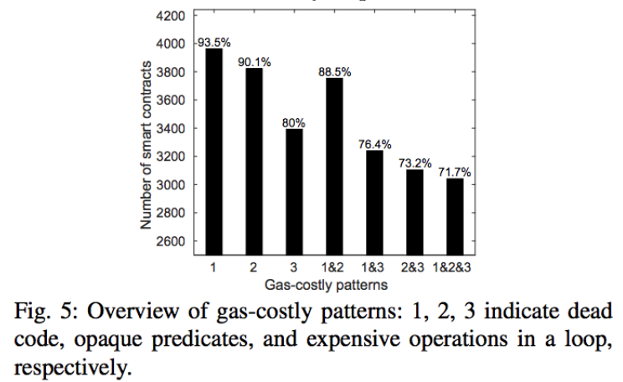
GASPER OUTCOMES

Slide 15
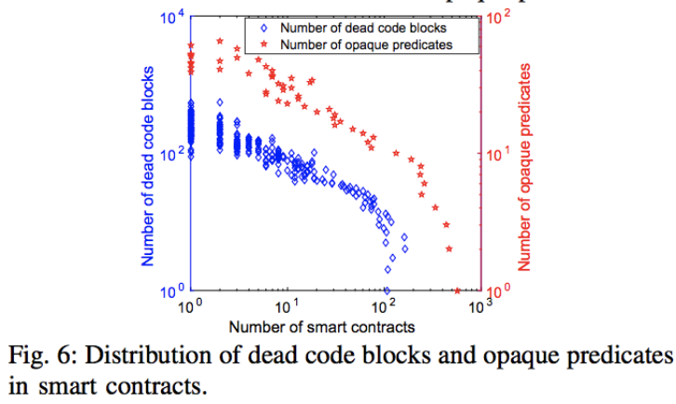
GASPER OUTCOMES

Slide 16
Thank You
References
Under-Optimized Smart Contracts Devour Your Money
Ting Chen, Xiaoqi Li, Xiapu Luo, Xiaosong Zhang
https://arxiv.org/abs/1703.03994
Making Smart Contracts Smarter
Loi Luu, Duc-Hiep Chu, Hrishi Olickel, Prateek Saxena, Aquinas Hobor
ACM Conference on Computer and Communications Security (CCS 2016 )

