Slide 1
SUMMER CAMP – Raffle Draw
https://github.com/DevchainUserGroup/RaffleDraw
(and branches)

Slide 2
Context
Goal: Create a « Lottery » contract to experiment ethereum contracts
3-4 programming sessions
4-5 programmers
Use of meetup environment (docker, truffle, solidity, …)
Solidity for contract creation
Javascript for tests
truffle init: code/test examples

Slide 3
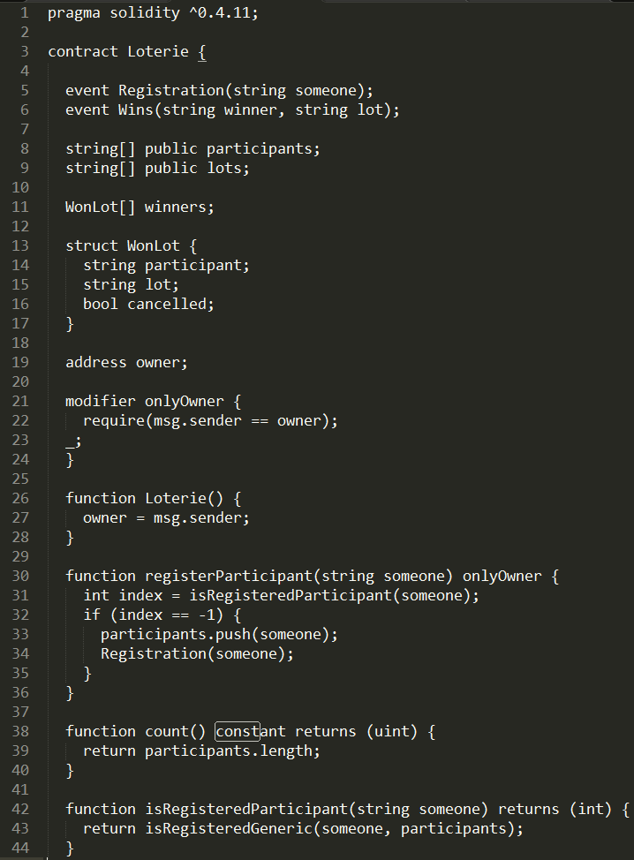
Solidity
Contract definition
Object Oriented
A Contract is a Class
Methods: 2 kinds:
Calls (constant) no write operation
Transaction included in a block (avoid return)

Slide 4
Solidity
Helpful doc
Collection types: Arrays, Mappings
String: very basic no equals function
Structs
Events (callback)
Modifiers (≈AOP)

Slide 5

Random function
Not possible to have a real random because the execution must be deterministic (all nodes must get the same result)
Our solution:

Slide 6
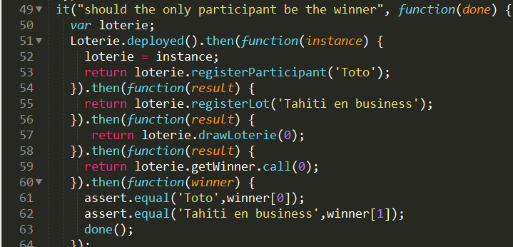
Unit tests
Asynchronous: use of promises
not easy to read
Javascript example:

Slide 7
DEMO
Notes:
// instantiate a new contract
Loterie.new()
// gt the instance for the contract address (in the logs)
l=Loterie.at('')
// representation of the contract (methods)
l
// count participants: 0
l.count.call()
// register a new participant
l.registerParticipant('Cyril')
// count participants: 1
l.count.call()
// watch all events
l.allEvents(null, (e, res) => console.log(res))
// register a new participant
l.registerParticipant('Christian')
// 2
l.count.call()
l.registerParticipant('Christian')
// still 2
l.count.call()
// other particapants
l.registerParticipant('Greg')
l.registerParticipant('Jacques')
l.registerParticipant('Alec')
// 5
l.count.call()
// register lots
l.registerLot('10 bitcoins')
l.registerLot('20 ethers')
// randomly choose winner for lot 0
l.drawLoterie(0);
// view stored result
l.getWinner.call(0)
// randomly choose winner for lot 1
l.drawLoterie(1);
// randomly choose other winner for lot 1
l.drawLoterie(1);

Slide 8
Conclusion
Tehno is young: new versions on tools are frequent -> new compiler checks, env install may work one day but not the next day,
With a few hours of experiments and the help of other meetup members, it is possible to create a contract that is usable on the real blockchain
Next step: graphical interface -> DAPP?

