Slide 1
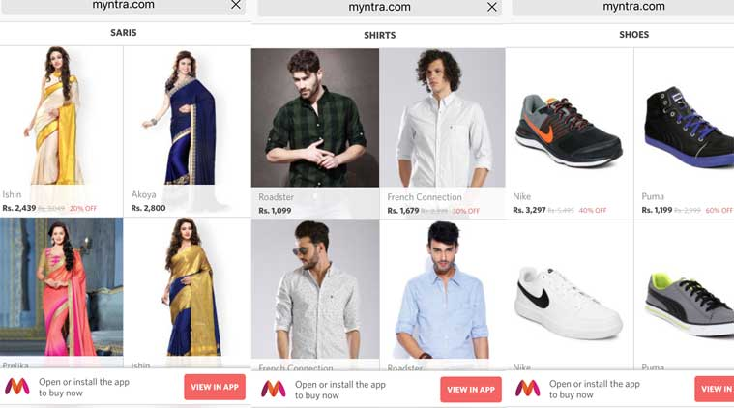
RESEARCH PROJECT ON MYNTRA
Using SQL
Data loaded using Command Prompt
SQL queries written and executed in MySQL workbench 8.0
DEVDATTA PIMPARKAR

Slide 2
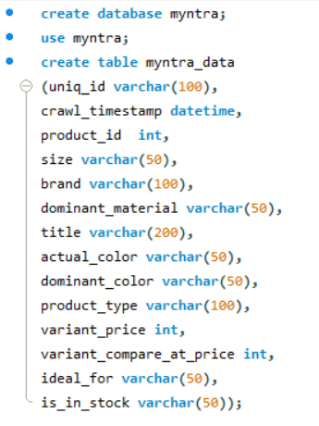
Data has 1 table which is a product table
It has more than 15000 products which is listed on myntra (15000+ rows)
Data has 14 columns which gives the product details in every manner.
Columns include product categories, title, brand, pricing, stock details etc
A table is created in workbench prior, with 14 attributes and having proper datatypes.
A detailed analysis of these products is then done and various aspects is been studied to tackle business problems more efficiently.
Snippet of Table create query

Slide 3
FINDINGS

Slide 4
A count of all the distinguished things Myntra has :
Total products : 12858
Total sizes : 148
Total brands : 364
Total materials : 28
Total Colours : 43
Total product types : 262
Ideal for : 5

Slide 5
Top 10 expensive Brands and Product types
 | Brands
 | V SALES
 | Shaily
 | RIYA
 | Ritu Kumar
 | Inddus
 | House of Pataudi
 | Chhabra 555
 | Bollywood Vogue
 | Biba
 | Aarrah
Product Types
Lehenga with Choli
Lehenga with Blouse
Lehenga Choli with Dupatta
Lehenga Choli
Lehenga & Choli with Dupatta
Lehenga & Blouse with Dupatta
Lehenga & Blouse
Kurta with Skirt
Embroidered Kurta with Palazzos & Dupatta
Dupatta

Slide 6
Product colour issues
There are always complaints from customers about the colour of products.
Colours shown by Myntra and actual colour customer sees is different.
In this table there are two columns for colours viz. actual_color and dominant_color.
The following things I observed in my findings :
Out of 12858 products only 7501 products have actual colour same as the dominant colour.
Which means 58% products have same colour as described and 42% products still lacks in fulfilling customers’ expectations

Slide 7
MRP vs actual price of products
We know about the pricing policy of e-commerce sites
The tagged MRP is always higher than the actual selling price
This price difference can be termed as “discounts”
There are 2836 products which are still priced same as their respective MRP
This figure contributes to 22% of the total products
This means 22% products are not available under “discount”

Slide 8
Gender contribution of all the listed products
Women are dominating here. We can clearly see Myntra has 61% of its products which are ideal for Women

Slide 9
Stock Overview
Count of out of stock items may lead to serious harm to business
Stock filling must be done on alert basis

Slide 10
Overview of out of stock items
A whopping number of products which are out of stock belongs to women category
Myntra needs pay more attention to products which are ideal for women

Slide 11
Price range of out of stock (women) products
There has a great demand for products of women category
We should figure out how price affects this most demanding products
By determining max. & min. price we can identify the price range
The price range is INR 249 – INR 25500 for the out of stock products belonging to women category
This means irrespective of the price, women has sky rocketing demand on myntra

Slide 12
Top 10 expensive materials and average price in INR
Net | 8210.3600
Velvet | 7699.3143
Satin | 5569.3043
Brocade | 4556.8947
Nylon | 4286.0000
Silk | 4068.6515
tencil | 3899.0000
Pure Silk | 3720.1860
Wool | 3706.3871
Georgette | 3621.1111

Slide 13
Top 10 expensive product types and average price in INR
Lehenga with Choli | 10549.0000
Lehenga with Blouse | 10529.4444
Kurta with Ethnic Jacket Churidar & Dupatta | 10500.0000
Semi-Stitched Lehenga & Unstitched Blouse with Dupatta | 10119.6429
Lehenga & Choli with Dupatta | 8553.7143
Lehenga Choli | 8488.4000
Lehenga & Blouse | 8415.0909
Anarkali Kurta with Dupatta | 8282.3333
Anarkali Kurta & Trousers with Dupatta | 7399.0000
Embroidered Kurta with Palazzos & Dupatta | 7078.6000

Slide 14
Top 10 expensive brands and their avg price
 | V SALES | 17384.6000
 | RIYA | 17099.0000
 | Aarrah | 15999.0000
 | Mitera | 15999.0000
 | Shaily | 14499.0000
 | Chhabra 555 | 13027.1212
 | Aasvaa | 11639.8333
 | Bollywood Vogue | 10464.4667
 | MANVAA | 9974.0000
 | Balance by Rohit Bal | 7990.0000

Slide 15
Gender wise avg price of products
Avg price for men products is the highest
Men products are lesser in demand as they are less probably remains out of stocks
Women products are in overwhelming demand and have least avg price

Slide 16
THANKS…
Thankful to Prateek Agrawal Sir for fantastic guidance throughout the module and still. Also many thanks Ivy Professional School.

