Slide 1
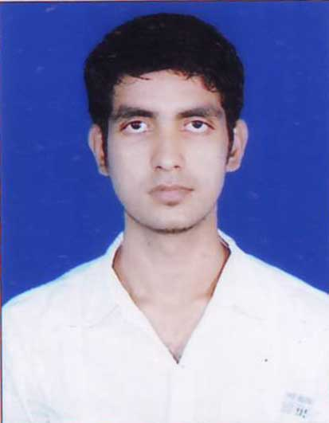
Deepak Kumar Singh | Analyst
Name Deepak Kumar Singh
Title Analyst
Location Bangalore, India
Professional Experience
Designed and developed RAML based API using Anypoint platform and imported the RAML to Anypoint Studio to build the Mule Application
Basic knowledge on API policies like ‘Basic Authentication’, ‘HTTP Caching’ and ‘Client ID Enforcement’.
Implemented Mule flows using Scopes, Error handling Strategies, Validation, Flow controls, Transformations.
Used Dataweave transformations to transform message to target formats like JSON, XML, CSV, etc. and have worked on various operators like map, pluck, Arrays, lookup and filter.
Used Database and HTTP connectors to implement API methods to fetch data from database.
Practical knowledge on Pub-Sub model implementation.
Practical knowledge on Confluence and Azure Devops.
Technical Skills: Mule 4, Core Java, SQL, XML, JSON
Integration Tools: Anypoint platform , Anypoint Studio ,Azure Devops ,Postman, Confluence
Competencies
Understanding on Integration Principles and Design Patterns.
Ability to design using Anypoint Platform to build, deploy, manage, and govern APIs.
Good knowledge on MuleSoft Integration Best Practices.
Hands on experience in building API-led and Connector-based integrations.
Certifications
Mulesoft Certified Developer Level 1
Agile Software Development
AWS Level 0 Migration Ambassador Foundations (Business)
TCA-TIBCO BusinessWorks™

