Slide 1
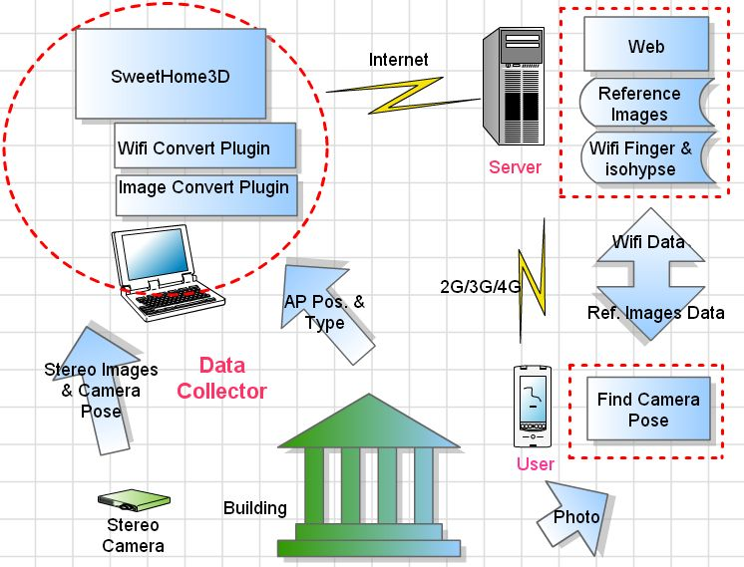
System Overview

Slide 2
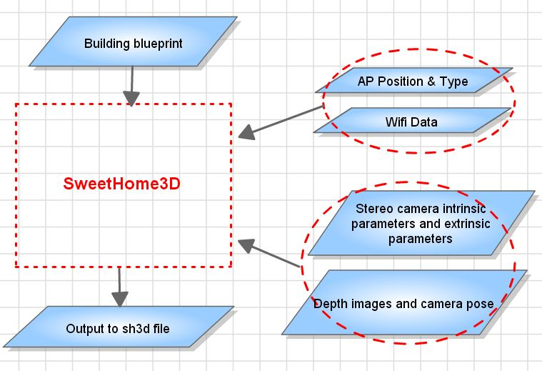
Initializing SWH-based 3D Models
Notes:
Camera coordinate system

Slide 3
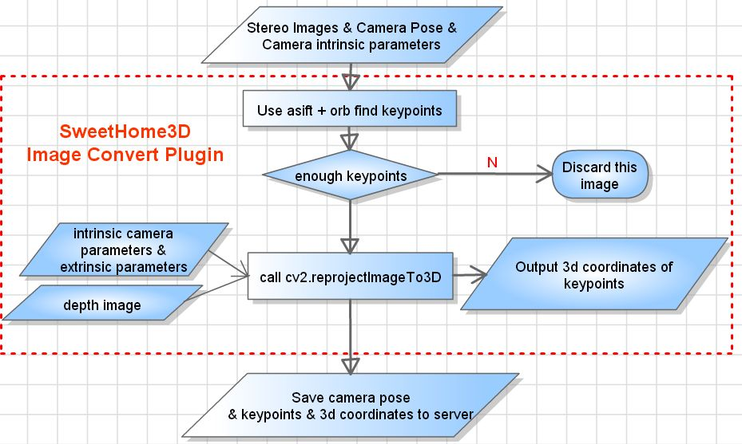
Initializing SWH-based 3D Models
Notes:
Note that the output of 3d coordinates are based on camera coordinate system, not world space coordinate

Slide 4
Updating SWH-based 3D Models

Slide 5
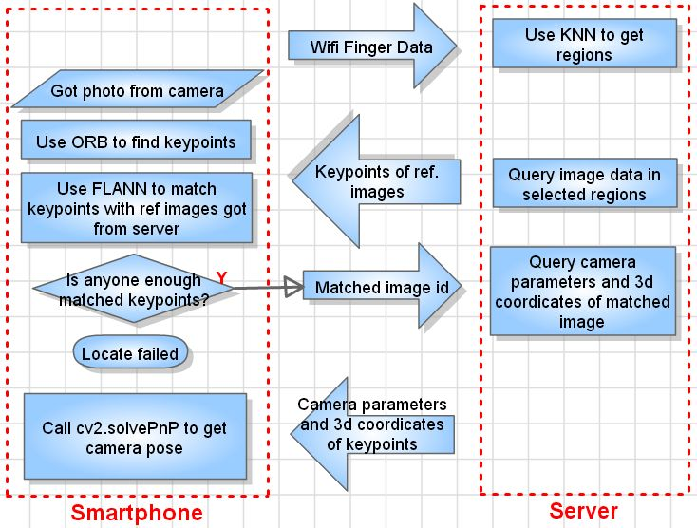
Indoor Localization

