Slide 1
Lab-10
Implement Dimensionality reduction using Principle
Component Analysis (PCA) method.
Notes:
Use an appropriate data set for building the decision tree.

Slide 2
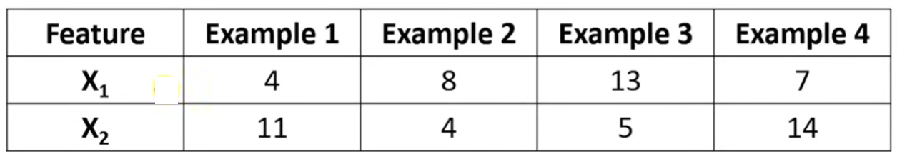
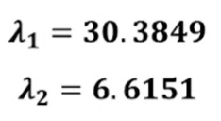
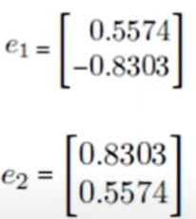
To write in Observation Book
Given the data in table, reduce the dimension from 2 to 1 using the Principal Component Analysis (PCA). Compute for First Principal Component.
Consider Eigen Values as follows:
Consider Eigen Vectors as follows:

Slide 3
To Do: Implementation – PCS
Write Python code to implement the following. Consider dataset files as “heart.csv”
Convert text columns to numbers using label encoding and one hot encoding
Apply scaling
Build a classification model using various methods (SVM, logistic regression, random forest) and check which model gives you the best accuracy
Now use PCA to reduce dimensions, retrain your model and see what impact it has on your model in terms of accuracy. Keep in mind that many times doing PCA reduces the accuracy but computation is much lighter and that's the trade off you need to consider while building models in real life.

Slide 4
To Upload to Github
In your github account create folder “6thSem-ML-Lab” and upload your python notebook worked on PCA with file name as “yourUSN_Lab-10-PCA. ipynb”

Slide 5
To write in the Observation Book
After building the model, write the answer for the following question in your observation book
1. For “heart.csv” dataset
Report the accuracy scores before and after applying PCA.

