Slide 1

Skill-It
Mobile Application Development
Review 2
Name 1 USN1 Name 2 USN2 Name 3 USN3 | SHASHANK SHANTHARAM NAYAK 1BM23CS313 SOHAM HATHI 1BM23CS335 SRUSHTI SUNKAD 1BM23CS341
Guide: RASHMI H.
Designation: ASSISTANT PROFESSOR
Department of Computer Science & Engineering
B.M.S. College of Engineering
Notes:
Arpana

Slide 2
OUTLINE
Introduction
Hardware and Software Requirements
Module description
Database Table Screen shots
ER Diagram
Design Layouts: Screen Shots of Mobile App
References
Notes:
ap

Slide 3
Introduction
Skill It is a mobile app designed to manage college fests, events, and competitions more efficiently. It allows students to register for events, view schedules, and receive real-time updates. Organizers can easily manage registrations, volunteers, and announcements. The app aims to simplify event coordination while boosting student participation and skill development.
Notes:
Niha

Slide 4
Hardware and Software Requirements
🔧 Hardware Requirements
Android smartphone (Android 8.0 or above)
Minimum 2 GB RAM, 100 MB storage
Server for admin panel (4GB RAM, 100GB storage)
🔧Software Requirements
Android Studio (IDE)
Spring Boot/Java for Backend design
PostgreSQL for database
Flutter for Frontend design
Figma for UI design

Slide 5
Module description
Hire: Search for a particular user with some required skill and view his profile.
Apply for new Skills: Allows users to add skillsets for public dissemination.
Call and Mail function: On viewing a profile, users can contact people by either call or mail.
Notes:
Anusree

Slide 6
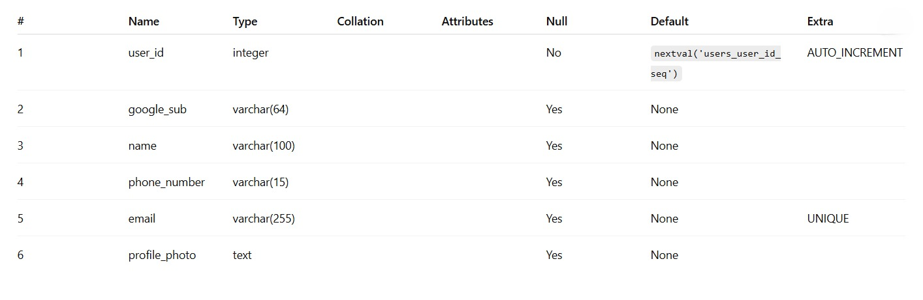
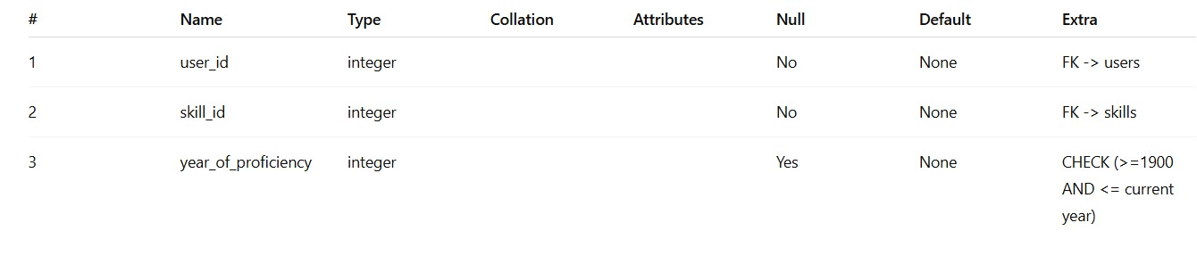
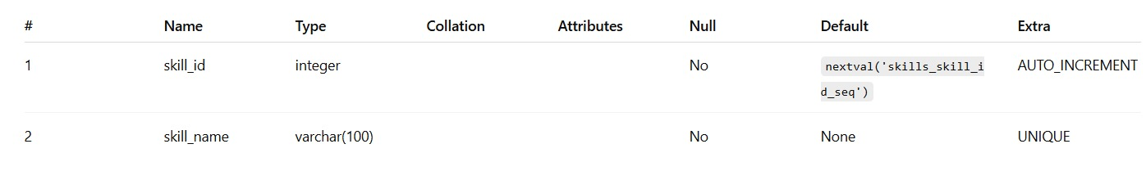
Database Table Screenshots

Slide 7
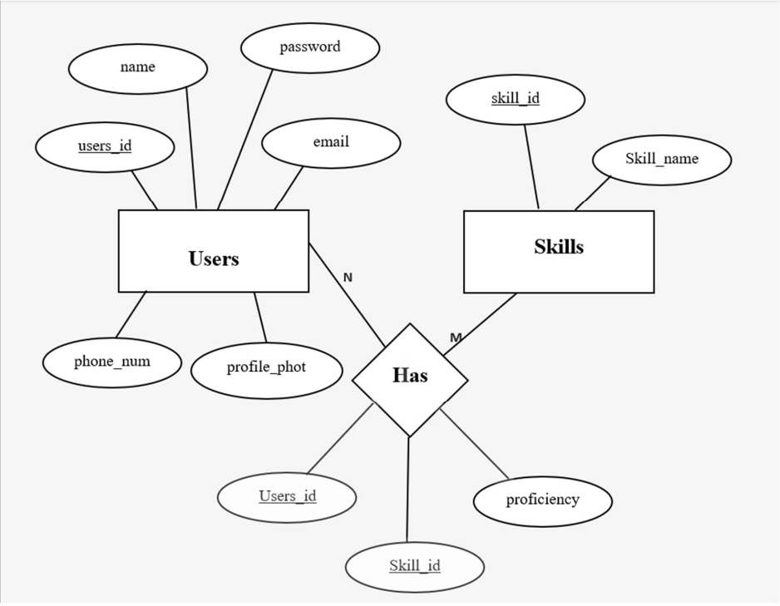
ER DIAGRAM

Slide 8
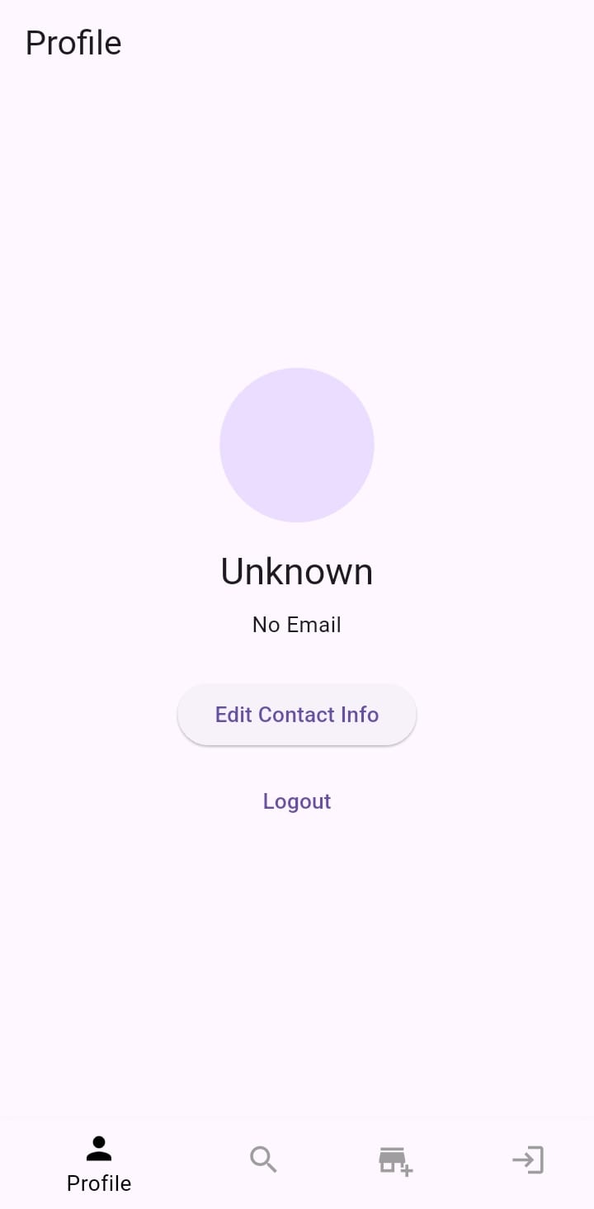
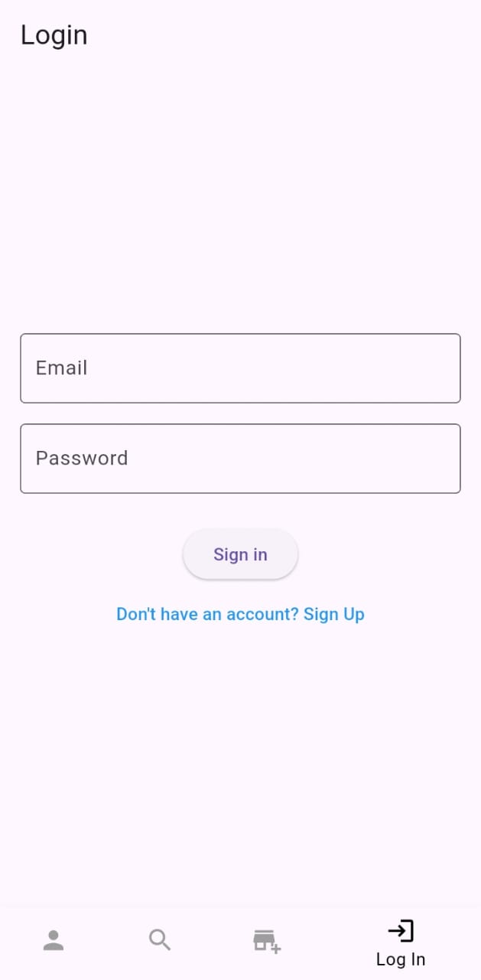
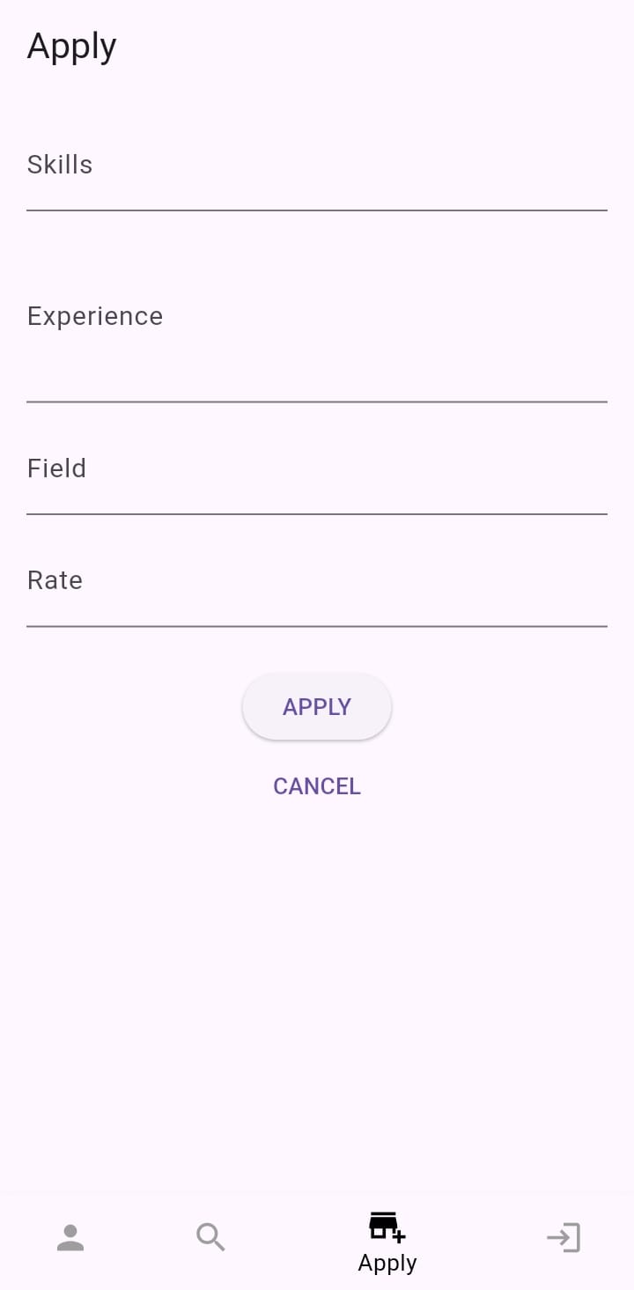
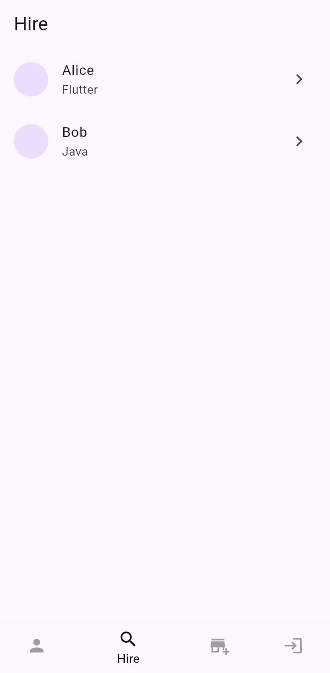
Design Layouts: Screen Shots of Mobile App

Slide 9
References
[1] Spring Boot. ‘Spring Boot Documentation’. Retrieved from https://docs.spring.io.
[2] PostgreSQL. ‘PostgreSQL Documentation’. Retrieved from https://postgresql.org/docs.
[3] Flutter. ‘Flutter Documentation’. Retrieved from https://flutter.dev/docs.

Slide 10
THANK YOU

