Slide 1
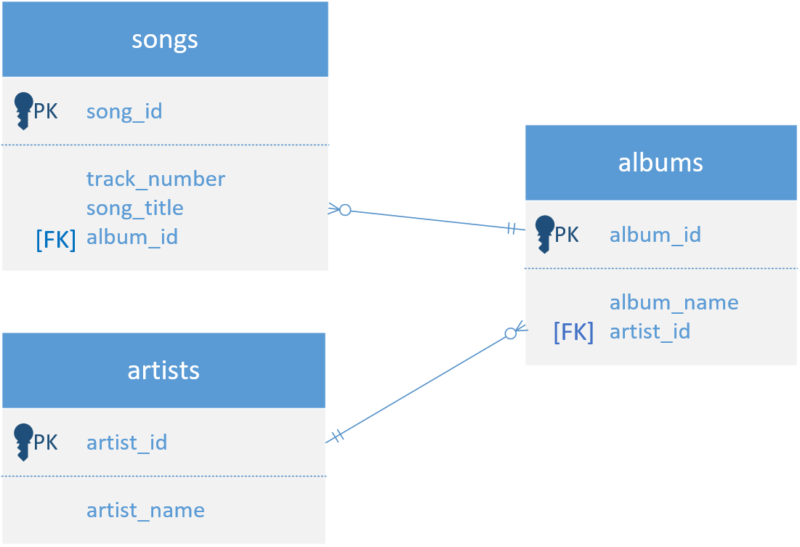

Music Entity Relationship Diagram
Foreign key relationships are commonly set up in databases, to prevent users from inadvertently deleting parent records.
COMPLETE JAVA MASTERCLASS
Update, Delete Statements, and Inserting related records

