Slide 1

Inheritance

Slide 2

Exam Objectives
Reusing Implementations Through Inheritance
Create and use subclasses and super classes.
Create and extend abstract classes.
Enable polymorphism by overriding methods.
Utilize polymorphism to cast and call methods, differentiating object type versus reference type.
Distinguish overloading, overriding, and hiding.

Slide 3
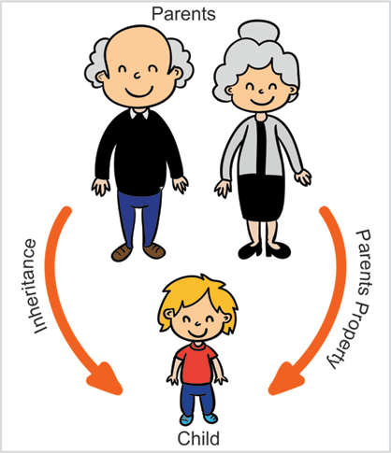
Inheritance defined
Inheritance is a common phenomenon that we view everywhere around us. We ourselves inherit many things from our parents like our face structure, our physique, our hair and many more.
Similarly in java, we have a concept of inheritance.
A class in java bundles together properties and behavior within itself.
Similar to the real world , when a class inherits another class then it receives properties and behaviours defined in the parent class as a part of inheritance relationship.
The class being inherited is referred to as superclass/supertype/base class/parent class and the class inheriting is referred to as subclass/subtype/derived class/child class.
The subclass can additionally modify the inherited members from the parent class.

Slide 4
Inheritance defined
In order to inherit from a class, the child class “extends” the parent class.
Java does not support multiple inheritance which means a class in java is not allowed to “extend” more than one class.

Slide 5
Inheritance defined: The Details
In order to inherit from a class, the child class “extends” the parent class.
Java does not support multiple inheritance which means a class in java is not allowed to “extend” more than one class.
Constructors are not considered as members of the class and hence are not inherited. Similarly static and instance initializers are also not considered members of the class and hence are not inherited.

Slide 6
We are all child of the “Object” class.
Individually we wear many identities like Indian, American, men , women. Over and above all this we all have a common identity that we all are humans. There are some properties and behaviors that we all humans have like we have two eyes, 2 legs , we talk, we listen etc.
Similar to human class that we all inherit, java.lang.Object class is the parent class of all the classes in java, whether classes in jdk or the classes defined by the user. So all objects have a set of default methods which can be invoked which are inherited from the Object class.
Methods from Objects class :
toString()
equals()
hashcode()
clone()
getClass()

Slide 7
Myth of Static Inheritance
Static members of the class look like they are inherited but are actually just shared between the parent & child class.
If the parent class contains a static member, then child class also shares the same copy of the static member.
This essentially means that both parent and child refer to the same copy of the member variable in memory and a change from either parent or child class reflects the change everywhere.
On the other hand for inherited instance member from the parent class there is a separate copy of the member for both parent and child.

Slide 8
Access Modifiers
Private
Members are visible only within the declaring class.
Default
Members are visible within the same package as that of the declaring class.
Default members are like public members within the package.
Protected
Extend the visibility of default package and are also visible in the inheriting class.
Public
Members are directly visible from everywhere.

Slide 9
Object Initialization : this & super
For an object of inheriting class, state consist if its data members along with the members of the parent class. Hence the object initialization process consists of initializing the state of the members from the current class as well as the parent.
For this purpose, JVM provides a super() constructor call for calling the parent class constructor which would initialize the parent class members.
We already have know about this() constructor chaining, which can be used to call different constructors within the same class.
Either of super() or this() calls can be the first call in any constructor.

Slide 10
Order of Object Initialization : this & super
Diagram showing algorithm

Slide 11
Stack Trace & Exceptions
Java exception handling mechanism is based upon a throw-catch architecture. Whenever an unwanted situation is arrived at, an exception is ‘thrown’. This exception is then ‘caught’ by a specific piece of code. This is referred to as ‘exception handler’.
The exception is thrown at runtime either by the program itself if it encounters a specific unexpected situation or it can be thrown by the JVM.
The exception can be caught at the point where it is raised or it can be propagated down the stack trace all the way to the first method call. If no piece of code handles the exception all the way down the full stack then JVM acts as the default exception handler and terminates the current program printing the entire stack trace till the point where exception first occurred. An uncaught exception results in the death of the thread in which the exception occurred.
This entire process together is referred to as try-catch-finally construct.

Slide 12
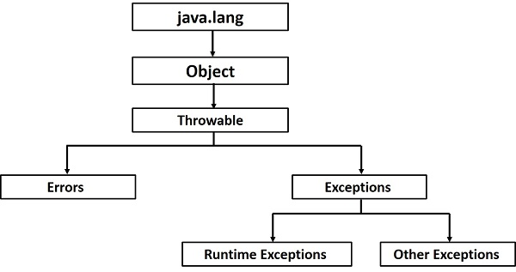
Exception Hierarchy
When an exception is raised, actually an object denoting the concerned exception is created.
An exception object wraps inside of it a message denoting the root cause of exception. Along with this it also contains the Stacktrace of the method that raised the exception.
Throwable interface is the root of the entire exception class hierarchy.
Errors are the situations which cannot be recovered. Hence most probably the only option in such cases is too abort the program execution. Some examples are :
StackOverFlowError
OutOfMemoryError
RuntimeException are those classes which denote those class of exception that may occur at runtime and that are mostly caused by programming errors.
All other exceptions lie under Exception class hierarchy.

Slide 13
Try-Catch or Throws Choice
In general when writing it is a common scenario that there are components or modules and then there are users of that module. Developer of the module generally specifies the input parameters for the module and return type. Apart from this if he thinks that he cannot handle a specific exception that occurs during the module execution then he can choose to delegate that exception to the user/caller of that module. This is referred to as module “throws” the exception to its caller.
On the other hand caller of the module chooses to handle the exception locally, he can put the exception raising module usage in the try block and correspondingly put a “catch” block containing the code to successfully recover from the exception
Alternatively the caller could also decide to delegate the exception further up the call hierarchy. In this case he could also say to its calling component that the code “throws” an exception.
So conclusively there are two things every programmer can do about exceptions. Either to handle it locally using the try-catch block or “throws” the exception to its calling component.
Using the “throws” way, if the exception keeps getting propagated down stack trace and ultimately if no code handles it then, JVM becomes the default handler and throws it out to the end user with the appropriate message and full stack trace down to the point where exception occurred.

Slide 14
Try-Catch block
A try block is the one which contains all the code that could potentially lead to an exception.
The try block can be followed by one or more catch blocks. Order of catch blocks is important.
Multiple catch blocks should be written in such a way that exception classes lower in the hierarchy should appear first while the higher one should come later.
If we try to put an exception class higher in the hierarchy above the class which is lower in the hierarchy then the catch block containing the lower exception class becomes unreachable.
Since a parent class present in a higher catch block hence lower catch blocks would never be able to catch an exception.

Slide 15
“throw”-ing Exception
A programmer also could “throw” an exception. If certain condition in the code that the programmer mandate to be fulfilled is violated and the programmer thinks that further execution is not possible then he can decide to throw an exception explicitly.
Only exception objects can be used with “throw” clause not any other object. Hence following is an example of incorrect throw usage :
throw new String(“Java”)
Only objects whose classes lie in the exception hierarchy are eligible to be used with “throw” clause.

Slide 16
Finally Block
A finally block is sure piece of code. This means that whether and exception occurs or not , the code in finally block is guaranteed to be executed.
This is a common place to close any open database connection or file streams or other common tasks like setting objects to null, rsetting any value etc. This block ideally contains code that is used for cleaning up affairs.

Slide 17
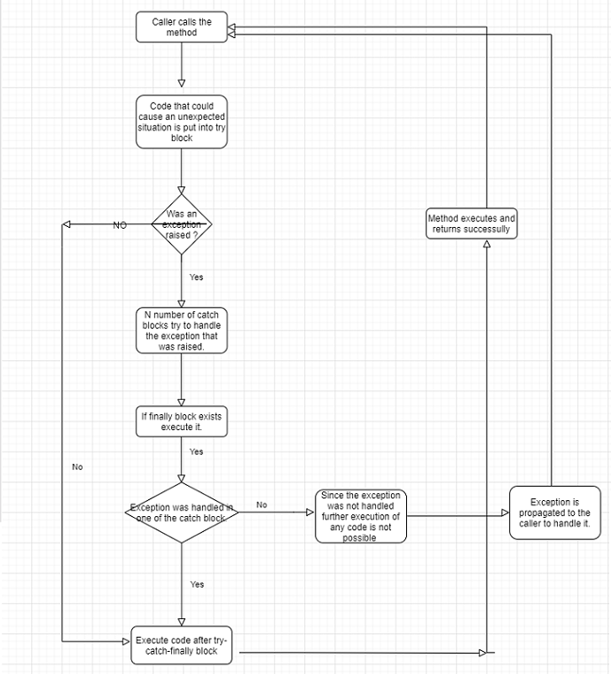
Try-Catch-Finally mechanism

Slide 18
Checked & Unchecked Exceptions
There are two types of exceptions in java
Unchecked.
Are those which are raised due to programming errors or situations which are irrecoverable. The compiler does not force the programmer to handle such sort of exceptions and it is upon programmers discretion to handle them or leave them.
All exception classes inheriting from Error & RuntimeException are examples of unchecked exceptions.
Checked
Those exception which compiler forces the programmer to mandatorily handle.
All exception classes extending from Exception class or any subclass except that of RuntimeException.

Slide 19
Handling Multiple Exceptions
A finally block is sure piece of code. This means that whether and exception occurs or not , the code in finally block is guaranteed to be executed.
This is a common place to close any open database connection or file streams or other common tasks like setting objects to null, rsetting any value etc. This block ideally contains code that is used for cleaning up affairs.

Slide 20
Exceptions in Static Initializers
Static Initializers are the piece of code that are called when the class is loaded by the JVM for the first time.
There is no application code that directly invokes it.
As a result following applies to static initializers :
No unchecked exceptions are allowed to be thrown from within the static initializer block.
Checked exceptions must be handled within the body of the static initializer block and are not allowed to be propagated further.

Slide 21
Exceptions in Initializers
Static Initializers are the piece of code that are called when the class is loaded by the JVM for the first time.
There is no application code that directly invokes it.
As a result following applies to static initializers :
No unchecked exceptions are allowed to be thrown from within the static initializer block.
Checked exceptions must be handled within the body of the static initializer block and are not allowed to be propagated further.
In case of Instance initializer, programmer does have a way to handle the exceptions via the constructors. Hence the instance initializer can throw checked exceptions provided the constructor provides a throws clause listing the same exception there.

Slide 22
Other Points
Exceptions in a constructor are no different than any other method except for one case which is in the case of super-sub class relationship.
If the super class constructor declares an exception in the throws clause then the subclass must also declare in its throws clause an exception of same class or higher.
Normally we should handle all the exceptions and do something in catch block to recover from it like log the exception or print the tack trace.
Try block can be nested within another try block.
Exception can also be thrown from a catch or finally block.

Slide 23
Checked & Unchecked Exceptions
All exception classes except those under Error & RuntimeException are referred to as Checked exceptions. Any user defined exception that extends from these is also a checked exception.
Checked exceptions are those for which the compiler forces the caller to handle the exception explicity. These are those exceptions for which compiler thinks that the caller can successfully recover from.
On the other hand unchecked exceptions are those that compiler wont asks the caller to handle explicitly nd it will be on the diecretion of the programmer to handle them.

Slide 24

Questions ??
a b c

