Slide 1

Exceptions

Slide 2
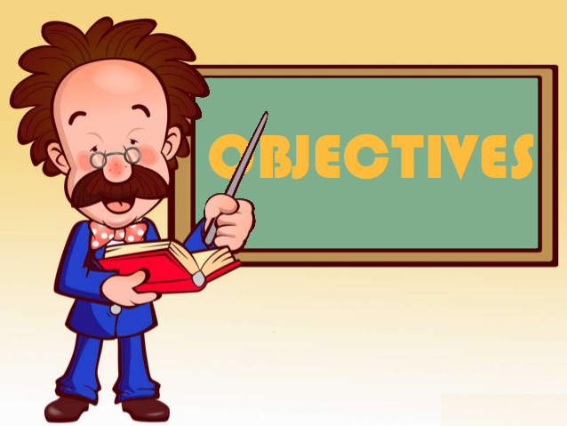
Exam Objectives
Handling Exception
Describe the advantages of Exception handling and differentiate among checked, unchecked exceptions, and Errors.
Create try-catch blocks and determine how exceptions alter program flow.
Create and invoke a method that throws an exception.

Slide 3
Exception Handling Mechanism
An exception in Java is an unexpected situation which breaks the normal execution flow of a program. In order to handle such exceptions, Java provides a handy mechanism referred to as exception handling.
Since these situations occur during the normal course of a program hence we call them as “Exception”.
Examples of exception :
Array index out of range.
Trying to access a field of an object through a reference when the reference points to null.
Trying to access a file that is not physically present in the location specified.

Slide 4
A word on Program Execution
At any point there are many threads executing inside the JVM. Each thread has its own call stack. Each record on the stack represents a method call. So the record/frame at the top is one that is active and being executed.
Each time a new method call is made a new stack frame is allocated and a record corresponding to the current method call is pushed onto this frame. Whenever a method call finishes its stack frame is popped off from the stack. This entire stack of any thread is referred to as its Stack Trace.

Slide 5
Stack Trace & Exceptions
Java exception handling mechanism is based upon a throw-catch architecture. Whenever an unwanted situation is arrived at, an exception is ‘thrown’. This exception is then ‘caught’ by a specific piece of code. This is referred to as ‘exception handler’.
The exception is thrown at runtime either by the program itself if it encounters a specific unexpected situation or it can be thrown by the JVM.
The exception can be caught at the point where it is raised or it can be propagated down the stack trace all the way to the first method call. If no piece of code handles the exception all the way down the full stack then JVM acts as the default exception handler and terminates the current program printing the entire stack trace till the point where exception first occurred. An uncaught exception results in the death of the thread in which the exception occurred.
This entire process together is referred to as try-catch-finally construct.

Slide 6
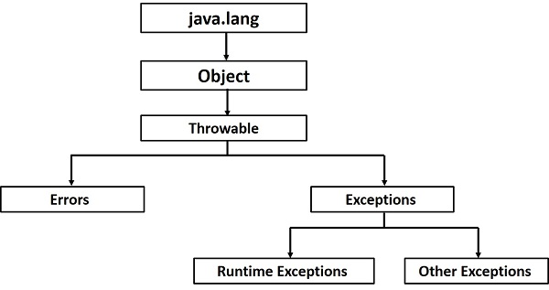
Exception Hierarchy
When an exception is raised, actually an object denoting the concerned exception is created.
An exception object wraps inside of it a message denoting the root cause of exception. Along with this it also contains the Stacktrace of the method that raised the exception.
Throwable interface is the root of the entire exception class hierarchy.
Errors are the situations which cannot be recovered. Hence most probably the only option in such cases is too abort the program execution. Some examples are :
StackOverFlowError
OutOfMemoryError
RuntimeException are those classes which denote those class of exception that may occur at runtime and that are mostly caused by programming errors.
All other exceptions lie under Exception class hierarchy.

Slide 7
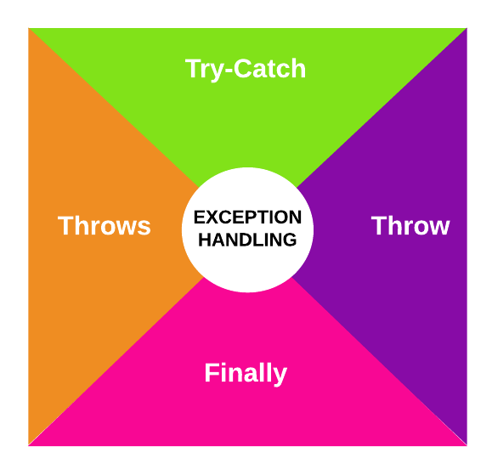
Exception Handling

Slide 8
Try-Catch or Throws Choice
In general when writing it is a common scenario that there are components or modules and then there are users of that module. Developer of the module generally specifies the input parameters for the module and return type. Apart from this if he thinks that he cannot handle a specific exception that occurs during the module execution then he can choose to delegate that exception to the user/caller of that module. This is referred to as module “throws” the exception to its caller.
On the other hand caller of the module chooses to handle the exception locally, he can put the exception raising module usage in the try block and correspondingly put a “catch” block containing the code to successfully recover from the exception
Alternatively the caller could also decide to delegate the exception further up the call hierarchy. In this case he could also say to its calling component that the code “throws” an exception.
So conclusively there are two things every programmer can do about exceptions. Either to handle it locally using the try-catch block or “throws” the exception to its calling component.
Using the “throws” way, if the exception keeps getting propagated down stack trace and ultimately if no code handles it then, JVM becomes the default handler and throws it out to the end user with the appropriate message and full stack trace down to the point where exception occurred.

Slide 9
Try-Catch block
A try block is the one which contains all the code that could potentially lead to an exception.
The try block can be followed by one or more catch blocks. Order of catch blocks is important.
Multiple catch blocks should be written in such a way that exception classes lower in the hierarchy should appear first while the higher one should come later.
If we try to put an exception class higher in the hierarchy above the class which is lower in the hierarchy then the catch block containing the lower exception class becomes unreachable.
Since a parent class present in a higher catch block hence lower catch blocks would never be able to catch an exception.

Slide 10
“throw”-ing Exception
A programmer also could “throw” an exception. If certain condition in the code that the programmer mandate to be fulfilled is violated and the programmer thinks that further execution is not possible then he can decide to throw an exception explicitly.
Only exception objects can be used with “throw” clause not any other object. Hence following is an example of incorrect throw usage :
throw new String(“Java”)
Only objects whose classes lie in the exception hierarchy are eligible to be used with “throw” clause.

Slide 11
Finally Block
A finally block is sure piece of code. This means that whether and exception occurs or not , the code in finally block is guaranteed to be executed.
This is a common place to close any open database connection or file streams or other common tasks like setting objects to null, resetting any value etc. This block ideally contains code that is used for cleaning up affairs.

Slide 12
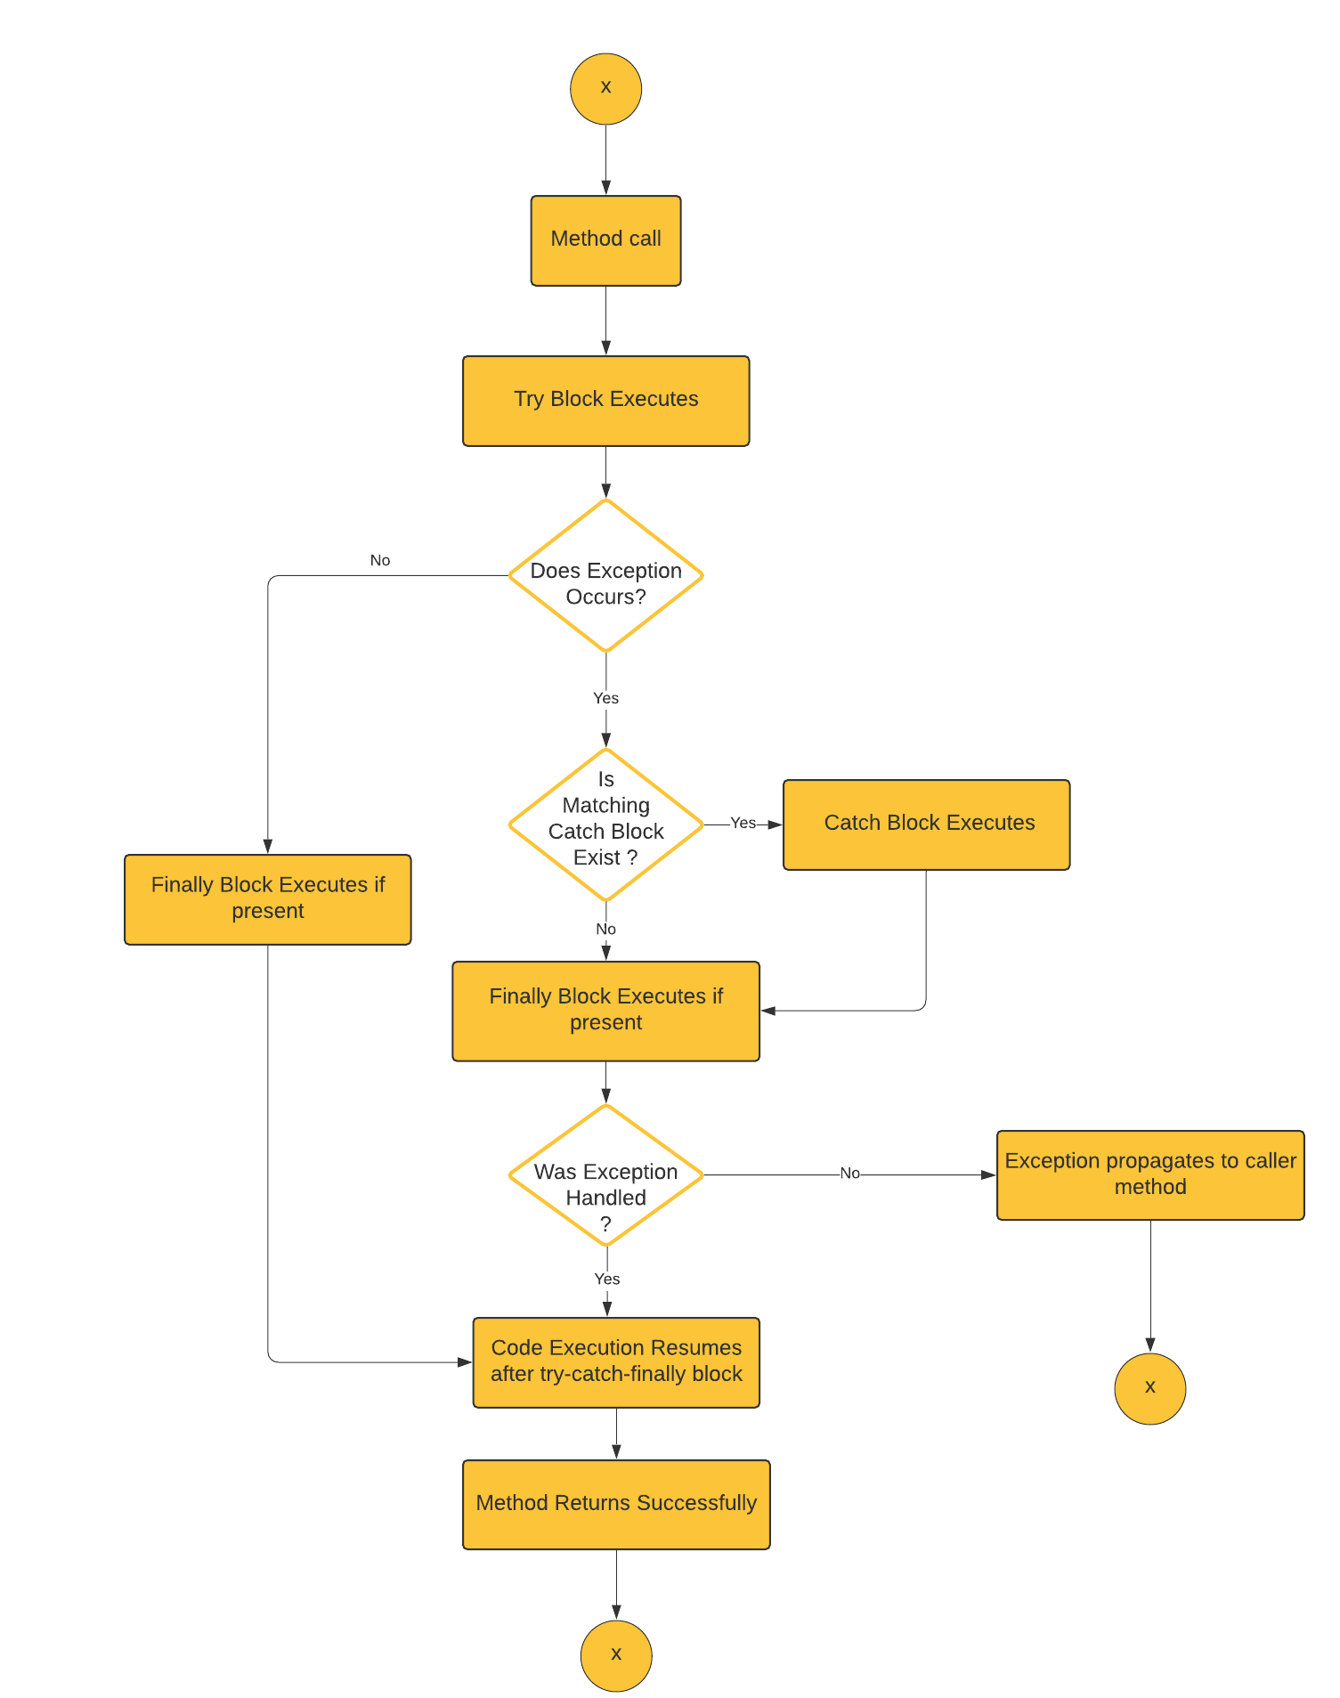
Try-Catch-Finally mechanism

Slide 13
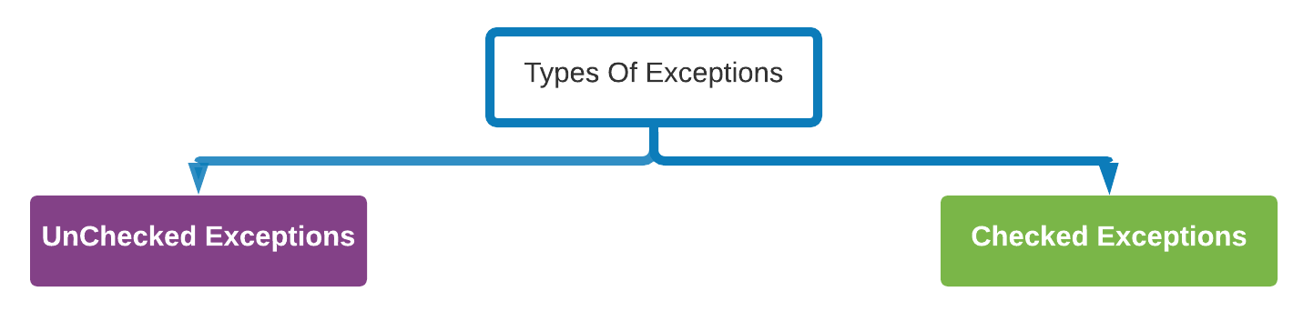
Exceptions that are raised due to programming errors or situations which are irrecoverable.
Compiler does not force to handle such sort of exceptions and it is upon programmers discretion to handle them or not.
All exception classes inheriting from Error & RuntimeException are examples of unchecked exceptions.
Exceptions for which compiler forces the programmer to mandatorily handle.
All exception classes extending from Exception class or any subclass except that of RuntimeException.

Slide 14
Handling Multiple Exceptions
A finally block is sure piece of code. This means that whether and exception occurs or not , the code in finally block is guaranteed to be executed.
This is a common place to close any open database connection or file streams or other common tasks like setting objects to null, resetting any value etc. This block ideally contains code that is used for cleaning up affairs.

Slide 15
Exceptions in Static Initializers
Static Initializers are the piece of code that are called when the class is loaded by the JVM for the first time.
There is no application code that directly invokes it.
As a result following applies to static initializers :
No unchecked exceptions are allowed to be thrown from within the static initializer block.
Checked exceptions must be handled within the body of the static initializer block and are not allowed to be propagated further.

Slide 16
Exceptions in Initializers
Static Initializers are the piece of code that are called when the class is loaded by the JVM for the first time.
There is no application code that directly invokes it.
As a result following applies to static initializers :
No unchecked exceptions are allowed to be thrown from within the static initializer block.
Checked exceptions must be handled within the body of the static initializer block and are not allowed to be propagated further.
In case of Instance initializer, programmer does have a way to handle the exceptions via the constructors. Hence the instance initializer can throw checked exceptions provided the constructor provides a throws clause listing the same exception there.

Slide 17
Other Points
Exceptions in a constructor are no different than any other method except for one case which is in the case of super-sub class relationship.
If the super class constructor declares an exception in the throws clause then the subclass must also declare in its throws clause an exception of same class or higher.
Normally we should handle all the exceptions and do something in catch block to recover from it like log the exception or print the tack trace.
Try block can be nested within another try block.
Exception can also be thrown from a catch or finally block.

Slide 18
Checked & Unchecked Exceptions
All exception classes except those under Error & RuntimeException are referred to as Checked exceptions. Any user defined exception that extends from these is also a checked exception.
Checked exceptions are those for which the compiler forces the caller to handle the exception explicity. These are those exceptions for which compiler thinks that the caller can successfully recover from.
On the other hand unchecked exceptions are those that compiler wont asks the caller to handle explicitly nd it will be on the diecretion of the programmer to handle them.

Slide 19

Questions ??
a b c

