Slide 1

String

Slide 2

Exam Objectives
Working with String APIs
Create and manipulate Strings.
Manipulate data using the StringBuilder class and its methods.

Slide 3
String: An Introduction
String in java is a class whose object is a collection of zero or more characters.
Examples of objects of String class : “String” , “ABC” , “123”.
Java manages whole implementation of String.
String is a final class which means it cant be inherited further and modified.
String objects are immutable. This means that object once created with a specific set of characters cannot be changed. New String can be created but original one cannot be modified.

Slide 4
String Interning
In java , String is allocated in a special portion of heap memory known as “string pool”.
In order to implement String in an efficient way , a single object is created for all objects of String that have the same character sequence. This means that all String references that point to an object which has same character sequence actually point to the same object.
If the compiler can resolve the character sequence of a string then only it is interned.
String pooling is Java's way of saving program memory by avoiding creation of multiple String objects containing the same value.
But what happens if a reference to the object modifies the String object. Will not all references start pointing to the changed copy of the object ?
This is where immutability of the String object comes in handy. Whenever a String object is modified, original object is never modified. Instead a new String object is created with the changed character pattern and assigned to the reference. This ensures that all other reference to the original object point to the same character pattern while the reference that changed the String object points to the changed object.
This phenomenon is referred to as interning of string.

Slide 5
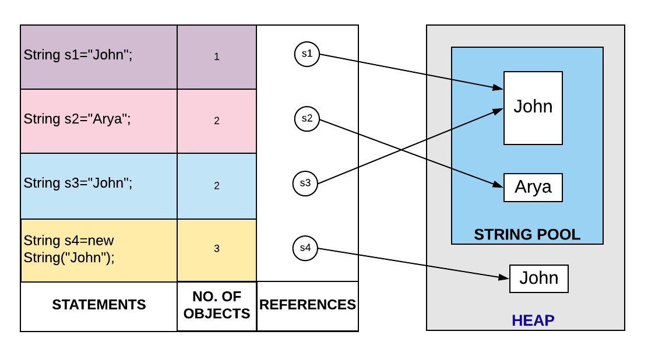
String Creation

Slide 6
String Creation
Strings can be creating by the way of direct assignment.
Example : String str = “OCP”
All string created using the above way are interned automatically by the JVM.
In order to create a normal heap based object of string, new operator is used. Interning does not apply on these objects and these act like any other Java object.
In order to convert a heap based normal String object, intern() method of String comes in handy. If intern() method is called on objects created using the new operator , JVM searches through the string pool and if an object with the same character pattern is found , it is returned. Otherwise a new object is created on the string pool and returned. Any future request to created an interned object with the same character pattern is satisfied using the above object.

Slide 7
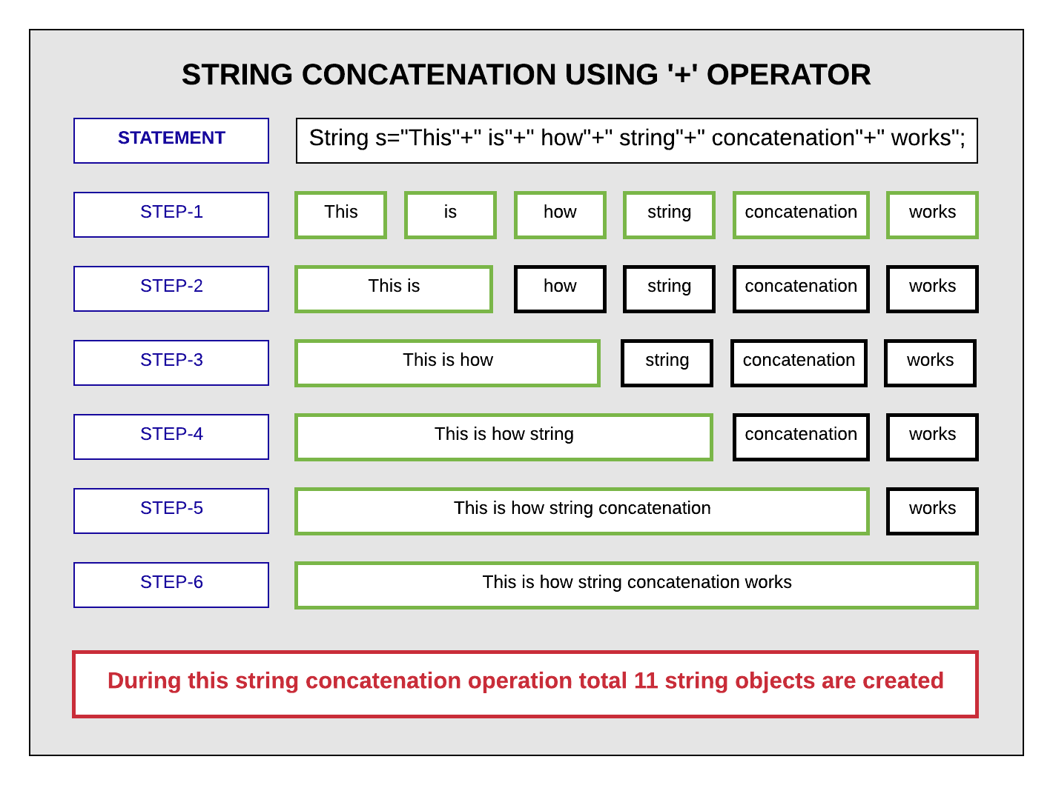
String Concatenation
‘+’ operator is overloaded for Strings and also known as string concatenation operator.
We can also use concat() method of string to join two strings.
Another way is to use StringBuffer and StringBuilder Classes.

Slide 8
Other Points
String concatenation rules:
If the non-string operand is a reference variable, the toString() method is invoked on that reference to get a string representation of that object.
If the non-string operand is a primitive variable or a primitive literal value, a wrapper object of the same type is created using the primitive value and then a string representation is obtained by invoking toString() on the wrapper object.
If the one of the operands is a null literal or a null reference variable, the string "null" is used.

Slide 9
String Builder
StringBuilder class is a mutable version of the String class. This class comes in handy when we need to do lots CRUD operations on the String and do not want that a new object is created each time a change happens.
No “interning” happens on a StringBuilder object.
StringBuilder is just like any other normal Java object. It has many useful utility methods which can used to implement String operations more efficiently.

Slide 10
Properties of An Array
As all objects in java extend from Object class , similarly an array object also extends from Object class.
Therefore an array of Object type can hold objects of all types whether it be primitive or reference types.
Since arrays are objects , hence all arrays are assigned default values at the time of creation. All primitive type arrays are assigned default values as zero while non-primitives are assigned null.

Slide 11

Questions ??
a b c

