Slide 1

Interfaces

Slide 2

Exam Objectives
Programming Abstractly Through Interfaces
Create and implement interfaces
Distinguish class inheritance from interface inheritance including abstract classes
Declare and use List and Array List instances

Slide 3
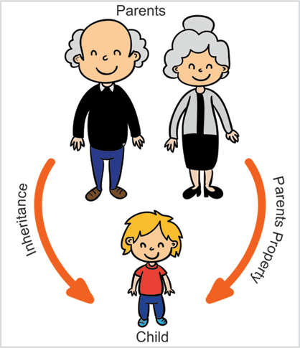
Interfaces
Display of the mobile serves as an interface to the world that lies inside our mobile phones. Inner complexigties of the working of the mobile phone are all hidden behind the user interface.
Similarly, in java we have Interfaces. Interfaces serves as a piece of contract that is visible to the outer world. Underlying it,the implementation may vary.
Interfaces in java are declared using the ‘interface’ keyword.

Slide 4
Interface: In Depths
An interface cannot be instantiated. It only serves to declare the contract and allow subclass to provide a definition.
Prior to java 8, interface members had following restrictions:
An interface does not provide any implementation and hence cannot be instantiated.
All methods were required to be abstract and public.
Static methods are not allowed.
All data members were required to be public, static, final.
After java 9, rules of interface were changed. Following are the new rules :
Methods can have implementation if :
They are implemented with a keyword default prefixed to their definition.
This feature was opened up with the launch of Java8.This was implemented so that any new functionality could be provided to all the classes down in the hierarchy rather than implementing it at multiple locations.
They have private accessibility. This allows for writing all the common functionality at a single place and allowing for a reuse with other methods/default methods.
Static methods can be defined.

Slide 5
Interface Inheritance
As already discussed, an interface provides a blue print of what tall the interface offers. Basis this any class can choose to implement and provide functionality to the interface.
An interface can implemented by any class using the ‘implements’ clause. Note that it is ‘implements’ and not ‘extends’ because it is actually there exist no implementation of an interface and we giving and implementation. On the other hand extending means their exist certain functionality and we are giving it an extension.
A class implementing an interface must provide implementation to all abstract methods in the interface. If a class decides to leave apart some method definitions from the interface then it needs to declare itself as an ‘abstract’ class.
An interface implementing class has option of implementing a default prefixed method in the interface as it already has a definition in the interface.
A class can inherit from only one class but can implement multiple interfaces.

Slide 6
Other points…
For interfaces unlike class inheritance, static methods are not shared with the implementing class. This means we cant reference the static methods using an implementing class reference.
With the introduction of default methods there arose a problem referred to as diamond problem. Diamond Problem : If a class implements multiple interfaces each of which have a default method with the same name then in the implementing class compiler is unable to resolve actually which method to refer to. Prior to java 8, since interfaces did not have default methods hence this problem did not occur.
Resolution : The interface implementing class is required to give an implementation of the same-named-method so as to resolve any ambiguity.

Slide 7
Other points…
Show accessibility of fields in the child class implementing two interfaces having same-named fields.
In interface can also inherit from other interface by using the ‘extends’ keyword.
A class cannot extend an interface, it can only implement an interface. On the other hand, an interface cannot implement any interface it can only extend an interface.
Interface to interface inheritance :
Same-named fields
Same-named default methods
Interface to class inheritance
Same-named fields
Same-named default methods
Anonymous classes.
Difference between an interface and an abstract class.

Slide 8
Marker Interface
Marker interfaces are special interfaces that are provided with the JDK api.

Slide 9
Access Modifiers
Private
Members are visible only within the declaring class.
Default
Members are visible within the same package as that of the declaring class.
Default members are like public members within the package.
Protected
Extend the visibility of default package and are also visible in the inheriting class.
Public
Members are directly visible from everywhere.

Slide 10
Object Initialization : this & super
For an object of inheriting class, state consist if its data members along with the members of the parent class. Hence the object initialization process consists of initializing the state of the members from the current class as well as the parent.
For this purpose, JVM provides a super() constructor call for calling the parent class constructor which would initialize the parent class members.
We already have know about this() constructor chaining, which can be used to call different constructors within the same class.
Either of super() or this() calls can be the first call in any constructor.

Slide 11
Order of Object Initialization : this & super
Diagram showing algorithm

Slide 12
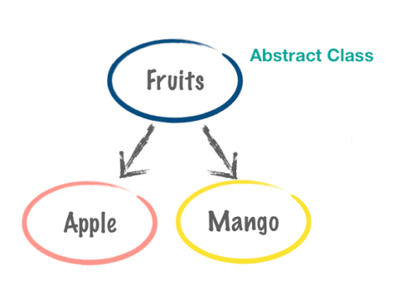
Abstract Classes
A home represents a place which provides all living beings with shelter and safety. However, home is a concept while flat, row house or farm house is an actuality.
Similarly Country represents a land where people live and share a common idea of homeland. However, country is a concept while India , USA, China are an actuality.
Based on similar lines we have abstract classes in java. These are those classes which cannot be instantiated.
An important part of being an abstract class is that it can have certain methods which can be left unimplemented by declaring them abstract while there can be some which can be fully implemented.

Slide 13
Abstract Classes
Abstract classes are declared as abstract.
Abstract classes have one or more methods defined as abstract. These are those methods which are intended to be left unimplemented. The y just have the method declaration but no body.
It can also have methods which are given fully implemented.
If a class chooses to extend the abstract class, then it is required that it gives definition to all the abstract methods from the parent class.
However if a class intends to partially implement an abstract class , then it will also have to declare itself abstract.

Slide 14
Polymorphism
With inheritance in place, the program is at liberty to play around with a reference and the object.

Slide 15
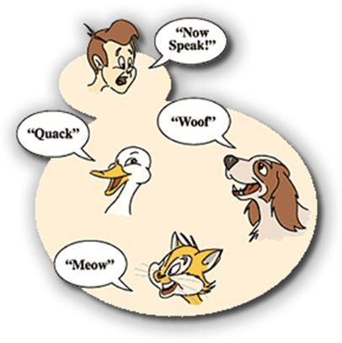
Polymorphism
With inheritance in our armory, we can now start playing around with the world of OOPS!!!
Enter polymorphism. Let the game begin.
With inheritance in place, a super class reference can point to any of the subclass object. This is referred to as polymorphism.
Combined with polymorphism is concept of dynamic method lookup. Dynamic method lookup as the name suggests invokes a method based on the runtime type of the object.
As the picture says, when an animal is asked to speak, each speaks out in his own unique and different ways depending on the animal.

Slide 16
Benefits of Polymorpohism
Promotes substitutability.
Instead of using specific class names, we make use of generic parent class references. This reduces the overall code that needs to be written.
Whenever there arises a need for introducing a new type, then the existing code can take care of the new type as well since it is written in a generic way.

Slide 17
Overriding
Inheritance provides us the luxury of using things from our parents, its like getting the to the hidden reassure of riches from my father. I can use it with no additional efforts.
On the other hand, it may be sometimes necessary that things inherited from our parents/ancestors be changed or modified to make them better or to make them into something that is more useful for us or more accustomed to what we need.
This is where we get to know the phenomenon of overriding.
Imagine getting an old car from your father , Yuck !! Who drives it today. You need something which looks more trendy.

Slide 18
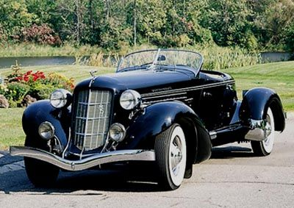
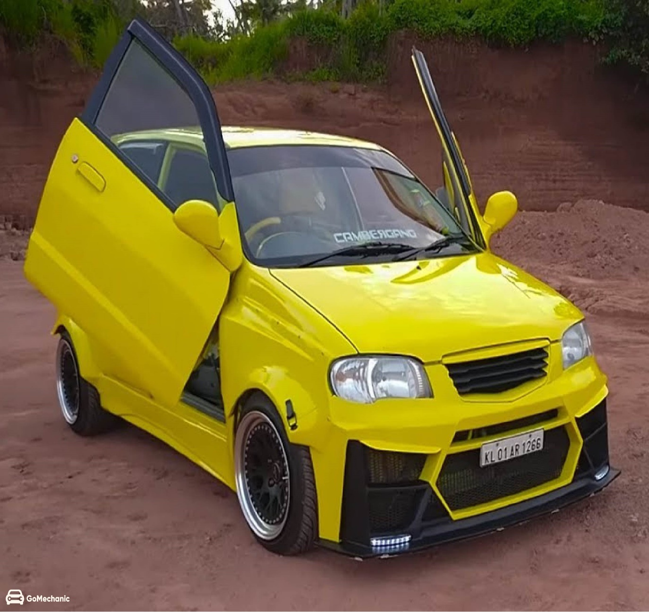


Overriding My father’s Old Car

Slide 19
Overriding….
Overriding only applies to behavioral aspect of the class. This means the subclass can override only the method of the parent class.
In order to transparently override the method from the parent class, it is important to follow certain rules of overriding.

Slide 20
Rules of Overriding
In order to override a method from parent class, the child class must ensure following rules :
Name
Name of the method must be the same as that of the parent class.
Accessibility
Overriding method can increase the accessibility of the method. This means that if a method is declared as protected in the parent class then the subclass can declare it as public.
Return Type
Overriding method can declare the same return type as that of the parent or can declare a return type which is a subtype of the return type of parent.
For ex. if the parent overridden method declares return type as Object then the overriding method in the subclass can declare return type as Object or a subclass of Object like String, Integer etc.
In case of primitive types the return type should match exactly.
Parameters
The number & type of parameters should be exactly the same along with its order.
Throws Clause
Overriding method can declare exception which are same or subtype of the exception declared in the parent class overriding method.
Any number of exceptions can be declared in the overridden method provided they are all subtype of the exception type declared in the parent class overriding method.
An overriding class cannot declare exception not listed in the throws clause of parent class overridden method.
Overriding method can choose to altogether skip the throws clause.
All rules relating to exceptions apply only to checked exceptions. They are no rules for unchecked exceptions.

Slide 21

The “final” class
Limited edition cars are a special form of art, style and performance of a model. Limited production cars are usually reserved for a special occasion, maybe an anniversary. They are a one time make and no new cars extending the features of the limited edition car comes out.
Similarly we can make a class that cannot be inherited further. This can be achieved by declaring a class as final.
Generally special purpose classes which have functionality that can be broken by inheriting them are declared as final.
Good example of this is String class. Strings in java are immutable, and if allowed to be inherited then any class can implement them and change the internal functionality.

Slide 22

The “final” method
We all have heard about the popularity of open source. One of the main reasons behind its popularity is that anyone can download the code and do changes to it and create something new out of the existing piece of software.
Being freely available and open for modification makes it all the more cool.
On the other hand we also know about licensed softwares like MS power point or Adobe photo shop.
These are proprietary software and can only be used and provide no way of extending their functionality.
Similarly we have “final” methods in java. These methods prevent the subclasses from overriding the final method.
Unlike “final” classes, in case of “final” method a parent class can be extended completely except that its final methods cannot be overridden by the child class.
Declaring a static method “final”, prevents it from getting hidden by the subclass method. In case we try to declare a method with same signature as parent then compiler raises an exception. This exception that compiler raises is incorrectly written and should I ideally say hiding instead of overriding.

Slide 23
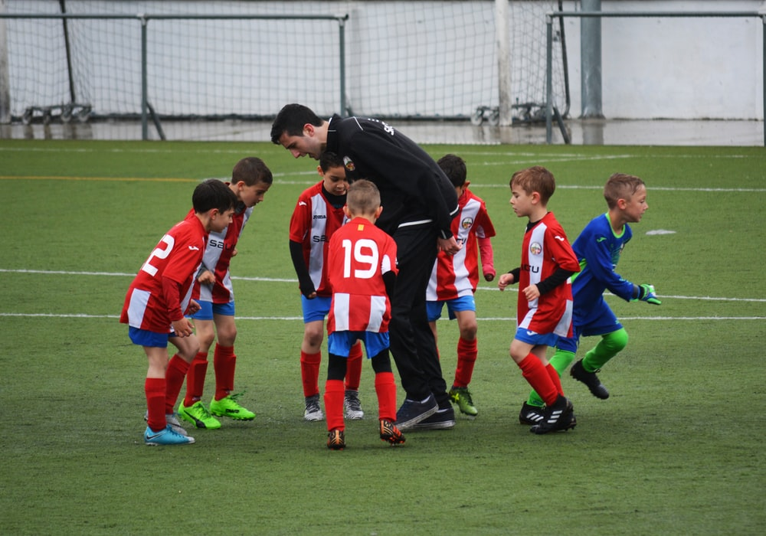
Compiler: Developers true well wisher
Ever saw a soccer coach, prepare his kids for the game. Why does he do that? To ensure that when they go out there in a real game they are able to give their best.
What does a coach do for this ? He points out each and every mistakes to his kids and ensures that every kid works on them, so that in a real game they come out with flying colors.
In the programmers world, none other than the compiler is our true well wisher.
Lets see , How ????

Slide 24
Compiler & Polymorphism
Due to polymorphic behavior, a reference and the object it points to can be completely different. This is possible because in the case of inheritance a class higher in the hierarchy can point to an object that is lower in the hierarchy.
Example : A reference of Object class can point to an object of String class.
Due to polymorphic behavior, at compile time only type of the reference is known while no whereabouts of the actual object can be known.
As a result of above fact, during assignment of one reference type to other, the compiler ensures that references on the right hand side of the assignment operator(=) always is a subclass of the reference type on the left hand side. This essentially means right hand side reference has “is a” relationship with the reference type on the left hand side.
For example, Fruit f = m(mango type). Here mango “is a” fruit.

Slide 25
Casting
Though the compiler ensures that only subclass reference type be assigned to a parent class reference, there are loopholes in this approach.

Slide 26

Questions ??
a b c

