Slide 1

Modules

Slide 2

Exam Objectives
Describe how a modular project is compiled and run
Declare modules and enable access between modules
Describe the Modular JDK

Slide 3

Modules
Modules were introduced in Java 9.
The whole effort to implement java module system in java 9 was named Project jigsaw.
As we have seen till now all java code is bundled into packages and those packages are bundled into a jar file.
Java module implementation provides one more level of packaging called as modules. Now java packages can be grouped into modules.
Every module declares set of packages that it imports and other modules that need to make use of other module declare which module they require.

Slide 4

Need for Modules
Drawbacks of current JDK
Large size of monolithic JDK.
Poor performance
Large testing efforts.
User access to internal apis.
Benefits of Modular system
Strong encapsulation.
User has the choice to restrict usage of internal apis.
Helps build small , modular and deployable application.
Modular JDK.

Slide 5
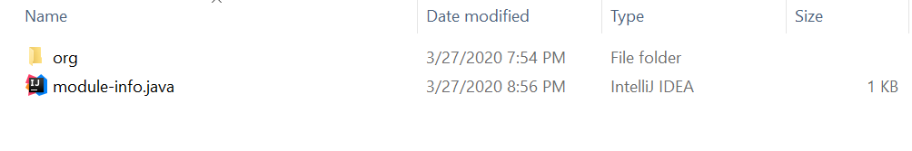
Implementing modules
The module-info.java file is the module descriptor.
This file declares a module.
Using ‘exports’ keyword inside the module-info.java file , user can state exactly which packages of the current module he wishes to be used by other modules.
Using ‘requires’ keyword inside the module-info.java file, user can specify which module he intends to utilize in his module.
Other important keywords being transitive,to.

Slide 6
Compile & Execute parameters
For JDK to identify and compile modules , the ‘javac’ command has certain extra arguments specifically for modules. These are :
--module-source-path <module-source-path>
Specify where to find input source files for multiple modules
--module-path <path>, -p <path>
Specify where to find application modules
--module <module-name>, -m <module-name>
Specifies the name of the module to compile.

Slide 7
Types of modules
Types of modules :
Named
Actual implementation of modules.
Unnamed
For supporting older versions of java code that compile on java 8 or lesser.
Automatic.
For existing jar files that were not created to support modules.

Slide 8
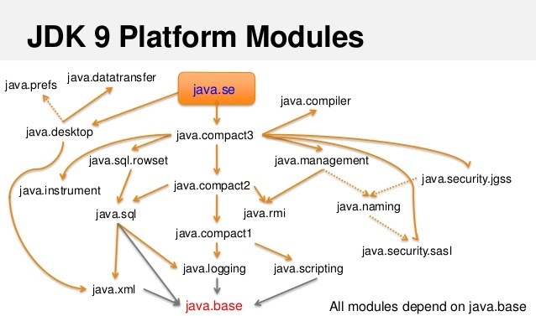
Modular JDK
Till Java 8 , JDK used to be one giant , monolithic software.
With coming of project jigsaw , entire JDK was itself modularized.
Entire JDK was divided into standard and non-standard parts.
The standard part was kept into a base module named java.base module. This module is by default available to all other modules and does need to required explicitly.
Non standard part is further divided into multiple modules which if needed to be used have to be explicitly required.

Slide 9
Linker
Best part of modular system is introduction of a tool named ‘jlink’.
This tool bundles the user modules along with the java.base modules and other required modules and outputs a minimalistic JDK.
This minimalistic JDK can be used in places even where there is not java installed.
In short this minimalistic version of JDK bundled with user module can be used to run the user module anywhere , independent of JDK installation.

Slide 10

Questions ??
a b c

