Slide 1
Data Engineering Day 3
Kerry Nakayama

Slide 2
Micro Partitions & Snowflake
Kerry Nakayama

Slide 3

Objectives
Snowflake Data Warehouse Review
Data Storage
Query Processing
Cloud Storage
Micro-Partitions vs Static Partitions
Query Pruning
Data Clustering
Clustering Depth
Clustering Keys
Benefits
Strategies

Slide 4

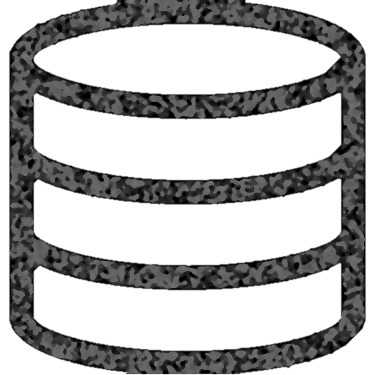
Snowflake Data Warehouse Review
Authentication and Access Control
Cloud
Services
Infrastructure Manager
Optimizer
Transaction Manager
Security
Virtual Warehouse
Virtual Warehouse
Virtual Warehouse
Query
Processing
Database
Storage
Notes:
Should be a review from previous days

Slide 5
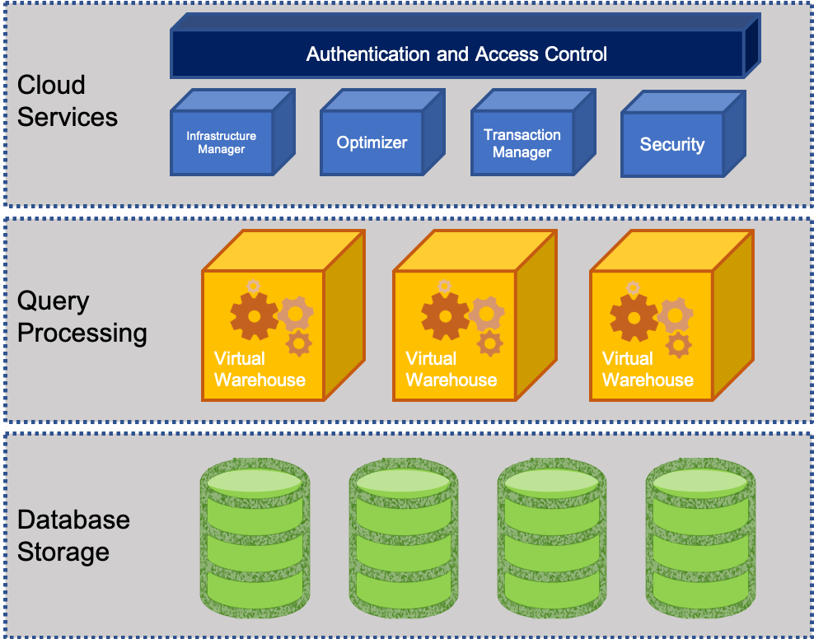
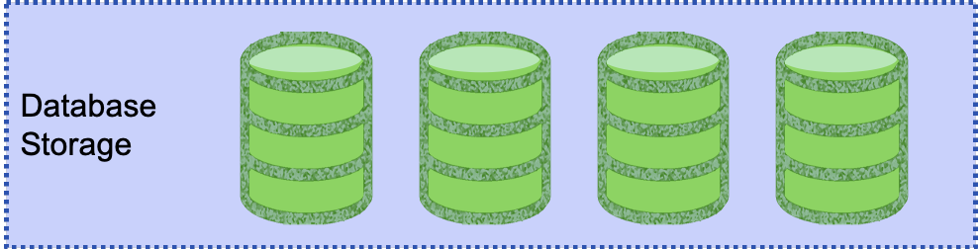
Efficient data storage in Snowflake Database Storage Layer
The storage layer contains tables, schemas, databases, and diverse data
If managed well storage layer can hold petabytes of data
Snowflake has scalable cloud blob storage type for storing structured and semi-structured data
Such as JSON, AVRO, and Parquet
Snowflake optimizes the metadata for easy extraction and query processing
Storage is made up of multiple micro partitions that are encrypted and scale automatically
Allows for efficient data retrieval and performance
Notes:
Should be a review from previous days

Slide 6

Efficient Query Processing in Snowflake Query Processing Layer
This layer contains virtual warehouses where all the queries are run on each respective virtual warehouse
Allows for a scalable compute capacity
Each Virtual warehouse gets data from the storage layer and has it cached to the compute resources
Multiple VW operate simultaneously to maintain ACID and follow multiple parallel processing
ACID (Atomic, Consistent, Isolated and Durable) that ensure a database management system (DBMS) will make changes to data in a reliable
VW can auto-suspend, auto-resume, and have auto-scaling that can be built in
Notes:
Should be a review from previous days

Slide 7

Efficient Cloud Storage in Snowflake Cloud Services Layer
This layer is the cerebrum of Snowflake where it maintains, optimizes, transacts on data, as well as provides security, and metadata management
Enables SQL client interface for DDL and DML like operations on data
VW can auto-suspend, auto-resume, and have auto-scaling that can be built in
Notes:
Should be a review from previous days

Slide 8

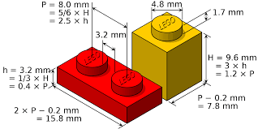
Understanding Micro-partitions vs Static partitions
Static partitioning - is used when the values for partition columns are known when loading data
Benefits
Works with data that is already known
Achieves acceptable performance and enables better scaling
Limitations
High maintenance cost to make changes
Data skew if partitions are not set up well
Disproportionately-sized partitions happen

Slide 9
Understanding Micro-partitions vs Static partitions
Micro partitioning – same value as static partitioning but removes the limitations
All data is Snowflake automatically divided into micro-partitions
Each micro-partition contains 50 MB – 500 MB of uncompressed data
(size is actually smaller since data is always stored compressed)
Groups of rows are mapped to individual micro-partitions and organized in columnar fashion
Allows for extreme granular pruning of large tables (millions of micro-partitions)
Benefits
Columnar Storage
Automatic
Efficient Scanning
Micro-partitions
Size is tiny
Overlapping Storage
DML
Notes:
Benefits
micro-partitions are derived automatically; do not need to be defined up-front or maintained by users.
micro-partitions are small in size (50 to 500 MB, before compression), which enables extremely efficient DML and fine-grained pruning for faster queries.
columnar storage - Columns are stored independently within micro-partitions
Columns are also compressed individually within micro-partitions.
Micro-partitions can overlap in their range of values, which, combined with their uniformly small size, helps prevent skew.
only the columns referenced by a query are scanned – efficient scanning
Snowflake automatically determines the most efficient compression algorithm for the columns in each micro-partition.
All DML operations (e.g. DELETE, UPDATE, MERGE) take advantage of the underlying micro-partition metadata to facilitate and simplify table maintenance. For example, some operations, such as deleting all rows from a table, are metadata-only operations.

Slide 10

Query Pruning
Snowflake enables precise pruning of columns in micro-partitions at query run-time, including columns containing semi-structured data
Date Hour Action Action_Category Feature Feature2 Feature3
1/1/2019
1/2/2019
.
.
.
.
.
7/14/2019
.
.
.
.
12/31/2019
1pm
12am
.
.
.
.
.
4pm
.
.
.
.
3am
xxxxx
yyyyy
.
.
.
.
.
zzzzz
.
.
.
.
www
xxxxx
yyyyy
.
.
.
.
.
zzzzz
.
.
.
.
www
xxxxx
yyyyy
.
.
.
.
.
zzzzz
.
.
.
.
www
xxxxx
yyyyy
.
.
.
.
.
zzzzz
.
.
.
.
www
xxxxx
yyyyy
.
.
.
.
.
zzzzz
.
.
.
.
www
1 year's worth of data
Notes:
a query that specifies a filter predicate on a range of values that accesses 10% of the values in the range should ideally only scan 10% of the micro-partitions
For example, assume a large table contains one year of historical data with date and hour columns. Assuming uniform distribution of the data, a query targeting a particular hour would ideally scan 1/8760th of the micro-partitions in the table and then only scan the portion of the micro-partitions that contain the data for the hour column;
Snowflake uses columnar scanning of partitions so that an entire partition is not scanned if a query only filters by one column.
the closer the ratio of scanned micro-partitions and columnar data is to the ratio of actual data selected, the more efficient is the pruning performed on the table.
Time series data allows for sub second response time
Not all predicate expressions can be used to prune. For example, Snowflake does not prune micro-partitions based on a predicate with a subquery, even if the subquery results in a constant.

Slide 11
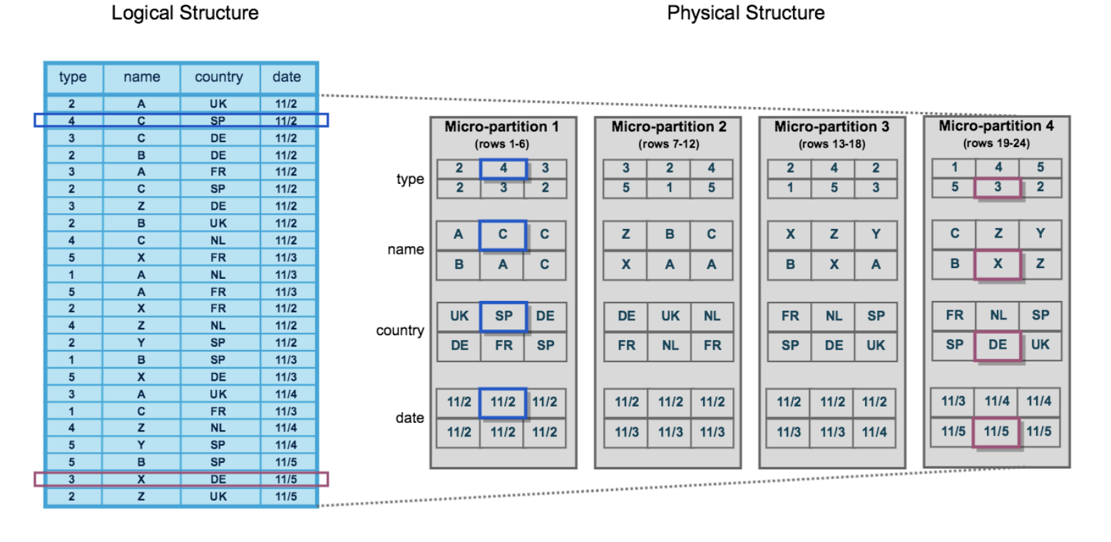
Data Clustering of Micro-Partitions
Clustering is a key factor in queries for unsorted tables which impacts query performance, particularly on very large tables
While Micro-Partitions data is stored in tables which is sorted/ordered along natural dimensions
e.g. date and/or geographic regions
Notes:
clustering metadata is collected and recorded for each micro-partition created during the process. Snowflake then leverages this clustering information to avoid unnecessary scanning of micro-partitions during querying, significantly accelerating the performance of queries that reference these columns.
The table consists of 24 rows stored across 4 micro-partitions, with the rows divided equally between each micro-partition. Within each micro-partition, the data is sorted and stored by column, which enables Snowflake to perform the following actions for queries on the table:
First, prune micro-partitions that are not needed for the query.
Then, prune by column within the remaining micro-partitions.
Note that this diagram is intended only as a small-scale conceptual representation of the data clustering that Snowflake utilizes in micro-partitions. A typical Snowflake table may consist of thousands, even millions, of micro-partitions.

Slide 12
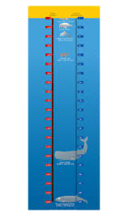
Data Clustering of Micro-Partitions
Snowflake maintains clustering metadata for the micro-partitions in a table, including:
The total number of micro-partitions that make up the table
The number of micro-partitions containing values that overlap with each other (in a specified subset of table columns).
The depth of the overlapping micro-partitions
Clustering Depth average depth (1 or greater) of the overlapping micro-partitions for specified columns in a table
Monitoring the clustering “health” of a large table, particularly over time as DML is performed on the table.
Determining whether a large table would benefit from explicitly defining a clustering key

Slide 13
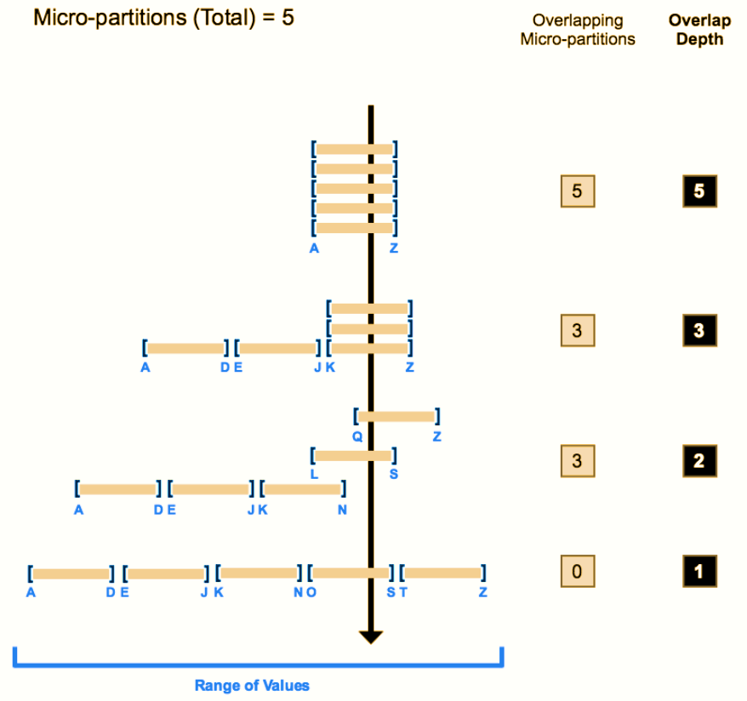
Data Clustering of Micro-Partitions
The line through shows the overlapping micro-partitions
The average depth shows how many overlap at any given moment
Clustering depth for a table is not an absolute or precise measure of a well clustered table
A well clustered table performs queries quickly
performance degrades if the table is likely no longer well-clustered
Notes:
The following diagram provides a conceptual example of a table consisting of five micro-partitions with values ranging from A to Z, and illustrates how overlap affects clustering depth:
As this diagram illustrates:
1. At the beginning, the range of values in all the micro-partitions overlap.
2. As the number of overlapping micro-partitions decreases, the overlap depth decreases.
3. When there is no overlap in the range of values across all micro-partitions, the micro-partitions are considered to be in a constant state (i.e. they cannot be improved by clustering).
The diagram is not intended to represent an actual table. In an actual table, with data contained in a large numbers of micro-partitions, reaching a constant state across all micro-partitions is neither likely nor required to improve query performance.

Slide 14




Clustering Keys
Clustering Keys can be used when DML takes place in large tables and snowflakes automatic clustering is no longer optimal
Re-inserting the data by manually sorting on key columns can fix the clustering but it can be expensive and cumbersome
A good practice is to identify one or more columns as clustering keys for very large tables that have DML done regularly
Clustering keys are not intended for all tables to see performance improvements
Tables need to be >1TB
DML causes changes that affect automatic clustering
Baseline tests should be run first before clustering is added

Slide 15

Benefits of Clustering Keys
Improved scan efficiency in queries by skipping data that does not match filtering predicates
compute resources used to perform clustering consume credits
Should only be used when it will benefit substantially
Better column compression than in tables with no clustering. This is especially true when other columns are strongly correlated with the columns that comprise the clustering key
After a key has been defined on a table, no additional administration is required, unless you chose to drop or modify the key
select ...
from my_table inner join my_materialized_view on my_materialized_view.col1 = my_table.col1
...
Notes:
In this pseudo-example, Snowflake is likely to sort the values in either my_materialized_view.col1 or my_table.col1. For example, if the values in my_table.col1 are sorted, then as the materialized view is being scanned, Snowflake can quickly find the corresponding row in my_table.
The more frequently a table is queried, the more benefit clustering provides. However, the more frequently a table changes, the more expensive it will be to keep it clustered. Therefore, clustering is generally most cost-effective for tables that are queried frequently and do not change frequently.
After you define a clustering key for a table, the rows are not necessarily updated immediately. Snowflake only performs automated maintenance if the table will benefit from the operation. For more details, see Reclustering (in this topic) and Automatic Clustering.

Slide 16
Clustering Strategies
You can use multiple columns to create a Cluster Key
More than 3-4 outweighs the benefit
Use columns that are used in the WHERE or JOIN fields
SELECT date …
FROM my_table
WHERE date BETWEEN x AND y
…
FROM table1 JOIN table2 ON table2.column_A = table1.column_B
Pick columns with high enough cardinality that enables effective pruning
Low cardinality – male or female
Too high cardinality – user id
Just right – product group
Notes:
In general, if a column (or expression) has higher cardinality, then maintaining clustering on that column is more expensive.
The cost of clustering on a unique key might be more than the benefit of clustering on that key, especially if point lookups are not the primary use case for that table.
If you want to use a column with very high cardinality as a clustering key, Snowflake recommends defining the key as an expression on the column, rather than on the column directly, to reduce the number of distinct values. The expression should preserve the original ordering of the column so that the minimum and maximum values in each partition still enable pruning.
For example, if a fact table has a TIMESTAMP column c_timestamp containing many discrete values (many more than the number of micro-partitions in the table), then a clustering key could be defined on the column by casting the values to dates instead of timestamps (e.g. to_date(c_timestamp)). This would reduce the cardinality to the total number of days, which typically produces much better pruning results.
As another example, you can truncate a number to fewer significant digits by using the TRUNC functions and a negative value for the scale, e.g., TRUNC(123456789, -5).
If you are defining a multi-column clustering key for a table, the order in which the columns are specified in the CLUSTER BY clause is important. As a general rule, Snowflake recommends ordering the columns from lowest cardinality to highest cardinality. Putting a higher cardinality column before a lower cardinality column will generally reduce the effectiveness of clustering on the latter column.

Slide 17

Confused? ASK QUESTIONS

Slide 18
Break & Lab 7
Notes:
Show in the lab how clustering and micro partitions work and how you can see it in real time by using query profile

