Slide 1


Introduction to GoLang VMWare 19 November – 21 November 2018 by Fernando Pombeiro

Slide 2
Module Four: Concurrency and Routines

Slide 3
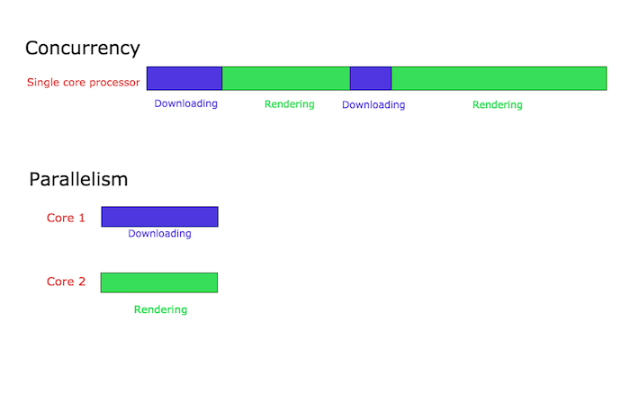
Concurrency vs Parallelism in GO
So let’s talk Parallelism vs Concurrency. A quick example:
Concurrency:
I’m out jogging. I look down and my shoelace is untied. I stop and tie my shoelace. I go back to jogging. Concurrency
This is in a single processor when I am doing a thing, I stop and do another thing, then I go back to doing the first thing.
In programmer language- I have a browser that does two things: renders HTML and downloads a file from the internets. The browser is running on a single core processor. This is what concurrency might look like:

Slide 4
Parallelism in GO
Basically two things happening at once. You can do this in multi-core systems by having things operate on different cores. So in the jogging example:
As you are jogging you are simultaneously listening to your ipod. You are now operating your jogging and ipod in parallel.

Slide 5

Concurrency vs Parallelism
Parallelism is not always faster- especially when one of the processes running in parallel must communicate with the other.
So to go back to our browser example- when the process to download the item has finished it must communicate back to the render process that the download is complete (which you see if you download anything). That takes some overhead.

Slide 6
How Go Handles Multi-threading
GoRoutines are methods that run concurrently with other methods (or functions) in GO. They are basically threads (NOT threads- but similar!)- but much more lightweight than threading in Python or C.
Advantages of goroutines:
Only a few KB of stack size (they grow and shrink by needs of the application)
They are multiplexed to a few OS threads. Check this out- you might have 100 goroutines running on very few threads CONCURRENTLY
IF an activity blocks a thread the routine can “jump” threads- like switching lanes in a traffic jam!

Slide 7

How do GoRoutines Communicate?
GoRoutines communicate via channels- which prevent race conditions from happening when multiple routines must access shared memory resources.
Think of channels as a pipe that GoRoutines use to communicate!

Slide 8

Running GoRoutines
Hop over to the lab and run the initial goroutine. What happened? ONLY the main function ran. Why?
First we started a new goRoutine (go troll2()) BUT- because we are running through main- the control flow did not wait for the go troll2 function to return it’s message
IF the main goRoutine is not running then no other goRoutines can run.

Slide 9
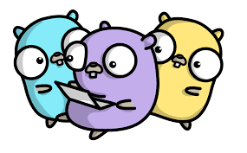
GoRoutines – managing them
Let’s look at multiple goRoutines running simultaneously (in the lab). Notice that they have different times. Here’s how this looks:

Slide 10
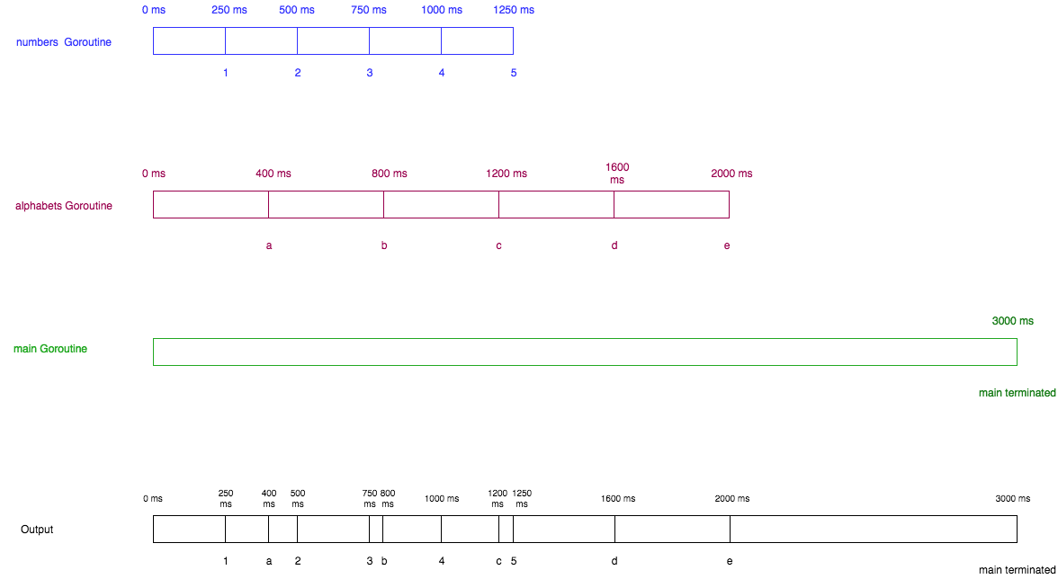
Concurrent GoRoutines

Slide 11

Channels and GoRoutines
So let’s assume that we want to have some shared resources between our goRoutines – we want to give the ability for GoRoutine A to talk to GoRoutine B
In order to do this effectively we need to make channels. The way we do this is with the make command:
make(chan <type>)
Then to CALL the channel we use the “->”

Slide 12

Channels- a couple of notes
We need to make channels with the chan keyword
Channel sends and receives automatically block- which is kind of an awesome feature because you don’t need explicit locks (or conditional variables) which are a PITA in other languages
newchan := make(chan int)
var rando := 2 + 19
newchan <- rando //write rando to newchan
total := <- newchan //read from newchan

Slide 13

Some more notes on Channels
You can also CLOSE channels with the built in close() function
AND you can use the select function (like switch) to set up blocking for your channels to complete:
select {
case msg1 := <-c1:
fmt.Println("received", msg1)
case msg2 := <-c2:
fmt.Println("received", msg2)
}

Slide 14

More on the SELECT statement
Now- since we mentioned select – it’s important to note that the select statement is blocking. It will block until one of the send/receive channels is ready. If multiple are ready at the same time then one of them is chosen at random.
It’s just like switch but we use channels as inputs.

Slide 15
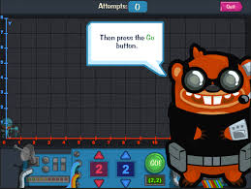
Situation for select
Lets assume we have a mission critical application and we need to return the output to the user as quickly as possible. The database for this application is replicated and stored in different servers across the world. Assume that the functions server1 and server2 are in fact communicating with 2 such servers. The response time of each server is dependent on the load on each and the network delay. We send the request to both the servers and then wait on the corresponding channels for the response using the select statement. The server which responds first is chosen by the select and the other response is ignored. This way we can send the same request to multiple servers and return the quickest response to the user :).

Slide 16

Select Statements
Finally- if you want to make your select NON BLOCKING you can utilize the default statement- similar to the way we use it in switch. THIS will be run until a channel is ready.

Slide 17

Buffer sizes in Channels
You can set the buffer size in a channel by setting the second argument when making the channel:
make(chan int, 10) //sets a buffer size of 10 values
So the channel will hold until it has 10 bytes of data then you can pull the data. If you overfill the buffer you will get a deadlock error.

Slide 18
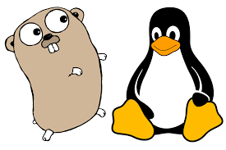
Lab follow along
So- in the example (8)- we create a channel (ch) with capacity two.
We then pass the channel to the write goroutine. Then we have everything sleep for 2 seconds. During that 2 seconds the write goroutine is running concurrently.
The write goRoutine has capacity 2. We’ve asked it to write values from 0 to 4 in the ch channel….SO…
The write goRoutine will write values 0 and 1 to the ch channel immediately and then BLOCK until at least one of those values is read from the ch channel.

Slide 19

Continuing Lab follow along
After sleeping for 2 seconds the MAIN function will read ONE value (“0”) from the channel.
When this happens the channel is immediately freed up to write the next value (2) to the channel.
successfully wrote 0 to ch
successfully wrote 1 to ch
read value 0 from ch
successfully wrote 2 to ch
read value 1 from ch
successfully wrote 3 to ch
read value 2 from ch
successfully wrote 4 to ch
read value 3 from ch
read value 4 from ch

Slide 20

Deadlocks and Channels
One issue with channels is that if you write to a channel but you never receive from that channel you end up with a panic/error resulting in deadlock
If you attempt to overload a channel over the buffering capacity you will also suffer a panic and deadlock error

Slide 21

Capacity and length of channels
Go comes with built-in functions that can help you determine the capacity (“cap”) and length (“len”) of the channels.
Obviously the capacity is the declared values capacity at the initialization of the buffer
The length is the current length of the current buffer

Slide 22

WaitGroups
So- let’s say we want to wait for completion of multiple goRoutines in the main function…
The way that we do this is to create a WaitGroup- which is used to wait for a collection of goRoutines to finish executing.

Slide 23

WaitGroups
So WaitGroup is a struct type. In the lab we are initially creating a zero value variable of type WaitGroup and then pass that address to our function.
What is happening in the lab is:
We create the waitgroup
We create the process function
We spawn three copies of the process function
With wg.Wait() we wait until all three of those processes are done running, then…
We exit.
NOTE: GoRoutines will NOT run synchronously- order?

Slide 24

Worker Pools
So- worker pools are useful for things like setting up a pool of threads that basically hang out and wait for tasks to be assigned to them.
So in my case- there have been situations where I have needed to move millions of api hits (for millions of sites) to an extremely large postgres database asynchronously.

Slide 25
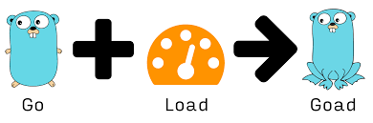
Worker Pools
So it’s nice to have multiple threads pre-made that basically hang out and wait for tasks to be sent (i.e: receive hits from said database).
Worker Pools are the ideal solution for this.
So let’s talk through them…

Slide 26

Worker Pools
So let’s repeat this- a worker pool is basically a collection of threads (channels) that hang out, wait for tasks to be assigned to them, do the tasks, then say “READY FOR NEXT TASK!”
So we’re going to walk through a fairly simple task in the lab section. It’s a nonsensical application- but should teach us about workers pools.

Slide 27

Worker Pool labs
So head over to the presentation 4 lab and let’s put together our worker pool channels!

Slide 28

Introduction to Mutex
So- to understand mutex we first must understand the concept of critical section regarding concurrent programming.
Let’s say you have a database that you want to do concurrent writes to. Call it Thanos. He’s defined as an INT- which represents the number of infinity stones which you currently posess.

Slide 29

Continuing with our Thanos example
So with each new infinity stone gained we want to increment our Thanos with a +1. But you must get them in a certain order!! So you send out two teams of bad guys to get you two infinity stones concurrently
These bad guys both get infinity stones BUT- who gets back to you first? What if they get back to you at the same time? How do you control this??

Slide 30
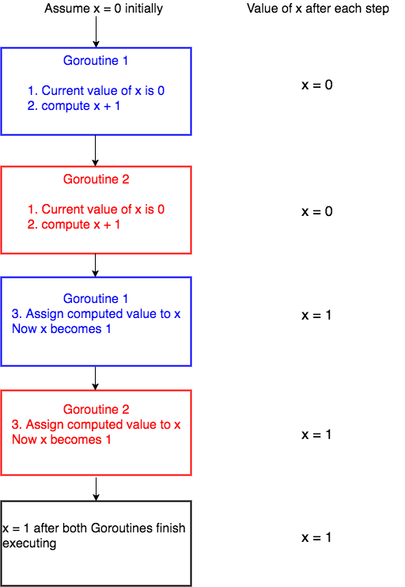
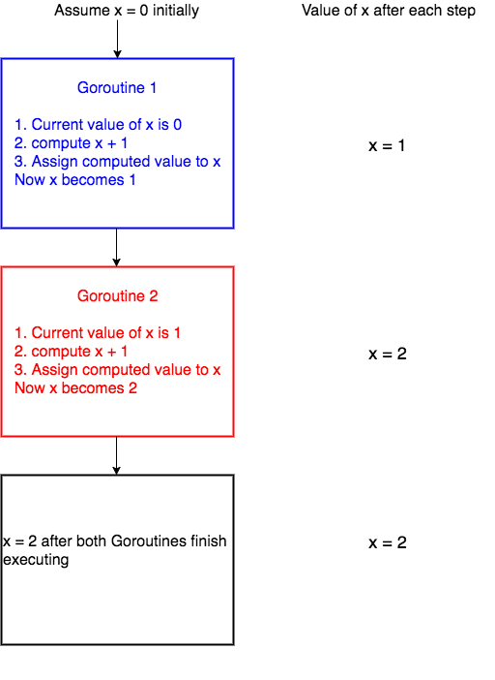
Either one of these could happen

Slide 31

Race conditions
So obviously- one of the dangers of handing concurrent processes over to the go runtime compiler is you lose control over which happens first.
In the practical world this can happen with, for example, updates to a database where you are using multiple workers– what if you UPDATE a row with information out of order?

Slide 32

Mutex
So a Mutex provides a locking mechanism that ensures that only one goRoutine is running a critical section of code at any single point in time.
This prevents race conditions from occurring when two separate goRoutines are attempting to work on one critical piece of your application (read database- since nine times out of ten that is the case)

Slide 33

Mutex Methods
Mutex comes as part of the sync package. It has two methods:
Lock(): Which means “lock this goroutine to only work on this”
Unlock(): Okay- freed up again.
Any code between these two is executed- so:
mutex.Lock()
x = x + 1
mutex.Unlock()

Slide 34

Mutex Locks
So if a single goRoutine holds the lock and another goRoutine attempts to acquire a lock- the new goRoutine will be blocked until the mutex is unlocked.
Go to your lab. Note that we are creating 1,000 increment goRoutines. Each is running concurrently.
Run the program multiple times. What happens?

Slide 35

Channels vs Mutex
So when to use a channel and when to use mutex?
Personally- I prefer MUTEX as for race-condition situations but that being said- channels are a perfectly acceptable way to do it and I recommend that everyone here utilize channels where possible as much as possible for the next few times we create goRoutines.

Slide 36

Rate Limiting in Go
So imagine we have a webserver that handles incoming requests and writes data to a database.
Now let’s suppose that our writes to our (one has to assume legacy) database are struggling to keep up with the incoming data.
SO- now we want to slow down our incoming data utililizing a rate limiter.

Slide 37

How to create rate limiters for channels
So if we want to handle basic rate limiting we serve the requests off of a buffered channel. We can then use the time.Tick method (from the built in time package) to ensure that something only happens at the time of the tick.
So in the case of the lab- every 200 milliseconds we’re going to have a message written.

Slide 38

Bursting data
Also as part of the lab we have a ”bursting” system that basically sets up the channel buffer to “burst” three “writes” to our database every 200 milliseconds.
A good system to set up is to check the concurrency of the database that you are writing to and line up your channel workers with that number.

Slide 39

Atomics vs Mutexes
So we’re going to go to another example of an auto-incrementer with a race condition to demonstrate the use of an atomic counter.
So what is actually happening behind the scenes is that there are very few pure atomic events in machine language. Even an increment has three portions:
FETCH the variable
INCREMENT the variable
STORE the new variable

Slide 40

Atomic processes
So basically what the atomic package is doing is similar to what the mutex package was doing- which is to take a three step method and make it an atomic one by locking the variable.

Slide 41

Moving on to Module 5….
AND WE’RE DONE!
ANY QUESTIONS?!?

